Slide 1
Relation-Part 3
Mahmuda Naznin
CSE 103

Slide 2
Partially Ordered Set (POSET)
A relation R on a set S is called a partial ordering or partial order if it is reflexive, antisymmetric, and transitive. A set S together with a partial ordering R is called a partially ordered set, or POSET, and is denoted by (S, R)

Slide 3
POSET-Example
Let S = {1, 2, 3} and
let R = {(1,1), (2,2), (3,3), (1, 2), (3,1), (3,2)}
1
2
3

Slide 4
POSET-Notation
In a POSET the notation a b denotes that
This notation is used because the “less than or equal to” relation is a paradigm for a partial ordering. (Note that the symbol is used to denote the relation in any POSET, not just the “less than or equals” relation.) The notation a b denotes that a b, but

Slide 5
POSET-Notation
Let S = {1, 2, 3} and
let R = {(1,1), (2,2), (3,3), (1, 2), (3,1), (3,2)}
(reflexive, antisymmetric, transitive)
2 2
3 2
1
2
3

Slide 6
POSET-Example
Show that ≥ is a partial order on the set of integers
It is reflexive: a ≥ a for all a ∈ Z
It is antisymmetric: if a ≥ b then the only way that b ≥ a is when b = a
It is transitive: if a ≥ b and b ≥ c, then a ≥ c
Note that ≥ is the partial ordering on the set of integers
(Z, ≥) is the partially ordered set, or POSET

Slide 7
Comparable / Incomparable
The elements a and b of a poset (S, ) are called comparable if either a b or b a. When a and b are elements of S such that neither a b nor b a, a and b are called incomparable.

Slide 8
Example
In the poset (Z⁺,|) with “divides” operator |, are the integers 3 and 9 comparable?
Yes, as 3 | 9
Are 7 and 5 comparable?
No, as 7 | 5 and 5 | 7

Slide 9
Comparable, Incomparable
Consider the power set of {a, b, c} and the subset relation. (P({a, b, c}), ` )
So, {a,c} and {a,b} are incomparable

Slide 10
Total Order/Linear Order, Chain
(S, )
If is a POSET and every two elements of S are comparable, S is called totally ordered or linearly ordered set, and is called a total order or a linear order. A totally ordered set is also called a chain.

Slide 11
Total Order or Chain Example
In the poset (Z⁺,≤), are the integers 3 and 9 comparable?
Yes, as 3 ≤ 9
Are 7 and 5 comparable?
Yes, as 5 ≤ 7
As all pairs of elements in Z⁺ are comparable, the poset (Z⁺,≤) is a total order
totally ordered poset, linear order, or chain

Slide 12
Example
In the poset (Z⁺,|) with “divides” operator |, are the integers 3 and 9 comparable?
Yes, as 3 | 9
Are 7 and 5 comparable?
No, as 7 | 5 and 5 | 7
Thus, as there are pairs of elements in Z⁺ that are not comparable, the poset (Z⁺,|) is a partial order. It is not a chain.

Slide 13
Lexicographic Order
This ordering is called lexicographic because it is the way that words are ordered in the dictionary.

Slide 14
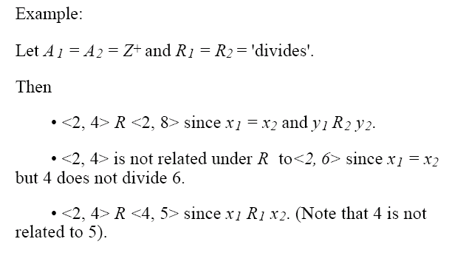
Lexicographic Order

Slide 15
Lexicographic Order
Lexigraphic ordering is the same as any dictionary or phone-book ordering:
We use alphabetic ordering
Starting with the first character in the string
Then the next character, if the first was equal, etc.
If a word is shorter than the other, than we consider that the ‘no character’ of the shorter word to be less than ‘a’

Slide 16
Well Ordered Set
(S, )
is a well-ordered set if it is a poset such that is a total ordering and such that every nonempty subset of S has a least element.
Example: Consider the ordered pairs of positive integers, (Z⁺xZ⁺) where

Slide 17
Hasse Diagrams
Given any partial order relation defined on a finite set, it is possible to draw the directed graph so that all of these properties are satisfied.
This makes it possible to associate a somewhat simpler graph, called a Hasse diagram, with a partial order relation defined on a finite set.

Slide 18
Hasse Diagrams (Steps)
Start with a directed graph of the relation in which all arrows point upward. Then we eliminate:
the loops at all the vertices,
all edges whose existence is implied by the transitive property,
the direction indicators on the arrows.

Slide 19
Hasse Diagram-Example
Let A = {1, 2, 3, 9, 18} and consider the “divides” relation on A:
For all
18
9
2
3
1

Slide 20
Hasse Diagram-Steps
Eliminate the loops at all the vertices.
Eliminate all arrows whose existence is implied by the transitive property.
Eliminate the direction indicators on the arrows.
18
9
2
3
1

Slide 21
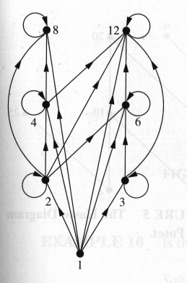
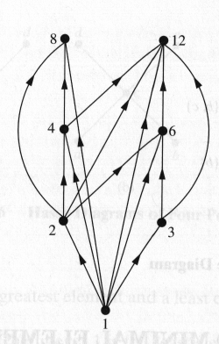
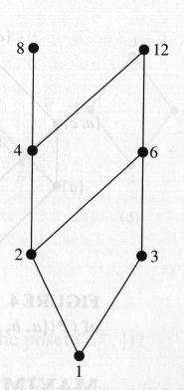
Hasse Diagram
For the poset ({1,2,3,4,6,8,12}, |)

Slide 22
Maximal and Minimal Elements
a is a maximal in the poset (S, ) if there is no such that a b. Similarly, an element of a poset is called minimal if it is not greater than any element of the poset. That is, a is minimal if there is no element such that b a.
It is possible to have multiple minimals and maximals.

Slide 23
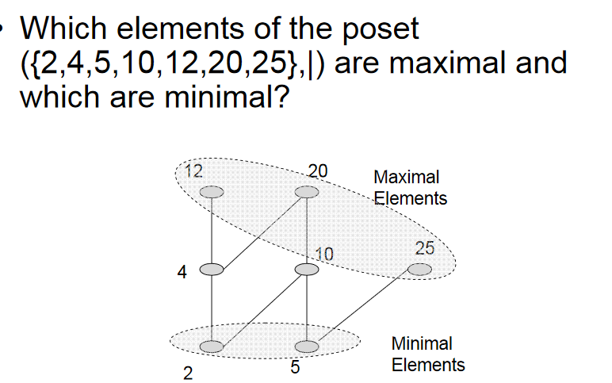
23

Slide 24
Greatest Element, Least Element
a is the greatest element in the poset (S, ) if b a for all . Similarly, an element of a poset is called the least element if it is less or equal than all other elements in the poset. That is, a is the least element if a b for all

Slide 25
Topological Sorting
A total ordering is said to be compatible with the partial ordering R if a b whenever a R b.
Constructing a total ordering from a partial ordering is called topological sorting.

Slide 26
Topological Sorting

Slide 27
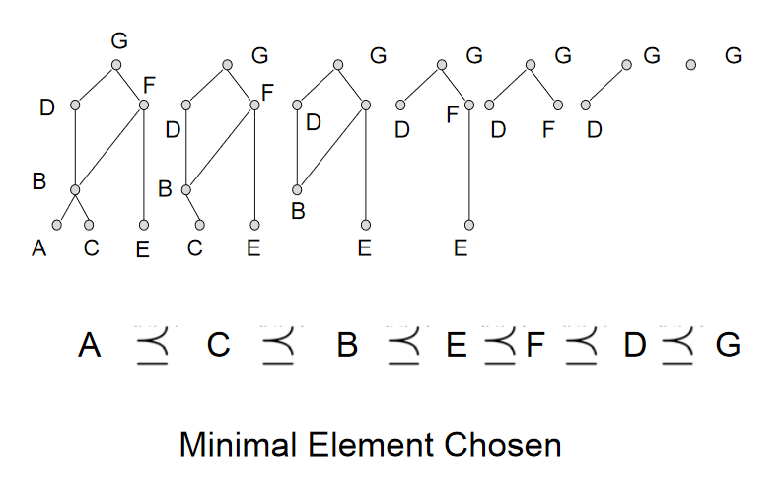
Topological Sorting

Slide 28
Example-Topological Sorting
Consider the set A = {2, 3, 4, 6, 18, 24} ordered by the “divides” relation. The Hasse diagram follows:
24
24
18
18
4
4
6
6
2
3
2
3

Slide 29
Example-Topological Sorting
Consider the set A = {2, 3, 4, 6, 18, 24} ordered by the “divides” relation. The Hasse diagram follows:
24
18
24
18
24
4
18
6
4
6
2
4
3
2
6
Sorting sequence selected- 3, 2, 6, 18, 4, 24
Or 2, 3, 6, 4, 18, 24

Slide 30
Assemble an Automobile
Build Frame
Install engine, power train components, gas tank.
Install brakes, wheels, tires.
Install dashboard, floor, seats.
Install electrical lines.
Install gas lines.
Install brake lines.
Attach body panels to frame
Paint body.

Slide 31
Prerequisite Task
Task | Immediately Preceding Tasks | Time Needed to Perform Task
1 2 3 4 5 6 7 8 9 | 1 1 2 2, 3 4 2, 3 4, 5 6, 7, 8 | 7 hours 6 hours 3 hours 6 hours 3 hours 1 hour 1 hour 2 hours 5 hours

Slide 32
Example – Job Scheduling What is the total order compatible with it? Tasks are in POSET
19 hr
Task 4 6 hr
20 hr
13 hr
Task 6 1 hour
Task 2 6 hr
Task 1 7 hr
16 hr
Task 5 3 hrs
21 hr
26 hr
10 hr
Task 3 3 hr
Task 9 5 hour
14 hr
Task 8 2 hr
Task 7 1 hr
1, 2, 4, 8, 9 critical path, 26hrs is the minimum project delay/time to complete all 9 tasks
For all tasks x and y, x y, x=y or x precedes y

Slide 33
Acknowledgement
Kenneth Rosen
Susanna S. Epp (Reading Materials)

