Slide 1
Tree
Mahmuda Naznin
CSE 103

Slide 2
What is a tree?
Trees are structures usually used to represent the hierarchical relationship among nodes
Each tree consists of nodes which are connected by edges
Each node represents an object, edge represents the relationship between two nodes.
There is no cycle
node
edge

Slide 3
Some Applications of Trees
Organization Chart
Expression Tree
President
+
VP
Personnel
VP
Marketing
*
5
3
2
Director
Customer
Relation
Director
Sales

Slide 4
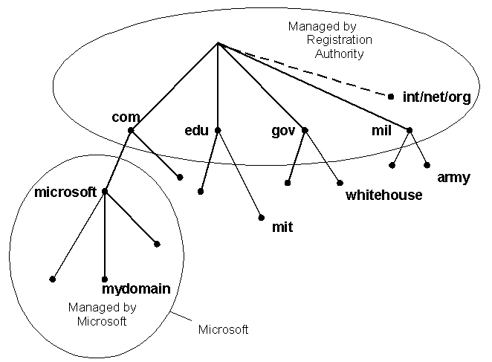
Applications
Domain Name System (Hierarchical Architecture)

Slide 5
Tree models/Applications
directory
subdirectory
subdirectory
subdirectory
file
file
file
file
file
file
file
file
file
Computer File System
This tree is a ternary (3-ary) tree, since each non-leaf node has three children

Slide 6
Definition
An undirected graph is a tree if and only if there is a unique simple path between any two of its vertices.

Slide 7
Rooted Trees
Once a vertex of a tree has been designated as the root of the tree, it is possible to assign direction to each of the edges.

Slide 8
Rooted Trees
g
a
e
f
e
c
b
b
d
d
a
c
g
f

Slide 9
Hierarchy in Tree
If two nodes have the same parent, they are siblings.
A node u is an ancestor of v if u is parent of v or parent of parent of v or …
A node v is a descendent of u if v is child of v or child of child of v or …
u
v and w are siblings
u and v are ancestors of x
v and x are descendents of u
v
w
z
x
y

Slide 10
Ancestor-Descendant
a
b
c
d
e
f
g
ancestors of h and i
h
i

Slide 11
Sub-tree
A subtree is any node together with all its descendants.
T
A subtree of T
v
v

Slide 12
Subtree
a
b
c
d
e
f
g
subtree with b as its root
h
i
subtree with c as its root

Slide 13
m-ary trees
A rooted tree is called an m-ary tree if every internal vertex has no more than m children.
The tree is called a full m-ary tree if every internal vertex has exactly m children.
An m-ary tree with m=2 is called a binary tree.

Slide 14
m-ary trees
T1=binary (2-ary)
T3=3-ary
T2=3-ary

Slide 15
Properties of Trees (I)
A tree with n vertices has n-1 edges.
A tree with 11 vertices has 10 edges.

Slide 16
Internal and Leaf Nodes
In a tree, the nodes without children are called leaves. Otherwise, they are called internal nodes.
internal nodes
leaves

Slide 17
Different Nodes in a Tree
root node
a
internal vertex
parent of g
b
c
d
e
f
g
leaf
siblings
h
i

Slide 18
Properties of Trees
A full m-ary tree with i internal vertices contains m*i+1 vertices.
3-ary tree 13 vertices has 4 internal nodes.

Slide 19
Level-Height
The level of a vertex v in a rooted tree is the length of the unique path from the root to this vertex.
root, level 0
level 1
level 2
level 3

Slide 20
Level-Height
Counting level of a node n: number of nodes on the path from root to node n
Height of a tree: maximum level among all of its node
Level 0
Level 1
height=3
n
Level 2
Level 3

Slide 21
Properties of Trees (II)
The height of a rooted tree is the maximum of the levels of vertices.
height=3

Slide 22
Properties of Trees (III)
There are at most m^{h} leaves in an m-ary tree of height h.
T1=binary (2-ary)
T3=3-ary
T2=3-ary

Slide 23
Properties of Trees (IV)
If an m-ary tree of height h has l leaves, then,
T1=binary (2-ary)
T3=3-ary
T2=3-ary

Slide 24
Forest
Graphs containing no simple cycles that are not connected, but each connected component is a tree. G is forest.
G
T1
T2

Slide 25
Binary Tree
Binary Tree: Tree in which every node has at most 2 children
Left child of u: the child on the left of u
Right child of u: the child on the right of u
x: left child of u
y: right child of u
w: right child of v
z: left child of w
u
v
x
y
w
z

Slide 26
Full binary tree
If T is empty, T is a full binary tree of height 0.
If T is not empty and of height h ≥ 0, T is a full binary tree if both subtrees of the root of T are full binary trees of height h.
Full binary tree
of height 2

Slide 27
Property of Binary Tree (I)
A full binary tree of height h has 2^{h} nodes
No. of nodes = 2⁰ + 2¹ + … + 2^{h}
Level 0: 2⁰ nodes
Level 1: 2¹ nodes
Level 2: 2² nodes

Slide 28
Property of Binary Tree (II)
Consider a binary tree T of height h. The number of nodes of T ≤ 2^{h}
We cannot have more nodes than the nodes of a full binary tree of height h.

Slide 29
Property of Binary Tree (III)
The minimum height of a binary tree with n nodes is log₂n
By property (II), n ≤ 2^{h}
Thus, 2^{h} ≥ n
That is, h ≥ log₂n

Slide 30
Binary Tree (Different Operations)
setElem
getElem
setLeft, setRight
binary
tree
getLeft, getRight
isEmpty, isFull,
isComplete
makeTree

Slide 31
Representation of a Binary Tree
An array-based representation
A reference-based representation or linked-list based representation

Slide 32
Array-based Representation
nodeNum | item | leftChild | rightChild
0 | d | 1 | 2
1 | b | 3 | 4
2 | f | 5 | -1
3 | a | -1 | -1
4 | c | -1 | -1
5 | e | -1 | -1
6 | ? | ? | ?
7 | ? | ? | ?
8 | ? | ? | ?
9 | ? | ? | ?
... | ..... | ..... | ....
–1: empty tree
root
0
d
b
f
free
6
a
c
e

Slide 33
Linked List Based Representation
Object
element
NULL: empty tree
left
right
You can code this with a class of three fields:
Object element;
BinaryNode left;
BinaryNode right;
d
d
b
f
b
f
a
c
a
c

Slide 34
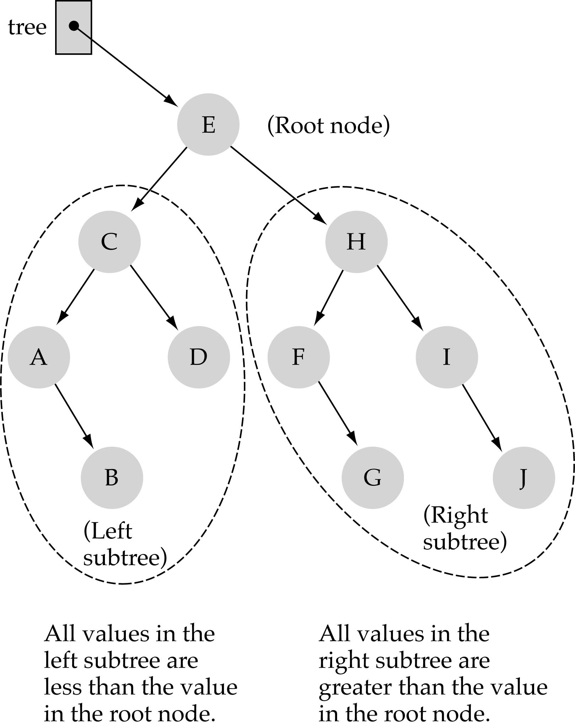
Application of Binary Tree -BST
Binary Search Tree (BST) Property:
The value stored at
a node is greater than
the value stored at its
left child and less than
the value stored at its
right child

Slide 35
Application-Binary Search Tree
In a BST, the value stored at the root of a subtree is greater than any value in its left subtree and less than any value in its right subtree!

Slide 36
Application-Binary Search Tree
Where is the smallest element?
Ans: leftmost element (A)
Where is the largest element?
Ans: rightmost element (J)

Slide 37
Acknowledgement
Kenneth Rosen (Reading Material)
Susanna Epp
Ralph P. Grimaldi, B. V. Ramana

Slide 38
Appendix

Slide 39
Tree Traversal
Given a binary tree, we may like to do some operations on all nodes in a binary tree. Why we need traversal-
For example, we may want to double the value in every node in a binary tree.
To do this, we need a traversal algorithm which visits every node in the binary tree.

Slide 40
Ways to traverse a tree
There are three main ways to traverse a tree:
Pre-order:
(1) visit node, (2) recursively visit left subtree, (3) recursively visit right subtree
In-order:
(1) recursively visit left subtree, (2) visit node, (3) recursively right subtree
Post-order:
(1) recursively visit left subtree, (2) recursively visit right subtree, (3) visit node
Level-order:
Traverse the nodes level by level
In different situations, we use different traversal algorithm.

Slide 41
Examples for an expression tree
By pre-order, (prefix-parent, left, right)
+ * 2 3 / 8 4
By in-order, (infix- left, parent, right)
2 * 3 + 8 / 4
By post-order, (postfix-left, right, parent)
2 3 * 8 4 / +
By level-order,
+ * / 2 3 8 4
Note 1: Infix is what we read!
Note 2: Postfix expression can be computed efficiently using stack
+
*
/
2
3
8
4

Slide 42
Pre-order, In-order, Post-order
Algorithm pre-order(Tree x)
If (x is not empty) {
print x.getItem(); // you can do other things!
pre-order(x.getLeftChild());
pre-order(x.getRightChild());
}
Algorithm in-order(Tree x)
If (x is not empty) {
in-order(x.getLeftChild());
print x.getItem(); // you can do other things!
in-order(x.getRightChild());
}
Algorithm post-order(Tree x)
If (x is not empty) {
post-order(x.getLeftChild());
post-order(x.getRightChild());
print x.getItem(); // you can do other things!
}

Slide 43
Pre-order example
Pre-order(a);
Print a;
Pre-order(b);
Pre-order(c);
Print b;
Pre-order(d);
Pre-order(null);
Print d;
Pre-order(null);
Pre-order(null);
Print c;
Pre-order(null);
Pre-order(null);
a
a
b
d
c
b
c
d

Slide 44
In-order example
In-order(a);
In-order(b);
Print a;
In-order(c);
In-order(d);
Print b;
In-order(null);
In-order(null);
Print d;
In-order(null);
In-order(null);
Print c;
In-order(null);
a
d
b
a
c
b
c
d

Slide 45
Post-order example
Post-order(a);
Post-order(b);
Post-order(c);
Print a;
Post-order(d);
Post-order(null);
Print b;
Post-order(null);
Post-order(null);
Print d;
Post-order(null);
Print c;
Post-order(null);
a
d
b
c
a
b
c
d

Slide 46
Time complexity of traversals
For every node x, we will call pre-order(x)/ in-order(x)/ post-order(x) one time, which performs O(1) operations.
Thus, the total time = O(n).

Slide 47
General tree implementation
struct TreeNode
{
Object element
TreeNode *firstChild
TreeNode *nextsibling
}
because we do not know how many children a
node has in advance.
Traversing a general tree is similar to traversing a binary tree
A
B
C
D
E
F
G

Slide 48
Level-order
Level-order traversal requires a queue!
Algorithm level-order(Tree t)
Queue Q = new Queue();
Tree n;
Q.enqueue(t); // insert pointer t into Q
while (! Q.empty()){
n = Q.dequeue(); //remove next node from the front of Q
if (!n.isEmpty()){
print n.getItem(); // you can do other things
Q.enqueue(n.getLeft()); // enqueue left subtree on rear of Q
Q.enqueue(n.getRight()); // enqueue right subtree on rear of Q
};
};

Slide 49
Time complexity of Level-order traversal
Each node will enqueue and dequeue one time.
For each node dequeued, it only does one print operation!
Thus, the time complexity is O(n).

