Slide 1
Graph-2
Mahmuda Naznin
CSE 103

Slide 2
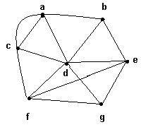
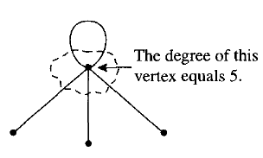
Degree of Vertex
The degree of a vertex v, denoted by δ(v), is the number of edges incident on v
Example:
δ(a) = 4, δ(b) = 3,
δ(c) = 4, δ(d) = 6,
δ(e) = 4, δ(f) = 4,
δ(g) = 3.

Slide 3
Sum of the degrees of Graph
Theorem : If G is a graph with m edges and n vertices v₁, v₂,…, v_{n}, then
_{n}
Σ δ(v_{i}) = 2m
^{i = 1}
In particular, the sum of the degrees of all the vertices of a graph is even.

Slide 4
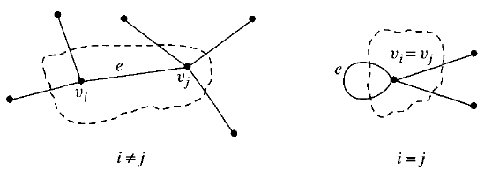
Sum of the degrees of Graph
Let G be a graph.
Case 1: If G is null graph, no vertices, no edges, so degree =0.
Case 2: If G has n vertices v₁, v₂, v₃,...... v_{n}, , n and m edges, m, n >0 and integer, Each edge of G contributes 2 to the total degree of G.
For example, e is an arbitrarily chosen edge with v_{i}, and v_{j}.
e contributes 1 to the degree of v_{i} and 1 to the degree v_{j}. As shown below, this is true even if i = j, because an edge that is a loop is counted twice in computing the degree of the vertex
So, e contributes 2 to the total degree of G. Since e was arbitrarily chosen, this shows that each edge of G contributes 2 to the total degree of G. Thus, the total degree of G = 2(the number of edges of G).

Slide 5
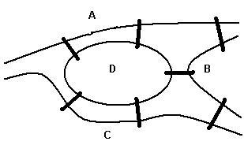
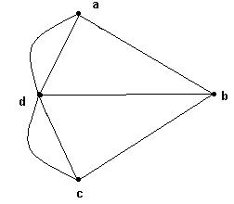
Euler Cycle
An Euler cycle in a graph G is a simple cycle that passes through every edge of G only once.
The Königsberg bridge problem:
Starting and ending at the same point, is it possible to cross all seven bridges just once and return to the starting point?
This problem can be represented by a graph
Edges represent bridges and each vertex represents a region.

Slide 6
Cycle
A cycle is a path that begins and ends with same vertex.
v
a
w
b
cycle: v ···b ···w ···w ···a ···v
also: a ···v ···b ···w ···w ···a

Slide 7
Euler Graphs
A graph G is an Euler graph if it has an Euler cycle and it is connected.
The connected graph represents the Konigsberg bridge problem.
Theorem: G is an Euler graph if and only if G is connected and all its vertices have even degree.
It is not an Euler graph.
Therefore, the Konigsberg bridge problem has no solution.

Slide 8
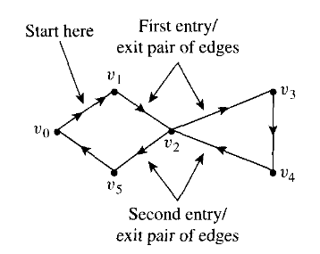
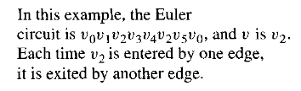
Euler Graphs
Theorem: G is an Euler graph if and only if G is connected and all its vertices have even degree.
Proof:
We assume all edges traverse through a vertex v.
So, every edge will be incident on v only once.
Entry/exit will contribute 2 for each edge on v.
Degree will be even

Slide 9
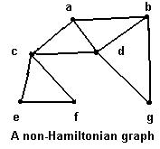
Hamiltonian Cycle
Traveling salesperson problem
To visit every vertex of a graph G only once by a simple cycle.
Such a cycle is called a Hamiltonian cycle.
If a connected graph G has a Hamiltonian cycle, G is called a Hamiltonian graph.

Slide 10
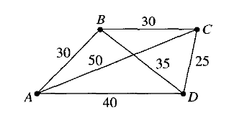
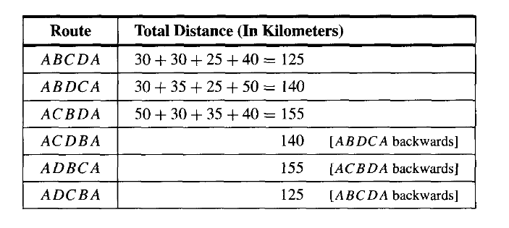
Hamiltonian Cycle
Example-Traveling salesperson problem
-To visit every city once with the minimum distance and come back to that city
-To visit every vertex of a graph G once and it is a Hamiltonian cycle
ABCDA or ADCBA, min.125km

Slide 11
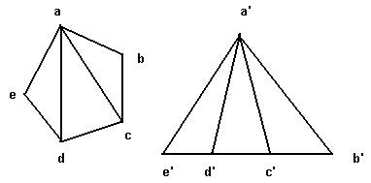
Isomorphic Graphs
G₁ and G₂ are isomorphic
if there exist one-to-one onto functions f: V(G₁) → V(G₂) and g: E(G₁) → E(G₂) such that
an edge e is adjacent to vertices v, w in G₁ if and only if g(e) is adjacent to f(v) and f(w) in G₂
Edge(G₁)= Edge (G₂)
{a, b}={a′ ,b′}= {f(a) , f(b)}
{a, c}={a′ ,c′}= {f(a) , f(c)}
{a, d}={a′ ,d′}= {f(a) , f(d)}
{a, e}={a′ ,e′}= {f(a) , f(e)}
{e, d}={e′, d′ }= {f(e) , f(d)}
G₁
G₂

Slide 12
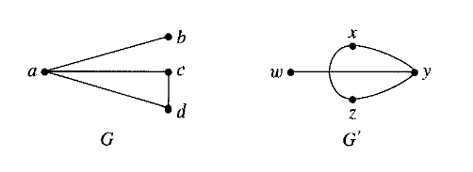
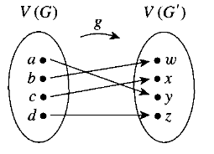
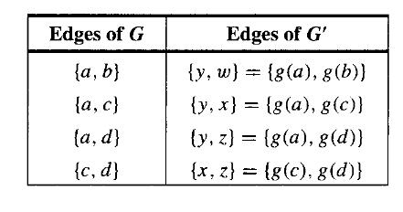
Isomorphic Graphs

Slide 13
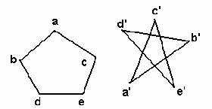
Isomorphism and Adjacency Matrices
Two graphs are isomorphic if and only if
after reordering the vertices their adjacency matrices are the same
 | a | b | c | d | e
a | 0 | 1 | 1 | 0 | 0
b | 1 | 0 | 0 | 1 | 0
c | 1 | 0 | 0 | 0 | 1
d | 0 | 1 | 0 | 0 | 1
e | 0 | 0 | 1 | 1 | 0

Slide 14
Isomophism Examples
Same graph (different drawings)
122
122
257
257
145
99
306
67
99
67
306
145
Same graph (different labels)
Gani
257
122
Amina
Sifat
145
306
67
Rahim
Sonya
99
Jesmin

Slide 15
Which is isomorphic to G1?
Testing graph isomorphism is not easy –
No known general method to test graph-ismorphism which is
much more efficient than checking all possibilities.

Slide 16
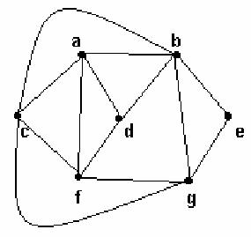
Planar Graphs
A graph is planar if it can be drawn in the plane without crossing edges
Applications-Circuit design, Network design, VLSI Design
16

Slide 17
Euler’s Theory for Planar Graph
If G is planar graph,
v = number of vertices
e = number of edges
f = number of faces, including the exterior face (v=7, e= 13, f=8)
Then: f = e – v + 2
17

Slide 18
Acknowledgement
Kenneth Rosen
Susanna Epp (Reading Material)
Ralph P. Grimaldi, B. V. Ramana

Slide 19
Appendix
Walk : Vertices may repeat. Edges may repeat (Closed or Open)
Trail : Vertices may repeat. Edges cannot repeat (Open)
Circuit : Vertices may repeat. Edges cannot repeat (Closed)
Path : Vertices cannot repeat. Edges cannot repeat (Open)
Cycle : Vertices cannot repeat. Edges cannot repeat (Closed)
NOTE : For closed sequences start and end vertices are the only ones that can repeat.
v
a
w
b
Closed walk: v ···b ···w ···w ···a ···v
Cycle: w..w or
w ···a ··· v ···b ···w

Slide 20
Idea
In general, if we have a “partial” Eulerian cycle C*,
and it intersects with a cycle C on a vertex v,
then we can extend the Eulerian cycle C* to include C.
C*
C
v
First follow C* until we visit v, then follow C until we go back to v, and then follow C* from v to the end.

Slide 21
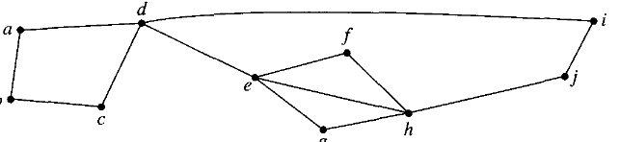
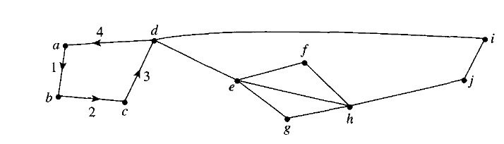
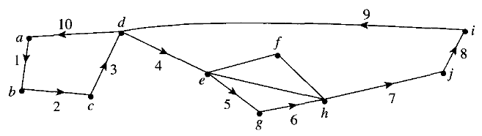
Finding Euler Cycle in a Graph
Firstly, check if the degree of each vertex is even, graph is connected
C: abcda
We find that C is not an Euler circuit for the graph (not all edges) and it intersects the rest of the graph at d (in (ii)).
Let C' be :deghjid. We patch C' into C to obtain C": abcdeghjida.
Set C = C". Then current C is represented by the labeled edges in (iii).
(i)
(ii)
(iii)

Slide 22
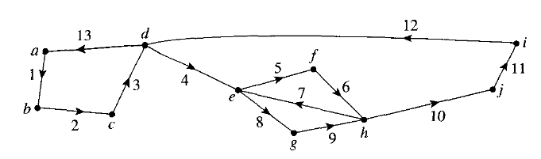
Finding Euler Cycle in a Graph
Firstly, check if the degree of each vertex is even, graph is connected
Let C' be :deghjid. We patch C' into C to obtain C": abcdeghjida.
Set C = C". Then current C is represented by the labeled edges in (iii).
Still C is not an Euler circuit for the graph but it intersects the rest of the graph at e. C': efhe and we patch C' into C and finally we get C: abcdefheghjida in (iv)
(iii)
(iv)

Slide 23

Hamiltonian Cycle-Parallel Computation Model
The n-cube I^{n} has 2^{n} processors, n > 1
Vertices are labeled 0, 1, 2,…, 2^{n-1}
An edge connects two vertices if the binary representation of their labels differs in exactly one bit
The n-cube simulates a ring model with 2^{n} processors if it contains a simple cycle with 2^{n} vertices which is a Hamiltonian cycle
The n-cube (n > 2) has a Gray code, therefore it contains a simple Hamiltonian cycle with 2^{n} vertices, and so it is a model for parallel computation.
I¹ has only two vertices 0 and 1. It has no cycles.

Slide 24

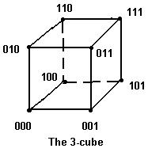
Parallel Computation Model
I² (a square) has 4 vertices labeled 00, 01, 10 and 11
A Hamiltonian cycle is (00, 01, 11, 10, 00)
I³ (a cube) has 8 vertices labeled 000, 001, 010, 011, 100, 101 and 111
A Hamiltonian cycle is (000, 001, 011, 010, 110, 111, 101, 100, 000)=(0, 1, 3, 2, 6, 7, 5, 4, 0)

Slide 25
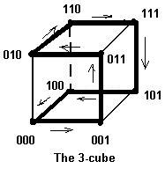
The 3Cube Model
The Hamiltonian cycle (000, 001, 011, 010, 110, 111, 101, 100, 000) joins vertices that differ by one bit.
(0, 1, 3, 2, 6, 7, 5, 4, 0)

Slide 26
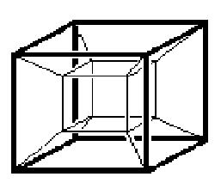
Hypercube or 4-Cube Model
I⁴ (the hypercube)
has16 vertices, 32 edges and 20 faces
Vertex labels:
0000 0001 0010 0011
0100 0101 0110 0111
1000 1001 1010 1011
1100 1101 1110 1111
0→1→3→2→6→7→5→4→12→13→15→14→10→11→9→8

