Slide 1
Graph-3
Mahmuda Naznin
CSE 103

Slide 2
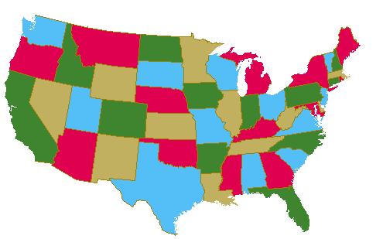
Graph Coloring

Slide 3
Graph Coloring
Graph Colouring Problem:
Given a graph, colour all the vertices so that
two adjacent vertices get different colours.
Objective: use minimum number of colours.
3-colourable

Slide 4
Optimal Coloring
Definition. min #colors for G is chromatic number, (G)
What graphs have chromatic number one?
when there are no edges…
What graphs have chromatic number 2?
What graphs have chromatic number larger than 2?

Slide 5
Simple Cycles

Slide 6
Complete Graphs

Slide 7
Wheel Graph
W₅
W₄
3 color for Odd cycle+1 in the middle
2 color for Even cycle+1 in the middle

Slide 8
Trees
root
Pick any vertex as “root.”
if (unique) path from root is
even length:
odd length:
Can prove more formally using induction.

Slide 9
2-Colourable Graphs
When exactly is a graph 2-colourable?
This is 2-colourable.
2 colourable: tree, even cycle, etc.
Not 2 colourable: triangle, odd cycle, etc.

Slide 10
Bipartite Graphs
When exactly is a graph 2-colourable?
Is a bipartite graph 2-colourable?
Is a 2-colourable graph bipartite?
Fact. A graph is 2-colourable if and only if it is bipartite.

Slide 11
Bipartite Graphs
When exactly is a graph bipartite?
Can a bipartite graph has an odd cycle?
NO
If a graph does not have an odd cycle, then it is bipartite?

Slide 12
Bipartite Graphs
When exactly is a graph bipartite?
No such edge because no 5-cycle
The idea is like colouring a tree.
Pick a vertex v, colour it red.
Colour all its neighbour green.
Colour all neighbours of green vertices red
Repeat until all vertices are coloured.
No such edge because no triangle
If a graph does not have an odd cycle, then it is bipartite?
Theorem. A graph is bipartite if and only if it has no odd cycle.

Slide 13
Chromatic Number
How do we estimate the chromatic number of a graph?
If there is a complete subgraph of size k,
then we need at least k colours?
YES
Is the converse true?
If a graph has no complete subgraph of size 4,
then we can colour it using 4 colours?
NO

Slide 14
Scheduling Flight Gates
flights need gates, but times overlap.
how many gates needed?
time
122
145
67
257
306
99
Flights

Slide 15
Conflict Graphs
Needs gate at same time
145
Each vertex represents a flight
Each edge represents a conflict
306
99

Slide 16
Coloring Conflict Graphs
257
122
145
67
306
9
There is a k-colouring in this graph iff the flights can be scheduled using k gates.
=> If there is a schedule, the flights scheduled at the same gate have no conflict,
and so we can colour the graph by using one colour for flights in each gate.
<= If there is a graph colouring, then the vertices using each colour have no conflict,
and so we can schedule the flights having the same colour in one gate.

Slide 17
Coloring Conflict Graphs
257
122
145
assign
gates:
67
306
257, 67
122,145
99
306
4 colors
4 gates
99

Slide 18
Better Coloring
257
122
145
67
306
3 colors
3 gates
99

Slide 19
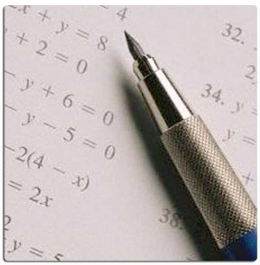
Example-Final Exam Schedule
subjects conflict if student takes both,
so need different days.
how to design an exam schedule?
This is a graph colouring problem.
Each vertex is a course, two courses have an edge if there is a conflict.
The graph has a k-colouring if and only if
the exams can be scheduled in k days.

Slide 20
Graph Coloring
CSE109
CSE103
Phy102
assign
times:
Math110
CSE103,
Phy102
CSE105
Math110,
CSE109
3 exam days
(best possible)
CSE105

Slide 21
Map Coloring
Colour the map using minimum number of colours so that
two countries sharing a border are assigned different colours.

Slide 22
Map Colouring
Can we draw a map so that there are 5 countries
such that any two of which are adjacent?
NO
Can we draw a map which need 5 colours?
NO
Conjecture (1852) Every map is 4-colourable.
“Proof” by Kempe 1879, an error is found 11 years later.
(Kempe 1879) Every map is 5-colourable.
Theorem (Apple Haken 1977). Every map is 4-colourable.
The proof is computer assisted, some mathematics are still not happy.

Slide 23
Coloring Graphs
- 4 color graph
Wheel graph of 3, so 4 color.
This is a planar graph too.

Slide 24
Acknowledgement
Kenneth Rosen
Susanna Epp` (Reading Materials)
Naveen Garg, IIT, India

