Slide 1
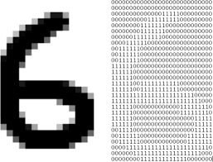
DIGITEYES
Name: Mohammed Maruf Islam
ID: MUH2125022M
Session: 2020 – 2021
Year:02 Term:01

Slide 2
Introduction
This software will extract a handwritten digit from an image and show it to the user as a digital format. The image can be black and white. Even the background color and the color in which the digit was written can be different.

Slide 3
Objective
1.Develop a efficient and accurate software for digit extraction.
2.Implement the the Software Using command line tools.
3.To handle a variety of images such as different background

Slide 4
Stakeholders
Data Scientist
Researcher
Shopkeepers
Financial Institution

Slide 5
Technical Details
Algorithm used:
1.Sobel Operator
2.Decision Tree
Data Structure:
1.HashMap
2.HashSet
3.Array
Programming Language:
JAVA

Slide 6
Sobel Operator Algorithm
The Sobel Operator, an edge detection algorithm, involves estimating the first derivative of an image by doing a convolution between an image (i.e. the input) and two special kernels, one to detect vertical edges and one to detect horizontal edges.
Gradient calculation: The algorithm calculates the gradient of an image by convolving it with small filters in the horizontal and vertical directions.
Gradient magnitude: The Sobel operator combines the horizontal and vertical gradients to compute the gradient magnitude, which represents the strength of the edges in the image.
Thresholding: After calculating the gradient magnitude, a threshold can be applied to identify significant edges. Pixels with gradient magnitudes above the threshold are considered as edges.

Slide 7
-1 | 0 | 1
-2 | 0 | 2
-1 | 0 | 1
-1 | -2 | -1
0 | 0 | 0
1 | 2 | 1
Horizontal Kernel, Gx
Verical Kernel, Gy
Gradient, G = sqrt(Gx^2 + Gy^2)

Slide 8
Output

Slide 9
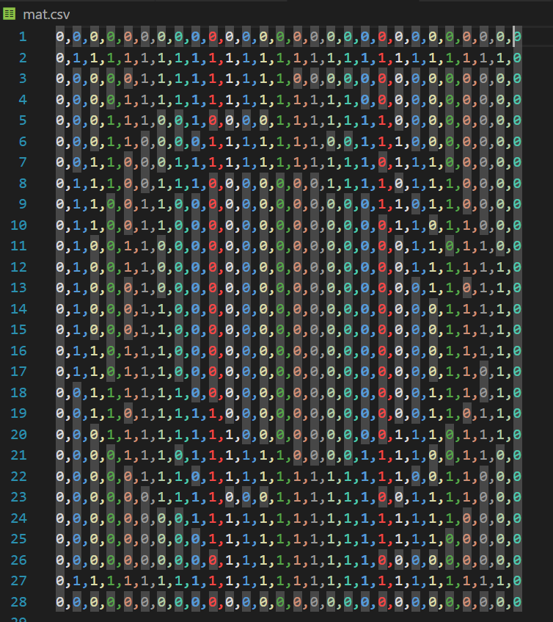

Slide 10
Decision Tree Algorithm
Tree-like structure: Decision trees have a hierarchical, tree-like structure. Each internal node represents a feature or attribute, branches represent decisions or outcomes based on those features, and leaf nodes represent final predictions or outcomes.
Feature importance: Decision trees provide a measure of feature importance. By evaluating the splitting criteria, the algorithm determines which features have the most significant impact on the target variable, allowing for feature selection and identification of key factors driving the decision process.
Nonlinear relationships: Decision trees can capture nonlinear relationships between features and the target variable. They can handle complex decision boundaries and interactions between multiple features without relying on linear assumptions.

Slide 11
Decision Tree Algorithm’s Equation
Entropy Calculation:
Entropy(S) = - Σ (p(c) * log₂(p(c)))
This equation calculates the entropy of a dataset or subset "S" by summing the probabilities of each class "c" weighted by the logarithm (base 2) of the probability. The summation symbol (Σ) indicates that you need to calculate the sum of this expression for all possible classes.
Information Gain Calculation:
InformationGain(S, A) = Entropy(S) - Σ ((|Sv| / |S|) * Entropy(Sv))
This equation calculates the information gain achieved by splitting the dataset or subset "S" on a particular attribute "A". It subtracts the weighted sum of entropies of the resulting subsets "Sv" after the split from the initial entropy of "S". The summation symbol (Σ) indicates that you need to calculate the sum of this expression for all possible attribute values.

Slide 12
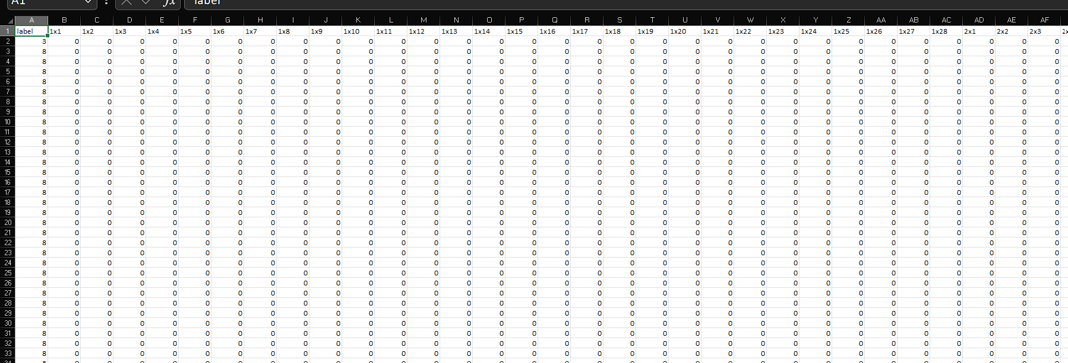
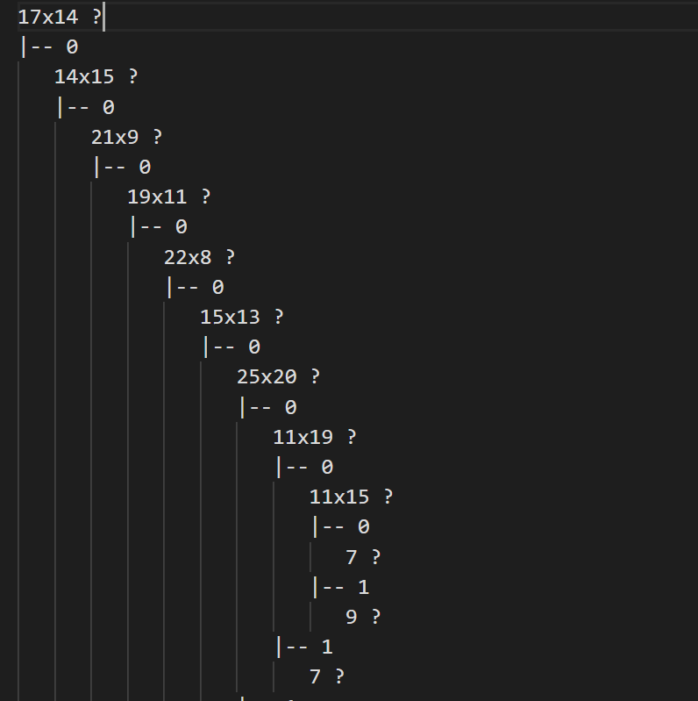

Slide 13
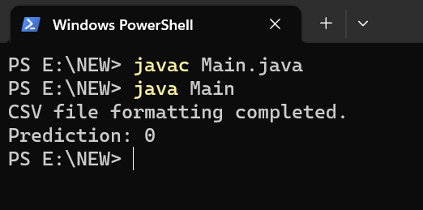

Slide 14
Classed and their corresponding methods
DecisionTree:
private double calcEntropy(String[][] dataset);
calculateAttributeEntropy(String[][] dataset, String attribute);
private HashSet<String> getAttributevalue(String[][] dataset, String attribute);
private String[][] getSubset(String[][] dataset, String attribute, String value);
private String bestAttribute(String[][] dataset, String[] attributes);
private int getIndex(String name); private String getMajority(String[][] dataset);
private String[] removeAttr(String[] attributes, String remove);
private boolean isHomogeneous(String[][] dataset); public TreeNode makeTree(String[][] dataset, String[] attributes); public void predict(String[] instance, TreeNode node);

Slide 15
Dataset:
public String[][] getDataset(String path) public int cntLine(String path) public String[] getHeaderattributes(String keyattr)
TreeNode:
public TreeNode(String attribute) public boolean isLeaf() public String getLeafValue() public void setLeafValue(String leafValue)
Sobel: public BufferedImage convertToGrayscale(BufferedImage image) public BufferedImage sobelAlgo(BufferedImage image) public int filterApply(BufferedImage image, int x, int y, int[][] operator) public int[][] convertMatrix(BufferedImage img,int val) public void formatCSV(String inputFilePath, String outputFilePath) public BufferedImage resizeImage(BufferedImage originalImage, int targetWidth, int targetHeight)

Slide 16
Challenges

Slide 17
Progress Update
Progress made so far:
1.Converted image into grayscale
2.Applied Sobel algorithm to detetct an edge
3.Thresoholding
4.Worked with Decision Tree algorithm
5.Detects a digit.

Slide 18

Any question?

