Slide 1
Solving problems by searching
Chapter 3

Slide 2
Outline
Problem-solving agents
Problem types
Problem formulation
Example problems
Basic search algorithms

Slide 3
Solving Problems by Searching
Reflex agent is simple
  base their actions on a direct mapping from states to actions
  but cannot work well in environments
    which this mapping would be too large to store
    and would take too long to learn
Hence, goal-based agent is used

Slide 4
Problem-solving agent
Problem-solving agent
  A kind of goal-based agent
  It solves problem by
    finding sequences of actions that lead to desirable states (goals)
  To solve a problem,
    the first step is the goal formulation, based on the current situation

Slide 5
Goal formulation
The goal is formulated
  as a set of world states, in which the goal is satisfied
Reaching from initial state → goal state
  Actions are required
Actions are the operators
  causing transitions between world states
  Actions should be abstract enough at a certain degree, instead of very detailed
  E.g., turn left VS turn left 30 degree, etc.

Slide 6
Problem formulation
The process of deciding
  what actions and states to consider
E.g., driving Amman → Zarqa
  in-between states and actions defined
  States: Some places in Amman & Zarqa
  Actions: Turn left, Turn right, go straight, accelerate & brake, etc.

Slide 7
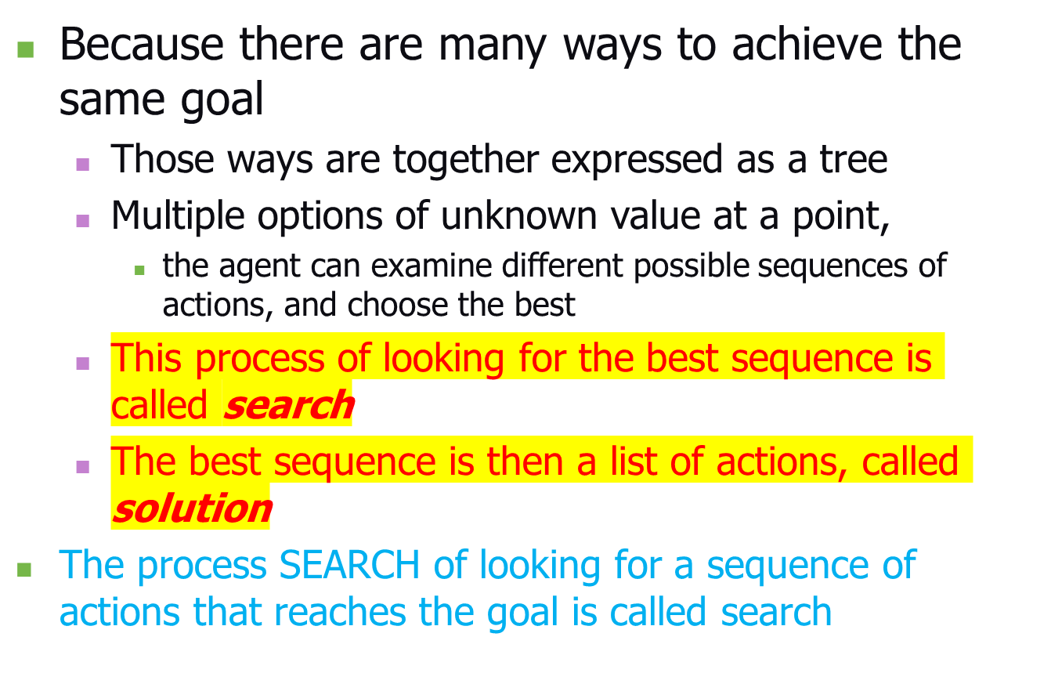
Search

Slide 8
Search algorithm
Defined as
  taking a problem
  and returns a solution
Once a solution is found
  the agent follows the solution
  and carries out the list of actions – execution phase
Design of an agent
  “Formulate, search, execute”

Slide 9
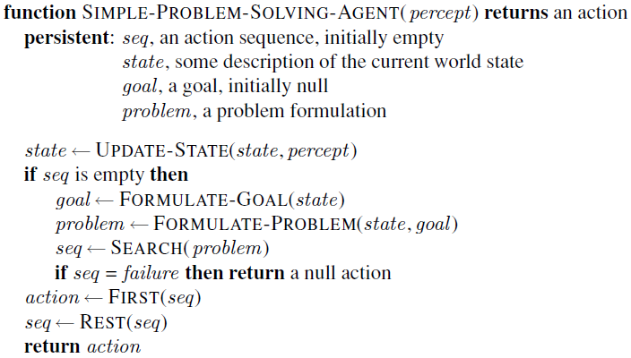

Slide 10
Well-defined problems and solutions
A problem is defined by 5 components:
Initial state
Actions
Transition model or
(Successor functions)
Goal Test.
Path Cost.

Slide 11
Well-defined problems and solutions
A problem is defined by 5 components:
  The initial state
    that the agent starts in
  The set of possible actions
  Transition model: description of what each action does.
  (successor functions): refer to any state reachable from given state by a single action
  Initial state, actions and Transition model define the state space
    the set of all states reachable from the initial state by any sequence of actions.
  A path in the state space:
    any sequence of states connected by a sequence of actions.

Slide 12
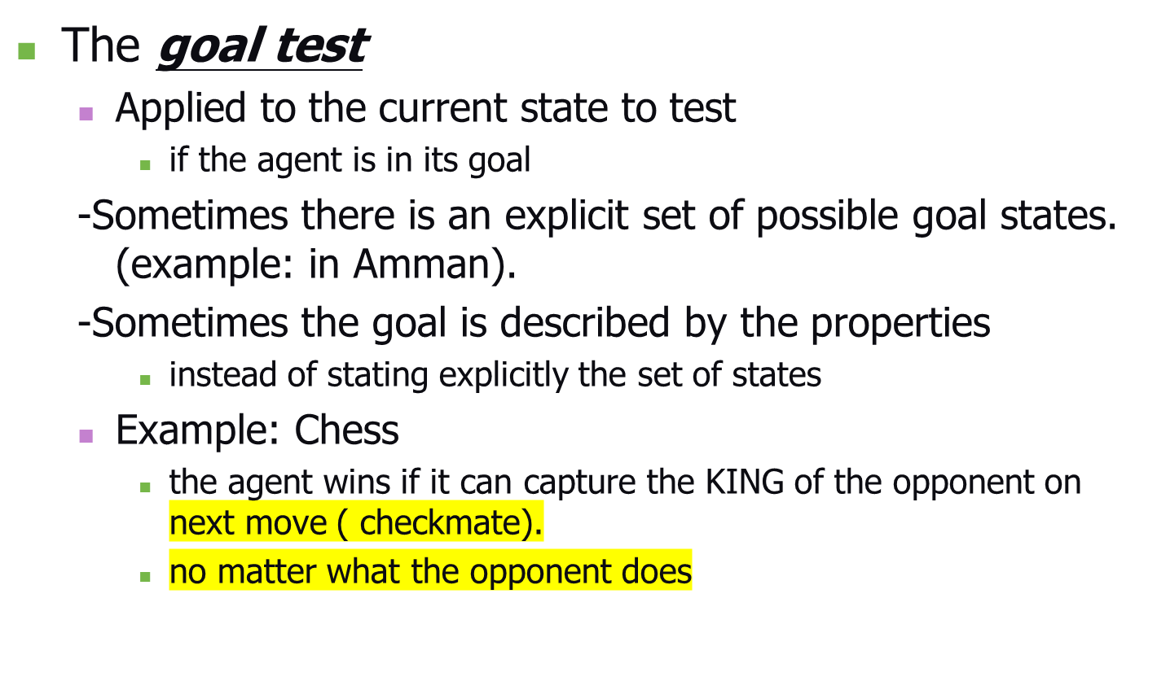
Well-defined problems and solutions

Slide 13
Well-defined problems and solutions
A path cost function,
  assigns a numeric cost to each path
  = to distinguishperformance measure
  denoted by g
  the best path from others
Usually the path cost is
  the sum of the step costs of the individual actions (in the action list)

Slide 14
Well-defined problems and solutions
Together a problem is defined by
  Initial state
  Actions
  Successor function
  Goal test
  Path cost function
The solution of a problem is then
  a path from the initial state to a state satisfying the goal test
Optimal solution
  the solution with lowest path cost among all solutions

Slide 15
Formulating problems
Besides the four components for problem formulation
  anything else?
Abstraction
  the process to take out the irrelevant information
  leave the most essential parts to the description of the states
  ( Remove detail from representation)
  Conclusion: Only the most important parts that are contributing to searching are used

Slide 16
Evaluation Criteria
formulation of a problem as search task
basic search strategies
important properties of search strategies
selection of search strategies for specific tasks
(The ordering of the nodes in FRINGE defines the search strategy)

Slide 17
Problem-Solving Agents
agents whose task is to solve a particular problem (steps)
  goal formulation
    what is the goal state
    what are important characteristics of the goal state
    how does the agent know that it has reached the goal
    are there several possible goal states
      are they equal or are some more preferable
  problem formulation
    what are the possible states of the world relevant for solving the problem
    what information is accessible to the agent
    how can the agent progress from state to state

Slide 18

Problem-solving agents

Slide 19
Example: Romania
On holiday in Romania; currently in Arad.
Flight leaves tomorrow from Bucharest
Formulate goal:
  be in Bucharest
Formulate problem:
  states: various cities
  actions: drive between cities
Find solution:
  sequence of cities, e.g., Arad, Sibiu, Fagaras, Bucharest

Slide 20

Example: Romania

Slide 21
Problem types
Deterministic, fully observable → single-state problem
  Agent knows exactly which state it will be in; solution is a sequence
Non-observable → sensorless problem (conformant problem)
  Agent may have no idea where it is; solution is a sequence
Nondeterministic and/or partially observable → contingency problem
  percepts provide new information about current state
  often interleave} search, execution
Unknown state space → exploration problem

Slide 22

Example: vacuum world
Single-state, start in #5. Solution?

Slide 23
Example: vacuum world
Single-state, start in #5.
Solution? [Right, Suck]
Sensorless, start in
{1,2,3,4,5,6,7,8} e.g.,
Right goes to {2,4,6,8}
Solution?

Slide 24
Example: vacuum world
Sensorless, start in
{1,2,3,4,5,6,7,8} e.g.,
Right goes to {2,4,6,8}
Solution?
[Right,Suck,Left,Suck]
Contingency
  Nondeterministic: Suck may
  dirty a clean carpet
  Partially observable: location, dirt at current location.
  Percept: [L, Clean], i.e., start in #5 or #7
  Solution?

Slide 25
Example: vacuum world
Sensorless, start in
{1,2,3,4,5,6,7,8} e.g.,
Right goes to {2,4,6,8}
Solution?
[Right,Suck,Left,Suck]
Contingency
  Nondeterministic: Suck may
  dirty a clean carpet
  Partially observable: location, dirt at current location.
  Percept: [L, Clean], i.e., start in #5 or #7
  Solution? [Right, if dirt then Suck]

Slide 26
Single-state problem formulation
A problem is defined by four items:
initial state e.g., "at Arad“
actions or successor function S(x) = set of action–state pairs
  e.g., S(Arad) = {<Arad → Zerind, Zerind>, … }
goal test, can be
  explicit, e.g., x = "at Bucharest"
  implicit, e.g., Checkmate(x)
path cost (additive)
  e.g., sum of distances, number of actions executed, etc.
  c(x,a,y) is the step cost, assumed to be ≥ 0
  A solution is a sequence of actions leading from the initial state to a goal state

Slide 27
Selecting a state space
Real world is absurdly complex
  → state space must be abstracted for problem solving
(Abstract) state = set of real states
(Abstract) action = complex combination of real actions
  e.g., "Arad → Zerind" represents a complex set of possible routes, detours, rest stops, etc.
For guaranteed realizability, any real state "in Arad“ must get to some real state "in Zerind"
(Abstract) solution =
  set of real paths that are solutions in the real world
Each abstract action should be "easier" than the original problem

Slide 28

Vacuum world state space graph
states?
actions?
goal test?
path cost?

Slide 29
Vacuum world state space graph
states? integer dirt and robot location
actions? Left, Right, Suck
goal test? no dirt at all locations
path cost? 1 per action

Slide 30

Example: The 8-puzzle
states?
actions?
goal test?
path cost?

Slide 31
Example: The 8-puzzle
states? locations of tiles
actions? move blank left, right, up, down
goal test? = goal state (given)
path cost? 1 per move
[Note: optimal solution of n-Puzzle family is NP-hard]

Slide 32

Example: robotic assembly
states?: real-valued coordinates of robot joint angles parts of the object to be assembled
actions?: continuous motions of robot joints
goal test?: complete assembly
path cost?: time to execute

Slide 33

Tree search algorithms
Basic idea:
  offline, simulated exploration of state space by generating successors of already-explored states (a.k.a.~expanding states)

Slide 34

Tree search example

Slide 35

Tree search example

Slide 36

Tree search example

Slide 37

Implementation: general tree search

Slide 38

Implementation: states vs. nodes
A state is a (representation of) a physical configuration
A node is a data structure constituting part of a search tree includes state, parent node, action, path cost g(x), depth
The Expand function creates new nodes, filling in the various fields and using the SuccessorFn of the problem to create the corresponding states.

Slide 39
Search strategies
A search strategy is defined by picking the order of node expansion
Strategies are evaluated along the following dimensions:
  completeness: does it always find a solution if one exists?
  time complexity: number of nodes generated
  space complexity: maximum number of nodes in memory
  optimality: does it always find a least-cost solution?
Time and space complexity are measured in terms of
  b: maximum branching factor of the search tree
  d: depth of the least-cost solution
  m: maximum depth of the state space (may be ∞)

Slide 40
Uninformed search strategies
Uninformed search strategies use only the information available in the problem definition
Breadth-first search
Uniform-cost search
Depth-first search
Depth-limited search
Iterative deepening search

Slide 41

Breadth-first search
Expand shallowest unexpanded node
Implementation:
  fringe is a FIFO queue, i.e., new successors go at end

Slide 42

Breadth-first search
Expand shallowest unexpanded node
Implementation:
  fringe is a FIFO queue, i.e., new successors go at end

Slide 43

Breadth-first search
Expand shallowest unexpanded node
Implementation:
  fringe is a FIFO queue, i.e., new successors go at end

Slide 44

Breadth-first search
Expand shallowest unexpanded node
Implementation:
  fringe is a FIFO queue, i.e., new successors go at end

Slide 45
Properties of breadth-first search
Complete? Yes (if b is finite)
Time? 1+b+b²+b³+… +b^{d} + b(b^{d}-1) = O(b^{d+1})
Space? O(b^{d+1}) (keeps every node in memory)
Optimal? Yes (if cost = 1 per step)
Space is the bigger problem (more than time)

Slide 46
Uniform-cost search
Expand least-cost unexpanded node
Implementation:
  fringe = queue ordered by path cost
Equivalent to breadth-first if step costs all equal
Complete? Yes, if step cost ≥ ε
Time? # of nodes with g ≤ cost of optimal solution, O(b^{ceiling(C*/ ε)}) where C* is the cost of the optimal solution
Space? # of nodes with g ≤ cost of optimal solution, O(b^{ceiling(C*/ ε)})
Optimal? Yes – nodes expanded in increasing order of g(n)

Slide 47

Depth-first search
Expand deepest unexpanded node
Implementation:
  fringe = LIFO queue, i.e., put successors at front

Slide 48

Depth-first search
Expand deepest unexpanded node
Implementation:
  fringe = LIFO queue, i.e., put successors at front

Slide 49

Depth-first search
Expand deepest unexpanded node
Implementation:
  fringe = LIFO queue, i.e., put successors at front

Slide 50

Depth-first search
Expand deepest unexpanded node
Implementation:
  fringe = LIFO queue, i.e., put successors at front

Slide 51

Depth-first search
Expand deepest unexpanded node
Implementation:
  fringe = LIFO queue, i.e., put successors at front

Slide 52

Depth-first search
Expand deepest unexpanded node
Implementation:
  fringe = LIFO queue, i.e., put successors at front

Slide 53

Depth-first search
Expand deepest unexpanded node
Implementation:
  fringe = LIFO queue, i.e., put successors at front

Slide 54

Depth-first search
Expand deepest unexpanded node
Implementation:
  fringe = LIFO queue, i.e., put successors at front

Slide 55

Depth-first search
Expand deepest unexpanded node
Implementation:
  fringe = LIFO queue, i.e., put successors at front

Slide 56

Depth-first search
Expand deepest unexpanded node
Implementation:
  fringe = LIFO queue, i.e., put successors at front

Slide 57

Depth-first search
Expand deepest unexpanded node
Implementation:
  fringe = LIFO queue, i.e., put successors at front

Slide 58

Depth-first search
Expand deepest unexpanded node
Implementation:
  fringe = LIFO queue, i.e., put successors at front

Slide 59
Properties of depth-first search
Complete? No: fails in infinite-depth spaces, spaces with loops
  Modify to avoid repeated states along path
    → complete in finite spaces
Time? O(b^{m}): terrible if m is much larger than d
  but if solutions are dense, may be much faster than breadth-first
Space? O(bm), i.e., linear space!
Optimal? No

Slide 60

Depth-limited search
= depth-first search with depth limit l,
i.e., nodes at depth l have no successors
Recursive implementation:

Slide 61

Iterative deepening search

Slide 62

Iterative deepening search l =0

Slide 63

Iterative deepening search l =1

Slide 64

Iterative deepening search l =2

Slide 65

Iterative deepening search l =3

Slide 66
Iterative deepening search
Number of nodes generated in a depth-limited search to depth d with branching factor b:
N_{DLS} = b⁰ + b¹ + b² + … + b^{d-2} + b^{d-1} + b^{d}
Number of nodes generated in an iterative deepening search to depth d with branching factor b:
N_{IDS} = (d+1)b⁰ + d b^¹ + (d-1)b^² + … + 3b^{d-2} +2b^{d-1} + 1b^{d}
For b = 10, d = 5,
  N_{DLS} = 1 + 10 + 100 + 1,000 + 10,000 + 100,000 = 111,111
  N_{IDS} = 6 + 50 + 400 + 3,000 + 20,000 + 100,000 = 123,456
Overhead = (123,456 - 111,111)/111,111 = 11%

Slide 67
Properties of iterative deepening search
Complete? Yes
Time? (d+1)b⁰ + d b¹ + (d-1)b² + … + b^{d} = O(b^{d})
Space? O(bd)
Optimal? Yes, if step cost = 1

Slide 68

Summary of algorithms

Slide 69

Repeated states
Failure to detect repeated states can turn a linear problem into an exponential one!

Slide 70

Graph search

Slide 71
Summary
Problem formulation usually requires abstracting away real-world details to define a state space that can feasibly be explored
Variety of uninformed search strategies
Iterative deepening search uses only linear space and not much more time than other uninformed algorithms

