Slide 1

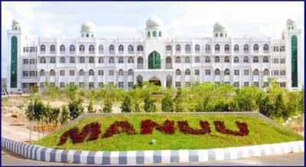
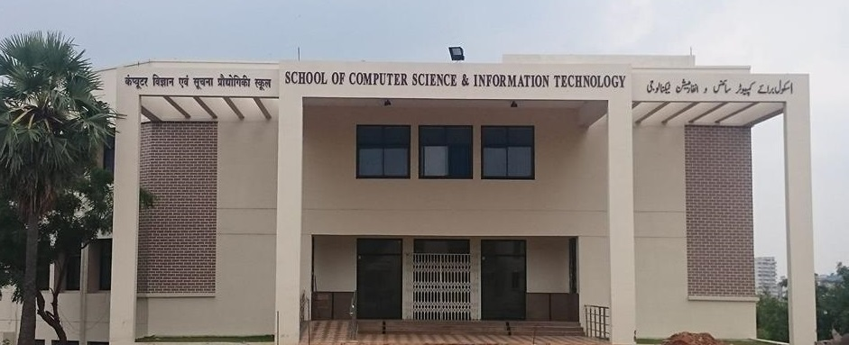
MAULANA AZAD NATIONAL URDU UNIVERSITY (A Central University Established By An Act Of Parliament In 1998)
TECH TURING
2k17
(DEPARTMENT OF CS & IT)
Innovation from waste to best

Slide 2
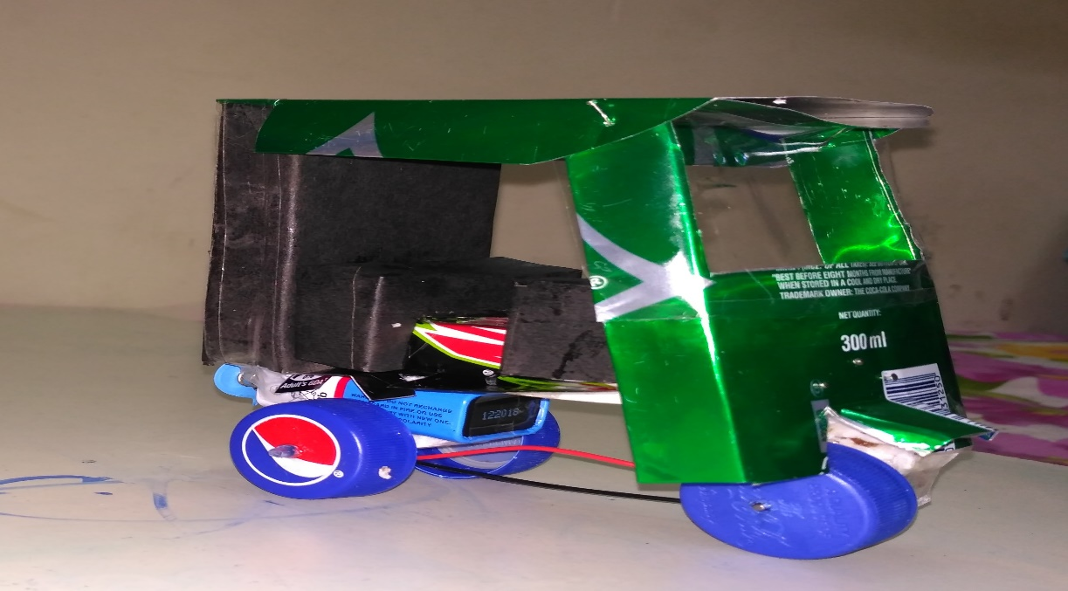
Topic:
E-Rickshaw
Presented by:
1. Name: Md Mozammil Anwar
Course: B.tech (3rd year)
Dept.:- CS&IT

Slide 3
CONTENTS
Introduction
History
Objective of solid waste mgmt.
Working function
Pros
cons

Slide 4
Introduction:
Most of the cities in developing countries are highly polluted. The main reasons are the air and noise pollution caused by transport vehicles, especially petrol-powered two and three wheelers.
An electric cycle rickshaw can provide a non-polluting and a very silent transport system for urban and rural area,
E Rickshaws are three wheel battery operated vehicles, which are considered as an upgrade to conventional rickshaws, and economically better than auto rickshaws and other fuel variants, these rickshaws, since are battery powered have zero emission, and is often argued to be much better than other rickshaws as they are considered almost pollution free.

Slide 5
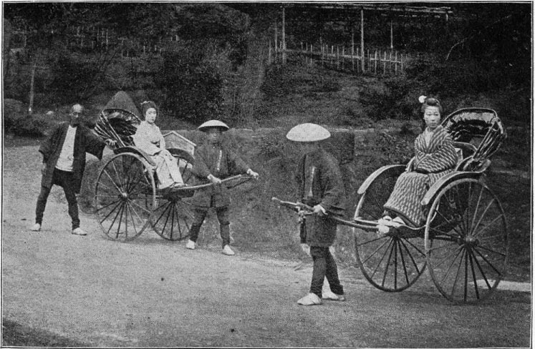
History:
Rickshaw began as a two or three-wheeled passenger cart, called a pulled rickshaw.
Jonathan Goble invented the rickshaw around 1869 to transport his invalid wife through the streets of Yokohama(Japan).
Auto rickshaws are becoming more popular in some cities in the 21st century as an alternative to taxis because of their low cost.

Slide 6
How it Works?
The electric rickshaw has been built with a light body so that the battery life may be increased.
The motor of most of the E Rickshaws is powered by a standard lead battery of 650W to 1250W; while government rules allow for a minimum of 650W.
The E rickshaw requires minimum maintenance.
The E Rickshaw is a vehicle that has been designed to provide efficiency, improved battery life, pollution free service, cost effectiveness and for contribution to resourceful income that will make rich dividends over a period of time.

Slide 7
Objective of solid waste mgmt:
To control, collect, process and dispose solid waste in an economical and consistent way with public health protection.
To reduce the quantity of toxic and hazardous chemicals and materials.
To maintain waste recycling programs regularly.
To reuse and recover the material from waste.

Slide 8
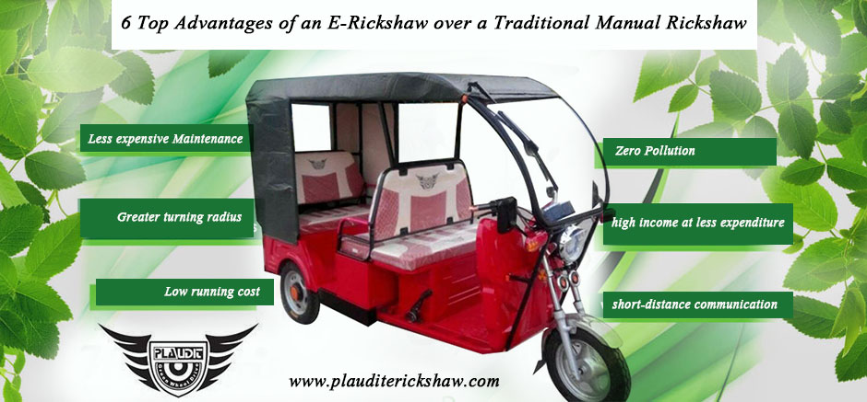
Pros:-
Zero pollution :
Eco-friendly:
Economical:
Easy to drive:
No noise pollution:
Generation of high income at less expenditure:

Slide 9
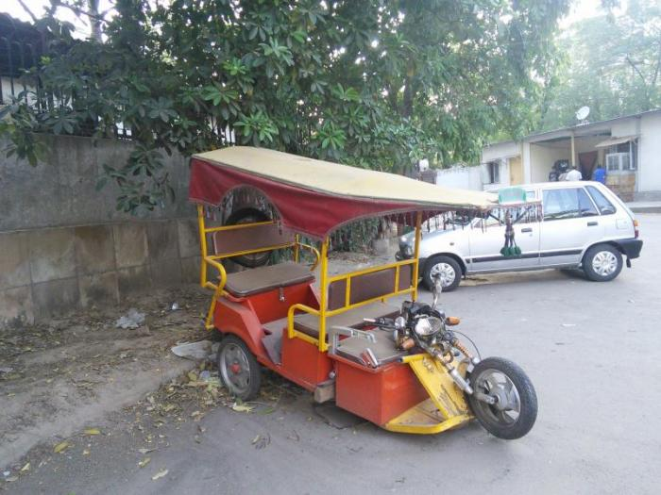
Cons:-
Not for long distance -
Safety -
Weather insulation inadequacy -

Slide 10
Conclusion:
In developing countries most of the cities are very congested with narrow roads. Because of historical reasons these roads cannot be broadened. For such roads non-polluting vehicles like auto,erickshaw etc. can provide a very attractive transport system.

Slide 11


