Slide 1

SURICATA
Intrusion Detection System

Slide 2
Agenda
Introduction to IDS
Installation & Configuration
Configuration Files
Suricata Rules
Network Intrusion Detection using Suricata
Integrating IDS with SIEM
What is Suricata

Slide 3
Intrusion Detection System
An Intrusion Detection System (IDS) is a cybersecurity solution designed to monitor network traffic and devices for anomalies, malicious activities, and policy violations (e.g.: Port scanning or Nmap Scans).
An IDS can be implemented as software on a device, dedicated hardware, or a cloud-based solution.
An IDS operates in passive mode. It only detects and reports potential threats, without taking any action, unlike an IPS.
IDS can be implemented alongside Honeypots and Canaries.
Types of IDS: Network-based, Host-based, Protocol-based, Application Protocol-based and Hybrid.

Slide 4
Common IDS Types
Network-based Intrusion Detection System (NIDS)
NIDS monitors traffic across a network by identifying known patterns of suspicious activity. They inspect both sides of network communications and, in IPS mode, can block malicious traffic when a threat is detected.
Typically, NIDS is connected to the network through a SPAN/mirror port or a network tap, allowing them to capture and analyze traffic without affecting network operations (e.g.: Snort, Suricata).
Host-based Intrusion Detection System (HIDS)
HIDS agent is installed on a host device (a server or workstation) to monitor and report system activities, application logs, and system calls.
It focuses on monitoring the device’s internal behaviour such as running processes and events, Registry settings and Network traffic (e.g.: OSSEC , Tripwire).

Slide 5
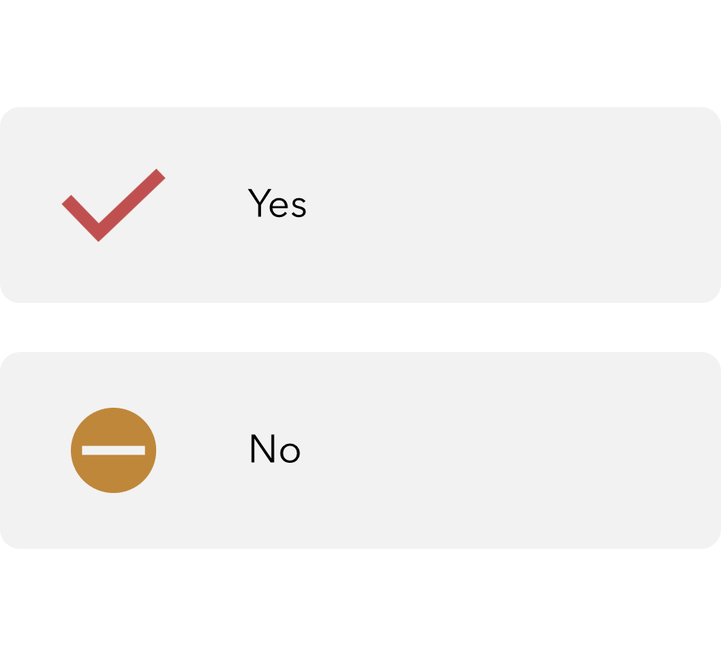
IDS/IPS can and can’t do
Monitor network traffic
Detect known threats
Identify Anomalies
Block malicious traffic (IPS only)
Provide Forensic Data
Detect zero-day attacks reliably
Remediate compromised systems
Replace firewalls
Prevent insider threats
Cannot fully eliminate false positives

Slide 6
Suricata
Suricata is a high performance, open-source network analysis and threat detection software used by many organizations and embedded by major vendors to protect their assets.
Suricata is developed and managed by OISF (Open Information Security Foundation).
It provides Real-time analysis of network traffic from layer 3 to layer 7.
Support for multi-threading and hardware acceleration, allowing efficient use of hardware.
Suricata can integrate with platforms like the Elastic Stack for log management and can be used in conjunction with Wazuh or Splunk for enhanced security monitoring.

Slide 7
Installation & Configuration
Suricata can be installed on OS X, Linux and Windows.
It can be downloaded from its official web site: https://suricata.io/download/
Suricata can be configured to operate in two different modes.
Active (IPS): Suricata is deployed in-line to prevent intrusions by blocking or dropping malicious packets in real-time.
Passive (IDS): Suricata monitors network traffic, detects intrusions, and generates alerts without blocking the traffic.
It is placed out of band within the network infrastructure.

Slide 8
Installation & Configuration
We will be using an Ubuntu server (latest version).
To install Suricata we must first add the official OISF repository by this commands:
sudo apt-get install software-properties-common
sudo add-apt-repository ppa:oisf/suricata-stable
sudo apt update
sudo apt install suricata jq
sudo systemctl status suricata

Slide 9
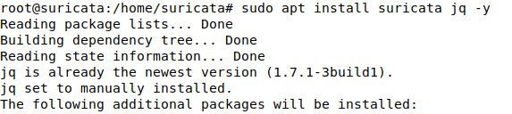
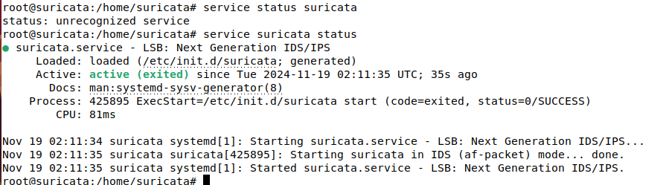
Installation & Configuration
Command Results

Slide 10
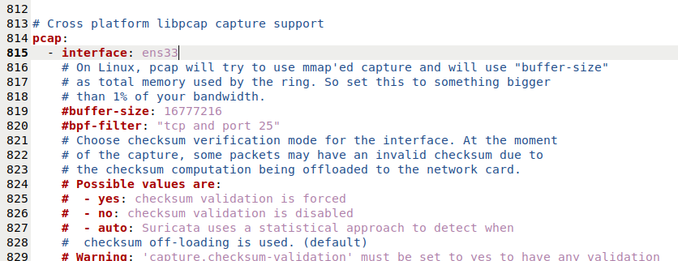
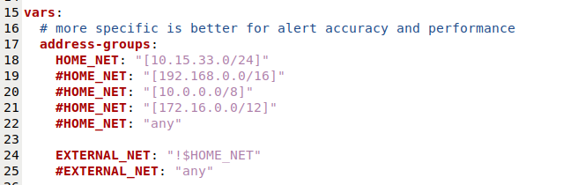
Configuration Files
To effectively monitor network traffic, we must specify the correct interfaces and the appropriate network address.
Suricata's configuration are stored in the suricata.yaml file, which is located in the /etc/suricata/ directory.

Slide 11
Rules
Rules are a set of instructions that tell Suricata how to detect attacks, unusual behaviour, or specific network events.
For example, a rule might look for a known malware signature, an unauthorized login attempt, or a large data transfer to an unfamiliar server.
Suricata provides predefined rules for various scenarios, and custom rules can be configured to suit our environment.
It compares network packets against predefined rules. If a packet matches, the configured action determines whether to drop or log the traffic.

Slide 12
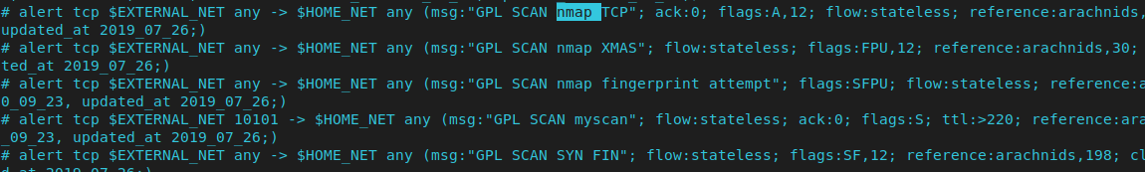
Rules
Suricata rules
Not all rules are enabled by default, a pound symbol indicates a disabled rule.

Slide 13
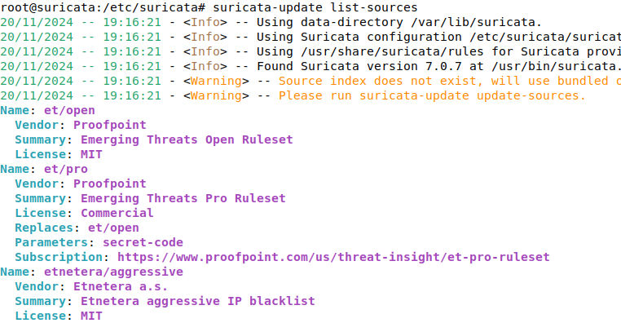
Rules
Suricata allows us to download rules from various sources. You can view the list of available sources by entering the command: suricata-update list-sources.
Selected rules can be enabled by the command suricata-update enable <source-name>
After enabling the source, you must update the rules by entering suricata-update

Slide 14
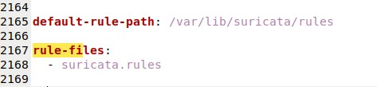
Rules
Custom rules can be created and added to the Suricata configuration.
Rules Examples;
A suspicious ping from the Corporate Network to the ICS Network.
alert icmp $CORP_NET any -> $ICS_NET any (msg: ”Suspicious PING Detected”; sid:1; rev:1;)
Detecting a Brute Force attack
alert tcp any any -> any 22 (msg:"Potential SSH Brute-Force Attack"; flags:S; threshold:type both, track by_src, count 5, seconds 60; sid:100002; rev:1;)
After adding these rules into a .rules file, you must specify the path to that file in suricata.yaml

Slide 15
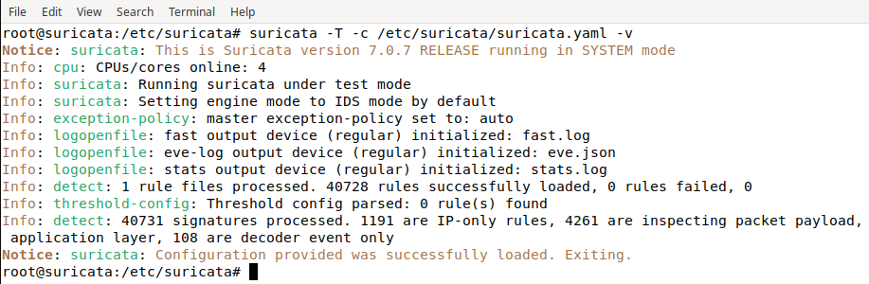
Configuration Test
Before running Suricata, we can execute the configuration file in the test environment to verify whether it detects the correct interface, utilizes the rules, generates .json logs, and so on.
suricata -T -c /etc/suricata/suricata.yaml –v
Options:
- T for test mode
- c specify the configuration file
- v for verbose output

Slide 16
Summary
We learned about IDS and the different types, including NIDS and HIDS.
We explored the purpose and use of IDSs.
Next, we studied Suricata, including the supported platforms and its different modes of operation, such as IPS and IDS.
We went through the installation process of Suricata, starting with adding the repository followed by the actual installation.
After installation, we configured the suricata.yaml file and reviewed the rules associated with Suricata.

Slide 17
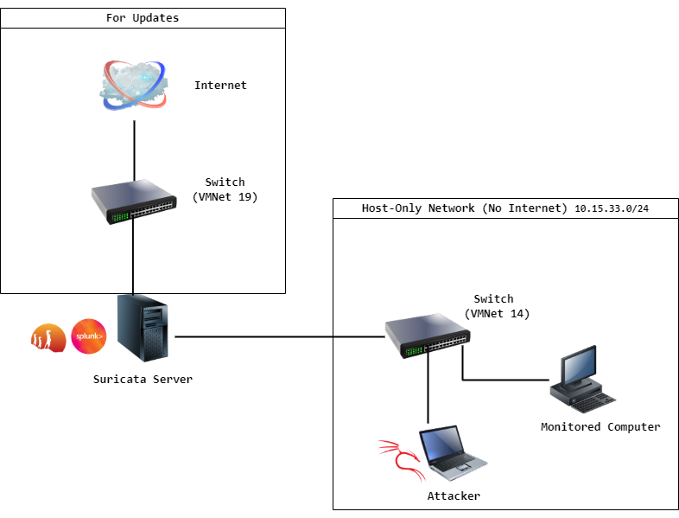
Demonstration Topology

Slide 18
References
Suricata - https://suricata.io/
OISF - https://oisf.net/
Splunk - https://www.splunk.com/
Ubuntu - https://ubuntu.com/download/server
Documentation - https://docs.suricata.io/en/latest/install.html
IDS/IPS - https://www.paloaltonetworks.ca/cyberpedia/what-is-an-intrusion-detection-system-ids
https://www.ibm.com/topics/intrusion-detection-system

