Slide 1
Project Funding Opportunity
Faculty: DR. MD. RAZIB HAYAT KHAN Course: Software Engineering Sec: E Group: 1
Name | ID
Arifur Rahman | 18-38852-3
Atanu Rudra Joy | 18-38876-3
Md Nabil Hossain | 18-38585-2
Abdullah Al Maksud | 18-38582-2

Slide 2
Introduction
Idea generation:
How we got the idea?
Overview
The purpose of the project

Slide 3
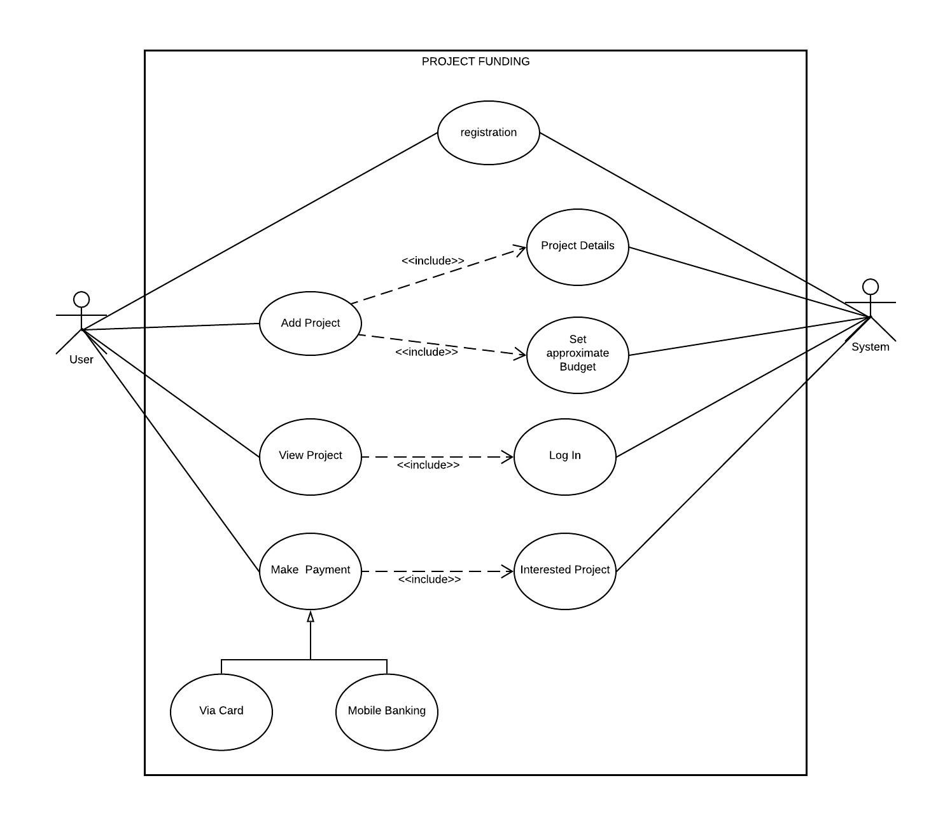
Use Case Diagram

Slide 4
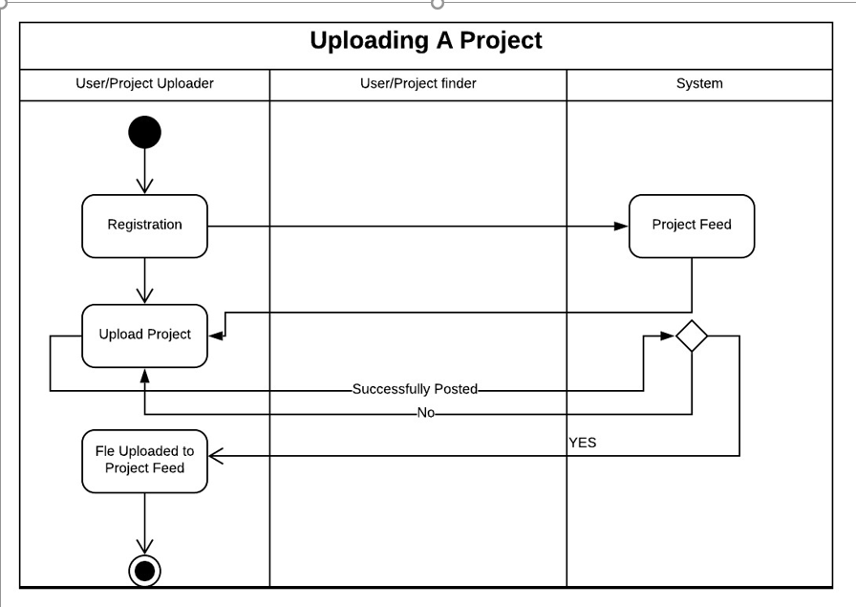
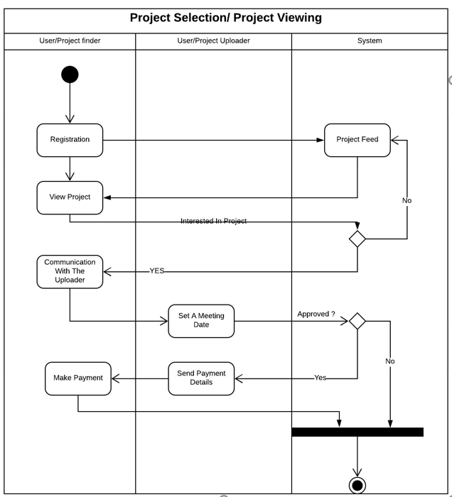
Activity Diagram

Slide 5
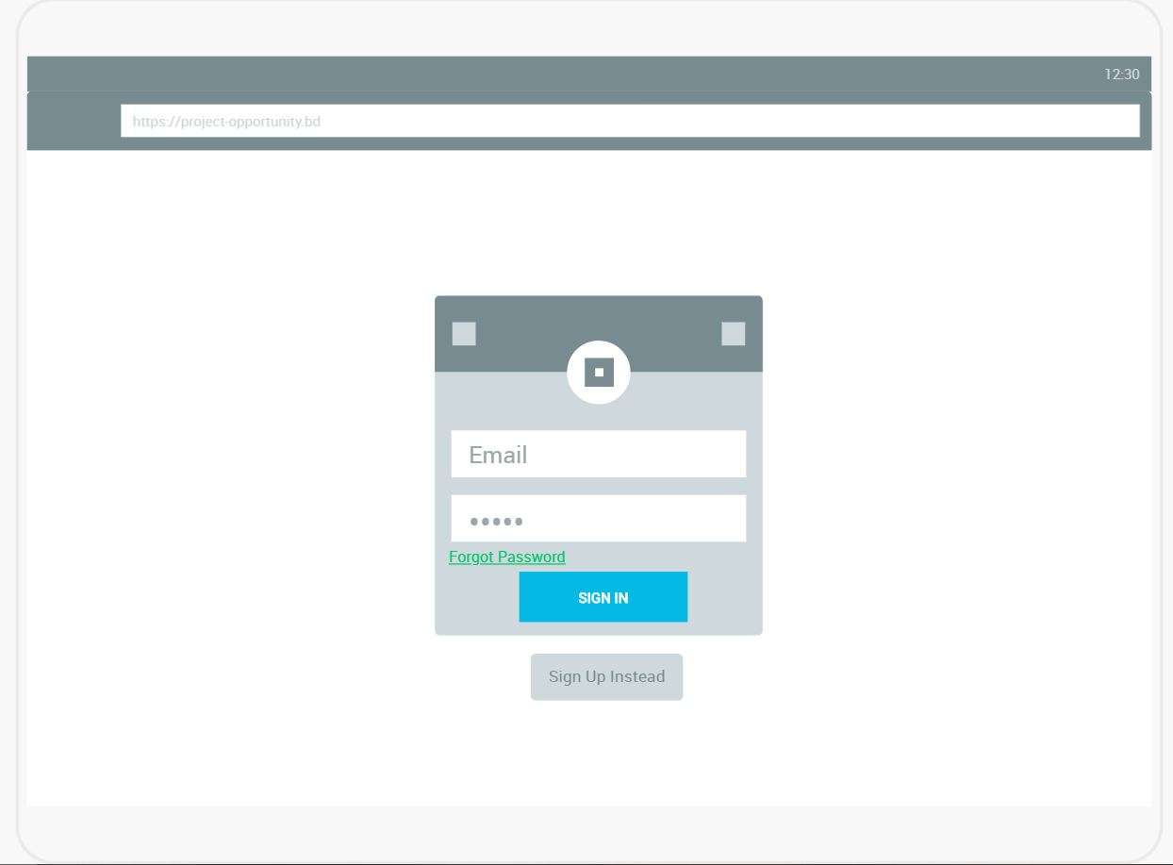
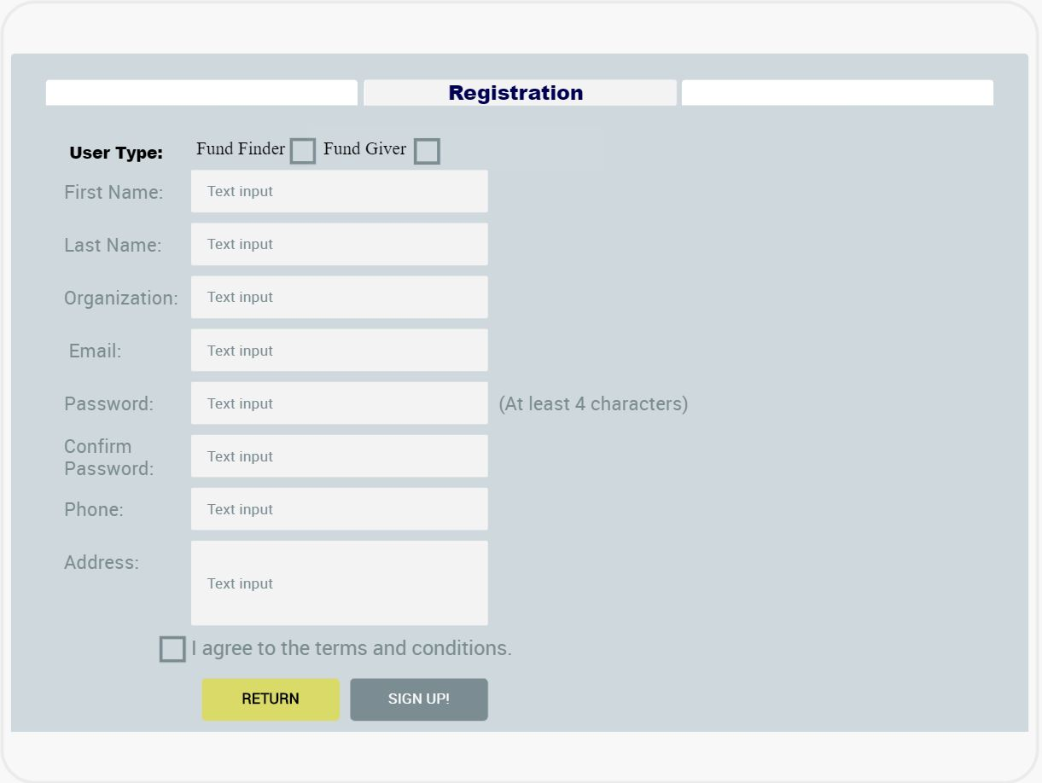
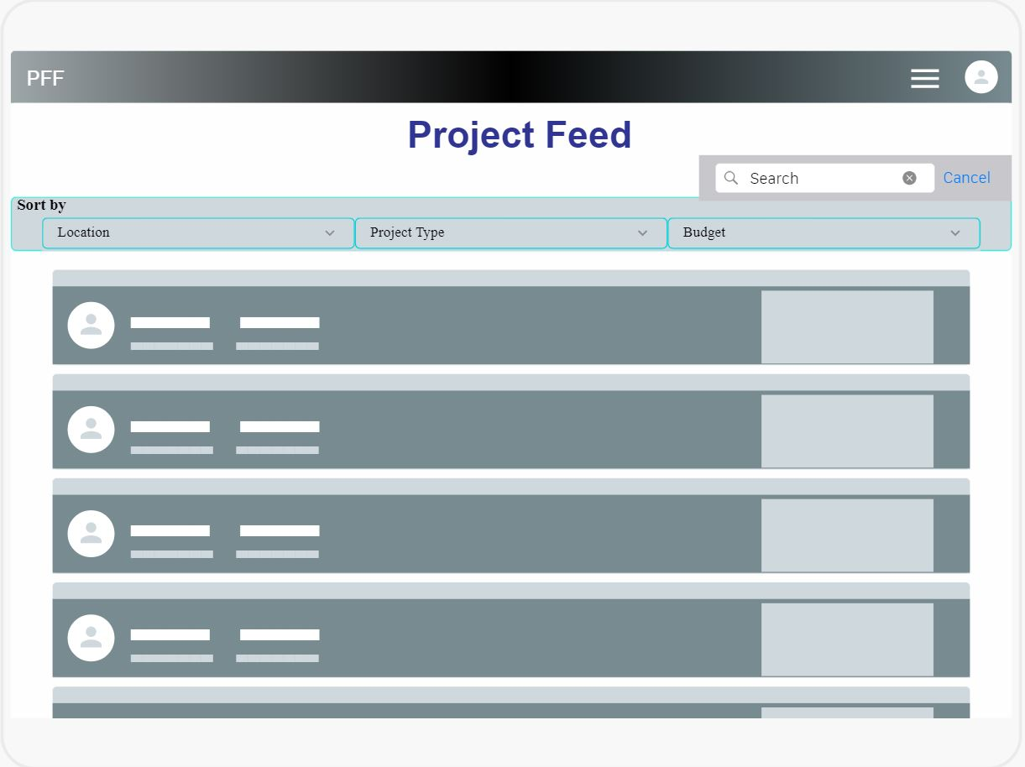
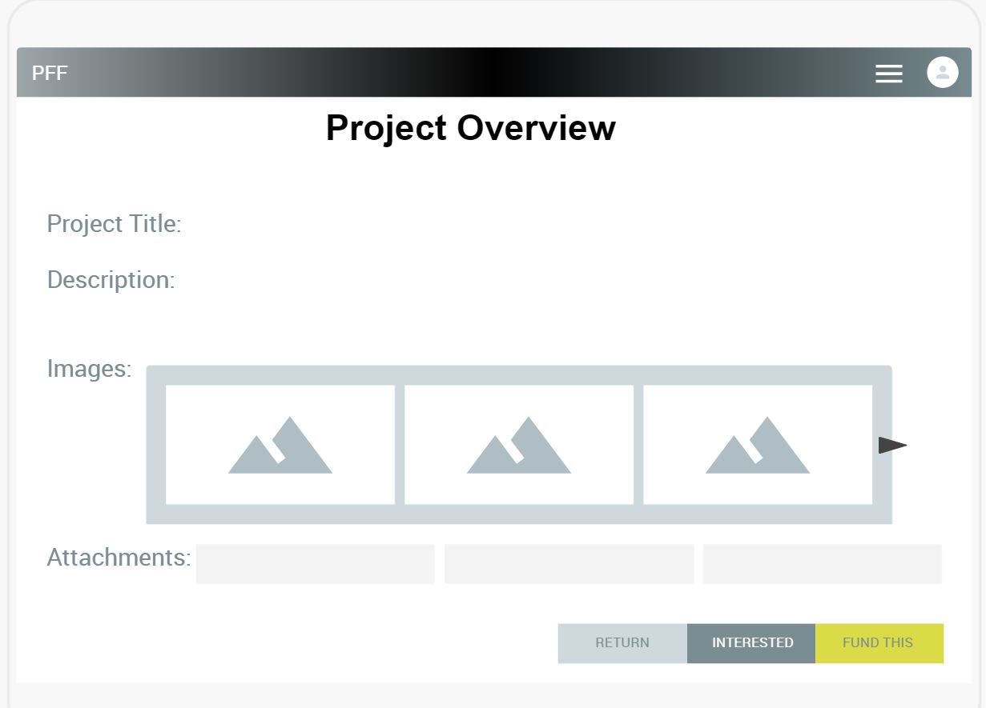
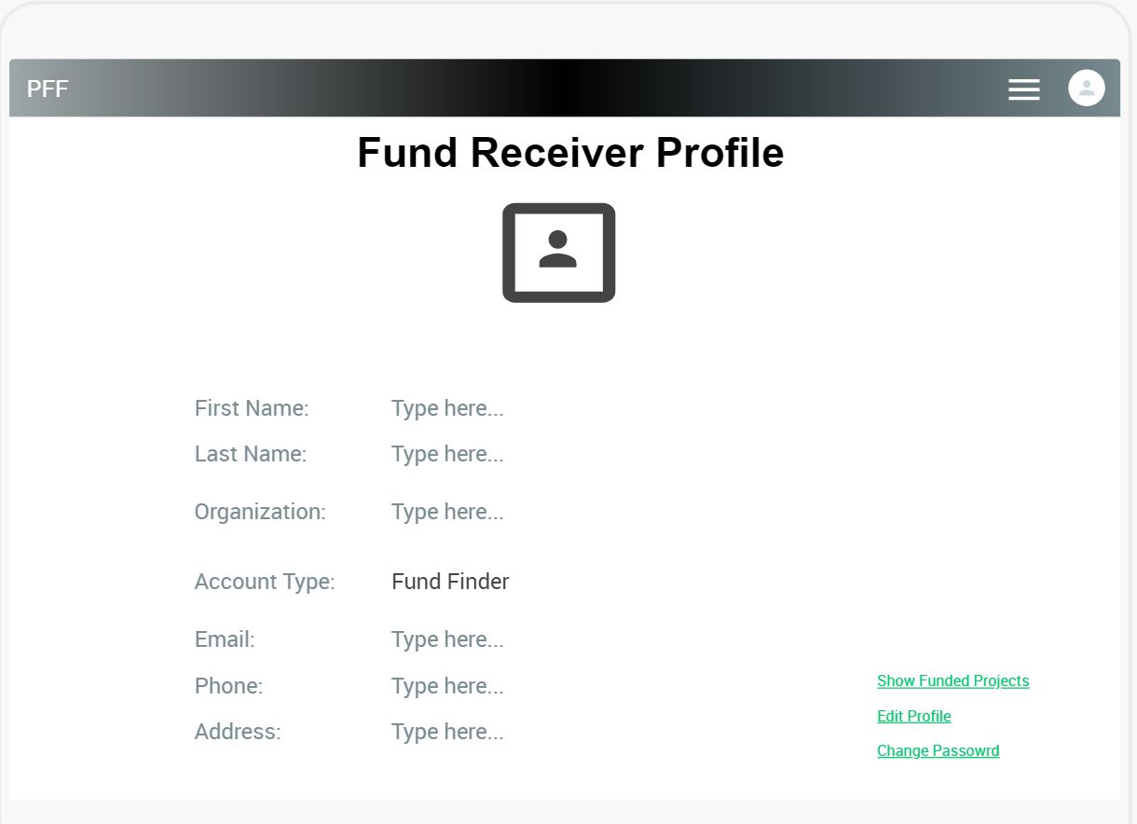
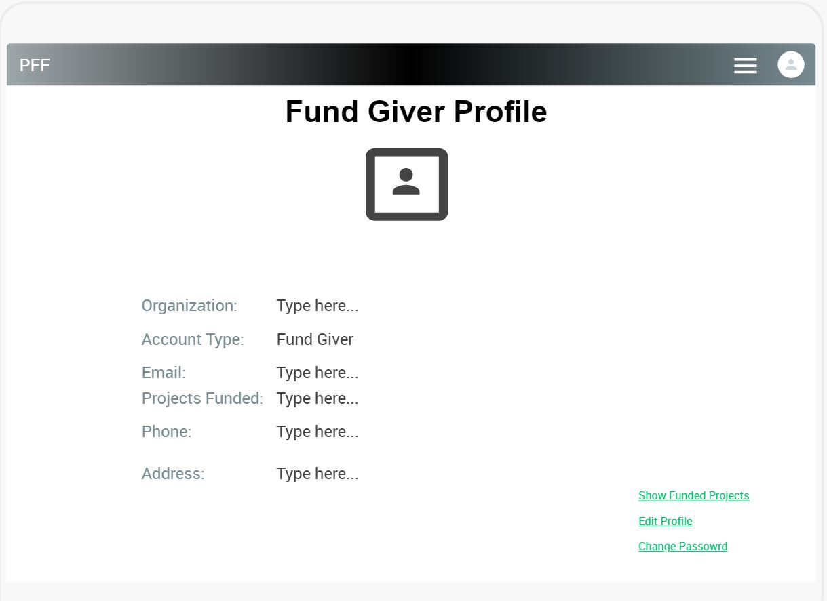
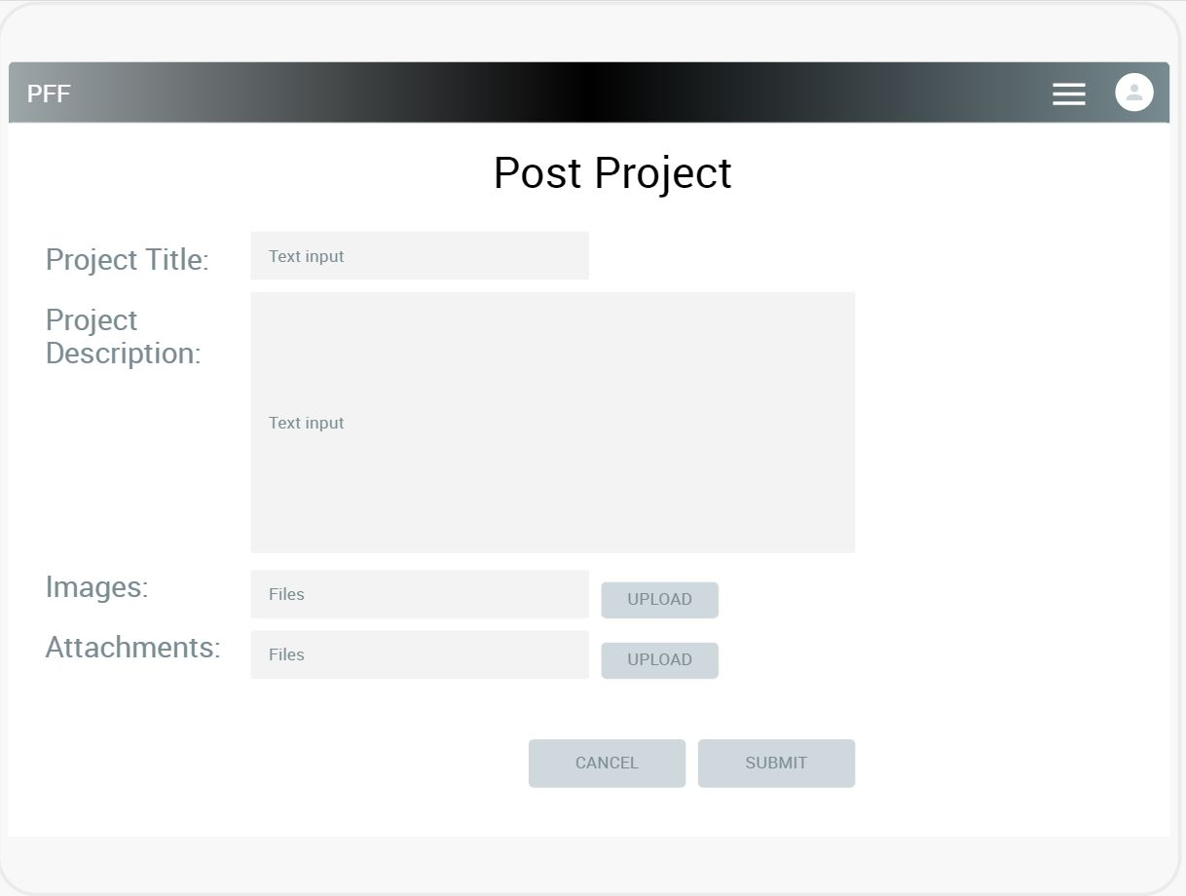
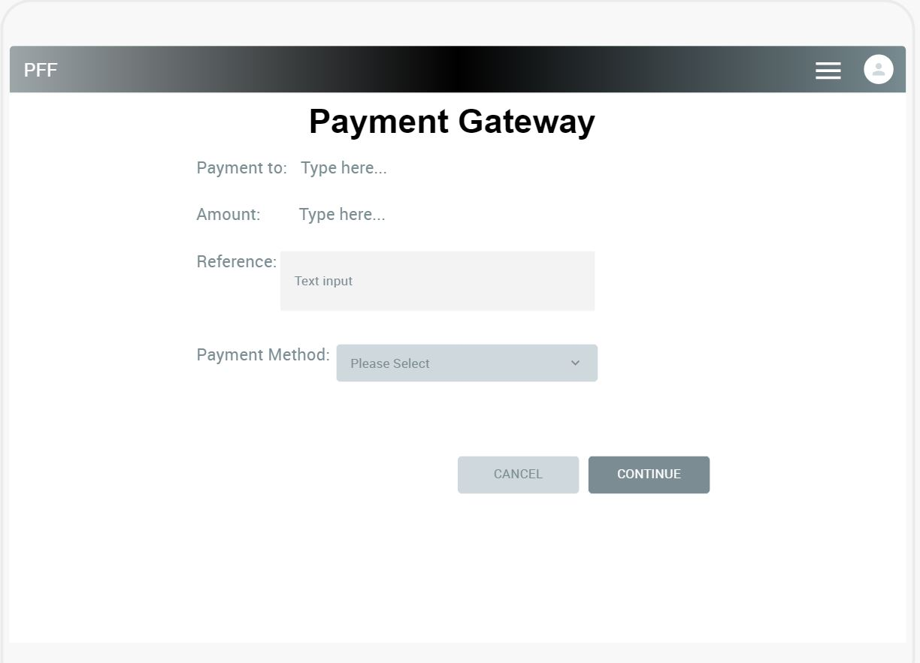
Mock Design

Slide 6
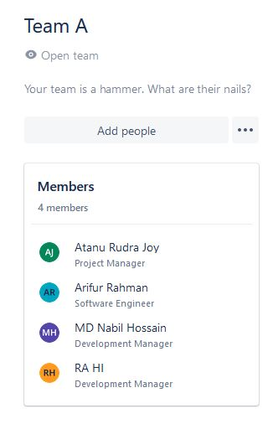
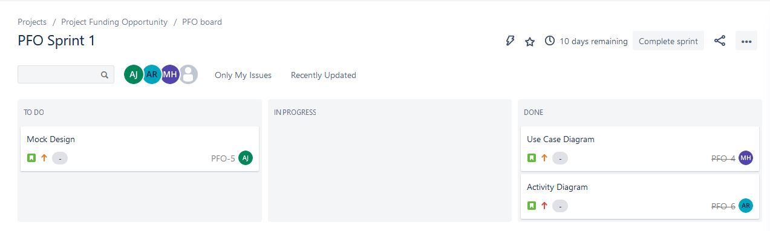
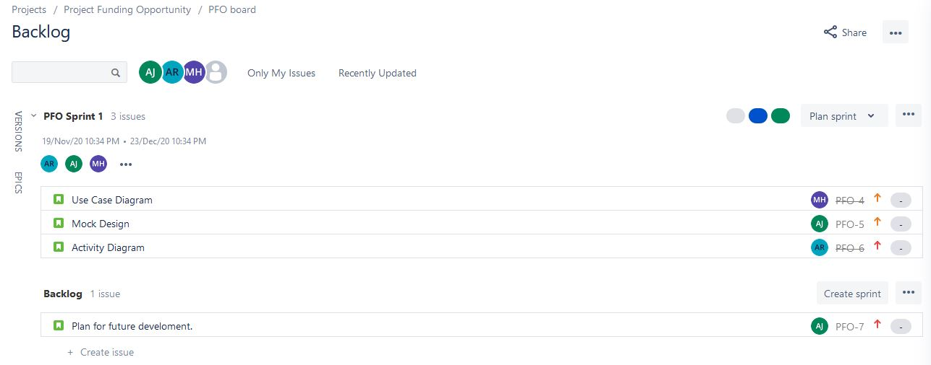
JIRA

Slide 7


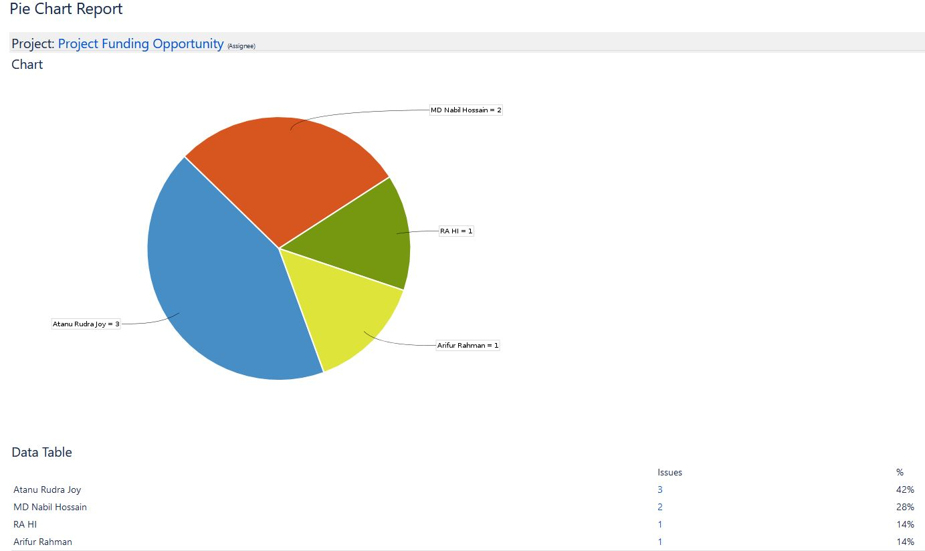




Slide 8
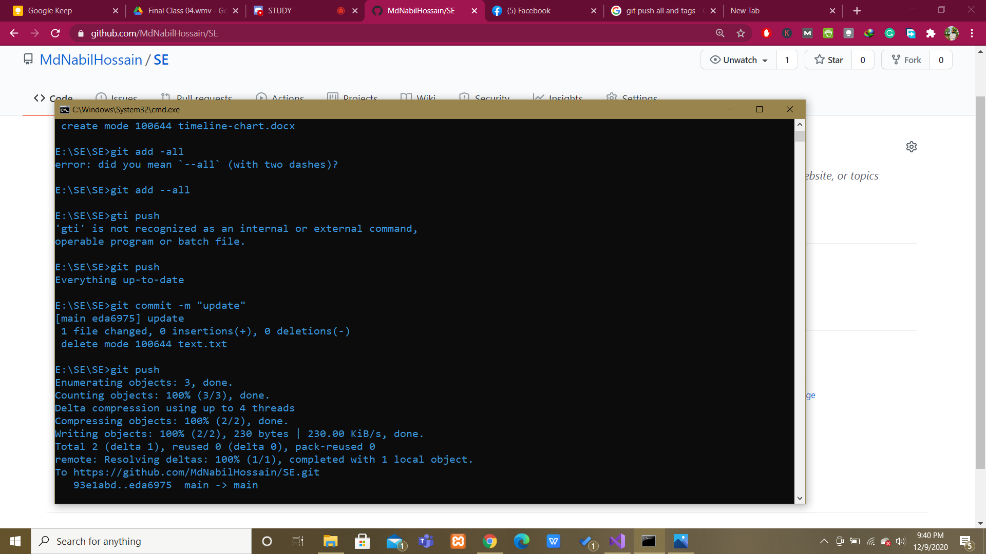
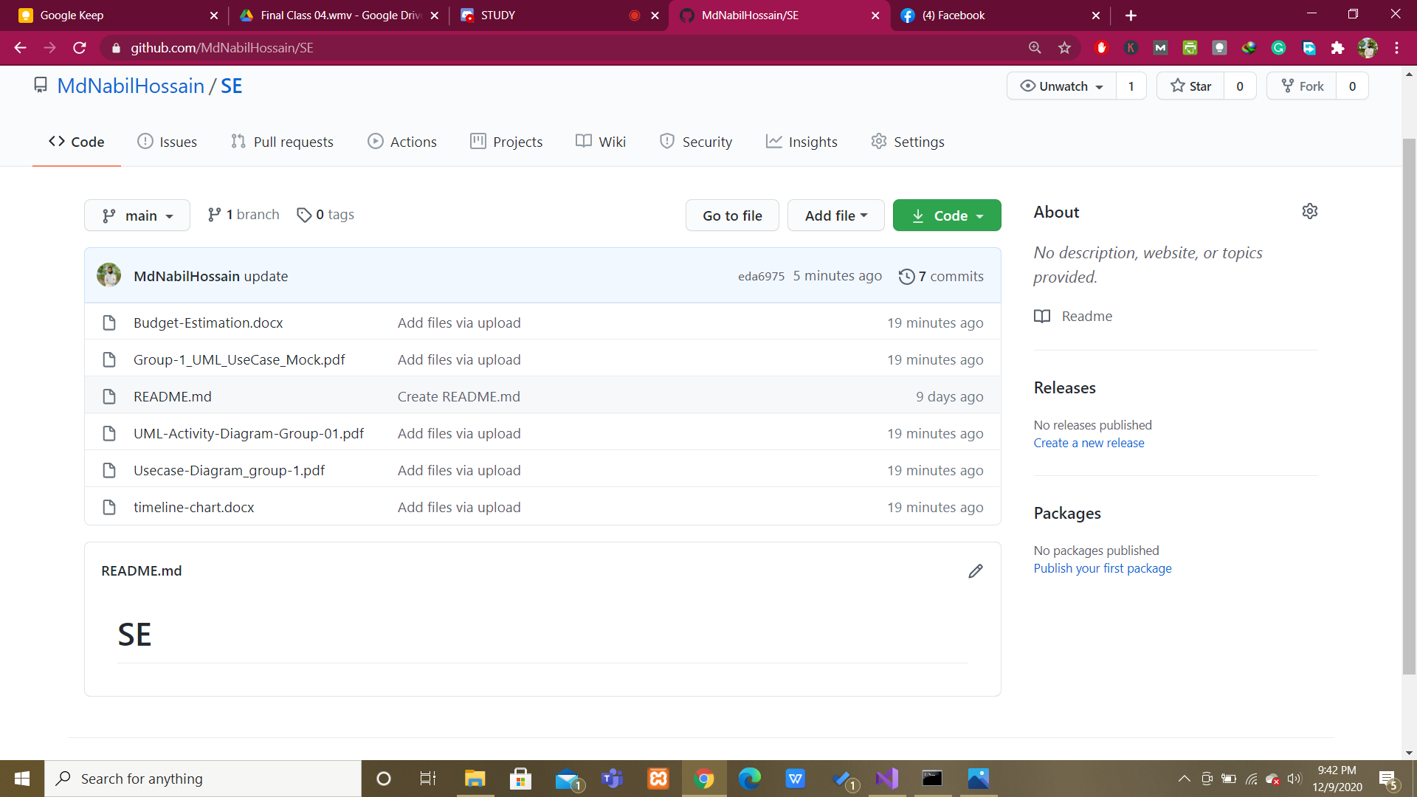
GITHUB Push Code
Online Depository

Slide 9
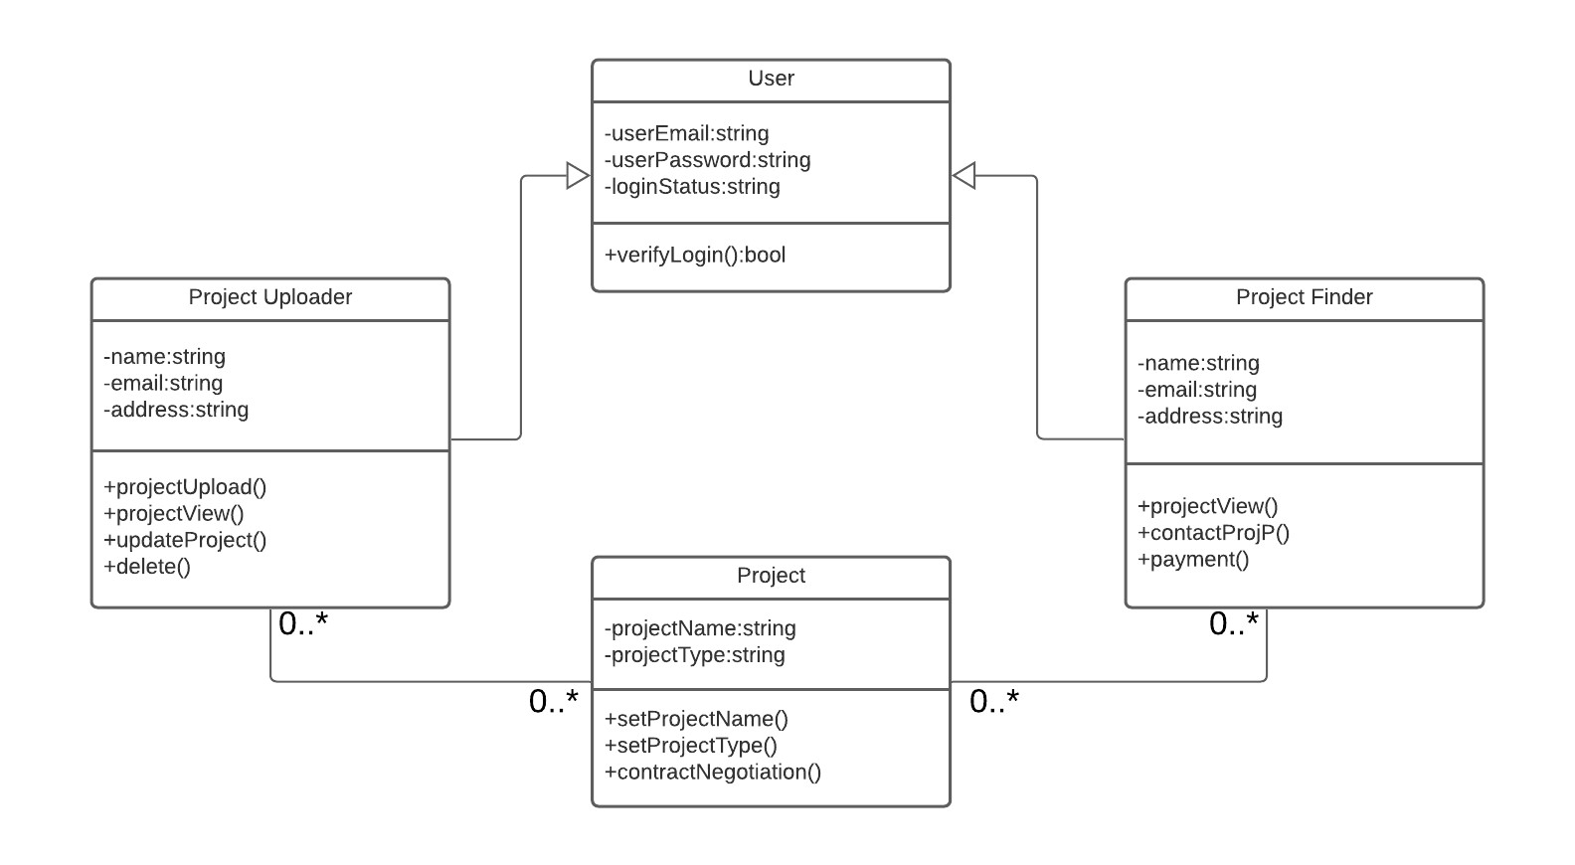
UML Class Diagram

Slide 10
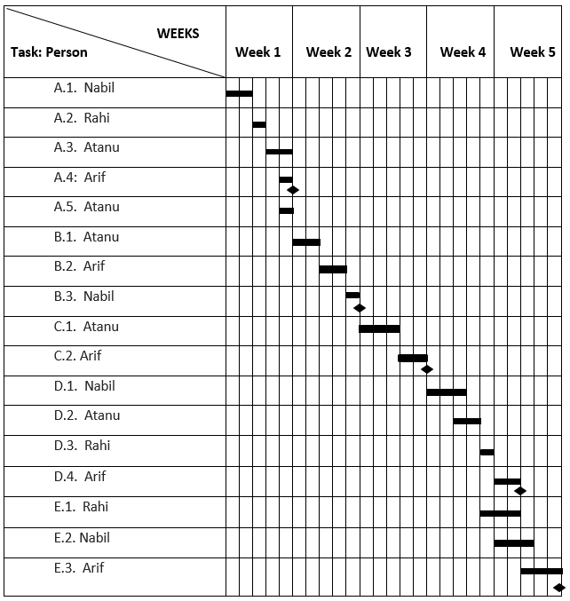
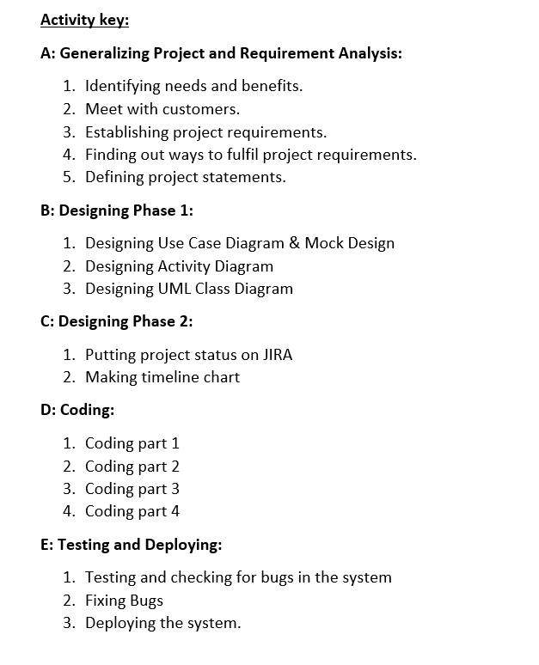
Project Scheduling

Slide 11
Budget Estimation
COCOMO
SLOC =12,000
Effort= PM =
Coefficient _{<Effort Factor>} * (SLOC/1000)^{P}
= 2.4*(12,000/1000)^{1.05}
= 2.4(12)^{1.05} = 33 person-months
Development time = DM = 2.50 * (PM)^{T}
=2.50*(33)^{0.38}
=10 months
Required Number of people = ST
= PM/DM
= 33/10
= 4 members
4 person 10 months = 305 (205 working days)
Hours =205*8
=1640 hours
Budget Estimation
Salary = 13,00,000/1,640
= 793 Taka/hour
Total Salary = 13,00,000
Requirement analysis = 15 days
=15*8 =120
Charge = 120*305 =36600
Utilities = 18,000
Maintenance = 8 months
= 8*10 hours
= 80 hours *1000
= 80000
Training and Hardware = 160000
Office rent expense = 1,80,000
Electricity =30000
Total cost = 13,00,000 +36600 +18000
+80000+160000 +180000+ 30000
=1804600
=18,05,000
Profit margin will be 10% of the total cost.
Profit Margin = 18,05,000 * 10%
= 1,80,500
Total Bill will be (18,05,000 + 1,80,500) Taka
= 19,85,500 Taka

Slide 12
Conclusion
The relevance of the project
Does the project have a clear target market or audience?
Does the team demonstrate a thorough understanding of the need, problem or opportunity, including evidence of research into the need, problem or opportunity?
Is the project’s purpose and basic functionality easily understood?
Business value

