Slide 1
Food Cycle
Presented by -
Yamlick Abdullah, (20-42678-1)
Hoq, Md Nafijul, (20-42366-1)
Supervised by: Prof. Dr. Kamruddin Nur

Slide 2
Outline
Overview
Project Size
Software tools for software development
Software tools for project management
Milestone
Schedule
Budget Requirement
. Resource management
Potential risk management
Quality Management
Conclusion

Slide 3
Overview
Problem Statement:
1.3 billion of food is wasted globally per year.
Destroy ecological balance.
Hunger all over the world
Objectives:
Built a system that reduces food waste.
Keep the environment safe
Reduce hunger issues.

Slide 4
Overview
How the system works
Establish booths
Collects food from households, restaurants, and bakery shops
Categories
Distribute

Slide 5
Overview
Challenges:
Food safety and quality.
Technology infostructure.
Privacy and data security.
Collaboration among stakeholders.
Public perception and task.

Slide 6
Overview
Why this system
Collect food from door to door
Connect with the locality.
Combine package.

Slide 7
Project Size
Medium size project.
Duration four months.

Slide 8
Software tools for development
Visual Studio
GitHub
Google meet
Selenium.
MySQL
Google docs
Figma

Slide 9
Software tools for project management
ClickUp
Asana
Monday.com

Slide 10
What is Gantt chart
Visual representation of tasks, timeline and resources.
Effective way to manage a complex project.

Slide 11
Benefits
Optimize team productivity.
Track progress and adjust project plan.

Slide 12
What is dependency
Relationships between task or activities.

Slide 13
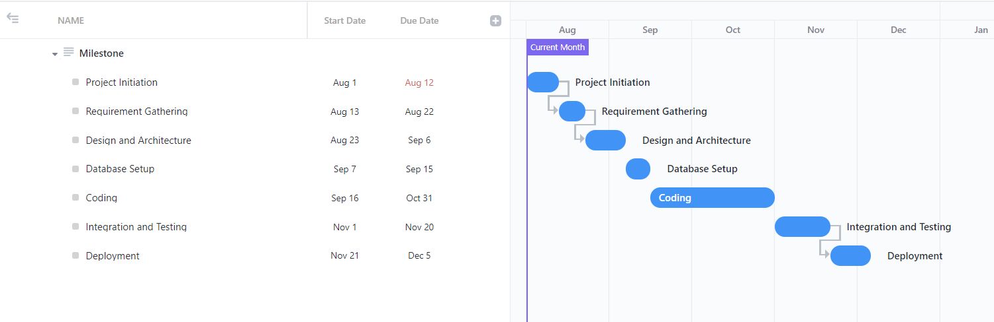
Milestone

Slide 14
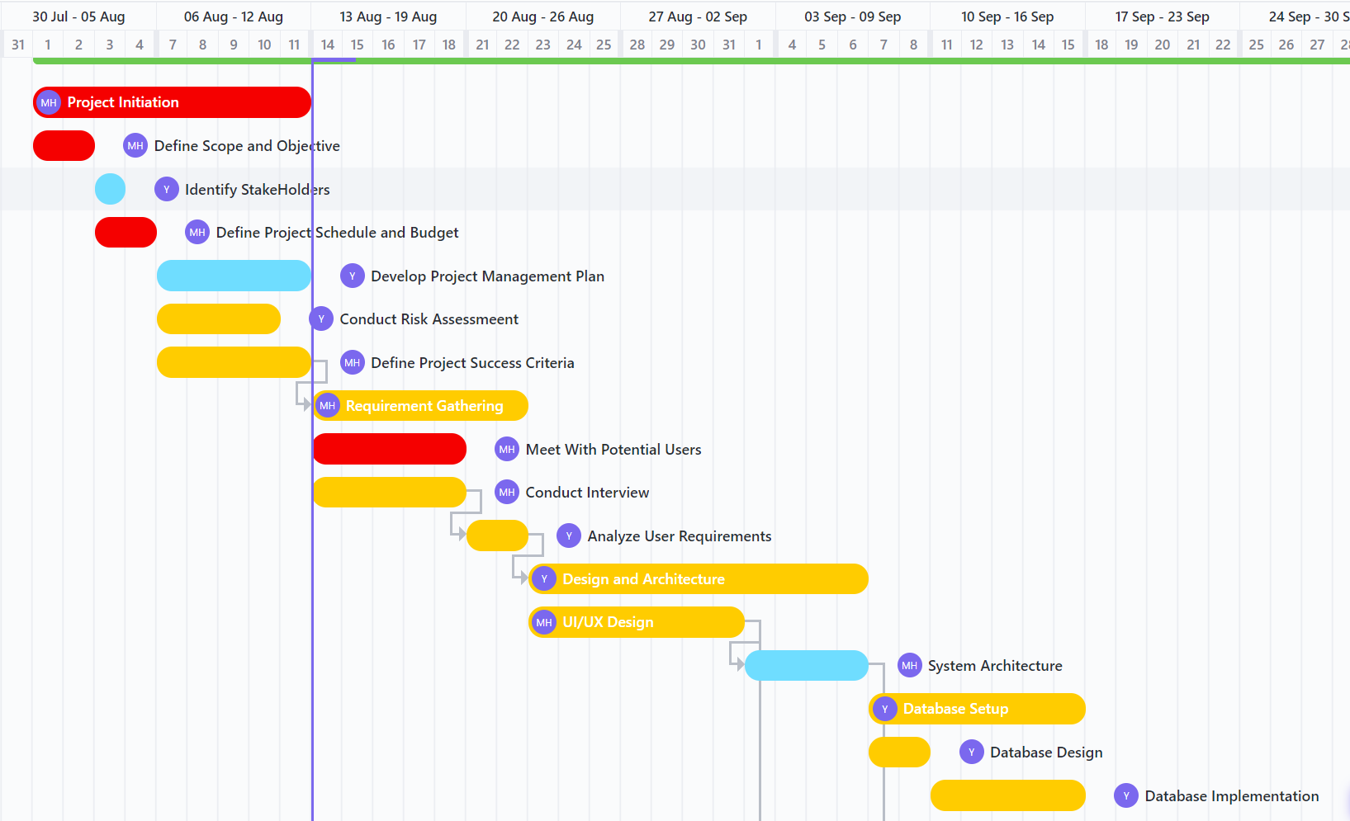
Scheduling

Slide 15
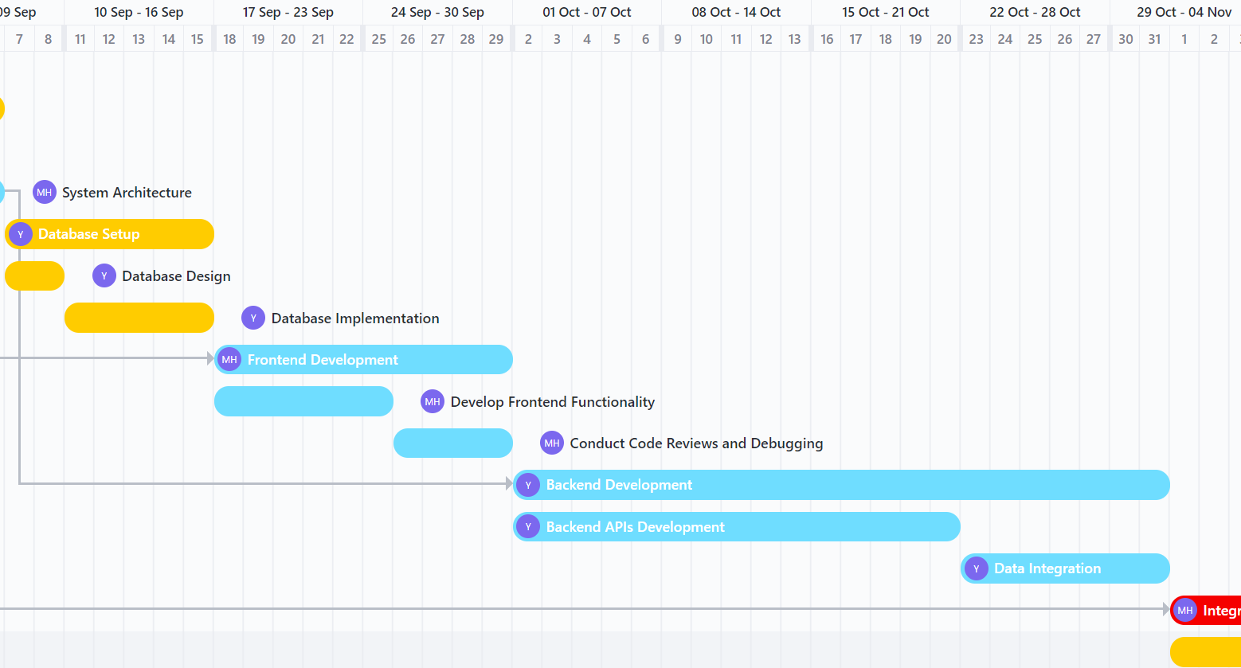
Scheduling

Slide 16
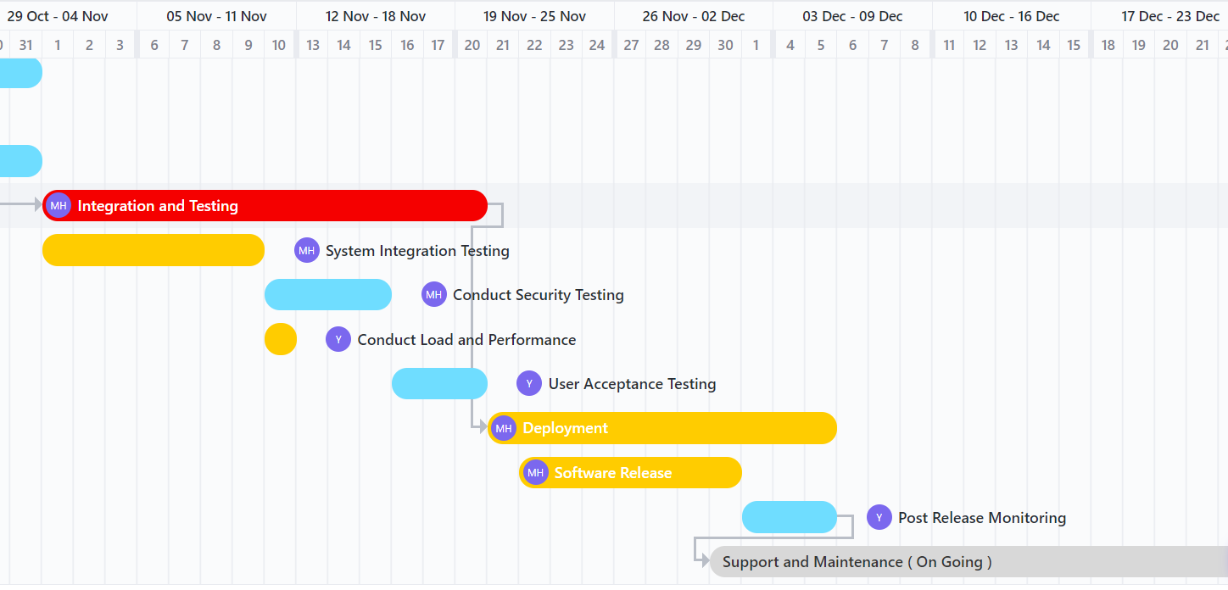
Scheduling

Slide 17
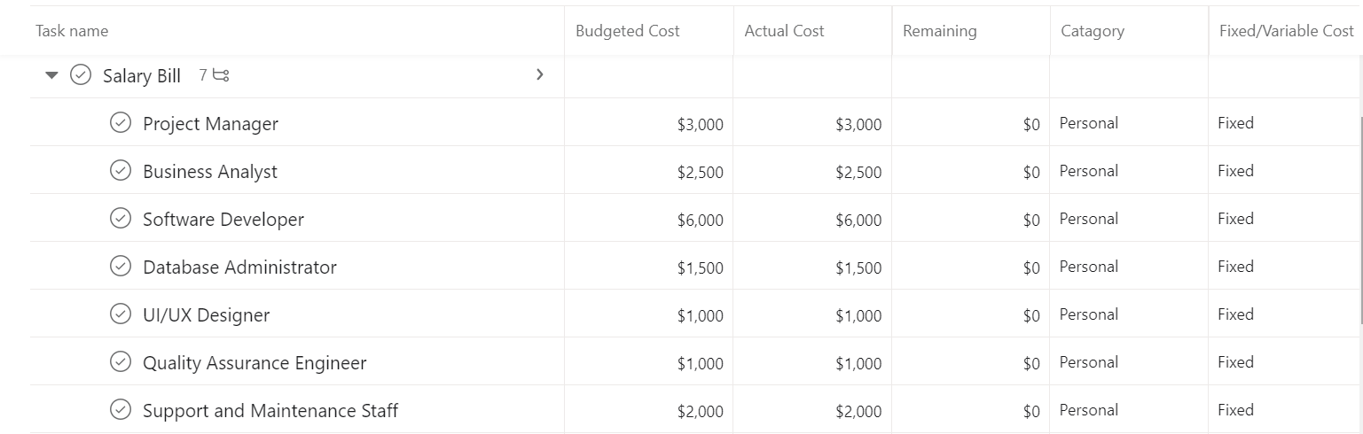
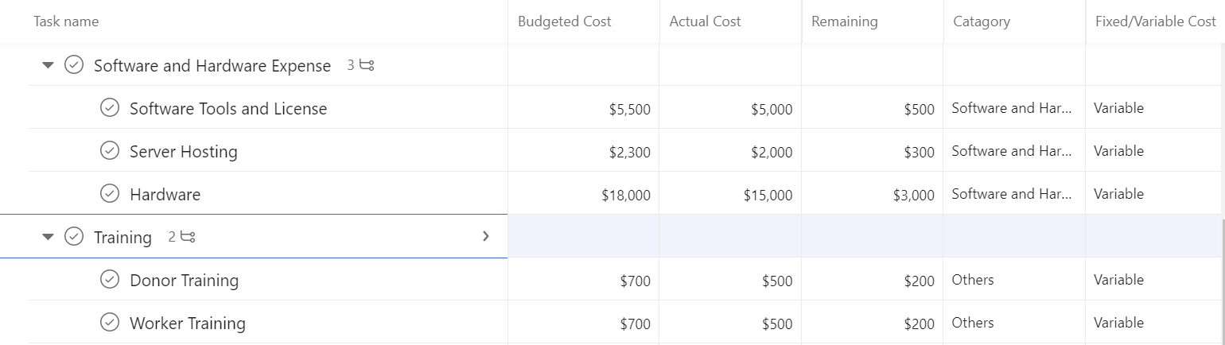
Budget Estimation

Slide 18
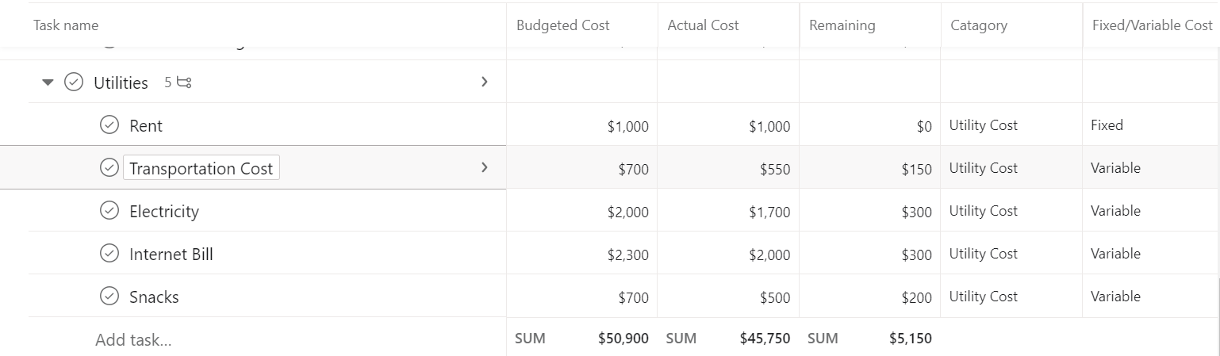
Budget Estimation

Slide 19
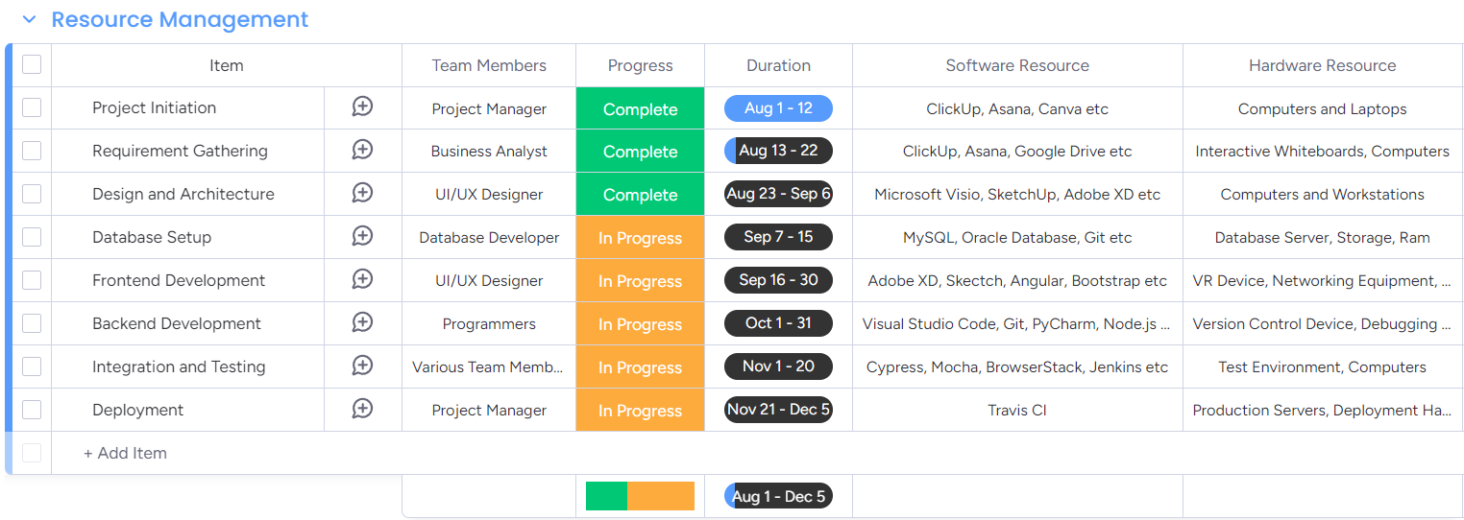
Resource Management

Slide 20
Potential risk management
What is risk management?
Assessing, identifying, and mitigating potential risks.
Negative effect of uncertainties on project objectives.

Slide 21
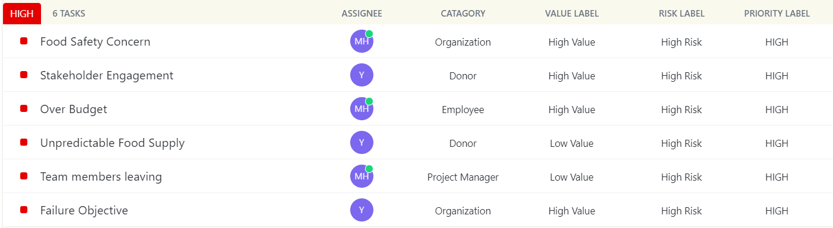
Risk Management

Slide 22
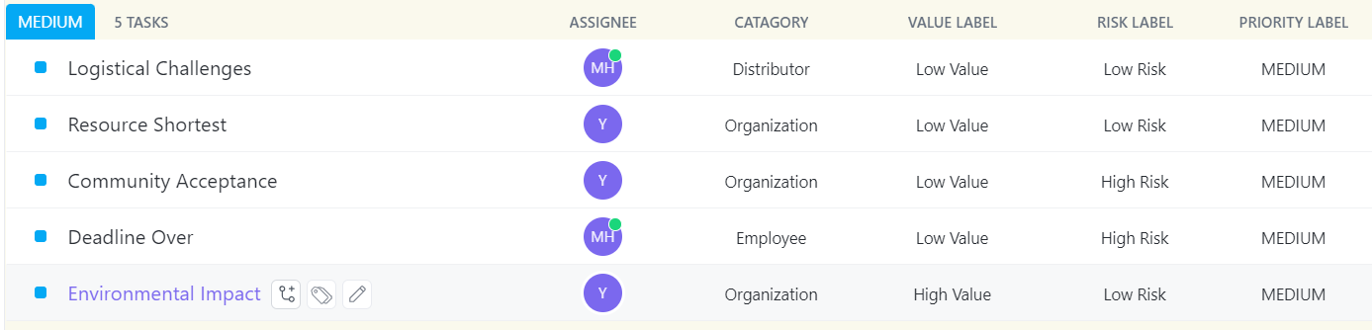
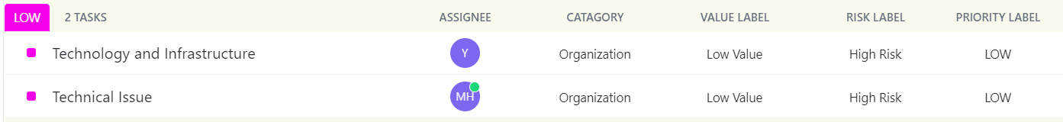
Risk Management

Slide 23
Quality Management
Meets the required standard.
Aimed at delivering high-quality products.

Slide 24
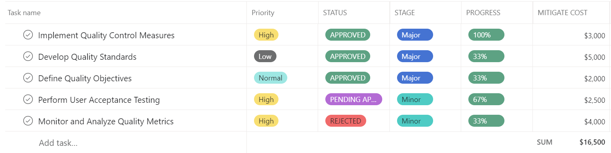
Quality Management

Slide 25
Conclusion
Reduce food waste.
Alleviating hunger.
Environmental benefits.
Economic savings.

