Slide 1
BIG DATA ANALYTICS • PROJECT FINAL PRESENTATION
FedHome
Device-Type-Aware Client Clustering for Privacy-Preserving
Federated Anomaly Detection in Non-IID Smart Home IoT Networks
Md. Raihan Sobhan
Big Data Analytics • October 2025
Dr. Muhammad Abdullah Adnan
Professor, Department of CSE, BUET

Slide 2
ROADMAP
Comprehensive presentation covering all phases and results
01
Problem & Motivation
02
FedMSE Baseline
03
FedHome Solution
04
Implementation Details
05
Experimental Results
06
Analysis & Figures
07
Conclusion
Device-Type-Aware Client Clustering for Federated Anomaly Detection
FedHome | 02

Slide 3
Problem Statement & Motivation
01
Device-Type-Aware Client Clustering for Federated Anomaly Detection
FedHome | 04

Slide 4
MOTIVATION
IoT botnet detection is critical but privacy-sensitive
Challenge
Detect anomalous IoT traffic while preserving household privacy and handling extreme client heterogeneity.
21.9B
Privacy
1
Raw traffic exposes routines → No centralization allowed
connected IoT devices
Heterogeneity
83%
2
50 gateways, different mixes → Camera vs Thermostat heavy
routers with vulnerabilities
Scale
3
Thousands of homes possible → Distributed processing needed
~1M
compromised devices in botnets
Attacks
4
Mirai & Gafgyt botnets → One-class detection only
Device-Type-Aware Client Clustering for Federated Anomaly Detection
FedHome | 05

Slide 5
NON-IID CHALLENGE
Different gateways have fundamentally different traffic distributions
Camera-heavy
Thermostat-heavy
Core Problem
✓ High-volume streams
✓ Video-heavy features
✓ Frequent burst behavior
✓ Periodic telemetry
✓ Lower bandwidth
✓ Different normal baseline
A single global model averaged over these diverse clients will compromise on both, fitting neither well.
FedHome's hypothesis: Can we cluster clients by device type before federation to improve results?
Device-Type-Aware Client Clustering for Federated Anomaly Detection
FedHome | 06

Slide 6
FedHome Solution
03
Cluster-aware federation for heterogeneous IoT networks
Device-Type-Aware Client Clustering for Federated Anomaly Detection
FedHome | 07

Slide 7
ARCHITECTURE
Four-phase pipeline: profile → cluster → train → merge
1
2
3
4
Profile
Cluster
Train
Merge
>
>
>
Extract device-type
proportions
Group gateways by
JS-divergence
Run FedMSE
per cluster
Weighted ensemble
of models
Output: One deployable model that preserves specialization while keeping raw traffic local
Device-Type-Aware Client Clustering for Federated Anomaly Detection
FedHome | 08

Slide 8
FedMSE Baseline
02
Strong reference point for comparison
Device-Type-Aware Client Clustering for Federated Anomaly Detection
FedHome | 09

Slide 9
THE BASELINE WE BUILD ON
FedMSE: SAE-CEN + MSEAvg for robust Non-IID learning
Combines a local anomaly detector with a quality-aware aggregation algorithm.
1
SAE-CEN — Local Model
2
MSEAvg — Aggregation
Shrink Autoencoder loss adds a latent-shrinkage term:
Weights clients by model quality, not dataset size:
L = ⅓Σ‖xᵢ − x̂ᵢ‖² + λ·⅓Σ‖hᵢ‖²
αᵢ = 1 / MSEᵢ W = ΣαᵢWᵢ / Σαᵢ
• Pulls “normal” samples into a compact cluster in latent space
• Centroid (CEN) detector: distance-to-centroid = anomaly score
• No extra hyperparameters, negligible compute cost
• Server holds a small shared dev set (normal traffic only)
• Better-reconstructing local models get more influence
• Quality-aware → robust to Non-IID heterogeneity (unlike FedAvg)
Architecture: 115 → 50 → 11 (latent) → 50 → 115, ReLU / Sigmoid
Reported Result: 93.98% → 97.30% AUC improvement in high Non-IID settings
FedHome | 10
FedHome • Big Data Analytics • Md. Raihan Sobhan

Slide 10
PART THREE
03
FedHome Proposed Architecture
FedHome's proposed 4-phase clustering pipeline.
FedHome • Big Data Analytics • Md. Raihan Sobhan
3

Slide 11
OUR CONTRIBUTION
FedHome: Our Proposed Extension
FedHome extends FedMSE by introducing a device-type-aware clustering layer before federation.
Aspect | FedMSE | FedHome
Gateway Selection | Random | Cluster-aware
Model Specialization | Single global model | Per-cluster specialized models
Device-Type Signal | Ignored | Used for clustering
Non-IID Robustness | Moderate | High (by design)
KEY INNOVATION
Using privacy-safe device-type distribution vectors ,
not raw traffic ,
as the clustering signal.
Device-Type-Aware Client Clustering for Federated Anomaly Detection
FedHome | 5 / 25

Slide 12
SYSTEM DESIGN
FedHome 4-Phase Architecture
1
2
3
4
Device-Type
Profiling
JS-Divergence
Clustering
Cluster-Aware
FL
Ensemble
Merge
dᵢ = [p₁, ..., pₖ]
proportion of traffic per device class, reported per gateway
D[i,j] = JS(dᵢ ‖ dⱼ)
Ward hierarchical clustering into C groups
Run FedMSE independently within each cluster → specialized model Mᶜ
M_global = Σ wᶜ·Mᶜ, wᶜ ∝ 1/MSE(Mᶜ, D_dev)
Output: per-cluster specialized anomaly detectors + one quality-weighted global ensemble, all without any gateway sharing raw traffic.
FedHome • Big Data Analytics • Md. Raihan Sobhan
7

Slide 13
ARCHITECTURE · PHASES 1-2
Device-Type Profiling + JS-Divergence Clustering
PHASE 1 : Profiling
PHASE 2 : JS-Divergence Clustering
Each gateway reports a privacy-safe device-mix vector — no raw packets, no timestamps, no content.
D[i,j] = JS(dᵢ ‖ dⱼ) = ½KL(dᵢ‖m) + ½KL(dⱼ‖m)
GW
Cam
Door
Therm
Baby
m = ½(dᵢ+dⱼ). Symmetric, bounded [0,1]: 0 = identical, 1 = completely different.
G1
0.70
0.20
0.05
0.05
G2
0.10
0.10
0.70
0.10
Ward Hierarchical Clustering
G3
0.05
0.05
0.10
0.80
• Start: every gateway is its own cluster
• Iteratively merge the closest clusters
• Objective: minimize within-cluster variance
• Output: C clusters of similar device-type mixes
N-BaIoT DEVICE TYPES (9 CLASSES)
• Danmini Doorbell
• Ecobee Thermostat
• Philips Baby Monitor
• Provision PT-737E Cam
• Provision PT-838 Cam
• Samsung SNH-1011-N Webcam
• SimpleHome XCS7-1002 Cam
• SimpleHome XCS7-1003 Cam
Privacy guarantee: only device-type proportions leave the gateway, never raw traffic.
• Ennio Doorbell
FedHome • Big Data Analytics • Md. Raihan Sobhan
8

Slide 14
ARCHITECTURE · PHASES 3–4
Cluster-Aware FL + Ensemble Merge
PHASE 3
PHASE 4
For each cluster:
Ensemble Merge
• Initialize a separate cluster model
• Run FedMSE federated learning only within the cluster
• Each cluster gets a specialized model optimized for its device-type mix
• Evaluate each cluster model on the shared development set
• Weight models by reconstruction quality
• Produce the final global ensemble model
Device-Type-Aware Client Clustering for Federated Anomaly Detection
FedHome | 8 / 25

Slide 15
Implementation Design
04
Detailed phases from data to results
Device-Type-Aware Client Clustering for Federated Anomaly Detection
FedHome | 11

Slide 16
PHASE 2
Spark-based data pipeline generates 50×9 profile matrix
Spark Workflow
Output
Distributed Value
- Load N-BaIoT CSVs into Spark DataFrames
- Compute per-gateway traffic statistics
- Normalize to 50 × 9 device-type matrix
- Export for downstream clustering
136,565 rows across 50 gateways
50 × 9 normalized profile matrix
Exported as CSV/JSON
Spark 17.03s → scales to multi-node.
Pandas 1.12s → faster locally.
But architecture matters: Spark is production-ready.
136K
50
50×9
rows
gateways
profiles
Device-Type-Aware Client Clustering for Federated Anomaly Detection
FedHome | 12

Slide 17
PHASE 3
Clustering: JS-divergence + Ward hierarchical
Clustering Algorithm
Metrics
Architecture
- Pairwise Jensen-Shannon distances
- Ward hierarchical clustering
- Spark Bisecting K-Means agreement
- Select C = 2 clusters (19, 31 size)
Silhouette: 0.3967
Ward vs BKM ARI: 0.6998
Interpretable separation (not perfect)
JS divergence is privacy-safe: only works with aggregated statistics, never raw data.
C=2
19+31
0.39
clusters
split
silhouette
Device-Type-Aware Client Clustering for Federated Anomaly Detection
FedHome | 13

Slide 18
PHASE 4
Cluster-aware federated training: FedMSE per cluster
Cluster 1 Training (19 clients)
Cluster 2 Training (31 clients)
- FedMSE with SAE-CEN + MSEAvg
- 20 global rounds, 100 local epochs
- 50% client selection per round
- Average AUC: 0.987283
- Identical FedMSE configuration
- Same 20 rounds, 100 epochs
- Deterministic split manifest reused
- Average AUC: 0.967393
0.987283
0.967393
120.5s+122s
Cluster 1 AUC
Cluster 2 AUC
Total train
Device-Type-Aware Client Clustering for Federated Anomaly Detection
FedHome | 14

Slide 19
PHASE 5
Ensemble merge: weighted parameter averaging
Merge Formula
W_global = (19/50) × W_cluster1 + (31/50) × W_cluster2
Rationale
Cluster weights respect original client mass while preserving each cluster's learned specialization. Neither cluster dominates; both perspectives inform the final global model.
0.993082
+0.022238
Ensemble AUC
Improvement
final result
vs baseline
Device-Type-Aware Client Clustering for Federated Anomaly Detection
FedHome | 15

Slide 20
Experimental Results
05
Comprehensive outcome analysis
Device-Type-Aware Client Clustering for Federated Anomaly Detection
FedHome | 16

Slide 21
RESULTS
Complete outcome sequence
Experiment | Avg AUC | Final Loss | Clients | Notes
FedMSE Baseline | 0.970844 | 0.8030 | 50 | Single global model reference
Cluster 1 (Phase 4) | 0.987283 | 0.8156 | 19 | Device-uniform subgroup
Cluster 2 (Phase 4) | 0.967393 | 0.8622 | 31 | Device-heterogeneous subgroup
FedHome Ensemble (Phase 5) | 0.993082 | N/A | 50 | Weighted merge: best result
Key insight: Neither cluster alone beats baseline, but their weighted merge surpasses it—demonstrating synergistic benefit of specialization + ensemble.
Device-Type-Aware Client Clustering for Federated Anomaly Detection
FedHome | 17

Slide 22
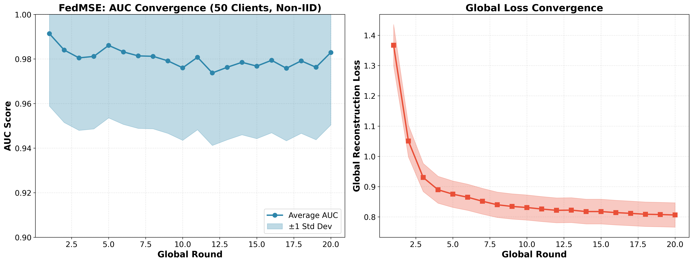
CONVERGENCE
AUC improvement over 20 training rounds
Both clusters show stable convergence. Cluster 1 (19 clients) reaches ~0.987 plateau; Cluster 2 (31 clients) plateaus at ~0.967, reflecting underlying difficulty differences.
Device-Type-Aware Client Clustering for Federated Anomaly Detection
FedHome | 18

Slide 23
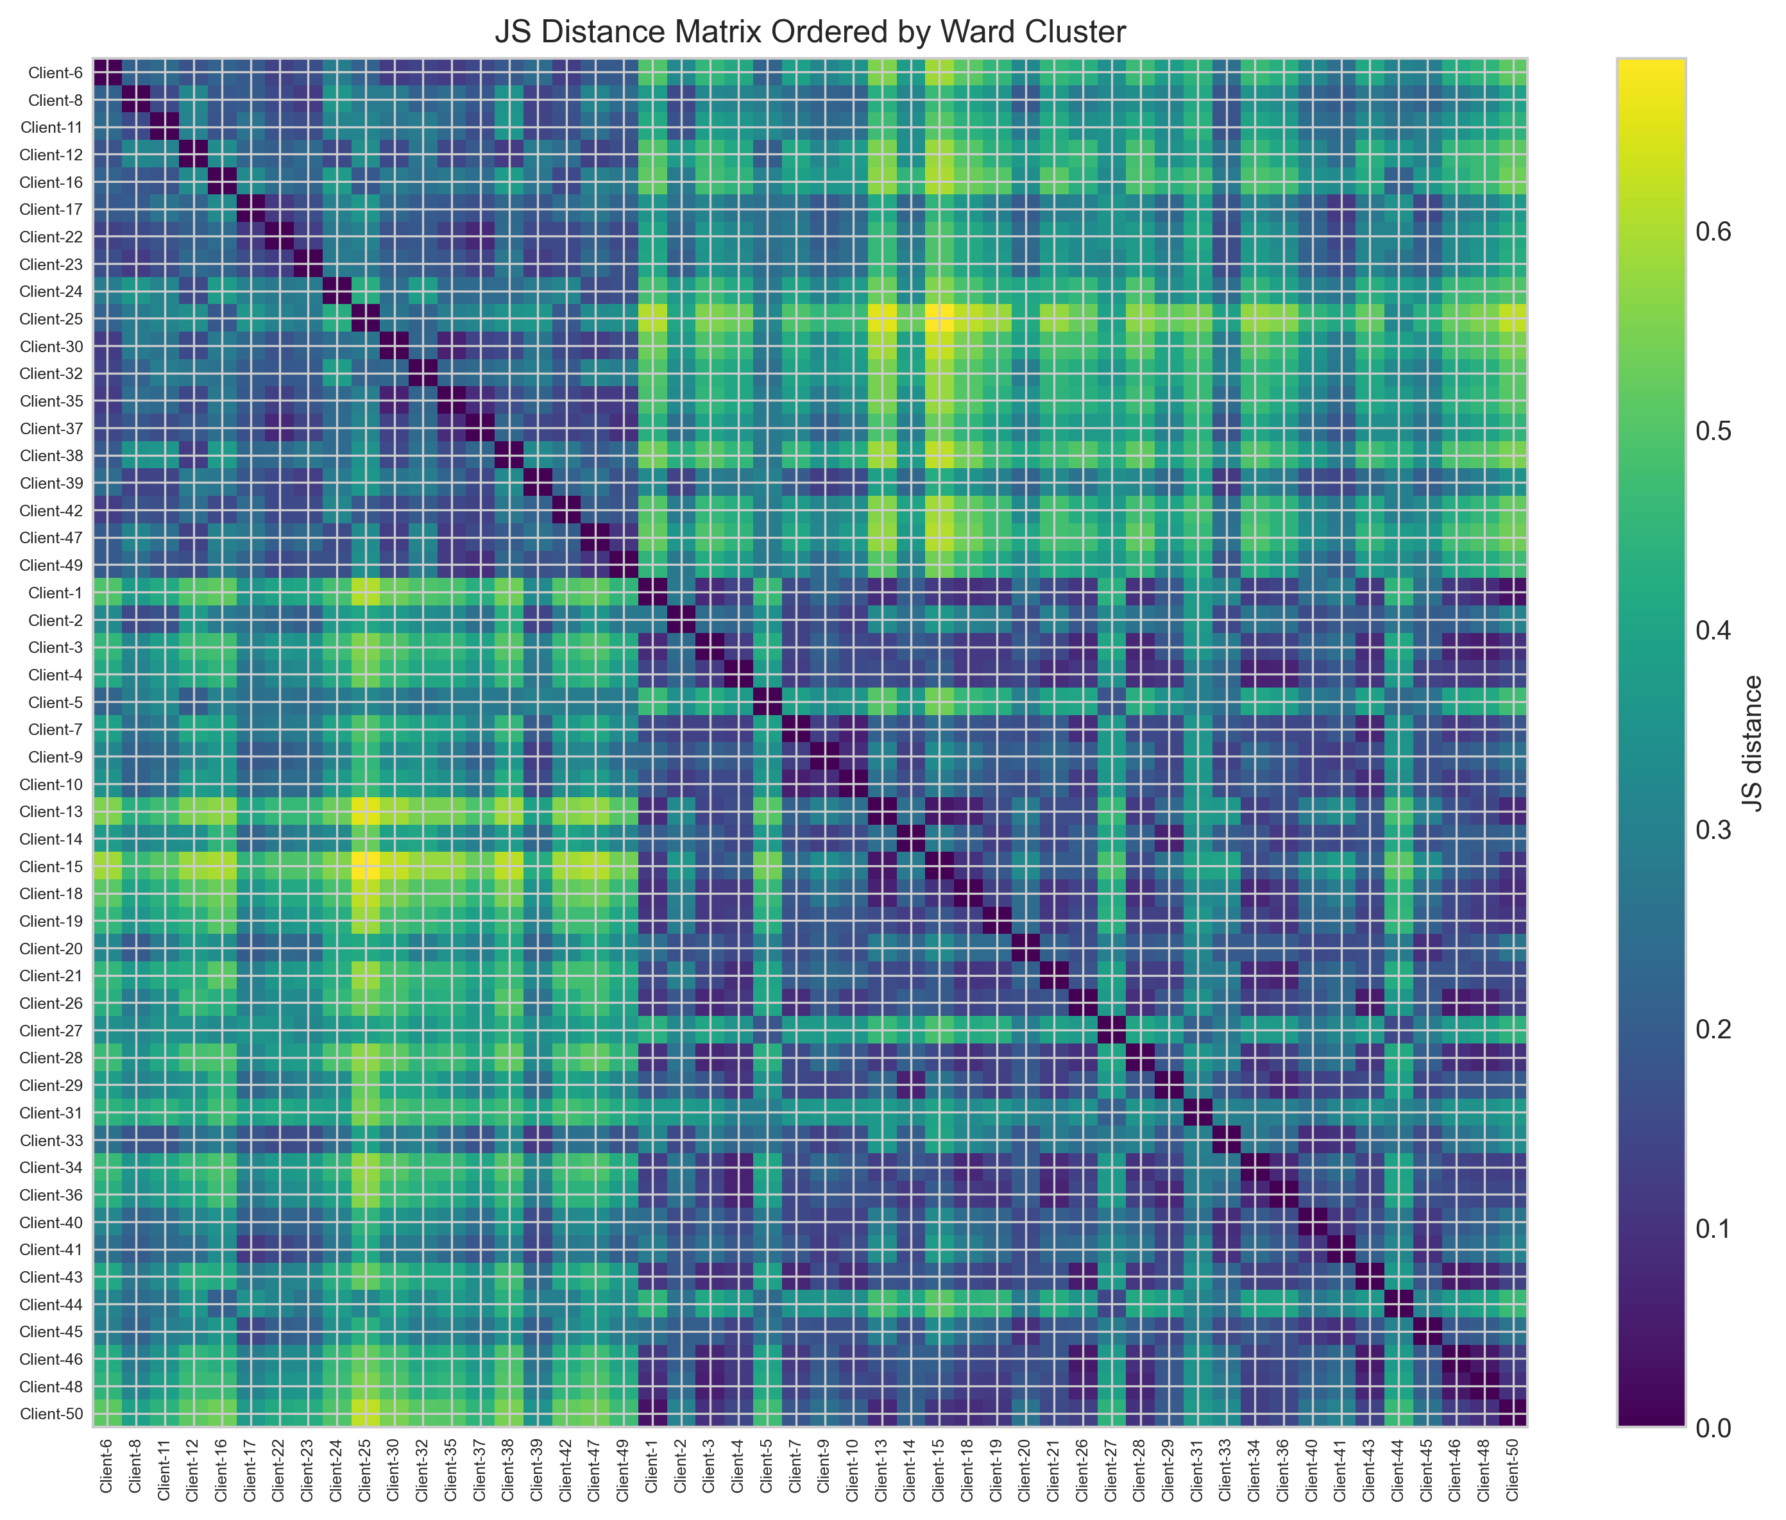
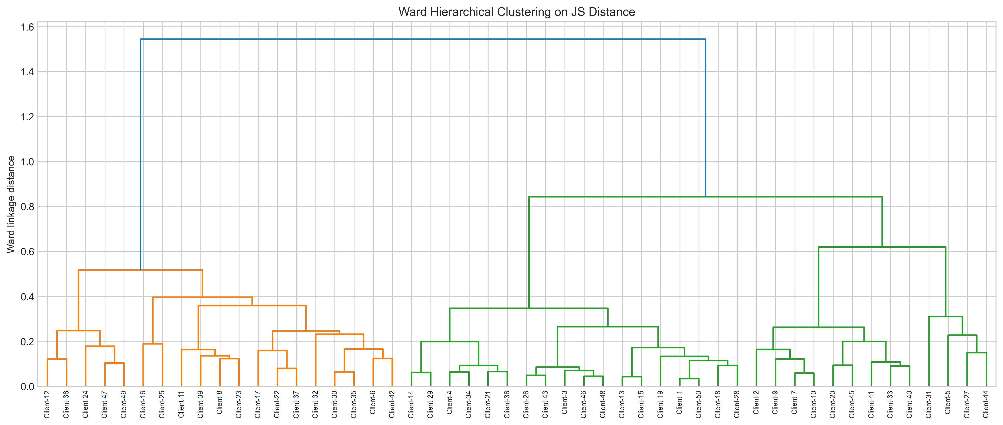
CLUSTERING DIAGNOSTICS
Ward dendrogram and JS-distance heatmap
Device-Type-Aware Client Clustering for Federated Anomaly Detection
FedHome | 19

Slide 24
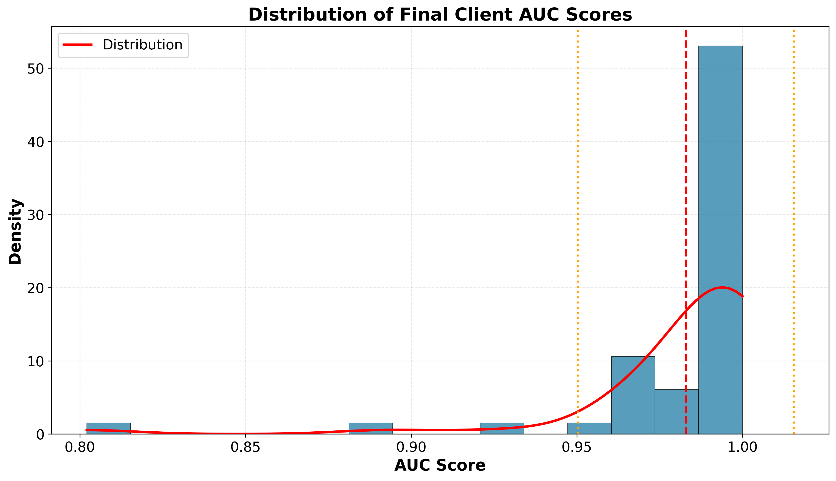
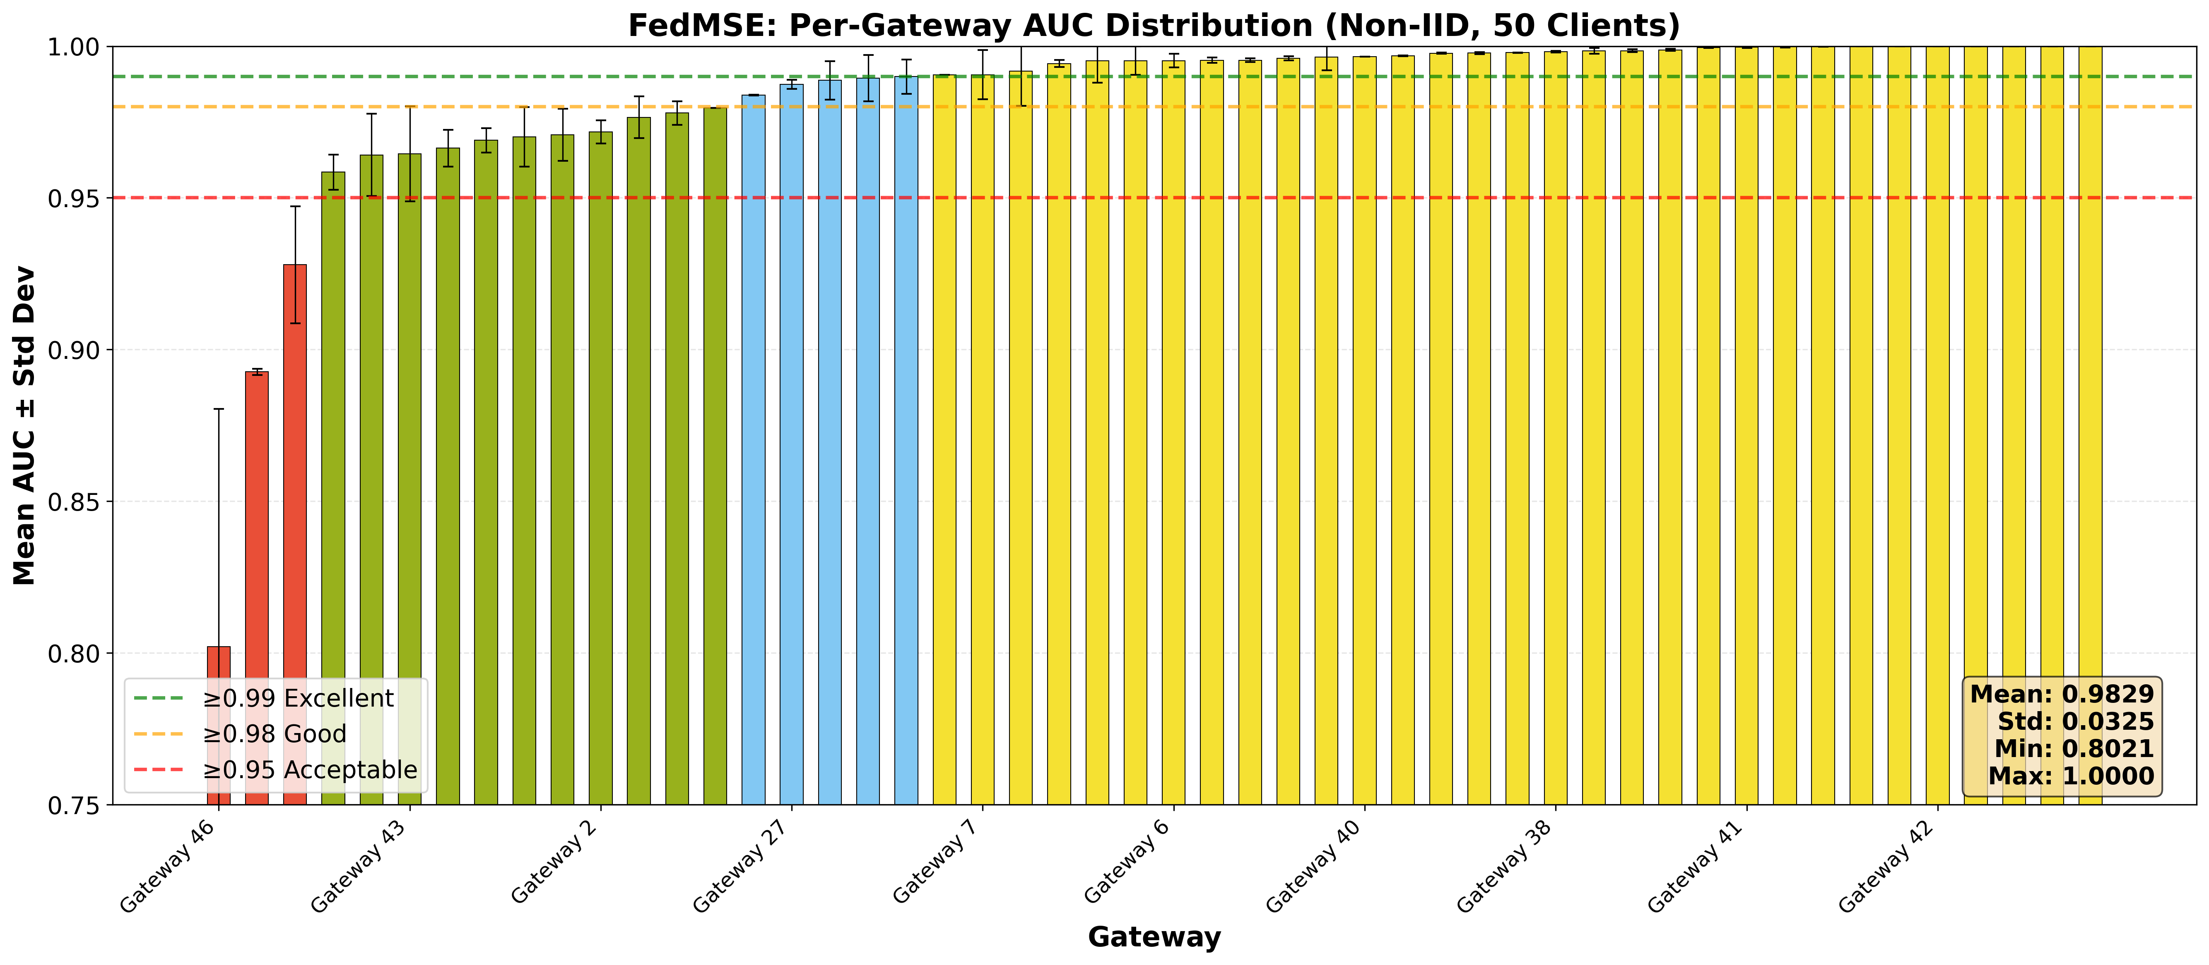
DISTRIBUTION ANALYSIS
Histogram and per-client AUC
Device-Type-Aware Client Clustering for Federated Anomaly Detection
FedHome | 20

Slide 25
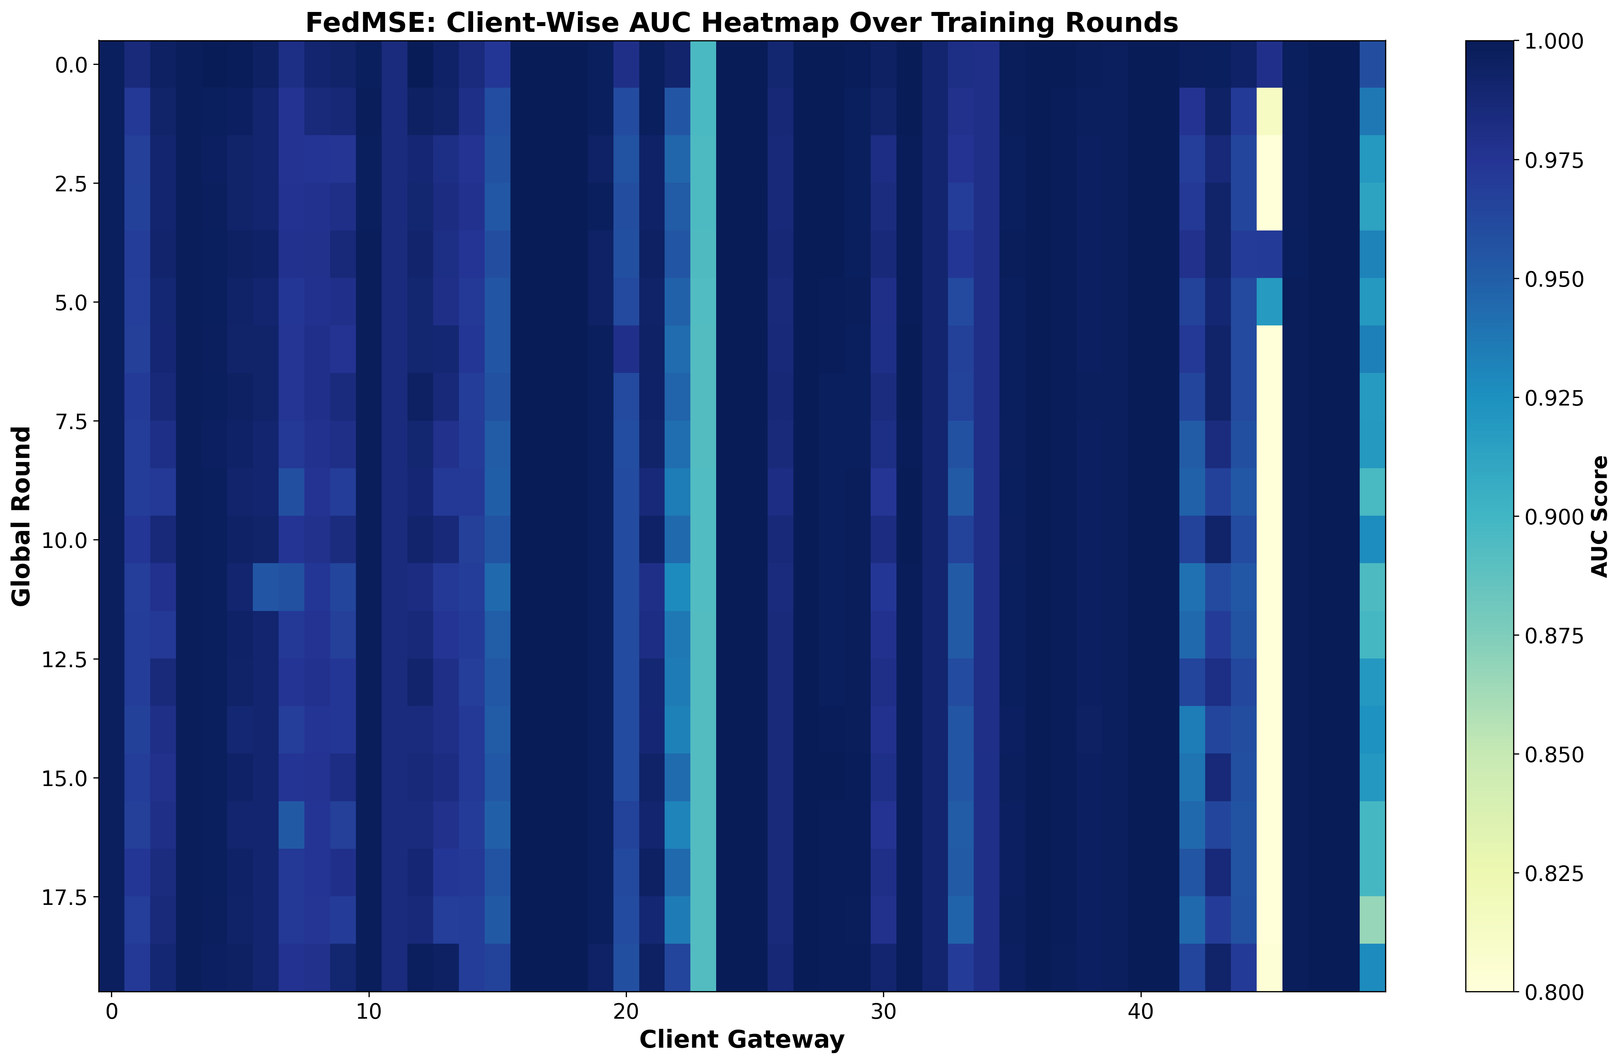
PER-CLIENT PERFORMANCE
Individual gateway AUC improvements
Heatmap shows per-client improvements. Ensemble benefits all gateways while respecting cluster specialization.
Device-Type-Aware Client Clustering for Federated Anomaly Detection
FedHome | 21

Slide 26
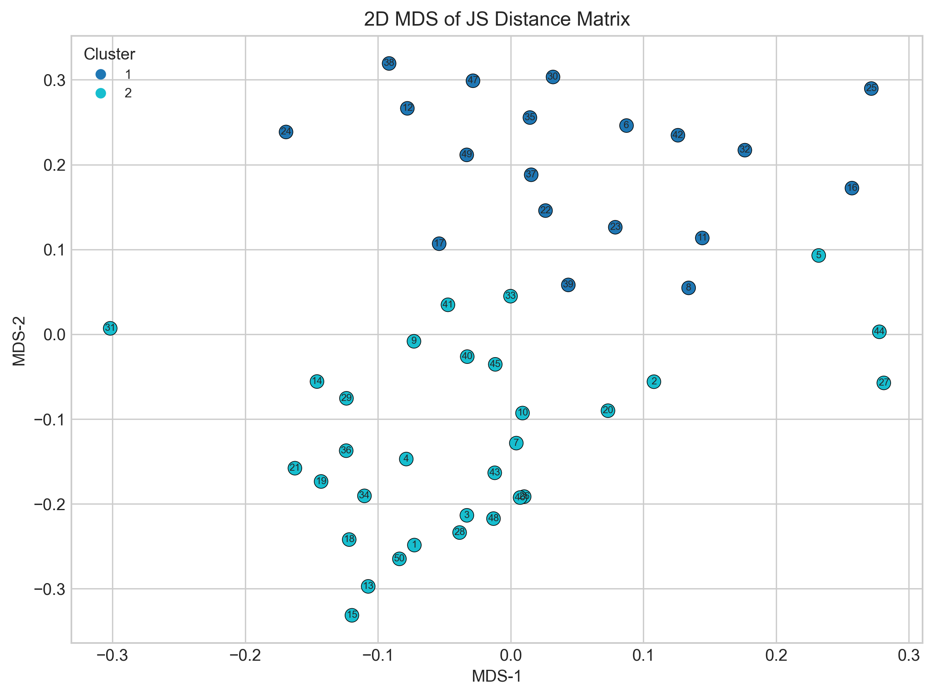
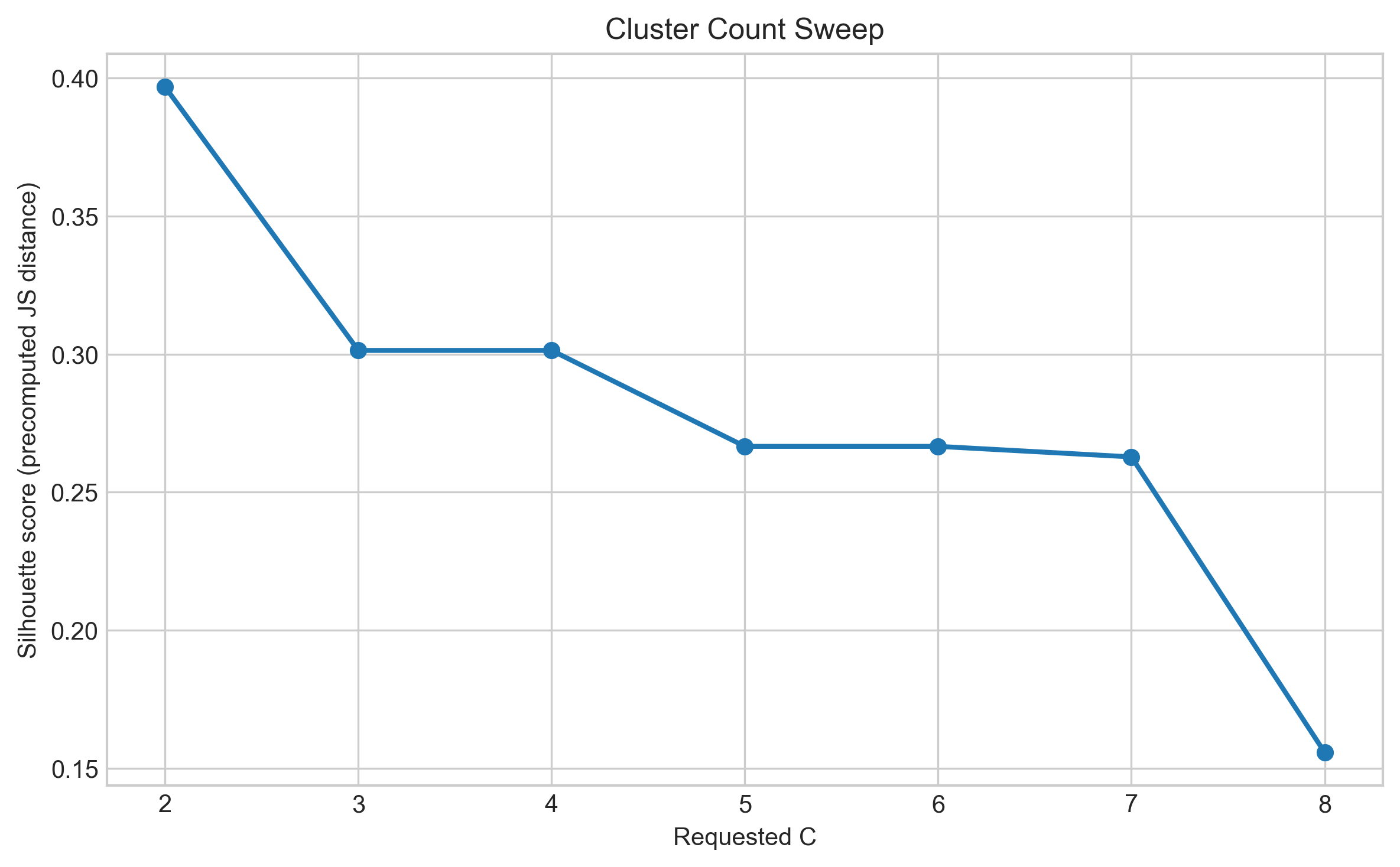
CLUSTER VISUALIZATION
MDS projection and silhouette analysis
Device-Type-Aware Client Clustering for Federated Anomaly Detection
FedHome | 22

Slide 27
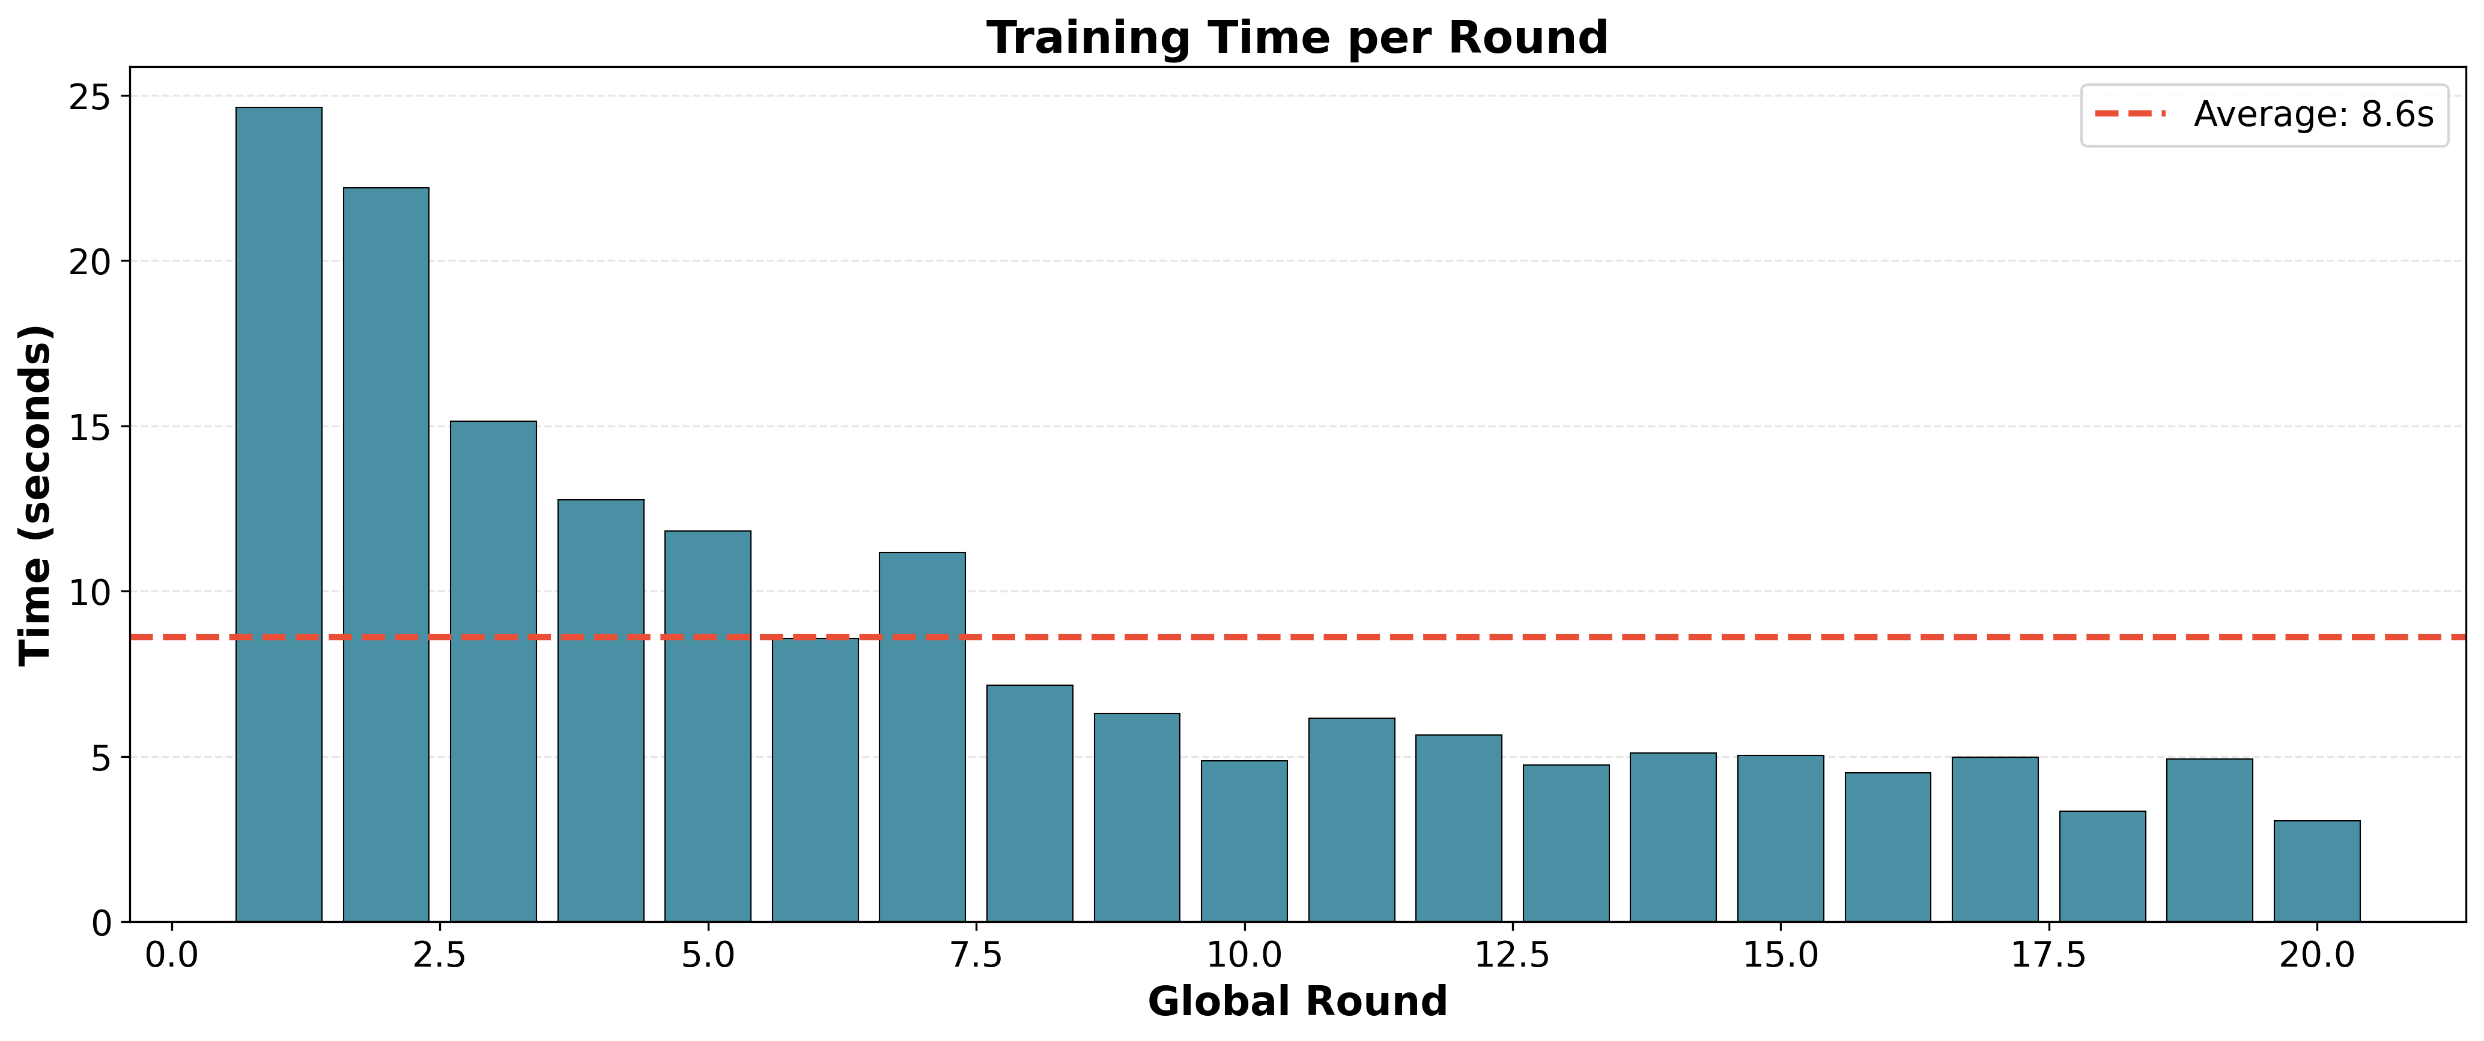
EFFICIENCY
Training time per round
2.9 min
120.5s
122.1s
10s
Baseline total
Cluster 1
Cluster 2
Merge
Device-Type-Aware Client Clustering for Federated Anomaly Detection
FedHome | 23

Slide 28
Conclusion & Future Work
06
Device-Type-Aware Client Clustering for Federated Anomaly Detection
FedHome | 24

Slide 29
SUMMARY
Key findings at a glance
0.993082
0.970844
+0.022238
50
Ensemble AUC
FedMSE Baseline
Absolute Gain
Gateways
final result
comparison point
improvement
clients
19 & 31
0.3967
2.9 min
Cluster Sizes
Silhouette
Baseline Time
C=2 clusters
clustering quality
total training
Device-Type-Aware Client Clustering for Federated Anomaly Detection
FedHome | 03

Slide 30
CONCLUSION
FedHome achieved the research objective
Main Finding
Under a reproducible 50-gateway Non-IID evaluation, cluster-aware federation achieved 0.993082 average AUC, outperforming FedMSE baseline (0.970844) by +0.022238 points.
This demonstrates that accounting for client heterogeneity through device-type clustering improves privacy-preserving IoT anomaly detection under high Non-IID conditions.
Device-Type-Aware Client Clustering for Federated Anomaly Detection
FedHome | 25

Slide 31
FUTURE DIRECTIONS
Promising research extensions
Row-Level Labels
More Baseline Comparison
Replace traffic archetypes with ground-truth device identity where available
Compare against FedProx, IFCA, and Ditto on same N-BaIoT scenario
Multi-Node Scaling
Dynamic Clustering
Deploy Spark pipeline to multi-node cluster and measure scaling
Explore per-round adaptive clustering based on convergence curves
Device-Type-Aware Client Clustering for Federated Anomaly Detection
FedHome | 27

Slide 32
CONTRIBUTIONS
Engineering and empirical outcomes
Deterministic split-manifest framework for reproducible FL baselines
Spark-assisted Phase 2 preprocessing pipeline (scalability-ready architecture)
JS-divergence clustering workflow with Ward hierarchical clustering
Cluster-aware federated training implementation (per-cluster FedMSE)
Weighted ensemble merge preserving cluster specialization
Empirical demonstration: +0.022238 AUC gain over strong FedMSE baseline
Comprehensive evaluation on 50-gateway Non-IID N-BaIoT dataset
Device-Type-Aware Client Clustering for Federated Anomaly Detection
FedHome | 28

Slide 33
THANK YOU
Questions?
Md. Raihan Sobhan
Big Data Analytics
FedHome final presentation
Device-Type-Aware Client Clustering for Federated Anomaly Detection
FedHome | 29

