Slide 1
FEDHOME
Device-Type-Aware Federated Anomaly Detection
0.970844
FedMSE deterministic baseline AUC
A cluster-aware extension of FedMSE for Non-IID smart-home IoT botnet detection
0.993082
FedHome ensemble AUC
Md. Raihan Sobhan | Big Data Analytics | August 2026
FedHome | Big Data Analytics
01
Notes:
[Sources]
PROJECT_REPORT.md, Executive Summary and Results; FINAL_RESULTS_20260808.md headline metrics.

Slide 2
FEDHOME
The security problem is distributed, private, and highly heterogeneous
Smart-home IoT gateways observe local traffic patterns that are sensitive and structurally different across homes.
50
115
- Raw network traffic can expose routines, occupancy, and device behavior.
- Mirai and Gafgyt attacks require anomaly detection under evolving threats.
- Gateway data is Non-IID: device composition changes the normal traffic distribution.
- The project evaluates a 50-gateway scenario with high heterogeneity.
gateways
features
Non-IID evaluation scenario
N-BaIoT traffic representation
0.83
2
JS divergence
botnets
high distributional heterogeneity
Mirai and Gafgyt
FedHome | Big Data Analytics
02
Notes:
[Sources]
PROJECT_REPORT.md Sections 2, 3, and 7; N-BaIoT and FedMSE references listed in PROJECT_REPORT.md.

Slide 3
FEDHOME
Existing federated approaches reduce privacy risk but struggle with client heterogeneity
STATE OF THE ART CONTEXT
Approach | Strength | Remaining gap for this project
Centralized IDS | Can pool traffic for global training | Violates privacy and bandwidth assumptions
FedAvg | Keeps raw data local | Size-weighted aggregation is brittle under Non-IID clients
FedMSE | SAE-CEN plus quality-aware MSEAvg | Still trains one global model across structurally different gateways
Clustered FL family | Specializes models for client groups | Requires a useful privacy-safe grouping signal
FedHome takes FedMSE as the strong baseline, then adds a clustering layer before federated training.
FedHome | Big Data Analytics
03
Notes:
[Sources]
PROJECT_REPORT.md Sections 4 and 5; references include Nguyen and Beuran (2025), McMahan et al. (2017), and Li et al. (2020).

Slide 4
FEDHOME
FedMSE is the right baseline because it is already designed for one-class IoT anomaly detection
SAE-CEN
MSEAvg
Baseline role
A shrink autoencoder learns compact latent representations of normal traffic. A centroid detector scores deviations as anomalies.
Aggregation weights are based on reconstruction quality over a shared development set, not simply on local dataset size.
FedHome must improve over this strong single-model reference while preserving the same privacy boundary.
FedHome | Big Data Analytics
04
Notes:
[Sources]
PROJECT_REPORT.md Section 4 explains SAE-CEN and MSEAvg; Nguyen and Beuran (2025) is cited in the report references.

Slide 5
FEDHOME
FedHome proposes a simple change: cluster first, federate inside clusters, then merge
Profile
Cluster
Specialize
Merge
Build a normalized traffic-profile vector for each gateway.
->
Compute JS distances and group gateways with Ward linkage.
->
Train one FedMSE model inside each cluster.
->
Average cluster model parameters using cluster-size weights.
The design keeps raw traffic local while letting the training process acknowledge that gateways are not exchangeable.
FedHome | Big Data Analytics
05
Notes:
[Sources]
PROJECT_REPORT.md Section 5 describes the FedHome method and achieved ensemble merge rule.

Slide 6
FEDHOME
The implementation is a reproducible pipeline, not a single experiment script
Module | Role
split_manifest.py | Persist and replay deterministic row-level data splits
spark_data.py | Process gateway CSVs and produce the 50 x 9 profile matrix
clustering.py | Compute JS distances, Ward clusters, and clustering figures
cluster_training.py | Train one FedMSE model per cluster
ensemble.py | Merge cluster models and evaluate the global ensemble
All final comparisons use the same saved split manifest, so the baseline and FedHome phases share identical data boundaries.
FedHome | Big Data Analytics
06
Notes:
[Sources]
PROJECT_REPORT.md Section 6.4 and 6.5; source modules under src/fedhome/ and scripts/.

Slide 7
FEDHOME
The reproducibility correction made the final comparison scientifically defensible
Original risk
Final fix
- Historical baseline did not persist row-level split indices.
- Pandas sampling introduced unrecoverable stochastic row order.
- Phase 4 would not be apples-to-apples without a new baseline.
- Saved train, validation, development, and test indices.
- Fixed Python, NumPy, and Torch seeds.
- Reran FedMSE and all FedHome phases on the manifest.
Authoritative manifest: results/data/split_manifests/fedmse_fullscale_seed42.json
FedHome | Big Data Analytics
07
Notes:
[Sources]
PROJECT_REPORT.md Section 6.3; FINAL_RESULTS_20260808.md authoritative artifacts; results/EXPERIMENT_LOG.md reproducibility gate entries.

Slide 8
FEDHOME
Experimental setup: 50 gateways, 115 traffic features, normal-only training
Dimension | Final setting
Dataset | N-BaIoT smart-home IoT traffic
Attacks | Mirai and Gafgyt botnet variants
Clients | 50 non-IID gateways
Features | 115 network traffic features
Training | 20 global rounds, 100 local epochs
Model | Shrink Autoencoder plus centroid detector, MSEAvg aggregation
Execution | Local Spark mode on MacBook Pro M5, 24GB RAM
FedHome | Big Data Analytics
08
Notes:
[Sources]
PROJECT_REPORT.md Section 7; configuration values are copied from the final report.

Slide 9
FEDHOME
Phase 2 transformed raw gateway files into a clustering-ready profile matrix
What Phase 2 produced
- 136,565 rows processed across 50 gateways
- normalized 50 x 9 profile matrix
- all profile rows sum to 1.0 +/- 1e-6
- Spark was slower locally, but the pipeline is structured for scale
Important caveat: profiles are traffic-archetype proxies because row-level device labels were absent from the scenario CSVs.
FedHome | Big Data Analytics
09
Notes:
[Sources]
PROJECT_REPORT.md Section 8.2; /Users/raihansobhan/Documents/10. Self Learning/Big Data Analytics/Project/FedHome_Spark/presentation/assets_20260808/tables/phase2_benchmark_summary.csv; results/EXPERIMENT_LOG.md Phase 2 entries.

Slide 10
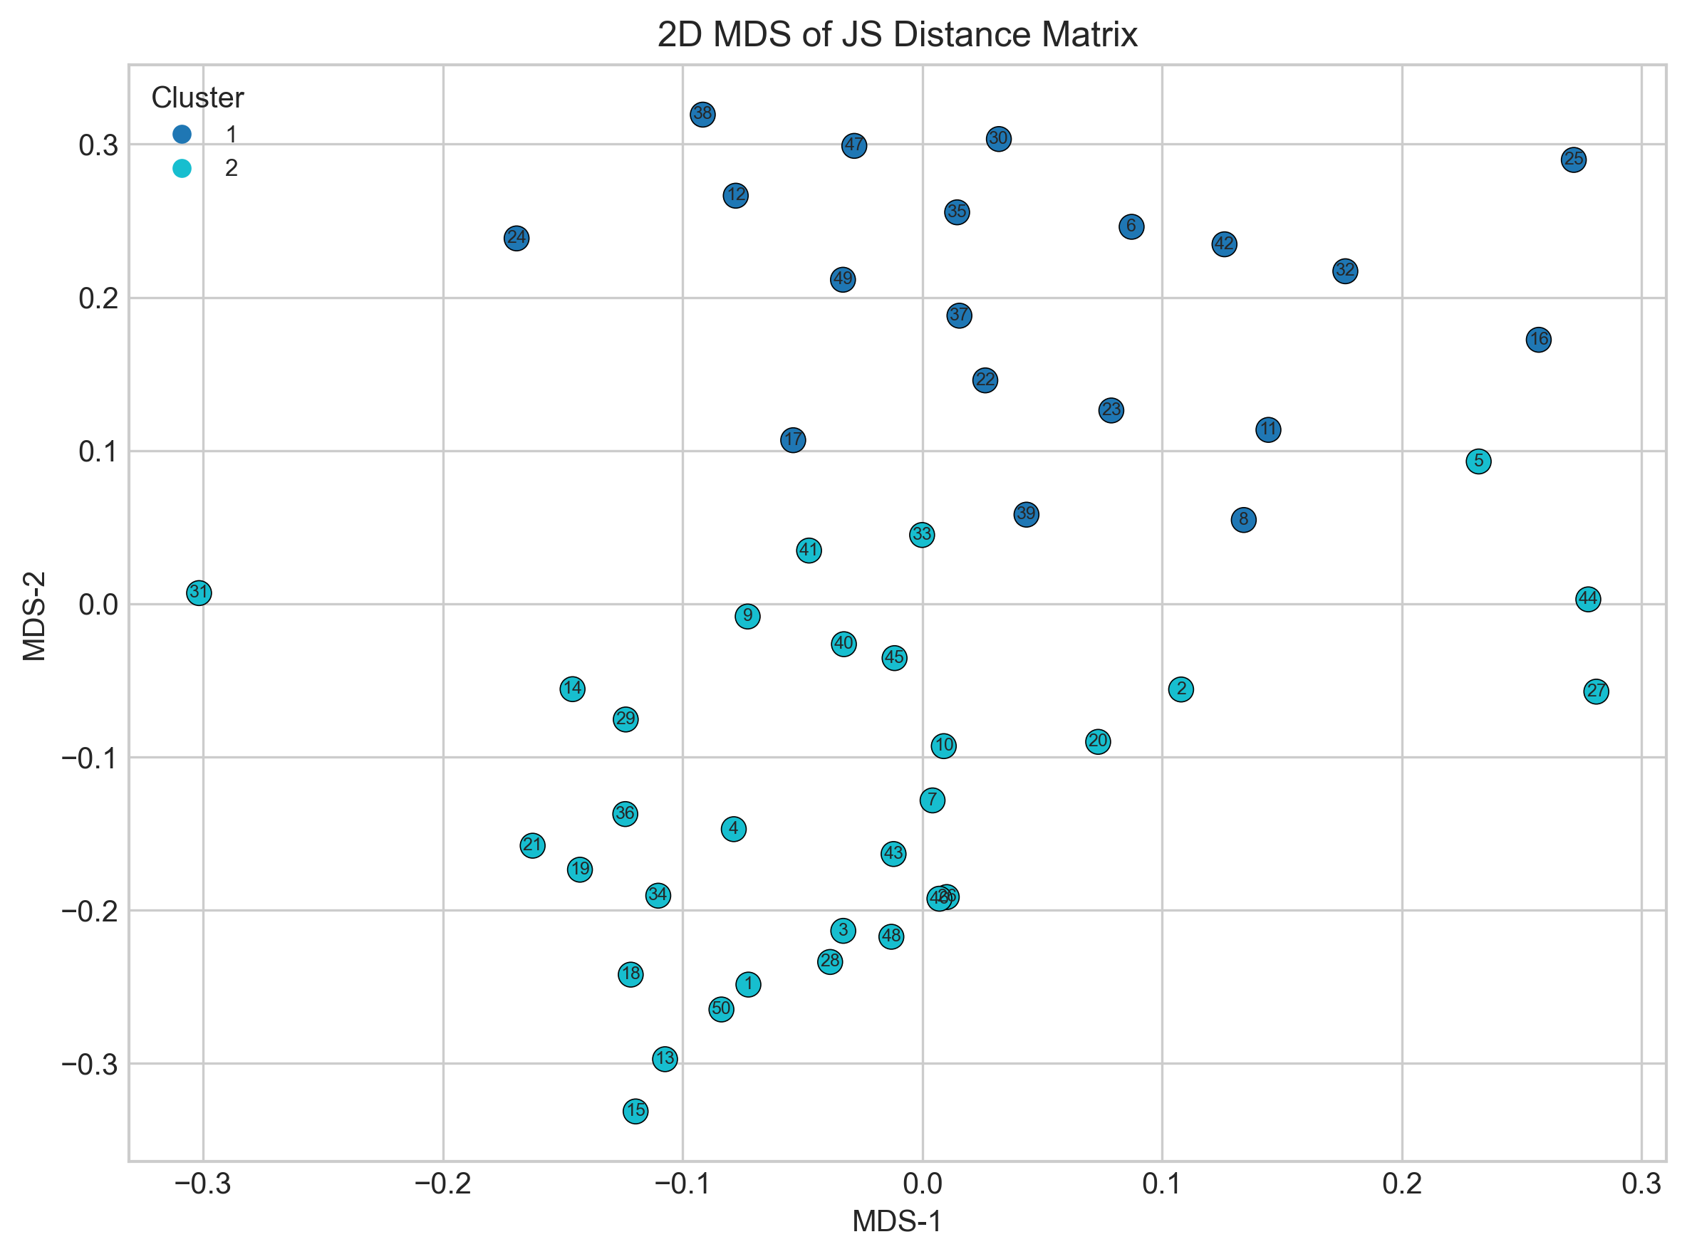
FEDHOME
Phase 3 found two gateway groups with useful but imperfect separation
2
19 / 31
0.3967
0.6998
selected clusters
cluster sizes
silhouette
ARI
Ward hierarchical clustering
client distribution across groups
useful, not perfect separation
Ward vs Spark BKM agreement
FedHome | Big Data Analytics
10
Notes:
[Sources]
PROJECT_REPORT.md Section 8.3; /Users/raihansobhan/Documents/10. Self Learning/Big Data Analytics/Project/FedHome_Spark/presentation/assets_20260808/figures/mds_clusters_phase3.png; /Users/raihansobhan/Documents/10. Self Learning/Big Data Analytics/Project/FedHome_Spark/presentation/assets_20260808/tables/phase3_clustering_summary.csv.

Slide 11
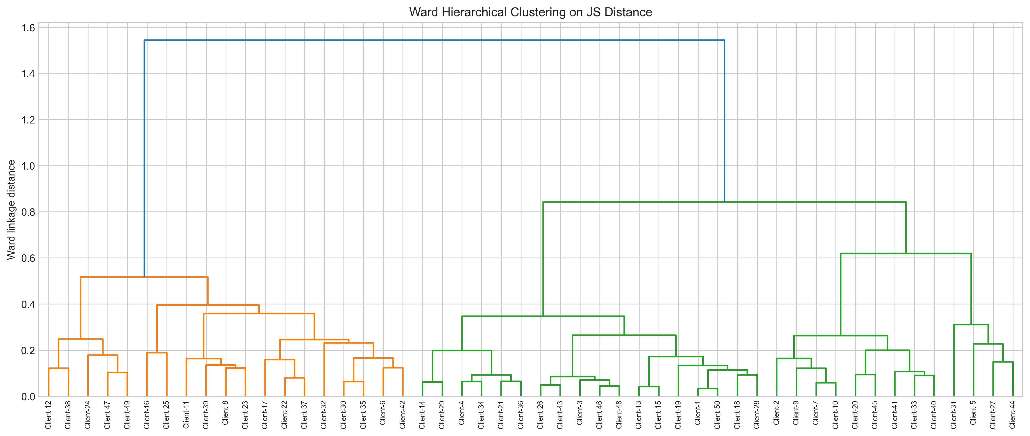
FEDHOME
The dendrogram shows why the pipeline settled on a two-cluster structure
Interpretation
- The partition is operationally useful.
- Cluster quality is limited by proxy profile construction.
- Cluster assignments feed directly into Phase 4 training.
FedHome | Big Data Analytics
11
Notes:
[Sources]
PROJECT_REPORT.md Sections 8.3 and 8.7; /Users/raihansobhan/Documents/10. Self Learning/Big Data Analytics/Project/FedHome_Spark/presentation/assets_20260808/figures/ward_dendrogram_phase3.png.

Slide 12
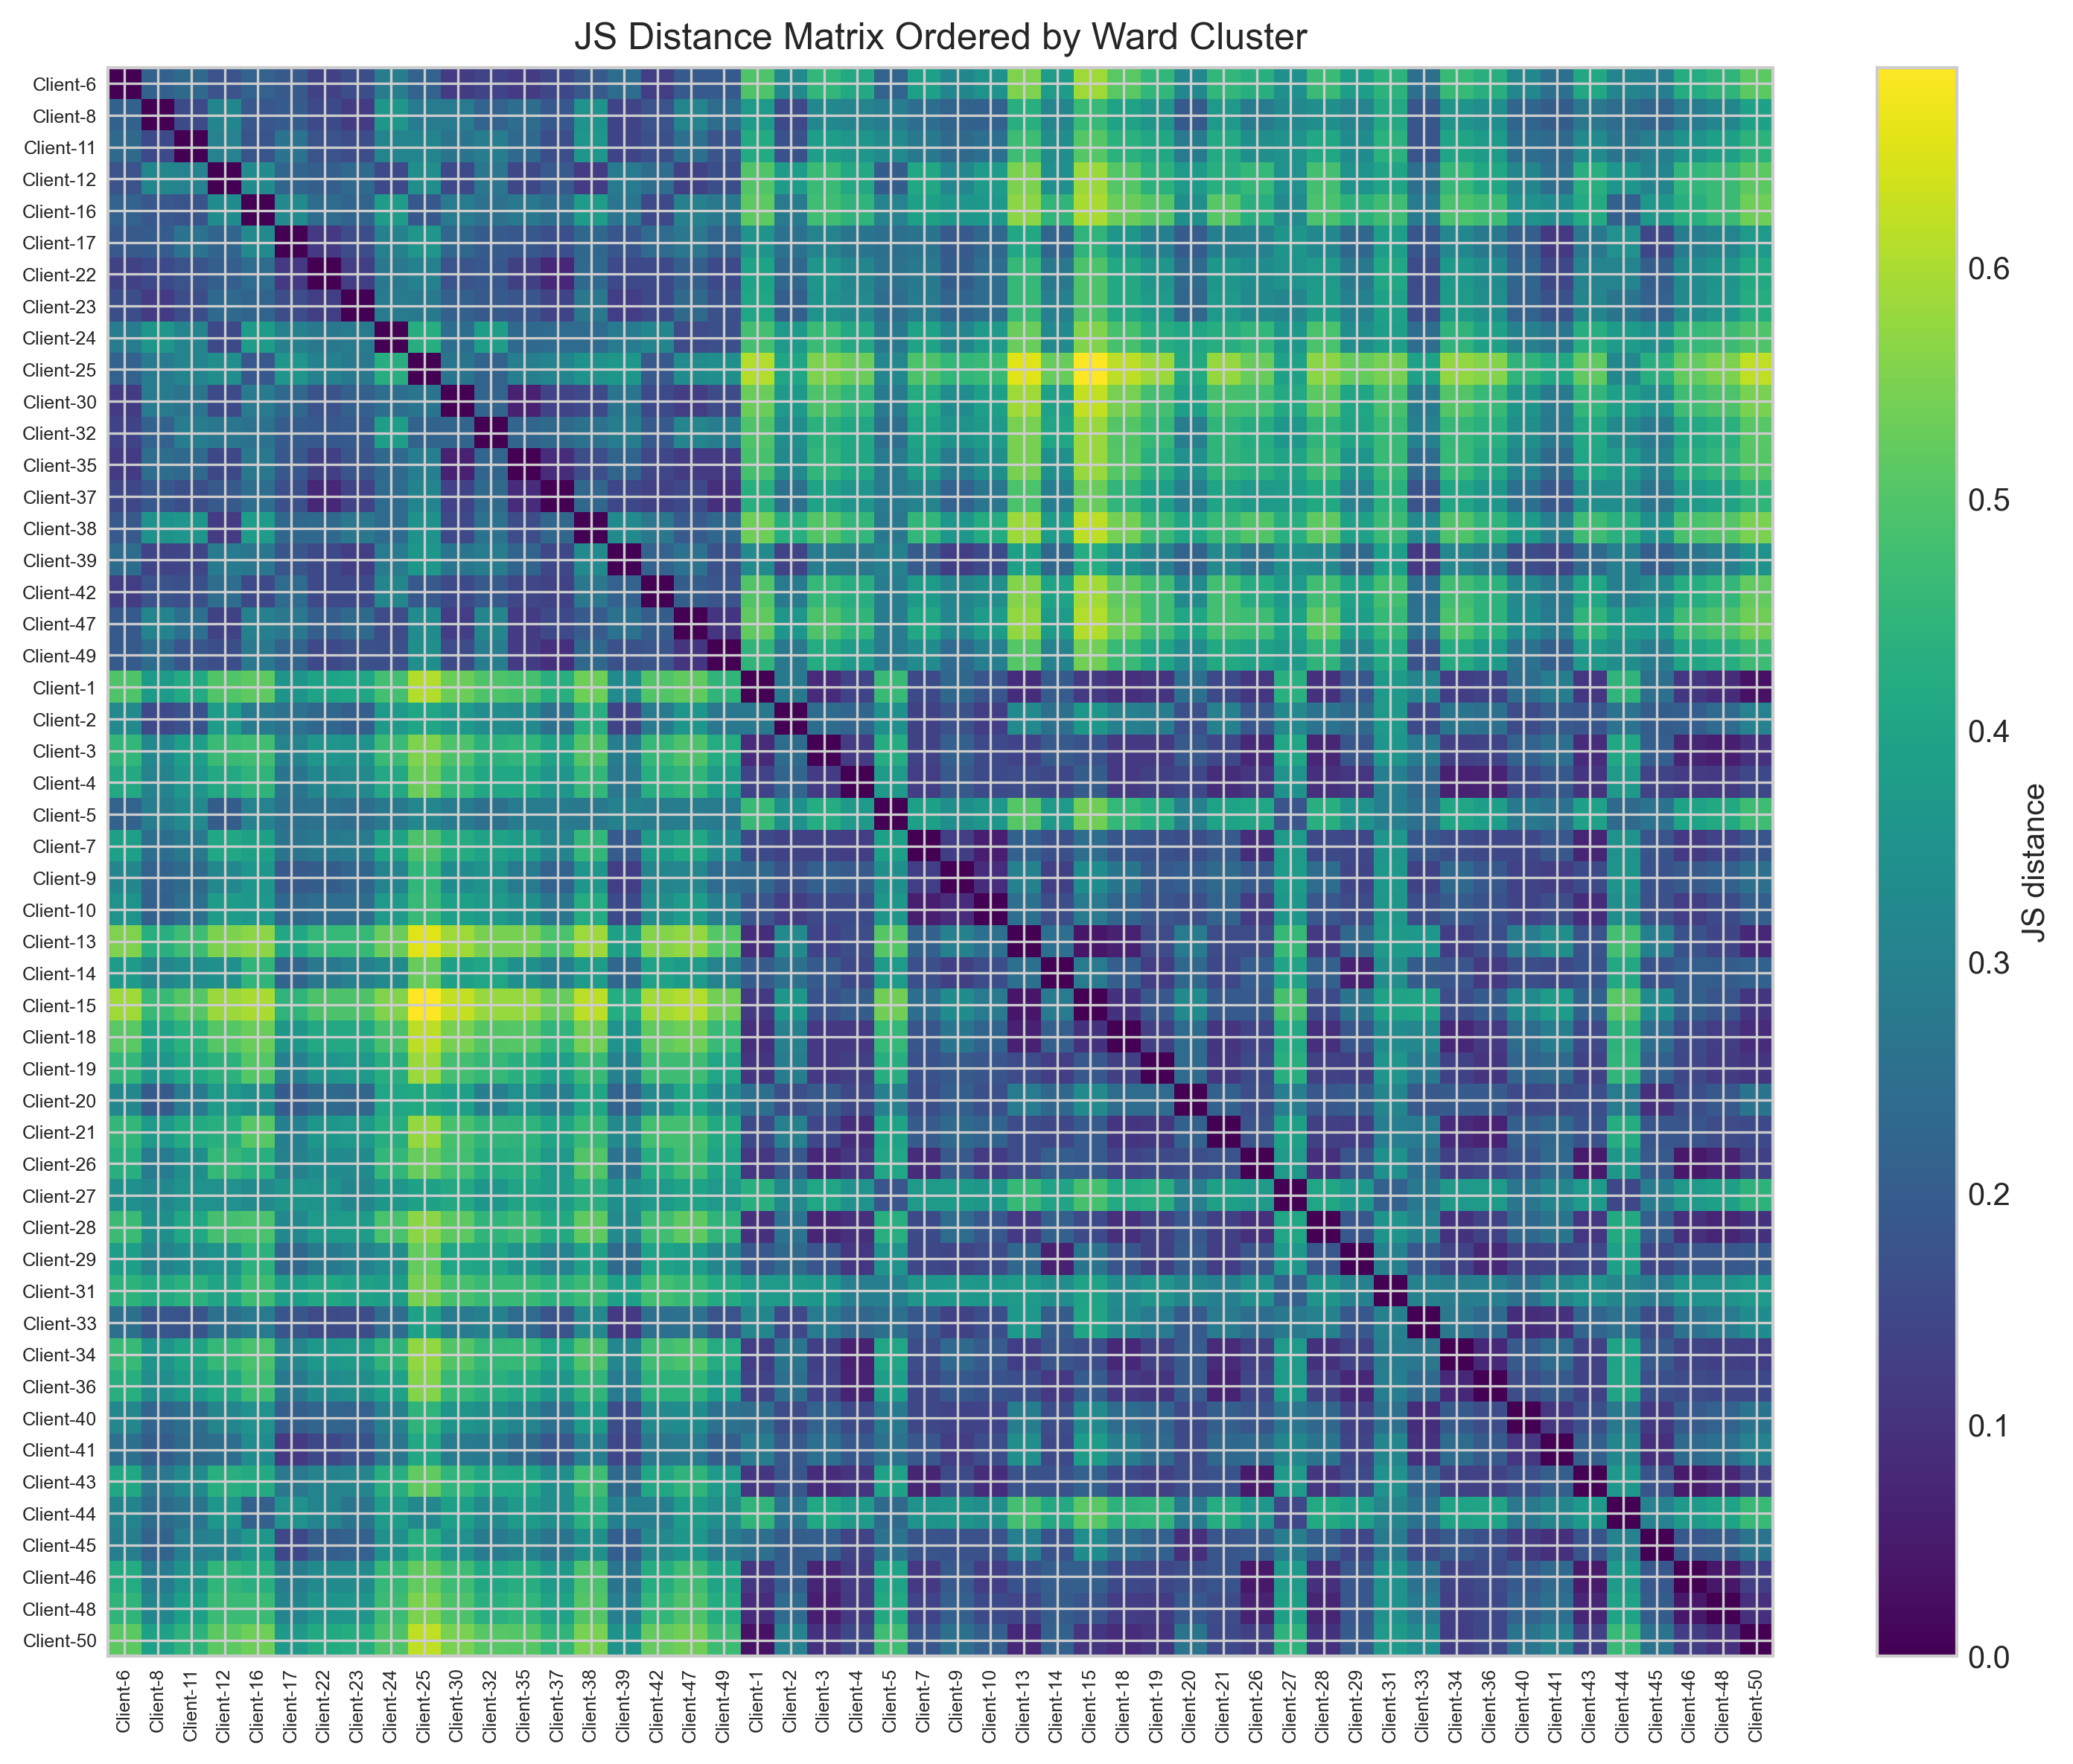
FEDHOME
The JS-distance heatmap makes heterogeneity visible before model training
This slide is the bridge from data engineering to federated learning: if gateways differ, training them as one homogeneous population is a modeling choice, not a neutral default.
FedHome | Big Data Analytics
12
Notes:
[Sources]
PROJECT_REPORT.md Sections 5 and 8.3; /Users/raihansobhan/Documents/10. Self Learning/Big Data Analytics/Project/FedHome_Spark/presentation/assets_20260808/figures/js_distance_heatmap_ordered_phase3.png.

Slide 13
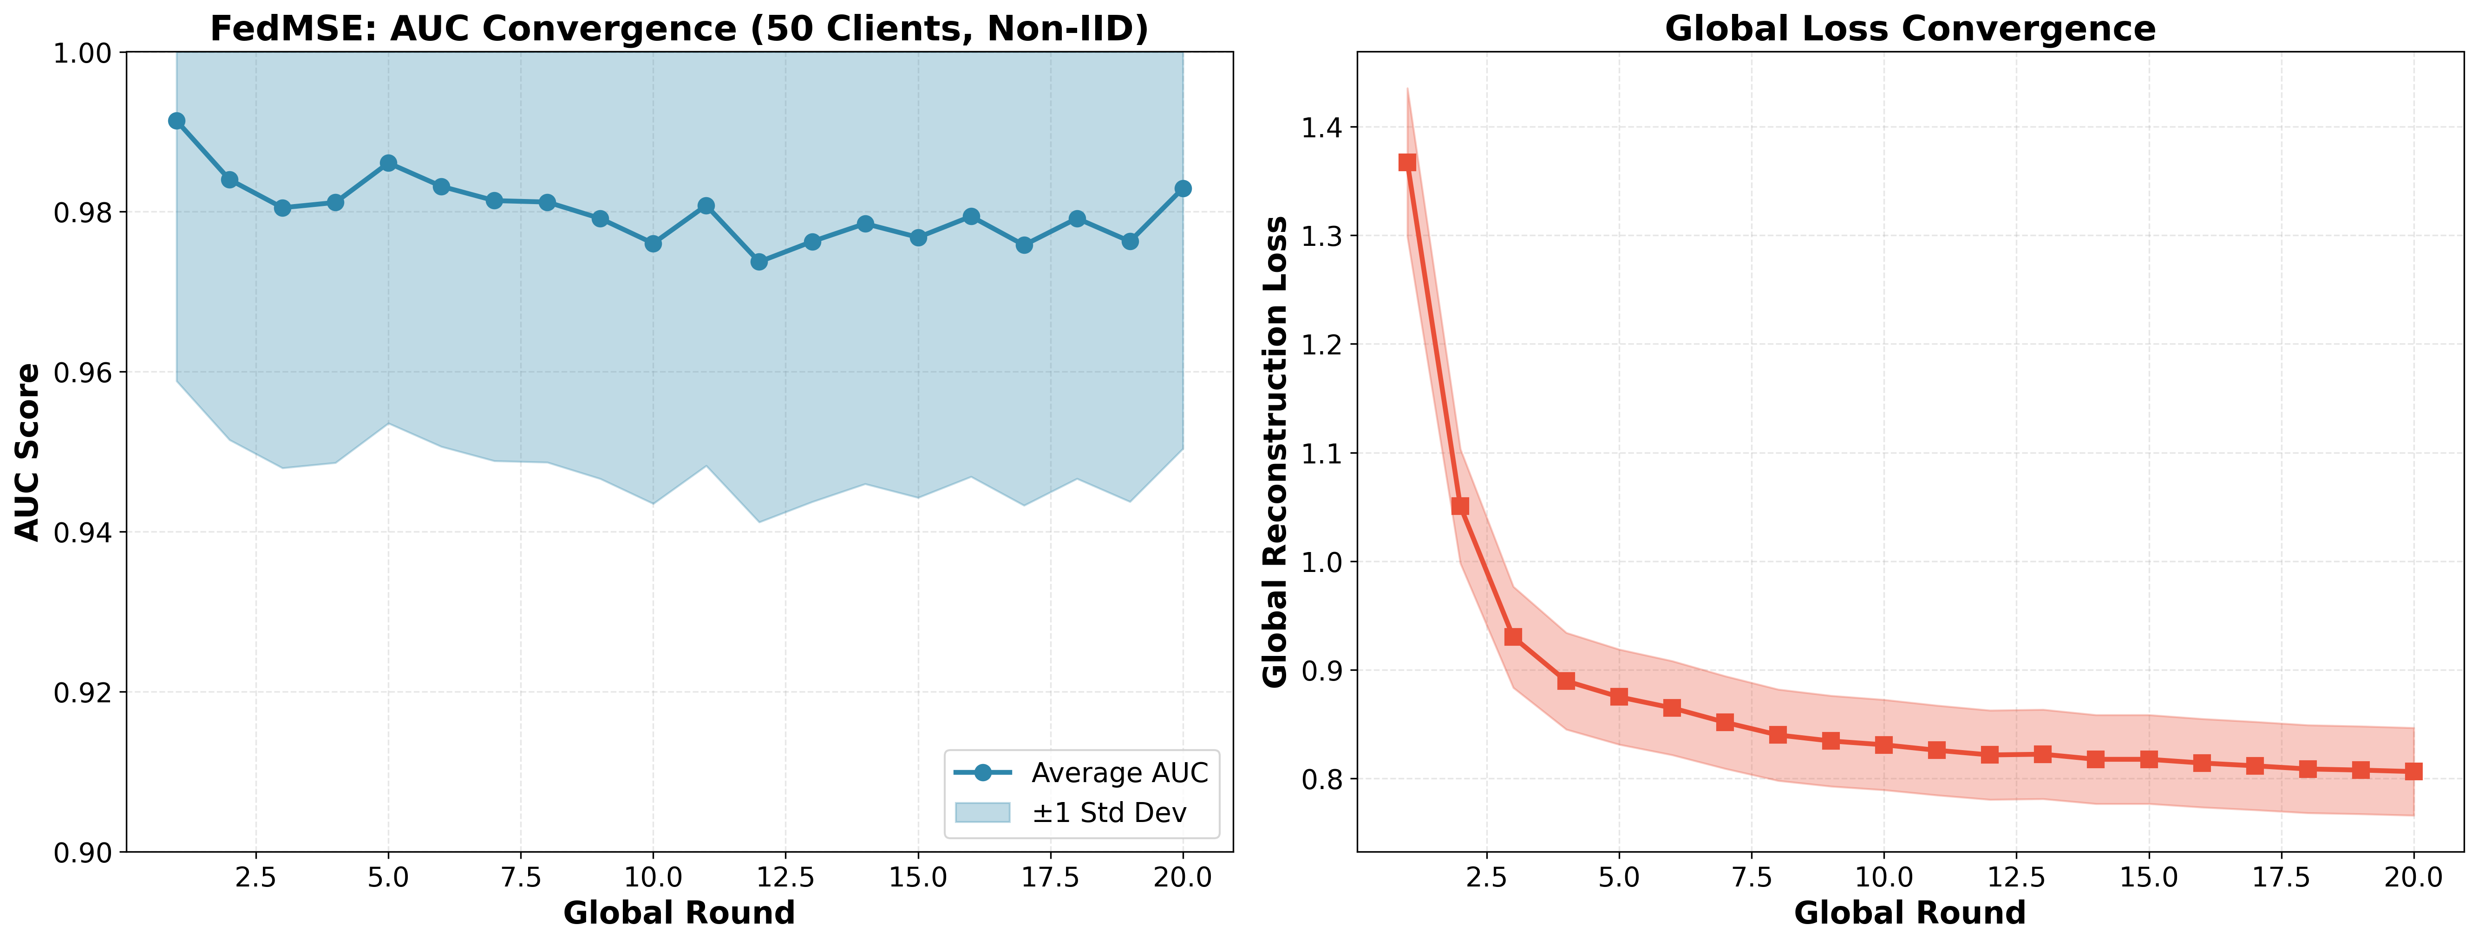
FEDHOME
The deterministic FedMSE baseline remained strong after the reproducibility fix
0.970844
average AUC
deterministic baseline
0.8030
final loss
40.3% loss reduction
This is the comparison anchor for every final FedHome result.
FedHome | Big Data Analytics
13
Notes:
[Sources]
PROJECT_REPORT.md Section 8.1; FINAL_RESULTS_20260808.md; /Users/raihansobhan/Documents/10. Self Learning/Big Data Analytics/Project/FedHome_Spark/presentation/assets_20260808/figures/auc_convergence_fullscale.png.

Slide 14
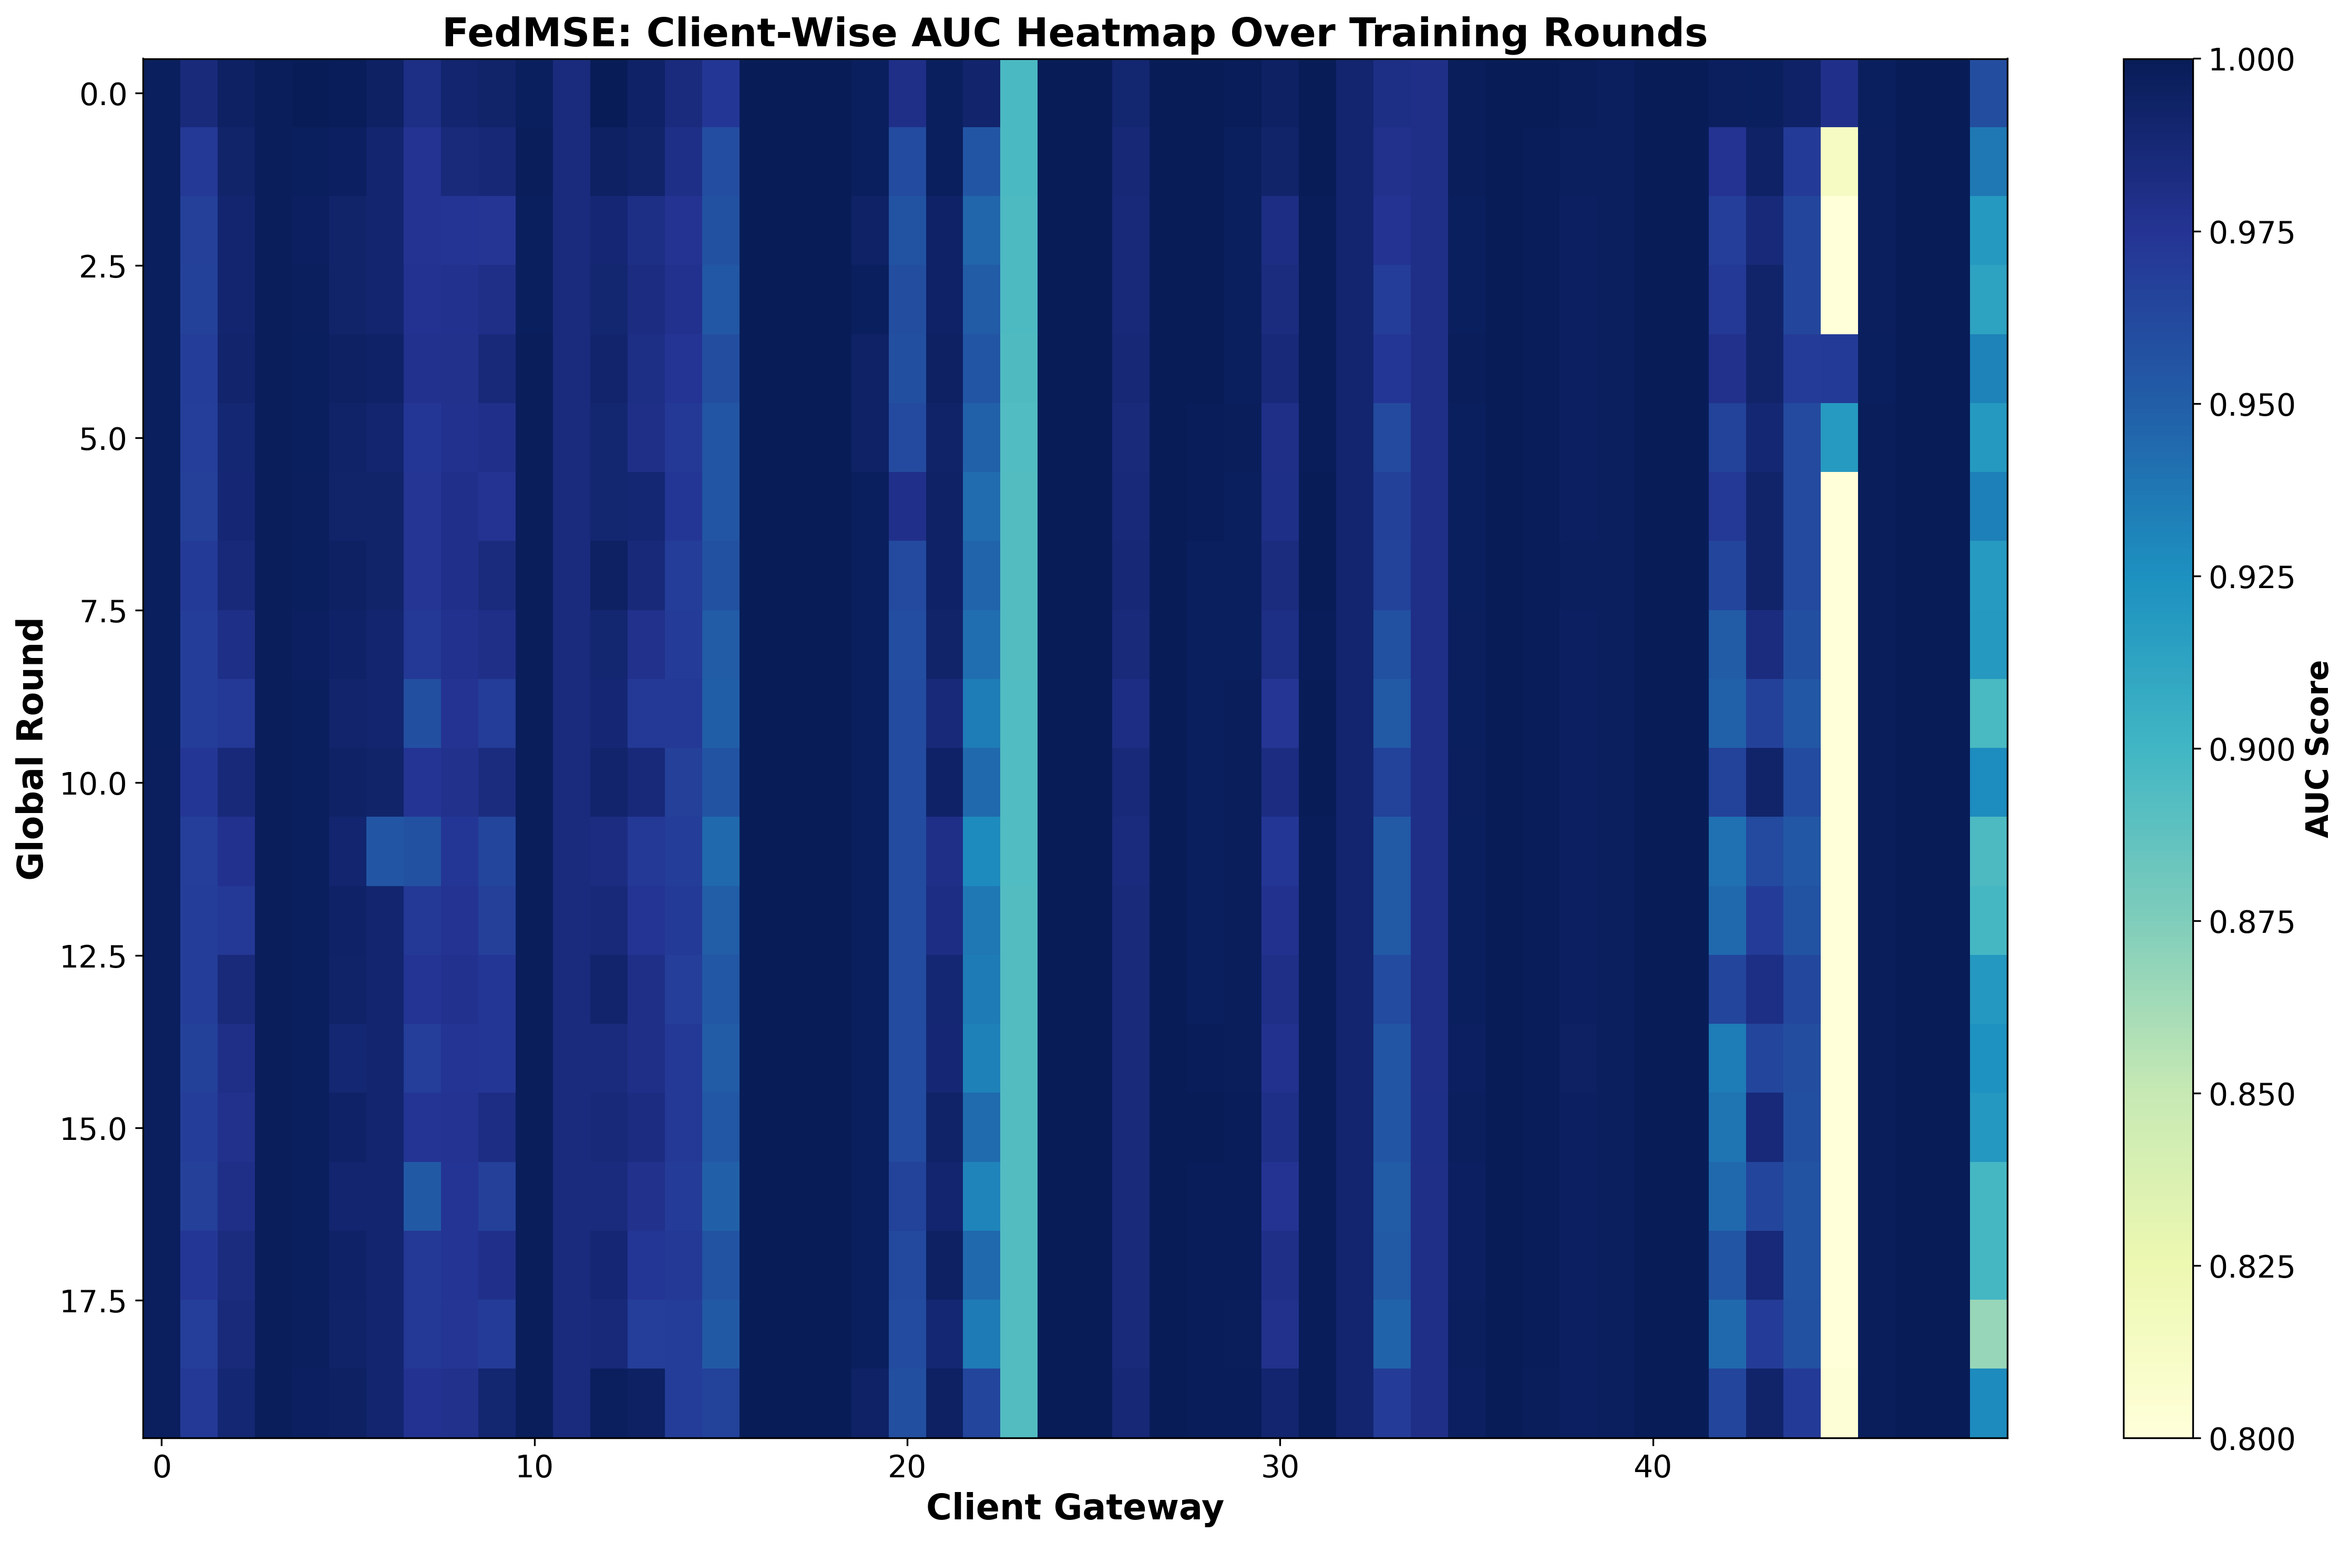
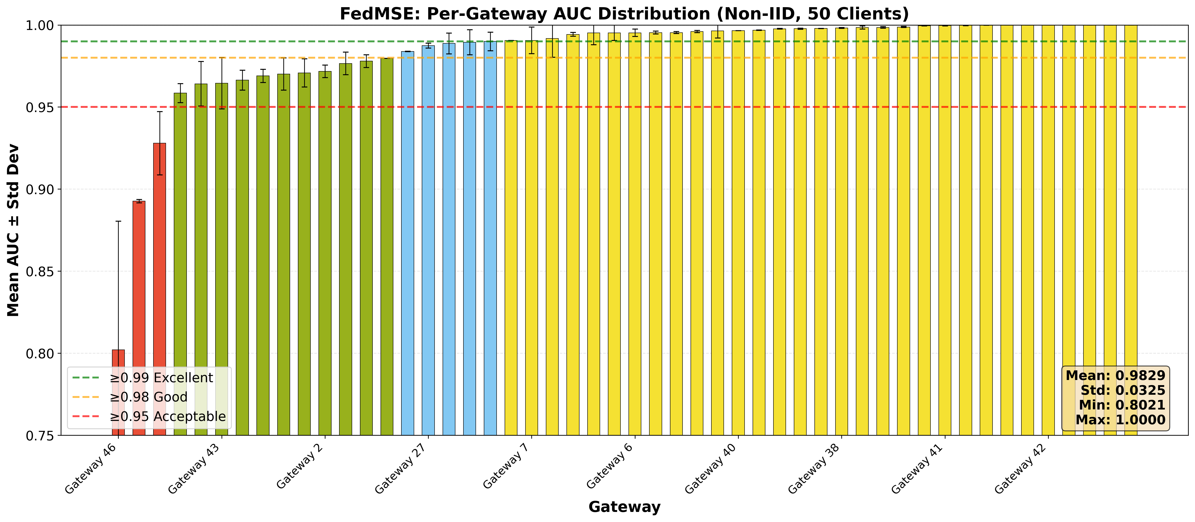
FEDHOME
Client-level baseline performance was high overall but not uniform
The spread across gateways motivates specialization: strong average performance can still hide client-specific difficulty.
FedHome | Big Data Analytics
14
Notes:
[Sources]
PROJECT_REPORT.md Section 8; /Users/raihansobhan/Documents/10. Self Learning/Big Data Analytics/Project/FedHome_Spark/presentation/assets_20260808/figures/client_auc_distribution.png; /Users/raihansobhan/Documents/10. Self Learning/Big Data Analytics/Project/FedHome_Spark/presentation/assets_20260808/figures/client_auc_heatmap.png.

Slide 15
FEDHOME
Cluster-aware training produced two specialized models with different behavior
Cluster | Clients | Average AUC | Final loss | Minimum AUC | Maximum AUC
1 | 19 | 0.987283 | 0.815616 | 0.952492 | 0.999997
2 | 31 | 0.967393 | 0.862165 | 0.621677 | 1.000000
FedHome | Big Data Analytics
15
Notes:
[Sources]
PROJECT_REPORT.md Section 8.4; /Users/raihansobhan/Documents/10. Self Learning/Big Data Analytics/Project/FedHome_Spark/presentation/assets_20260808/tables/phase4_cluster_summary.csv; phase4_cluster_training_summary.json.

Slide 16
FEDHOME
The final ensemble improved the main metric by 2.22 AUC points
+0.022238
absolute AUC gain
19/50 + 31/50
merge weights
cluster-size-weighted parameter averaging
This is the central empirical result of the project.
FedHome | Big Data Analytics
16
Notes:
[Sources]
PROJECT_REPORT.md Sections 8.5 and 8.6; FINAL_RESULTS_20260808.md; /Users/raihansobhan/Documents/10. Self Learning/Big Data Analytics/Project/FedHome_Spark/presentation/assets_20260808/tables/baseline_final_summary.csv; /Users/raihansobhan/Documents/10. Self Learning/Big Data Analytics/Project/FedHome_Spark/presentation/assets_20260808/tables/phase5_ensemble_summary.csv.

Slide 17
FEDHOME
The full result sequence supports the heterogeneity-aware design choice
Experiment | Average AUC | Final loss | Interpretation
FedMSE baseline | 0.970844 | 0.8030 | strong single global model
Cluster 1 model | 0.987283 | 0.815616 | specialized model for 19 clients
Cluster 2 model | 0.967393 | 0.862165 | harder group with broader difficulty
FedHome ensemble | 0.993082 | N/A | best global AUC after cluster merge
The ensemble did not merely reproduce the baseline; it produced the highest global average AUC in the final comparison set.
FedHome | Big Data Analytics
17
Notes:
[Sources]
PROJECT_REPORT.md Section 8.6; FINAL_RESULTS_20260808.md headline metrics.

Slide 18
FEDHOME
What the result means: specialization helped without breaking the privacy boundary
Scientific meaning
Engineering meaning
Practical meaning
Gateway heterogeneity is not just noise; using it as a grouping signal improved the final detector.
The split manifest, modular scripts, and saved artifacts make the pipeline rerunnable and auditable.
Privacy is preserved because raw traffic remains local; only derived profiles and model parameters are used centrally.
FedHome | Big Data Analytics
18
Notes:
[Sources]
PROJECT_REPORT.md Sections 3, 5, 6, and 8.

Slide 19
FEDHOME
Limitations are important, and they guide the next research step
- The 50 x 9 profiles are traffic-archetype proxies, not ground-truth row-level device labels.
- The clustering silhouette score is 0.3967, so separation is useful but imperfect.
- The Spark pipeline was slower than pandas locally; scale benefits require larger or distributed settings.
- Additional baselines such as FedProx or IFCA would strengthen the comparative study.
These limitations do not erase the final result; they make the claim appropriately scoped.
FedHome | Big Data Analytics
19
Notes:
[Sources]
PROJECT_REPORT.md Sections 8.2, 8.3, and 9.3.

Slide 20
FEDHOME
The project contributes a complete and reproducible FedHome prototype
Data
Clustering
Training
Evaluation
Spark-assisted profile construction and benchmark outputs.
->
JS distance matrix, Ward assignments, and diagnostics.
->
Cluster-wise FedMSE runs on deterministic splits.
->
Final ensemble model and baseline comparison.
The artifacts are ready for presentation and can support a later paper draft.
FedHome | Big Data Analytics
20
Notes:
[Sources]
PROJECT_REPORT.md Sections 9 and 10; README.md final artifact list.

Slide 21
FEDHOME
Presentation and paper assets are already consolidated
Asset type | Folder | Use
Figures | presentation/assets_20260808/figures | clustering, convergence, heatmaps, distributions
Tables | presentation/assets_20260808/tables | baseline, phase summaries, client results
Report | PROJECT_REPORT.md | academic narrative and exact screenshot ranges
Final result note | FINAL_RESULTS_20260808.md | headline metrics and authoritative artifacts
This deck uses the consolidated asset folder as the visual source of truth.
FedHome | Big Data Analytics
21
Notes:
[Sources]
PROJECT_REPORT.md Section 10.1; README.md slide and paper asset section.

Slide 22
FEDHOME
Accounting for heterogeneity improved privacy-preserving IoT anomaly detection.
Under a reproducible 50-gateway non-IID evaluation, the cluster-aware FedHome ensemble improved global average AUC over a strong FedMSE baseline.
0.993082
final ensemble AUC
baseline: 0.970844
FedHome | Big Data Analytics
22
Notes:
[Sources]
PROJECT_REPORT.md Executive Summary and Sections 8.5-8.6; FINAL_RESULTS_20260808.md.

