Slide 1




BIM 2025 3rd International Conference on Big Data, IoT and Machine Learning
Dhaka Internation University, Dhaka, Bangladesh
25th - 27th September 2025
Paper ID:
10
Topic:
Evaluation Targeted Productivity in Bangladesh’s Garment Sector Using Machine Learning and Deep Learning with Explainable AI: A Data-Driven Method for Enhanced Production Planning
Md. Rifat Hossen
Department of Information and Communication Engineering.
Pabna University of Science and Technology, Pabna, Bangladesh.

Slide 2
Introduction
The Garment Industry is the backbone of Bangladesh’s economy, contributing over 80% of export earnings and employing millions.
Production planning is crucial but often relies on manual judgment, leading to unrealistic targets and inefficiency.
Our Research:
  We present a data-driven framework using Machine Learning, Deep Learning, and Explainable AI to predict targeted productivity, enabling smarter, Transparent planning accurately.
1
Dhaka International University, Dhaka, Bangladesh
25th - 27th September 2025

Slide 3
Problem Statement (The Challenge: Manual vs Data-Driven Targets)
Current Practice is that factor managers set “Targeted Productivity” based on experience and manual estimates
The problem manual process is-
  Influenced by personal judgment
  Inaccuracies often ignore real-time operational data (SVM, WIP, Idle time)
  Leads to unrealistic goals, wasted resources, and missed deadlines.
Research Gap: Previous work focused on predicting actual productivity. Predicting the optimal target itself remains an under-explored challenge critical for effective planning.
SMV -Standard Minute Value for a specific task
WIP- Work in Progress
1
Dhaka International University, Dhaka, Bangladesh
25th - 27th September 2025

Slide 4
Related Work
Study | Contribution | Limitation | Our Difference
Begum et al. [7] | Hybrid model (Decision Tree + CatBoost) with preprocessing for predicting actual productivity. | Focused on actual, not targeted, productivity. No interpretability (XAI). | We predict the target and use XAI to explain why a target is set.
Biswas et al. [8] | Predicted actual productivity and used optimization (Particle Filter) for incentive and overtime. | Complex optimization, not easily deployable. No explainability. | We directly predict the target and use SHAP/LIME for transparency.
Imran et al. [10] & Goyzueta et al. [12] | [10] DNN lowers error for actual productivity. [12] XGBoost outperforms traditional methods. | Focused only on actual productivity post-operation. Did not use DL for target setting. | We apply Neural Network + XAI for targeted productivity prediction, bridging planning and execution.
1
Dhaka International University, Dhaka, Bangladesh
25th - 27th September 2025

Slide 5
Research Questions
Can Machine and Deep Learning models accurately predict targeted productivity in the garment sector using operational data?
Which model architecture delivers the best performance for this prediction task?
How can Explainable AI (XAI) techniques make the model's predictions interpretable and actionable for factory managers?
1
Dhaka International University, Dhaka, Bangladesh
25th - 27th September 2025

Slide 6
Research Objectives
To develop and compare ML/DL models for predicting targeted productivity.
To identify the most influential operational features driving productivity targets.
To integrate XAI tools (SHAP and LIME) to interpret and validate the model's predictions.
To provide a transparent, data-driven framework for setting realistic production goals.
1
Dhaka International University, Dhaka, Bangladesh
25th - 27th September 2025

Slide 7
Outcomes and Impacts
A Neural Network model achieving R² = 0.987, significantly outperforming traditional methods.
Identification of key drivers: SMV, Idle Men, and Style Changes.
XAI integration provides clear explanations for every prediction, building trust.
Enables managers to set realistic, optimized targets, reducing inefficiency and improving resource allocation.
1
Dhaka International University, Dhaka, Bangladesh
25th - 27th September 2025

Slide 8
Methodology
Data Source: "Productivity Prediction of Garment Employees" dataset from Kaggle (1197 instances, 15 attributes). We also collect similar data (350 cases, 15 attributes) from Square Food and beverage.
Preprocessing Steps:
  Handling Missing Values: Interpolation.
  Outlier Removal: Using IQR method.
  Feature Encoding: Label Encoding for categorical variables.
  Feature Scaling: Standardization (Z-score normalization).
1
[https://www.kaggle.com/datasets/ishadss/productivity-prediction-ofgarment-employees
Dhaka International University, Dhaka, Bangladesh
25th - 27th September 2025

Slide 9
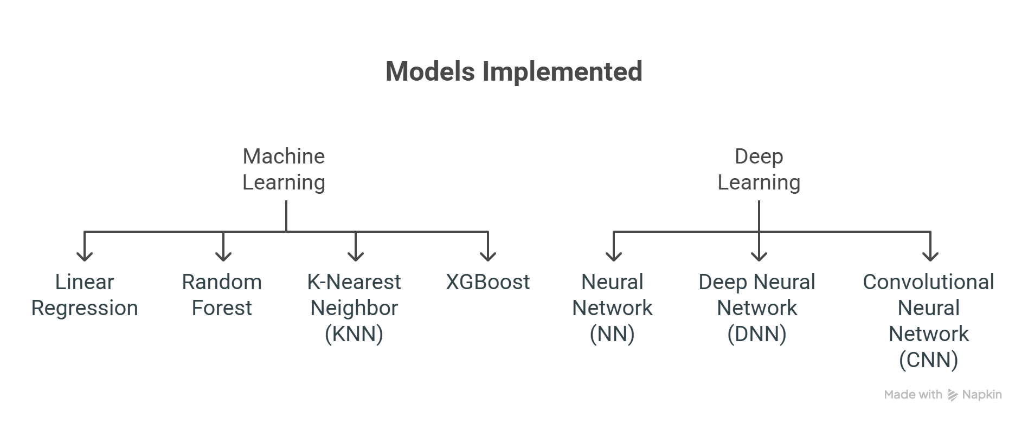
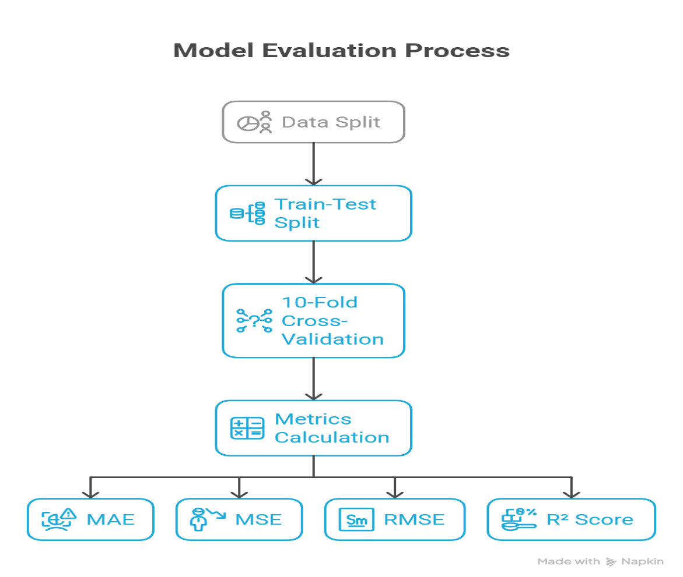
Methodology: Models and Evaluation
1
Dhaka International University, Dhaka, Bangladesh
25th - 27th September 2025

Slide 10
Methodology: Model Interpretability
SHAP (Global Explainability): Provides a consistent measure of each feature's overall contribution to the model's predictions.
LIME (Local Explainability): Explains individual predictions by approximating the model locally around a specific instance.
Goal: To answer "Why did the model set this specific target?"
1
Dhaka International University, Dhaka, Bangladesh
25th - 27th September 2025

Slide 11
Model Performance Comparison
Table 1.3 Model-wise Performance
Table 1.4 Fold-wise Performance of Best Model
Model | MAE | MSE | RMSE | R2 Score
Linear Regression | 0.052 | 0.027 | 0.166 | 0.037
KNN | 0.045 | 0.026 | 0.160 | 0.069
Random Forest | 0.039 | 0.019 | 0.130 | 0.330
XGBoost | 0.0436 | 0.024 | 0.150 | 0.150
NN | 0.080 | 0.010 | 0.0100 | 0.987
DNN | 0.209 | 0.066 | 0.258 | 0.923
CNN | 0.220 | 0.081 | 0.284 | 0.905
Fold | MAE | MSE | RMSE | R2 Score
1 | 0.0870 | 0.0120 | 0.1130 | 0.9880
2 | 0.0816 | 0.0102 | 0.1008 | 0.9874
3 | 0.0887 | 0.0131 | 0.1143 | 0.9855
4 | 0.0856 | 0.0114 | 0.1067 | 0.9862
5 | 0.0809 | 0.0098 | 0.0992 | 0.9879
6 | 0.0710 | 0.0079 | 0.0891 | 0.9921
7 | 0.0879 | 0.0118 | 0.1086 | 0.9872
8 | 0.0810 | 0.0106 | 0.1030 | 0.9849
9 | 0.0772 | 0.0094 | 0.0970 | 0.9881
10 | 0.0784 | 0.0096 | 0.0981 | 0.9907
1
Dhaka International University, Dhaka, Bangladesh
25th - 27th September 2025

Slide 12
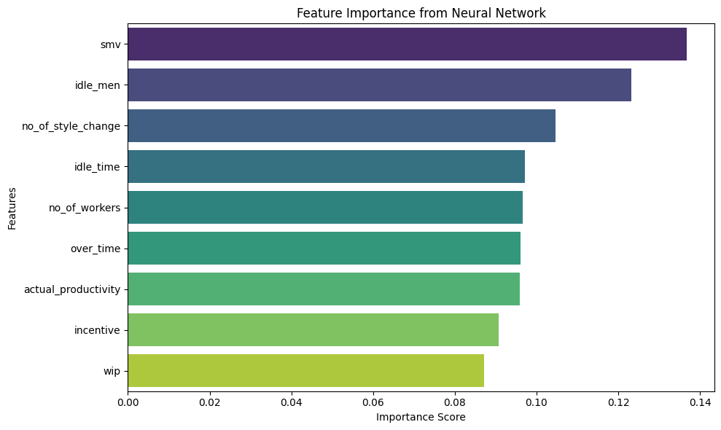
Result 2: Key Drivers of Productivity
1
Dhaka International University, Dhaka, Bangladesh
25th - 27th September 2025

Slide 13
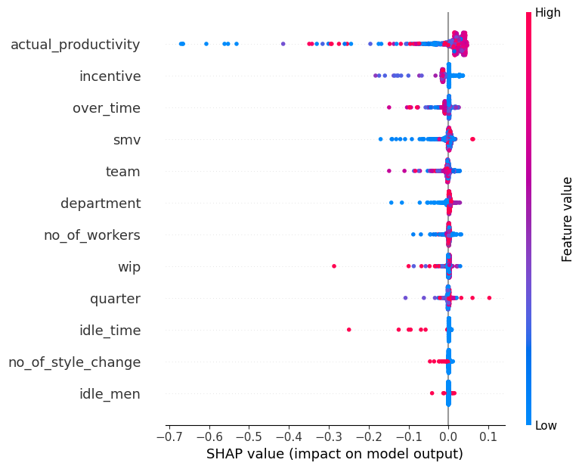
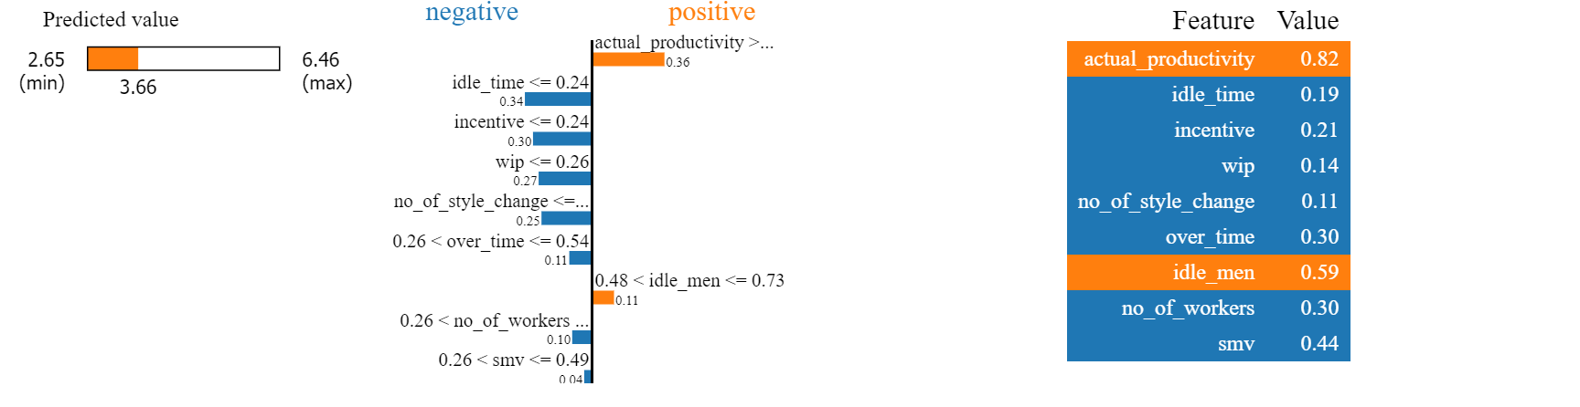
Explainable AI in Action
SHAP Summary Plot: Shows global feature importance and impact direction (e.g., high actual_productivity increases the target prediction).
LIME Explanation: For a single instance, it shows how features like overtime or idle_men locally pushed the prediction up or down.
1
Dhaka International University, Dhaka, Bangladesh
25th - 27th September 2025

Slide 14
Table 1.5 Comparison of Previous Studies on Productivity Prediction Models
Study | Best Model | MAE | R2 Score | Prediction Target | Dataset (with Size) | XAI
[7] | CatBoost Regressor | – | Higher than Decision Tree | Actual team productivity | – | –
[8] | HGBR | 0.0428 | 0.7142 | Actual productivity + required incentive & overtime | 1197 | –
[9] | Stacking Ensemble | 0.04 | 0.65 | Actual productivity | 1197 | –
[10] | Deep Neural Network (DNN) | 0.086 | – | Actual productivity (0–1) | 1197 | –
[11] | Logistic Regression | – | – | Worker status (stay/leave) | 512 | –
[12] | Gradient Boosting | 0.084 | – | Actual productivity (0–1) | 1197 | –
Proposed Neural Network (NN) | NN | 0.080 | 0.987 | Targeted Productivity | 1197 | YES (SHAP, LIME)
1
Dhaka International University, Dhaka, Bangladesh
25th - 27th September 2025

Slide 15
Conclusion
We successfully developed a data-driven framework for predicting targeted productivity.
A Neural Network model proved most accurate, capturing complex patterns in the data.
The integration of XAI (SHAP & LIME) provides crucial interpretability, making the framework a trustworthy and practical tool for intelligent production planning in the garment industry.
1
Dhaka International University, Dhaka, Bangladesh
25th - 27th September 2025

Slide 16
Future Work
Integrate real-time data streams for dynamic target adjustment.
Test and validate the model across multiple garment factories.
Explore temporal models (e.g., RNNs, LSTMs) to capture time-series patterns.
Develop a full Decision Support System (DSS) dashboard for factory managers.
1
Dhaka International University, Dhaka, Bangladesh
25th - 27th September 2025

Slide 17
References
[7] Begum, Z., Anjan, A., Abhivardhan, G., Tej, M. V., & Hashwanthratna, E. (2025). Machine learning models for analysing and predicting team productivity in garment manufacturing. International Journal of Information and Electronics Engineering, 15(4), 171–179.
[8] Biswas, M. E., Shahzamal, M., & Haque, M. D. (2024). Machine learning approach to estimate requirements for target productivity of garments employees. 2024 6th International Conference on Electrical Engineering and Information & Communication Technology (ICEEICT), 921–926. IEEE.
[9] Hosen, M. H., Tasnia, N., Amran, M., Chowdhury, R., Uddin, A., & Saha, A. (2024). Stacking ensemble techniques for productivity forecasting in Bangladesh’s garment industry. 2024 IEEE International Conference on Computing, Applications and Systems (COMPAS), 1–6. IEEE.
[10] Al Imran, A., Amin, M. N., Rifat, M. R. I., & Mehreen, S. (2019). Deep neural network approach for predicting the productivity of garment employees. 2019 6th International Conference on Control, Decision and Information Technologies (CoDIT), 1402–1407. IEEE.
[11] Keya, M. S., Emon, M. U., Akter, H., Imran, M. A. M., Hassan, M. K., & Mojumdar, M. U. (2021). Predicting performance analysis of garments women working status in Bangladesh using machine learning approaches. 2021 6th International Conference on Inventive Computation Technologies (ICICT), 602–608. IEEE.
[12] Goyzueta, C. A. R., De la Cruz, J. E. C., & Machaca, W. A. M. (2021). Advantages of assembly machine learning models for predicting employee productivity in a garment manufacturing company. 2021 IEEE Engineering International Research Conference (EIRCON), 1–4. IEEE.
1
Dhaka International University, Dhaka, Bangladesh
25th - 27th September 2025

Slide 18
Acknowledgement
We thank Square Food Beverage LTD, Pabna, for its support.
1
Dhaka International University, Dhaka, Bangladesh
25th - 27th September 2025

Slide 19
Thank you for your Kind attention
Have any questions?
1
Dhaka International University, Dhaka, Bangladesh
25th - 27th September 2025

