Slide 1





RUEC 2025 1st International Research Conference (IRC)
Rajshahi University Education Club, Rajshahi, Bangladesh
6th & 7th September 2025
Paper ID:
109
Topic:
Intelligent Overspeed Control in Autonomous Vehicles with DQN Deep Reinforcement Learning
Md. Rifat Hossen
Department of Information and Communication Engineering.
Pabna University of Science and Technology, Pabna, Bangladesh.

Slide 2

Outline of Presentation
Introduction
Research Background
Research Objective
Methodology
System Architecture
Key Findings
Discussion & Implications
Conclusion
Future Work
1
Rajshahi University Education Club, Rajshahi, Bangladesh
6th & 7th September 2025

Slide 3
Introduction
Road accidents cause 3700 deaths/ day (WHO)
Reckless driving & over speeding in varying speed zones
Maintaining safe speed limits across diverse environments ( residential, school, highway)
Development an intelligent speed control system to reduce road mishaps
2
Rajshahi University Education Club, Rajshahi, Bangladesh
6th & 7th September 2025

Slide 4
Research Background
Traditional speed control has limited adaptability
Reinforcement learning is learned by interacting with the environment
Deep Reinforcement learning uses neural networks for better performance
Gap is that few studies address zone-specific speed control with deep Reinforcement learning
3
Rajshahi University Education Club, Rajshahi, Bangladesh
6th & 7th September 2025

Slide 5
Research Objective
We propose a Deep Q-Network (DQN) based Deep RL method.
Goals:
  Detect over-speeding across different zones.
  Apply intelligent deceleration (High, mid, low).
  Optimize vehicle speed to match zone limits.
4
Rajshahi University Education Club, Rajshahi, Bangladesh
6th & 7th September 2025

Slide 6
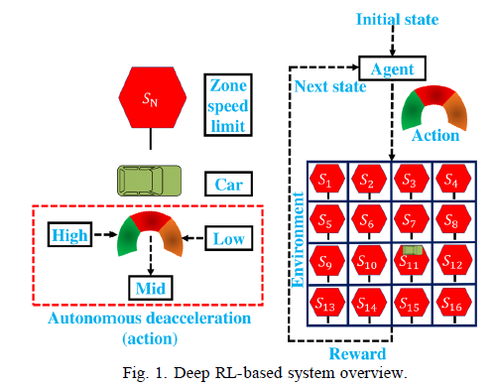
Methodology
We create a 4x4 grid with zone-based speed limits (20-80km/h)
Detect the current speed, zone speed limit, and speed difference
Action Space:
  High Deceleration (-9.8 m/s2)
  Middle Deceleration (-5.9 m/s2)
  Low Deceleration (-2.8 m/s2)
Reward Function Encourages staying within sage speed limits
We use LSTM-based DQN for sequential state prediction
5
Rajshahi University Education Club, Rajshahi, Bangladesh
6th & 7th September 2025

Slide 7
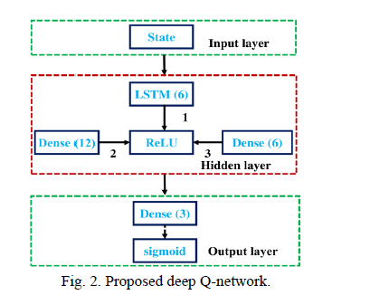
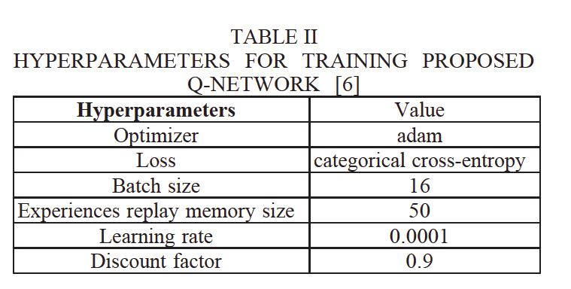
System Architecture
6
Rajshahi University Education Club, Rajshahi, Bangladesh
6th & 7th September 2025

Slide 8
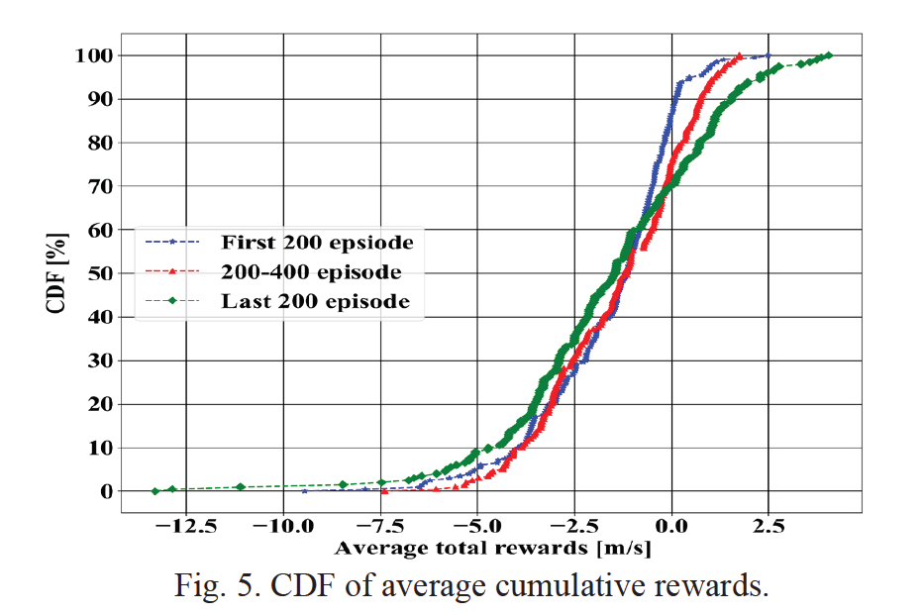
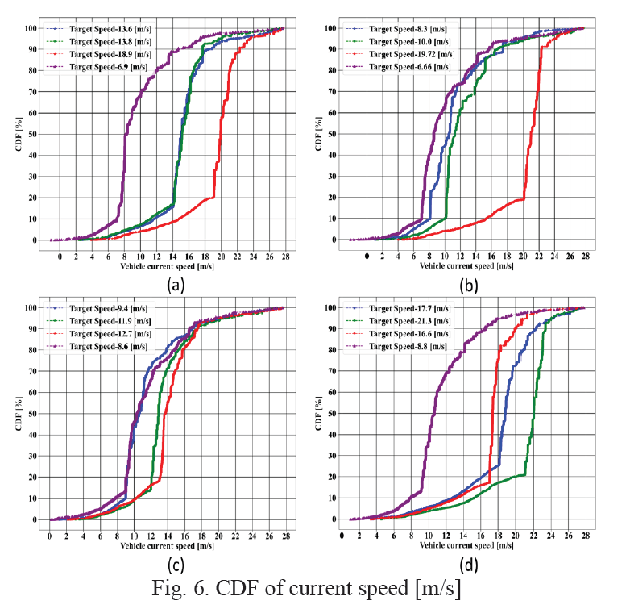
Key Findings
7
Rajshahi University Education Club, Rajshahi, Bangladesh
6th & 7th September 2025

Slide 9
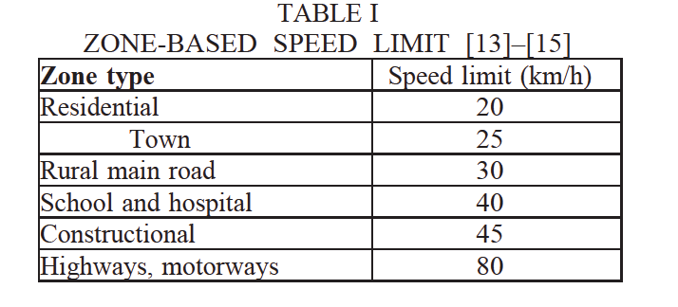


Discussion & Implications
The proposed model successfully reduces over-speeding in diverse zones.
DQN-based control adapts to uncertain environments
Our contribution to demonstrate zone-specific Deep RL-Based Speed control.
Practical Impact is that it supports safer autonomous and semi-autonomous driving systems.
8
Rajshahi University Education Club, Rajshahi, Bangladesh
6th & 7th September 2025

Slide 10
Conclusion
Road mishaps can be mitigated by DQN-based Deep RL speed control.
LSTM-DQN effectively selects deceleration levels under varied conditions
Key Takeaways:
  Dynamic speed control improves road safety.
  Positive simulation results validate effectiveness
9
Rajshahi University Education Club, Rajshahi, Bangladesh
6th & 7th September 2025

Slide 11
Future Work
Extend the model to real-world driving datasets
Incorporate multi-agent learning for complex traffic scenarios.
Enhance with pedestrian/collision detection modules
Explore real-time deployment in autonomous vehicles
10
Rajshahi University Education Club, Rajshahi, Bangladesh
6th & 7th September 2025

Slide 12
Thank You !
11
Rajshahi University Education Club, Rajshahi, Bangladesh
6th & 7th September 2025

