Slide 1



Exploring the EmoBone Dataset with Bi-Directional LSTM for Emotion Recognition via Bone Conducted Speech
Md. Sarwar Hosain, Md. Rifat Hossen, Md. Uzzal Mia,
Yosuke Sugiura and Tetsuya Shimamura
Presented by
Md. Rifat Hossen
Pabna University of Science and Technology

Slide 2


Presentation Outline
Motivation
Research Question
Objectives
Introduction
Dataset Preparation
Dataset Evaluation
Reliability of Evaluation
Methodology
Results
Discussion
Conclusions
NCSP’25

Slide 3
Motivation
Address speech emotion recognition issues in deep neural networks including degradation and information loss
Utilize bi-directional LSTM (BiLSTM) to capture the temporal dynamics of emotional expression
Provide a novel bone-conducted speech emotion identification system
NCSP’25

Slide 4
Research Question
How can a BiLSTM network enhance its performance in emotion recognition using bone-conducted speech?
Objective
To develop and optimize a BiLSTM based model
To evaluate and compare the performance of the model
To attain state-of-the-art EmoBone dataset performance
NCSP’25

Slide 5

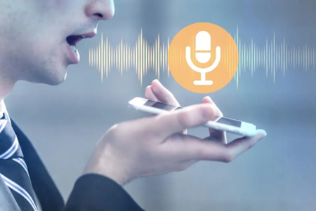
Introduction
Speech:
  Speech is a primary mode of human communication
  It conveys not just information but also emotions
  Accurately recognizing emotions in speech is crucial for various applications
Speech Recognition:
  Computers can recognize our words and turn them into text.
  Speech recognition analyzes features like pitch, sound waves, and pronunciation
  Voice assistants (e.g., Siri, Alexa, Google Assistant)
Figure 1: Speech delivery
Figure 2: Speech recognition
NCSP’25

Slide 6
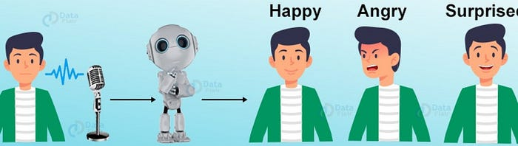
Introduction(Cont.)
Speech Emotion Recognition (SER):
  SER aims to automatically recognize emotions from spoken language.
  SER analyzes features like tone, pitch, and energy to identify emotions
  Emotion recognition is important for understanding human behavior
  It can be used to improve social interactions, human-computer interaction (HCI), and affective computing
  SER has applications in diverse areas, such as call centers, in-vehicle services, and medical services etc.
Figure 3: Speech emotion recognition
NCSP’25

Slide 7
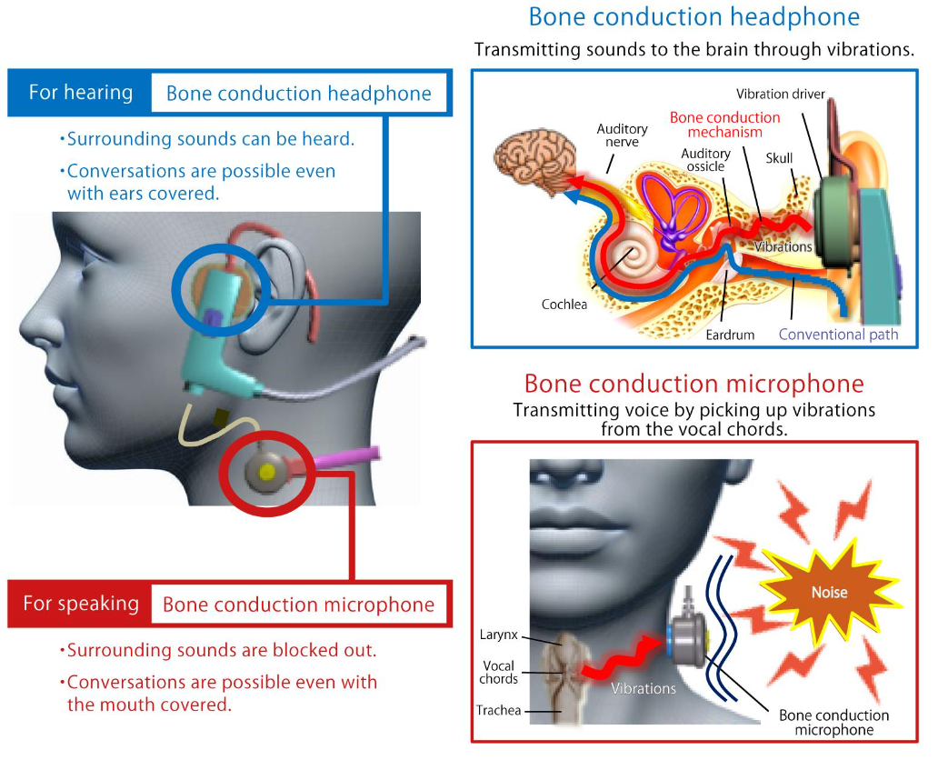
Introduction(Cont.)
Figure 4: Bone conduction technology
NCSP’25
Notes:
Conductive hearing loss is associated with faulty transmission of sound and is mostly due to damage to the eardrums​
Perceptive hearing loss is associated with difficulty in sensing the vibrations by the auditory nerves at the cochlea​
As for mixed hearing loss, it is best to suggest a trial in advance to find out whether bone conduction could be an aid to mixed hearing loss because it differs among individual​

Slide 8
Introduction(Cont.)
Probable application areas of BC speech emotion recognition system
Human Computer Interaction :
  Smartphones and wearables devices
  Virtual assistants and chatbots
  Biometric authentication
Healthcare and Mental Health:
  Mental health monitoring
  Telehealth and remote monitoring
  Speech therapy and language learning
Education and Learning:
  Personalized learning environments
  Educational games and applications
  Sports training and performance analysis
Security and Law Enforcement:
  Stress detection in high-pressure situations
  Passenger screening at airports or borders
  Lie detection and deception analysis
Customer Service and Marketing:
  Empathy detection in call centers
  Targeted marketing and advertising
NCSP’25

Slide 9
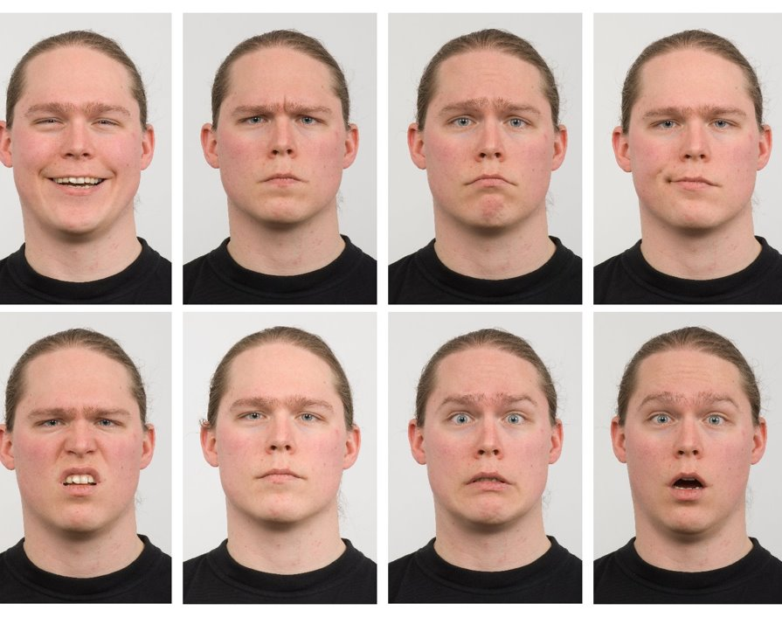
Dataset Preparation
Figure 5: Emotion categories
Emotion Categories
Happy
Angry
Sad
Calm​
Disgust
Neutral
Fear
Surprise​
NCSP’25

Slide 10
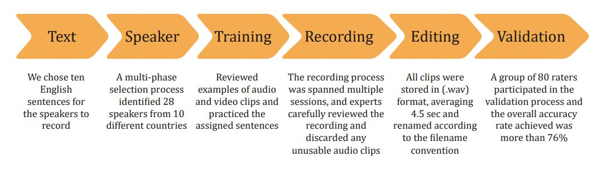
Dataset Preparation(Cont.)
Figure 6: Flowchart for dataset preparation
Table 1: Sentences used for dataset
No | Sentences
1 | We have to cancel our plans for tonight.
2 | Argentina won the FIFA World Cup in Qatar.
3 | Life is too short to waste time on regrets.
4 | It is very cold outside today in Saitama.
5 | Do not go outside at night.
6 | Students are gossiping in the class.
7 | Never underestimate the power of a positive attitude.
8 | He loves his family very much.
9 | The cat chases the mouse around the house.
10 | They are planning to go to Bangladesh.
NCSP’25

Slide 11
Dataset Preparation(Cont.)
Table 2: Dataset summary
Table 3: Speaker number and language status by country
Parameters | Types/Value
Year of production | 2023
Language | English
Dataset type | Acted
File type | Audio only
Sampling rate | 48KHz
Speakers number | 28
Emotions | 7
Sentences | 10
Number of audio clips | 15680
Average duration | 4.5 sec
Software | Ocenaudio
Dataset duration | 70560 sec=19 hours 36 min
Validators | 80
Recognition rate | 76.49%
Country | Speaker | English language status | Age groups
Japan | 3 | Officially recognized | 30-40
China | 2 | Officially recognized | 25-30
Bangladesh | 13 | Officially recognized | 30-42
Myanmar | 3 | Officially recognized | 25-35
Sri Lanka | 2 | Officially recognized | 30-35
Nigeria | 1 | Official | 30-35
Nepal | 1 | Officially recognized | 30-35
Malaysia | 1 | Officially recognized | 25-30
Afghanistan | 1 | Officially recognized | 25-30
Pakistan | 1 | Official | 30-35
NCSP’25

Slide 12
Dataset Evaluation
It examined how well-untrained listeners identified emotional content in speech
Resource limits, student workload, and finding female raters were challenges
Collaboration with a Bangladeshi university provided access to a larger pool of raters
80 raters, 40 males and 40 females, assessed two sets of recordings
The evaluation focused solely on the acoustic information
40 audio sets were carefully picked out, each consisting of 392 files
Participants chose one emotion to match an audio sample
NCSP’25

Slide 13
Reliability of Evaluation
The evaluation process was conducted in a controlled classroom environment
User login and activation-deactivation sessions were implemented for data security
Raters were required to register and verify their details
After registration, raters could access designated audio files
Audio tracks were shuffled before playback to prevent predictability
The submit button remained inactive until the user had fully experienced the audio
Raters were allowed a 15-minute break after each 45-minute session
The administrator prevented raters from retaking the experiment
NCSP’25

Slide 14
Methodology
Data Collection and Preprocessing:
  Utilized the EmoBone dataset, processed using Python's torchaudio library, resampled, and transformed into feature representations using MFCC
Model Architecture Design:
  BiLSTM model: develop with bidirectional LSTM layers and a fully connected layer, and train it for emotion classification using PyTorch with the Adam optimizer over 100 epochs
Training Process:
  trained using the same dataset, minimizing cross-entropy loss, and adjusting the learning rate to prevent overfitting and improve generalization performance
Evaluation Measures:
  Assess model performance with accuracy, confusion matrices, and classification reports.
NCSP’25

Slide 15
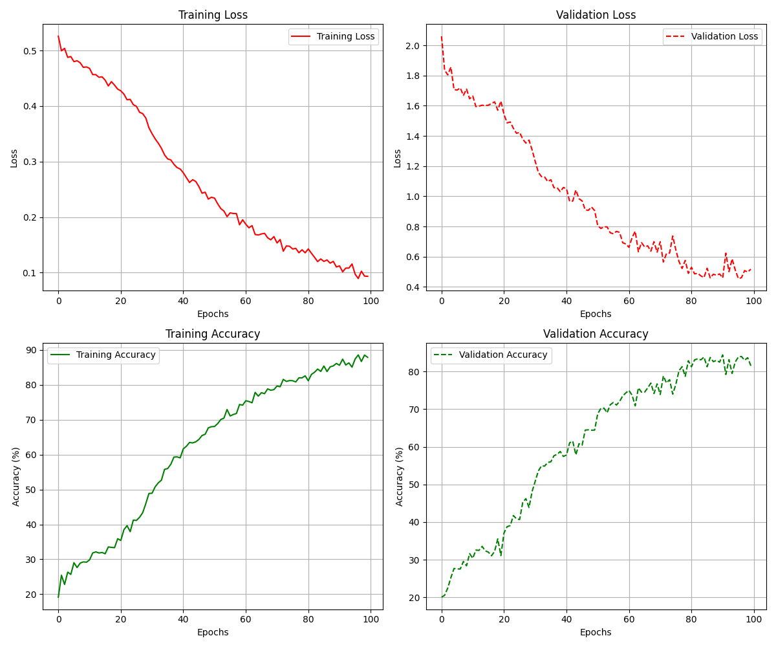
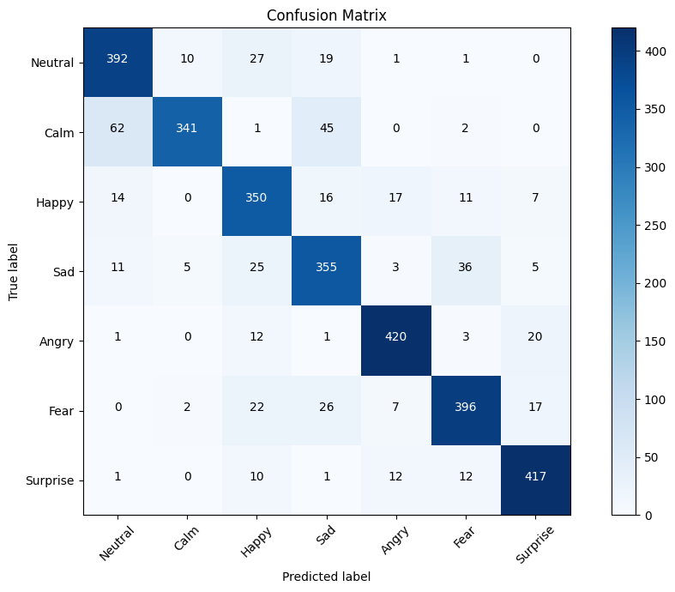
Results
Figure 7: Training and Validation Loss and Accuracy
over 100 epochs
Figure 8: Confusion matrix using BLSTM
NCSP’25

Slide 16
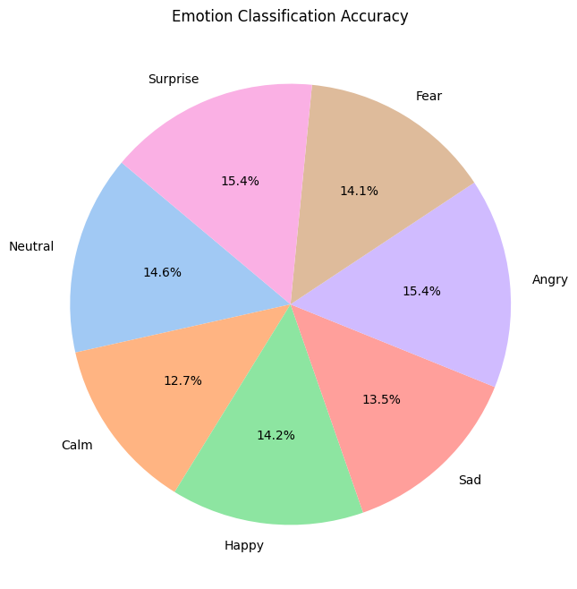
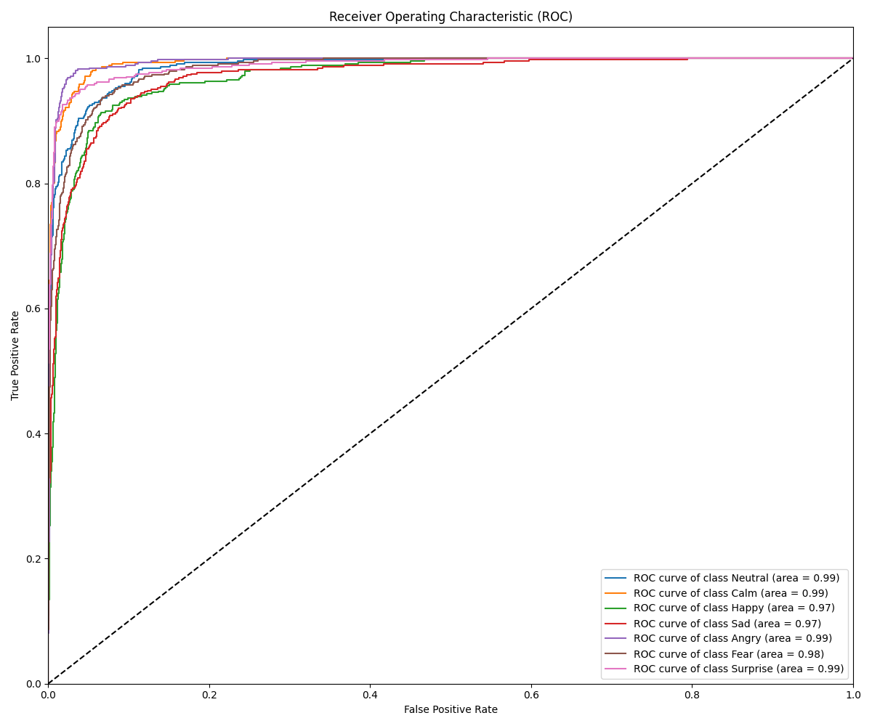
Results (Cont.)
Figure 9: Emotion wise pie chart
Figure 10: Receiver operating curve
NCSP’25

Slide 17
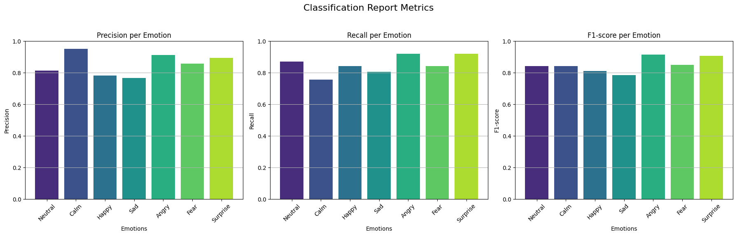
Results(Cont.)
Figure 11: Classification accuracy
NCSP’25

Slide 18
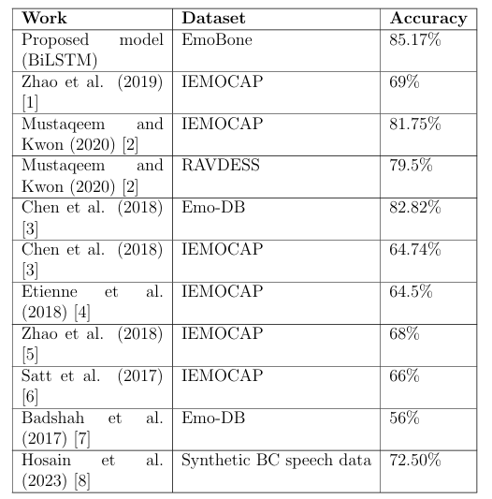
Discussion
Table 4: Comparison of accuracy across different studies
NCSP’25

Slide 19
Balanced dataset impact:
  Distribution of seven emotion classes enables unbiased model training and provides a robust foundation for performance evaluation
BiLSTM model performance:
  Effectively learns with steady loss reduction and accuracy gains, but struggles to distinguish between similar emotions like calm and neutral
Confusion matrix analysis:
  Show that the prominent diagonal elements and improved performance across all emotion classes
Overall Accuracy Enhancement:
  Achieves a notable accuracy of 85.17%, surpassing the baseline of 72.50%, highlighting the BLSTM effectiveness in improving emotion recognition from bone-conducted speech
Discussion(Cont.)
NCSP’25

Slide 20
Conclusion
Achievements: State-of-the-art accuracy of 85.17% using the EmoBone dataset.
Demonstrated the effectiveness of BiLSTM techniques.
Significance: Improved emotion classification for BC speech.
Addressed key challenges such as information loss and degradation.
Future Scope: Incorporate transfer learning and multi-modal fusion for further performance improvement.
NCSP’25

Slide 21
References
[1] Z. Zhao, Z. Bao, Z. Zhang, N. Cummins, H. Wang, and B. W. Schuller,“Attention-enhanced connectionist temporal classification for discrete speech emotion recognition,” in Proc. Interspeech, pp. 206–210, 2019.
[2] N. Mustaqeem and S. Kwon, “A CNN-Assisted Enhanced Audio Signal Processing for Speech Emotion Recognition,” Sensors, vol. 20, no. 1, p. 183, Dec. 2019, doi: 10.3390/s20010183
[3] M. Chen, X. He, J. Yang, and H. Zhang, “3-D convolutional recur rentneural networks with attention model for speech emotion recogni tion,”IEEE Signal Process. Lett., vol. 25, no. 10, pp. 1440–1444, Oct. 2018
[4] C. Etienne, G. Fidanza, A. Petrovskii, L. Devillers, and B. Schmauch,“CNN+LSTM architecture for speech emotion recognition with data aug-mentation,” 2018, arXiv:1802.05630.
[5] Z. Zhao, Y. Zhao, Z. Bao, H. Wang, Z. Zhang, and C. Li, “Deep spectrum feature representations for speech emotion recognition,” in Proc. JointWorkshop 4th Workshop Affect. Social Multimedia Comput. 1st Multi-Modal Affect. Comput. Large-Scale Multimedia Data, pp. 27–33, 2018.
[6] . Satt, S. Rozenberg, and R. Hoory, “Efficient Emotion Recognition from Speech Using Deep Learning on Spectrograms,” Aug. 2017, doi: 10.21437/interspeech.2017-200.
[7] A. M. Badshah, J. Ahmad, N. Rahim, and S. W. Baik, “Speech Emo tion Recognition from Spectrograms with Deep Convolutional Neural Network,” Feb. 2017, doi: 10.1109/platcon.2017.7883728.
[8] M. S. Hosain, Y. Sugiura, N. Yasui, and T. Shimamura, “Deep-Learning Based Speech Emotion Recognition Using Synthetic Bone-Conducted Speech,” Journal of Signal Processing, vol. 27, no. 6, pp. 151–163, Nov. 2023, doi: 10.2299/jsp.27.151.
NCSP’25

Slide 22

Thank You for Your Kind Attention
Please Give Your Valuable Comments and Suggestions

