Slide 1



IEEE 10th International Conference on Electrical Engineering and Informatics (ICEEI 2025)
HOSTED BY: Universiti Kebangsaan Malaysia and Institut Teknologi Bandung
13-15 November 2025
Paper ID:
Paper Title :
70
Enhancing Robustness and Accuracy of Bone-Conducted Speech Emotion Recognition via Transformer Models
Md. Rifat Hossen
Department of Information and Communication Engineering,
Pabna University of Science and Technology
Pabna, Bangladesh

Slide 2
OUTLINE OF PRESENTATION
Motivation
Research Question
Objectives
Introduction
Methodology
Result and Discussion
Conclusion
Reference
1
HOSTED BY: : Universiti Kebangsaan Malaysia and Institut Teknologi Bandung

Slide 3
Motivation
Address speech emotion recognition issues in deep neural networks including degradation and information loss
Utilize Transformer Model to capture the temporal dynamics of emotional expression
Provide a novel bone-conducted speech emotion identification system
2
HOSTED BY: CENTRAL LABORATORY, ISLAMIC UNIVERSITY, KUSHTIA, BANGLADESH

Slide 4
Research Question
How can a Transformer Model enhance its performance in emotion recognition using bone-conducted speech for Malaysian speakers?
Objective
To develop and optimize a Transformer based model
To evaluate and compare the performance of the model
To attain state-of-the-art EmoBone dataset performance
3
HOSTED BY: : Universiti Kebangsaan Malaysia and Institut Teknologi Bandung

Slide 5

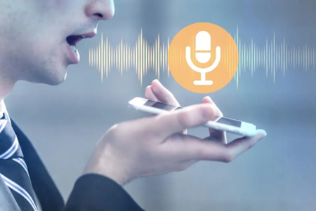
Introduction
Speech:
  Speech is a primary mode of human communication
  It conveys not just information but also emotions
  Accurately recognizing emotions in speech is crucial for various applications
Speech Recognition:
  Computers can recognize our words and turn them into text.
  Speech recognition analyzes features like pitch, sound waves, and pronunciation
  Voice assistants (e.g., Siri, Alexa, Google Assistant)
Figure 1: Speech delivery
Figure 2: Speech recognition
4
HOSTED BY: : Universiti Kebangsaan Malaysia and Institut Teknologi Bandung

Slide 6
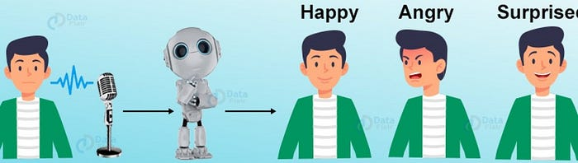
Introduction(Cont.)
Speech Emotion Recognition (SER):
  SER aims to recognize emotions from spoken language automatically.
  SER analyzes features like tone, pitch, and energy to identify emotions
  Emotion recognition is important for understanding human behavior
  It can be used to improve social interactions, human-computer interaction (HCI), and affective computing
  SER has applications in diverse areas, such as call centers, in-vehicle services, and medical services etc.
5
HOSTED BY: : Universiti Kebangsaan Malaysia and Institut Teknologi Bandung

Slide 7
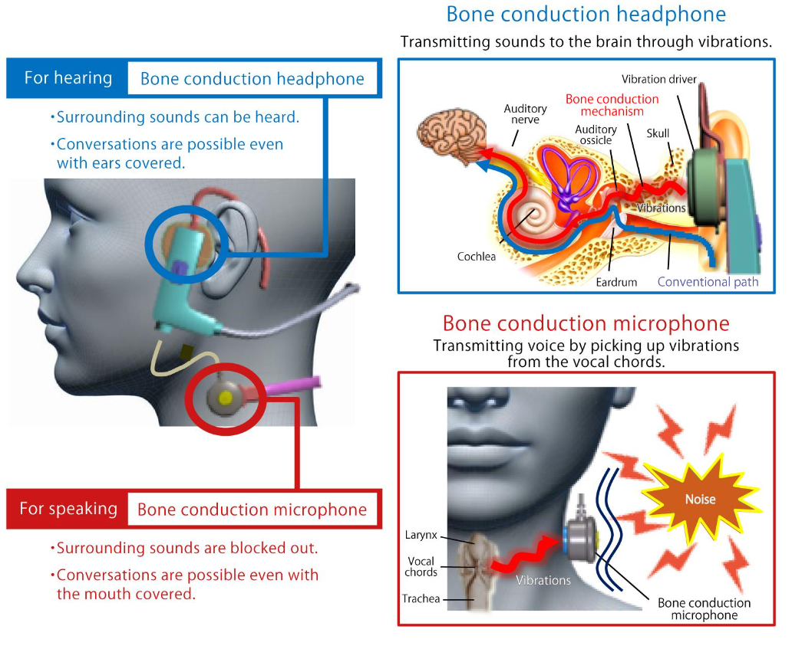
Introduction(Cont.)
Figure 4: Bone conduction technology
6
HOSTED BY: : Universiti Kebangsaan Malaysia and Institut Teknologi Bandung

Slide 8
Introduction(Cont.)
Probable application areas of BC speech emotion recognition system
Human Computer Interaction :
  Smartphones and wearables devices
  Virtual assistants and chatbots
  Biometric authentication
Healthcare and Mental Health:
  Mental health monitoring
  Telehealth and remote monitoring
  Speech therapy and language learning
Education and Learning:
  Personalized learning environments
  Educational games and applications
  Sports training and performance analysis
Security and Law Enforcement:
  Stress detection in high-pressure situations
  Passenger screening at airports or borders
  Lie detection and deception analysis
Customer Service and Marketing:
  Empathy detection in call centers
  Targeted marketing and advertising
7
HOSTED BY: : Universiti Kebangsaan Malaysia and Institut Teknologi Bandung

Slide 9
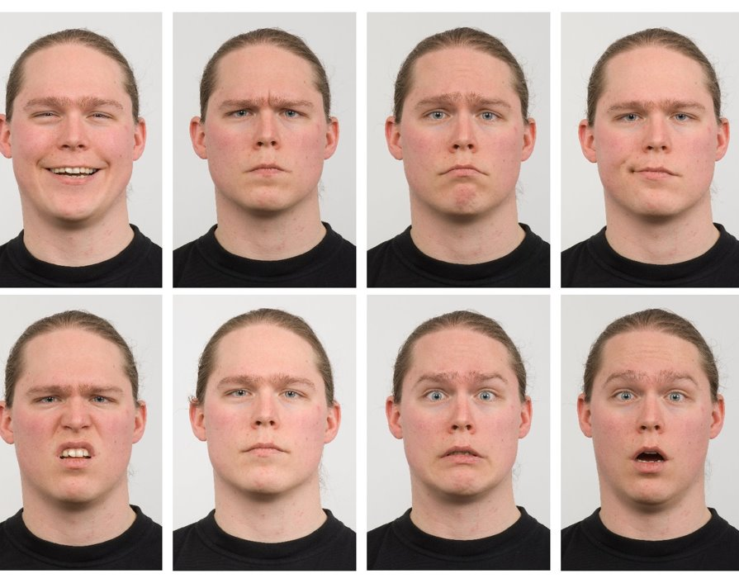
Dataset Preparation
Figure 5: Emotion categories
Emotion Categories
Happy
Angry
Sad
Calm​
Disgust
Neutral
Fear
Surprise​
8
HOSTED BY: : Universiti Kebangsaan Malaysia and Institut Teknologi Bandung

Slide 10
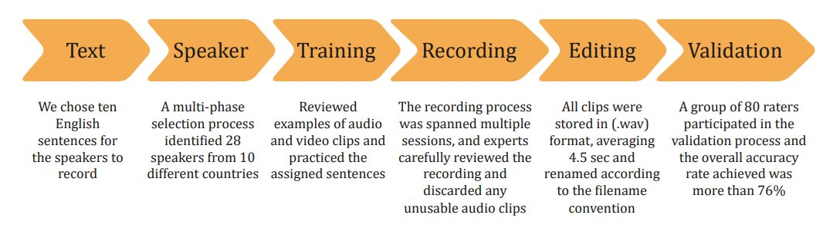
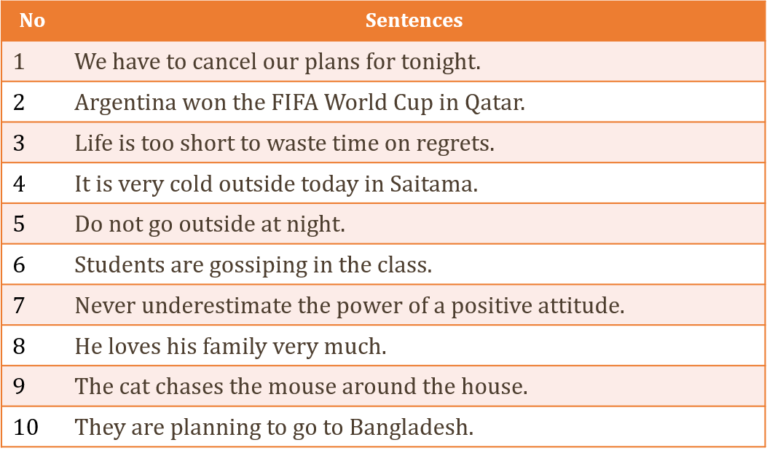
Dataset Preparation(Cont.)
Figure 6: Flowchart for dataset preparation
Table 1: Sentences used for dataset
9
HOSTED BY: : Universiti Kebangsaan Malaysia and Institut Teknologi Bandung

Slide 11
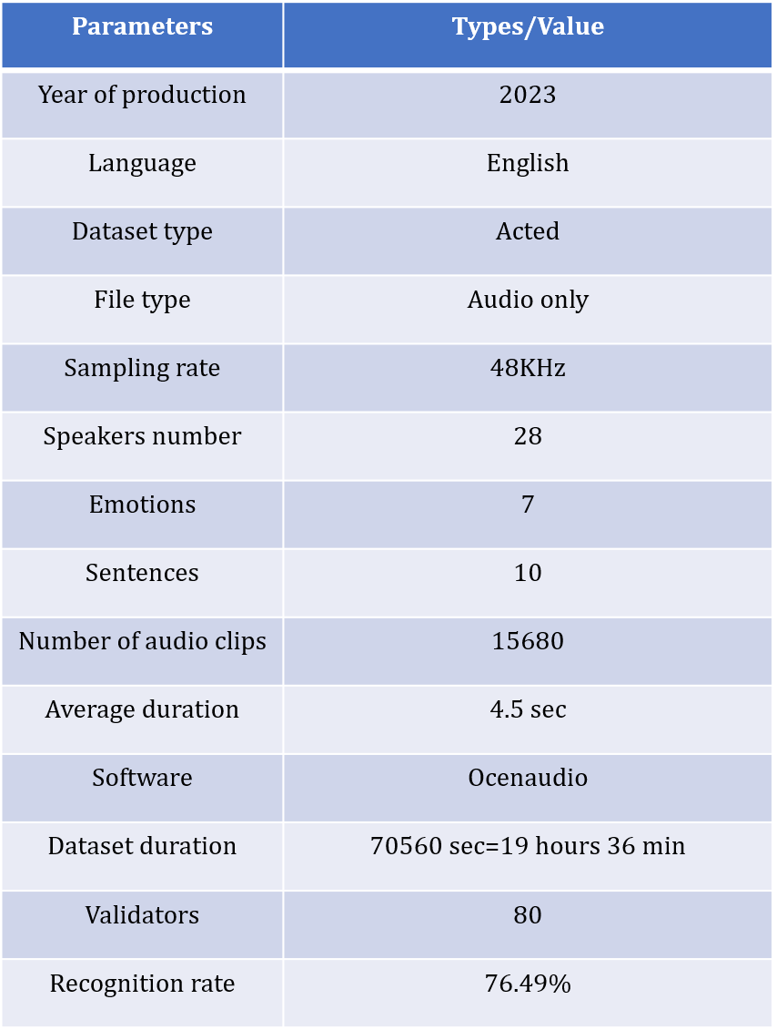
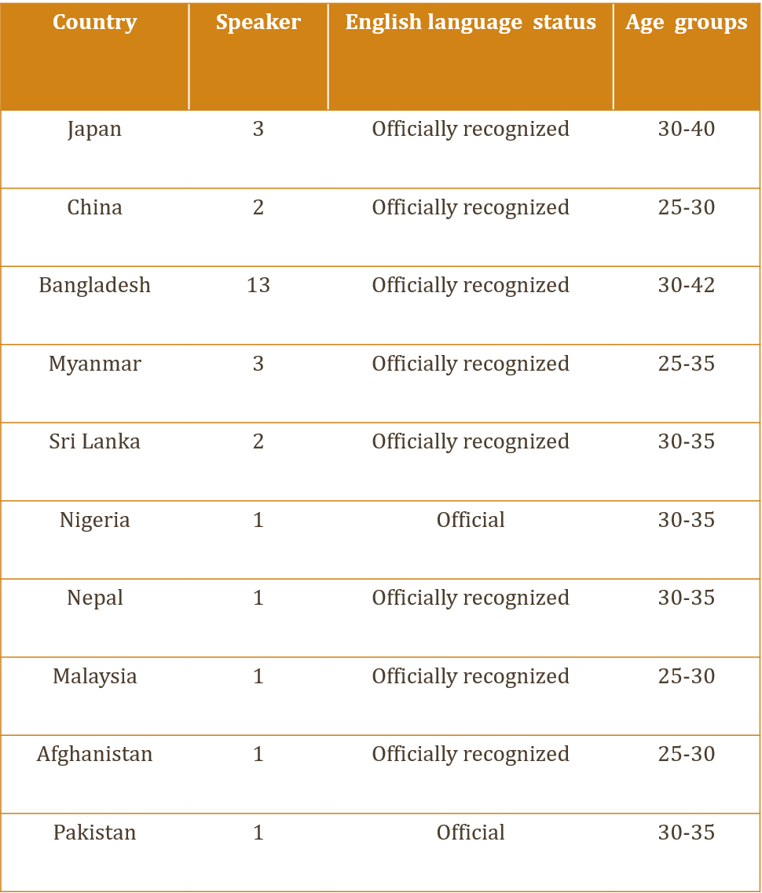
Dataset Preparation(Cont.)
Table 2: Dataset summary
Table 3: Speaker number and language status by country
10
HOSTED BY: : Universiti Kebangsaan Malaysia and Institut Teknologi Bandung

Slide 12
Dataset Evaluation
It examined how well-untrained listeners identified emotional content in speech
Resource limits, student workload, and finding female raters were challenges
Collaboration with a Bangladeshi university provided access to a larger pool of raters
80 raters, 40 males and 40 females, assessed two sets of recordings
The evaluation focused solely on the acoustic information
40 audio sets were carefully picked out, each consisting of 392 files
Participants chose one emotion to match an audio sample
11
HOSTED BY: : Universiti Kebangsaan Malaysia and Institut Teknologi Bandung

Slide 13
Reliability of Evaluation
The evaluation process was conducted in a controlled classroom environment
User login and activation-deactivation sessions were implemented for data security
Raters were required to register and verify their details
After registration, raters could access designated audio files
Audio tracks were shuffled before playback to prevent predictability
The submit button remained inactive until the user had fully experienced the audio
Raters were allowed a 15-minute break after each 45-minute session
The administrator prevented raters from retaking the experiment
12
HOSTED BY: : Universiti Kebangsaan Malaysia and Institut Teknologi Bandung

Slide 14
Methodology
Data Collection and Preprocessing:
  Utilized the EmoBone dataset, processed using Python's torchaudio library, resampled, and transformed into feature representations using MFCC
Model Architecture Design:
  Transformer model: a speech emotion recognition pipeline where raw audio is processed through CNN-based feature extraction, a Transformer encoder for contextual embeddings, and a dense layer with softmax to classify emotions.
  Training Process:
  trained using the same dataset, minimizing cross-entropy loss, and adjusting the learning rate to prevent overfitting and improve generalization performance
Evaluation Measures:
  Assess model performance with accuracy, confusion matrices, and classification reports.
13
HOSTED BY: : Universiti Kebangsaan Malaysia and Institut Teknologi Bandung

Slide 15
Results
Figure 8: Confusion matrix using Transformer
Figure 7: Training and Validation Loss and Accuracy
13
HOSTED BY: : Universiti Kebangsaan Malaysia and Institut Teknologi Bandung

Slide 16
Results
Figure 10: Receiver operating curve
Figure 10: per Class Emotion Accuracy
Figure 10: per Class Emotion Accuracy F1 score and Precision
14
HOSTED BY: : Universiti Kebangsaan Malaysia and Institut Teknologi Bandung

Slide 17
Discussion
TABLE IV: Comparison of Speech Emotion Recognition
Study | Dataset | Model | Accuracy
[3] | EmoBone | Not Specified | 76.49%
[4] | RAVDESS, SAVEE | Gradient Boosting | 33%,87%
[5] | Local RVDESS | CNN | 61.20%
[7] | RAVDESS | CNN | 72.50%
[9] | BC speech | BiLSTM | 85.17%
Our | EmoBone | Transformer | 99.00%
15
HOSTED BY: : Universiti Kebangsaan Malaysia and Institut Teknologi Bandung

Slide 18
Discussion
Balanced dataset impact:
  Distribution of seven emotion classes enables unbiased model training and provides a robust foundation for performance evaluation
Transformer model performance:
  Effectively learns with steady loss reduction and accuracy gains, but struggles to distinguish between similar emotions like calm and neutral
Confusion matrix analysis:
  Show that the prominent diagonal elements and improved performance across all emotion classes
Overall Accuracy Enhancement:
  Achieves a notable accuracy of 99.00%, highlighting the Transformer’s effectiveness in improving emotion recognition from bone-conducted speech
16
HOSTED BY: : Universiti Kebangsaan Malaysia and Institut Teknologi Bandung

Slide 19
Discussion
Achievements: State-of-the-art accuracy of 99% using the EmoBone dataset.
Demonstrated the effectiveness of Transformer techniques.
Significance: Improved emotion classification for BC speech.
Addressed key challenges such as information loss and degradation.
Future Scope: Incorporate transfer learning and multi-modal fusion for further performance improvement.
17
HOSTED BY: : Universiti Kebangsaan Malaysia and Institut Teknologi Bandung

Slide 20
References
[1] S. Madanian, T. Chen, O. Adeleye, J. M. Templeton, C. Poellabauer, D. Parry, and S. L. Schneider, “Speech emotion recognition using machine learning—a systematic review,” Intelligent systems with applications, vol. 20, p. 200266, 2023.
[2] B. W. Schuller, “Speech emotion recognition,” Communications of the ACM, vol. 61, no. 5, pp. 90–99, 2018.
[3] M. S. Hosain, Y. Sugiura, M. S. Rahman, and T. Shimamura, “Emobone: A multinational audio dataset of emotional bone conducted speech,” IEEJ Transactions on Electrical and Electronic Engineering, vol. 19, no. 9, pp. 1492–1506, 2024.
[4] M. R. Hossen, E. Hossain, J. Al-Faruk, J. Sultana, M. B. Islam, and M. S. Hosain, “Tversky loss mechanisms: A resunet approach to improving brain tumor segmentation,” in 2025 International Conference on Quantum Photonics, Artificial Intelligence, and Networking (QPAIN), 2025, pp. 1–6.
[5] A. Iqbal and K. Barua, “A real-time emotion recognition from speech using gradient boosting,” in 2019 international conference on electrical, computer and communication engineering (ECCE). IEEE, 2019, pp. 1–5.
[6] S. N. Zisad, M. S. Hossain, and K. Andersson, “Speech emotion recognition in neurological disorders using convolutional neural network,” in International conference on brain informatics. Springer, 2020, pp. 287–296.
[7] R. Aloufi, H. Haddadi, and D. Boyle, “Emotionless: Privacy-preserving speech analysis for voice assistants,” arXiv preprint arXiv:1908.03632, 2019.
[8] M. S. Hosain, Y. Sugiura, N. Yasui, and T. Shimamura, “Deep-learningbased speech emotion recognition using synthetic bone-conducted speech,” Journal of Signal Processing, vol. 27, no. 6, pp. 151–163, 2023.
[9] N. Wang and D. Yang, “Speech emotion recognition using fine-tuned wav2vec2. 0 and neural controlled differential equations classifier,” PloS
one, vol. 20, no. 2, p. e0318297, 2025.
[10] M. S. Hosain, M. R. Hossen, M. U. Mia, Y. Sugiura, and T. Shimamura, “Exploring the emobone dataset with bi-directional LSTM for emotion recognition via bone conducted speech,” in 2025 International Workshop on Nonlinear Circuits, Communications and Signal Processing (NCSP), 2025, pp. 97–100.
[11] M. R. Hossen, M. U. Mia, R. Islam, M. S. Hosain, M. K. Hasan, and T. Shimamura, “Facial expression recognition: A machine learning approach with svm, random forest, knn, and decision tree using grid search method,” in 2025 International Workshop on Nonlinear Circuits, Communications and Signal Processing (NCSP), 2025, pp. 421–424.
[12] A. Baevski, Y. Zhou, A. Mohamed, and M. Auli, “wav2vec 2.0: A framework for self-supervised learning of speech representations,” Advances in neural information processing systems, vol. 33, pp. 12 449– 12 460, 2020.
[13] A. Vaswani, N. Shazeer, N. Parmar, J. Uszkoreit, L. Jones, A. N. Gomez, Ł. Kaiser, and I. Polosukhin, “Attention is all you need,” Advances in neural information processing systems, vol. 30, 2017.
[14] D. Jurafsky and J. H. Martin, Speech and Language Processing, 2025, draft of January 12, 2025. [Online]. Available: https://web.stanford.edu/ jurafsky/slp3/
[15] I. Goodfellow, Y. Bengio, and A. Courville, Deep Learning. MIT Press, 2016, http://www.deeplearningbook.org.
18
HOSTED BY: : Universiti Kebangsaan Malaysia and Institut Teknologi Bandung

Slide 21
Thank You for Your Kind Attention …
HOSTED BY: : Universiti Kebangsaan Malaysia and Institut Teknologi Bandung

