Slide 1
Catalyst
SVM
Latency aware zkSVM batcher
for solana
Sadiq
x.com/Md_Sadiq_Md
github.com/MdSadiqMd

Slide 2

Problem
Statement
How can we batch Solana transactions efficiently while still “proving” correctness with minimal latency?

Slide 3
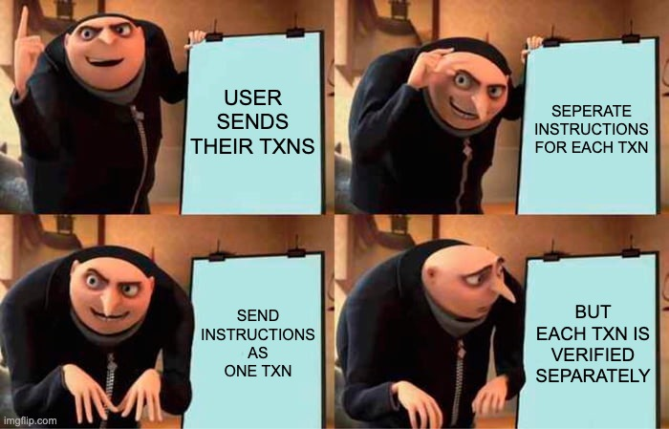
Current Implementation

Slide 4
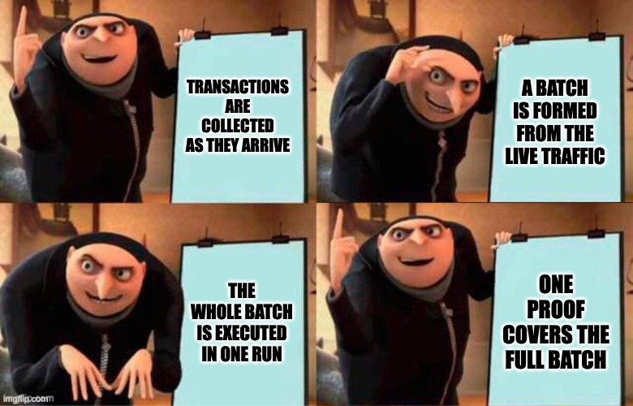
Proposed Implementation

Slide 5
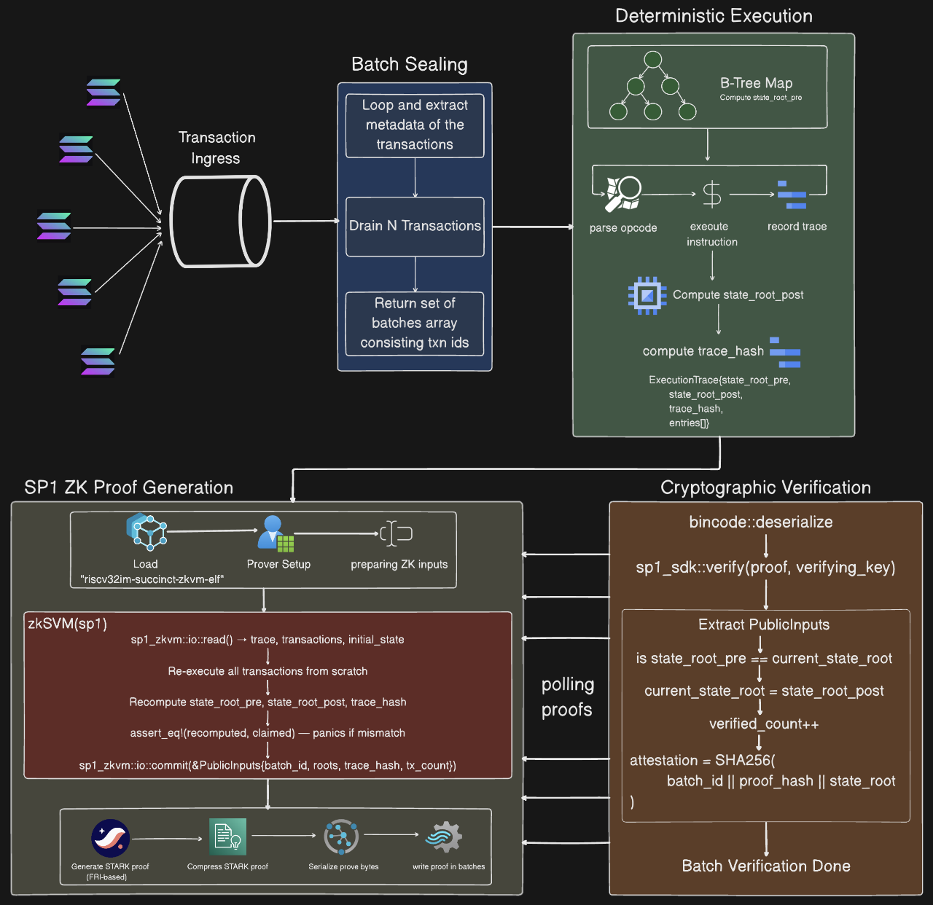
Architecture

Slide 6
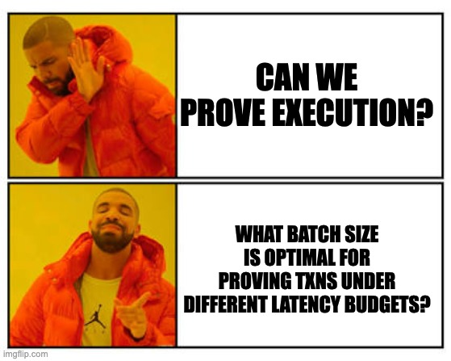
Core Idea

Slide 7
Thank you

