Slide 1
Signal Processing – Analog Part
Submitted To:
Prof. Ulf Witkowski
South Westphalia University of Applied Sciences
Soest Campus
Presented by,
Md. Saiful Islam Sajol
Matriculation no. 30042836

Slide 2
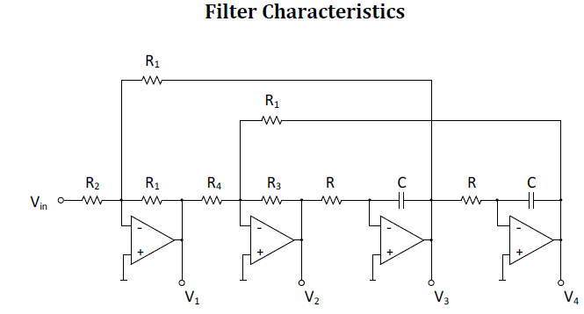




Task 1
R₁R₃ R₄ +R²R₁²R₄s²C²
$$\frac{V1}{Vin}$$
=
-
R₂R₃R₄ +R²R₁R₂R₄s²C²+RR₁R₂R₃sC
Notch (Band Reject Filter)
$$\frac{V2}{Vin}$$
=
R²R₁²R₃s²C²
RR₁R₂R₃ sC+R₂ R₃R₄+R²R₁R₂R₄ s²C²
High Pass Filter
$$\frac{V3}{Vin}$$
-RR₁² R₃ s C
=
Band Pass Filter
RR₁R₂R₃ sC+R₂ R₃ R₄ +R² R₁ R₂ R₄ s² C²
$$\frac{V4}{Vin}$$
=
R₁² R₃
Low Pass Filter
R R₁ R₂ R₃ s C + R₂ R₃ R₄ + R² R₁ R₂ R₄ s² C²

Slide 3
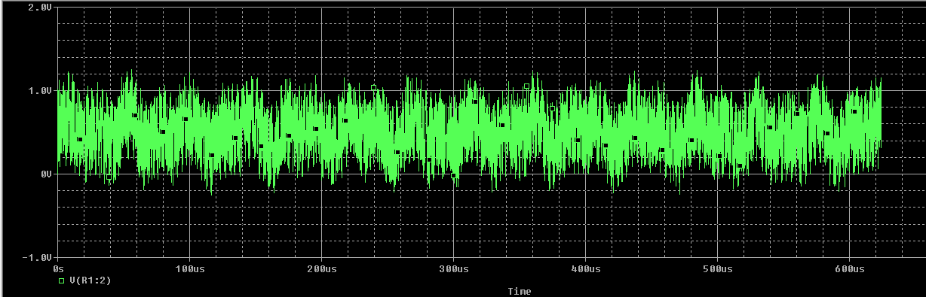
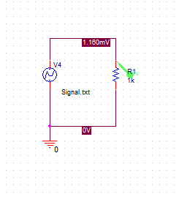
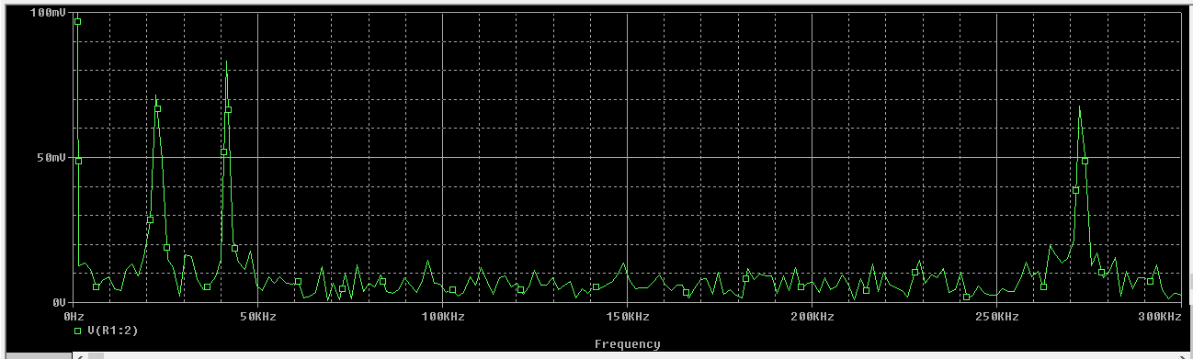
Task 2
voltage source
generating the
noisy signal.
FFT
frequency of the wanted
signal, it is ftarget = 42KHz

Slide 4
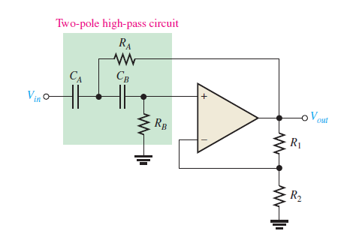
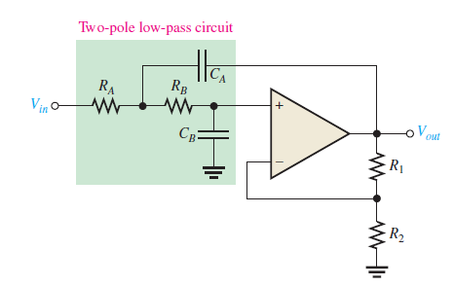

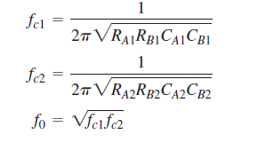
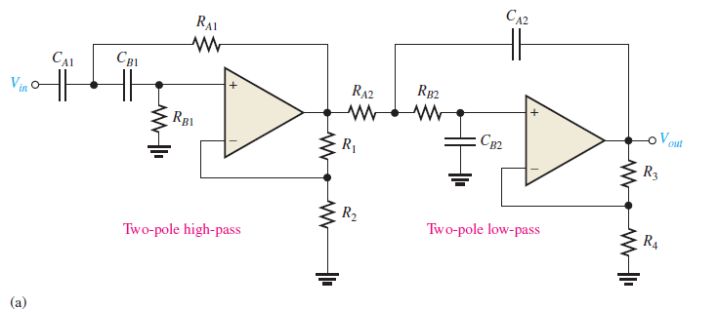

Solution :

Slide 5
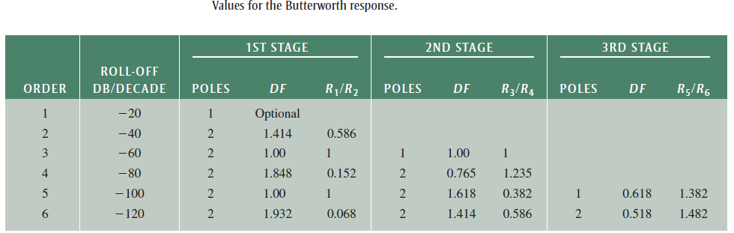
f_{c}=42kHz and f_{c1}=39kHz(arbitrary)
f_{c2}=f_{c}²/f_{c1}=42²/39=45.23kHz
Bandwidth,B=(45.23-39)kHz=6.231kHz
Finding parameters of High pass Filter Side
For simplicity,
We select R_{B1}=R_{A1}=R₂=3.9kΩ (arbitrary)
F_{c1}=1/(2*pie*RC)
C=1046pF ~1000pF (E-24 sequence)
C_{A1}= C_{B1} =C₁ ₌ 1000pF
R1/R2=0.586 (from chart)
R1=0.586*3.9k=2.285kΩ
Finding parameters of Low pass Filter Side
For simplicity,
We select R_{B2}=R_{A2}=R₄=3.9kΩ (arbitrary)
F_{c2}=1/(2*pie*RC)
C=902.25pF ~910pF (E-24 sequence)
C_{A2}= C_{B2} = 910pF
R3/R4=1 (from chart)
R3=R4=3.9kΩ

Slide 6
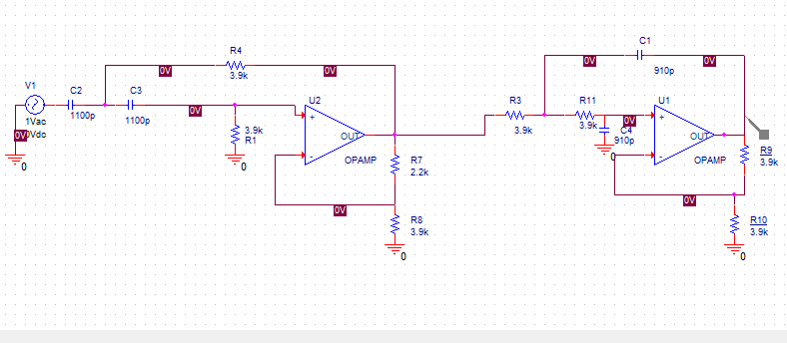
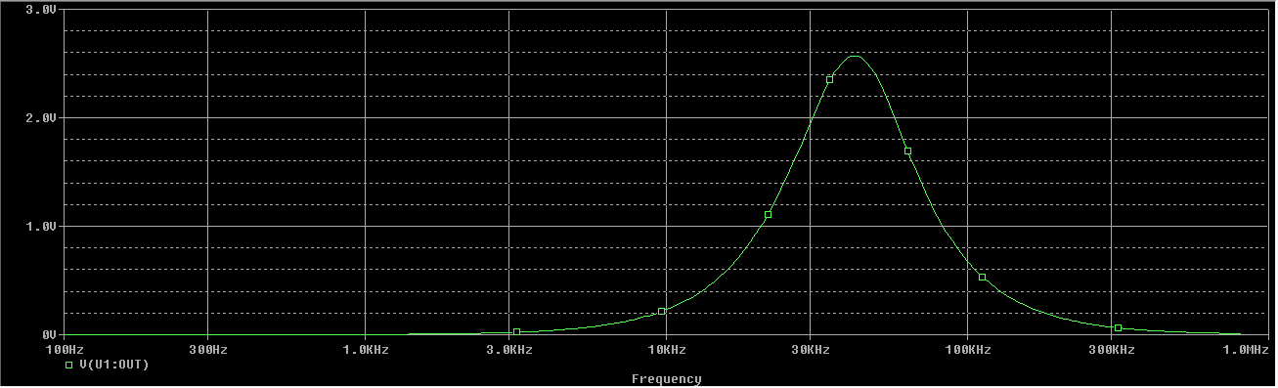
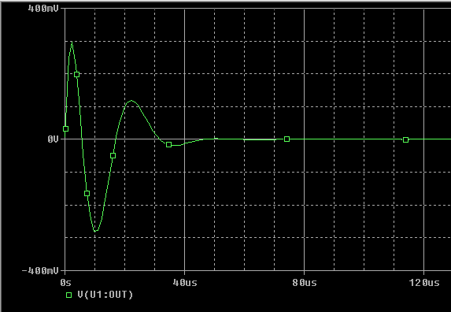
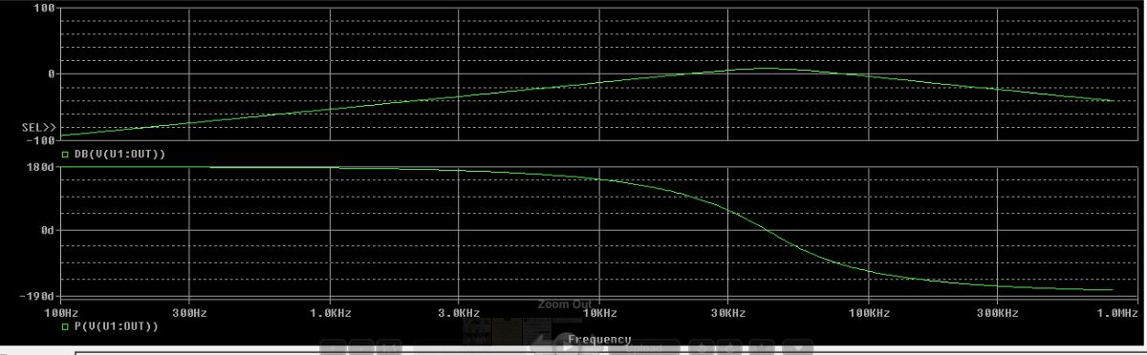
Time Domain

