Slide 1

GIT & GIThub Basics
Dil ware Alam 143014006

Slide 2
I’m not a Git expert or pro ☺

Slide 3


What is Git & Github ?
Git is an example of version control
Revert files or the whole project to an earlier state
Compare changes over time
See who modified what?
Control modifications by collaborators with the permission of admin/owners

Slide 4
What is Git & Github ? (Continued)
Github is a repository hosting service for Git
While Git is a command line tool, GitHub provides a web-based graphical interface that works on top of GIT. It can also be treated as a social platform to share knowledge and work.
It also provides access control and several collaboration features, such as wikis and basic task management tools

Slide 5
Now we set up git in our computer and create an account in github

Slide 6
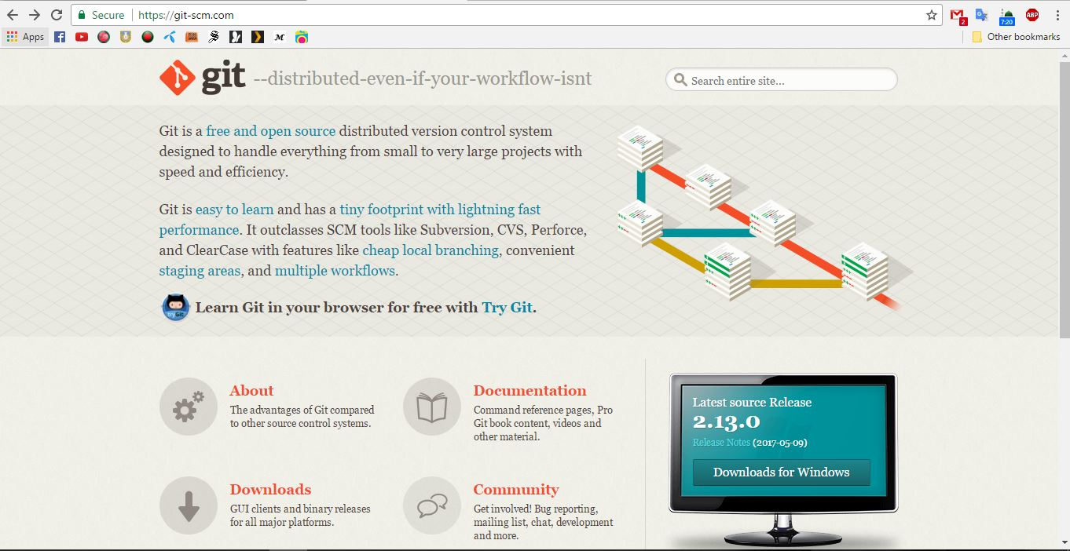

Slide 7
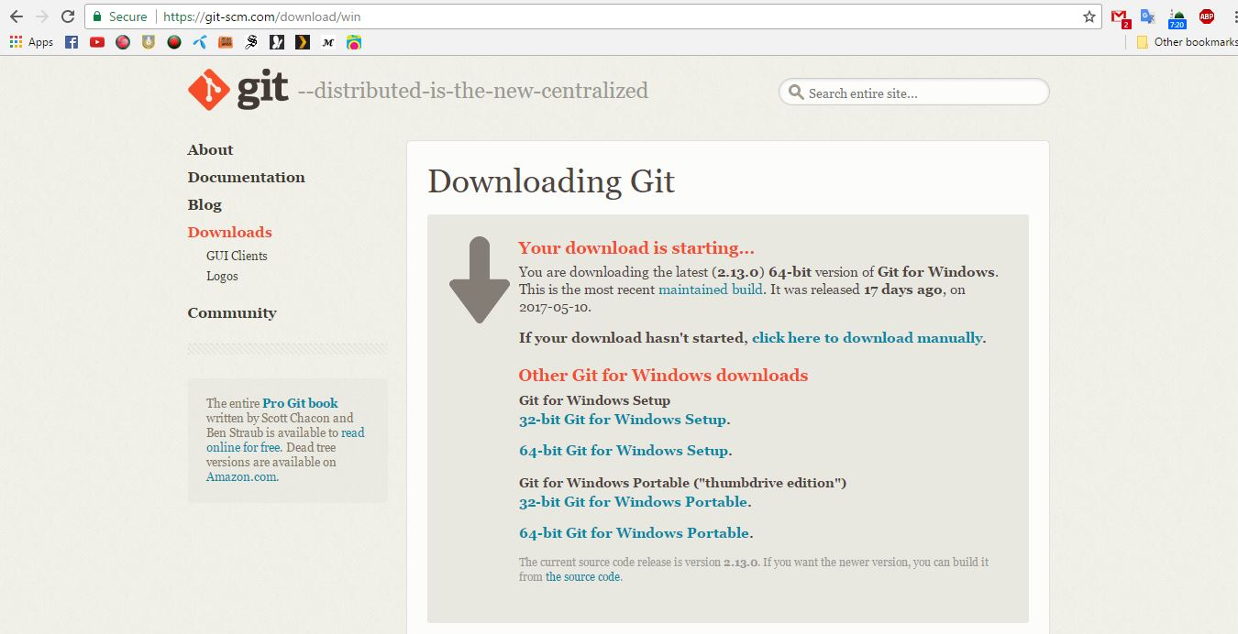

Slide 8
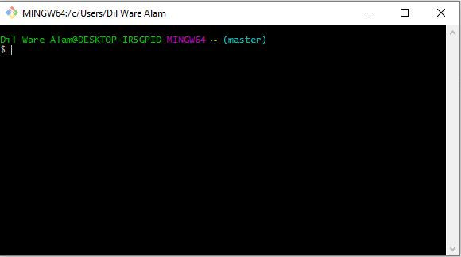

Slide 9
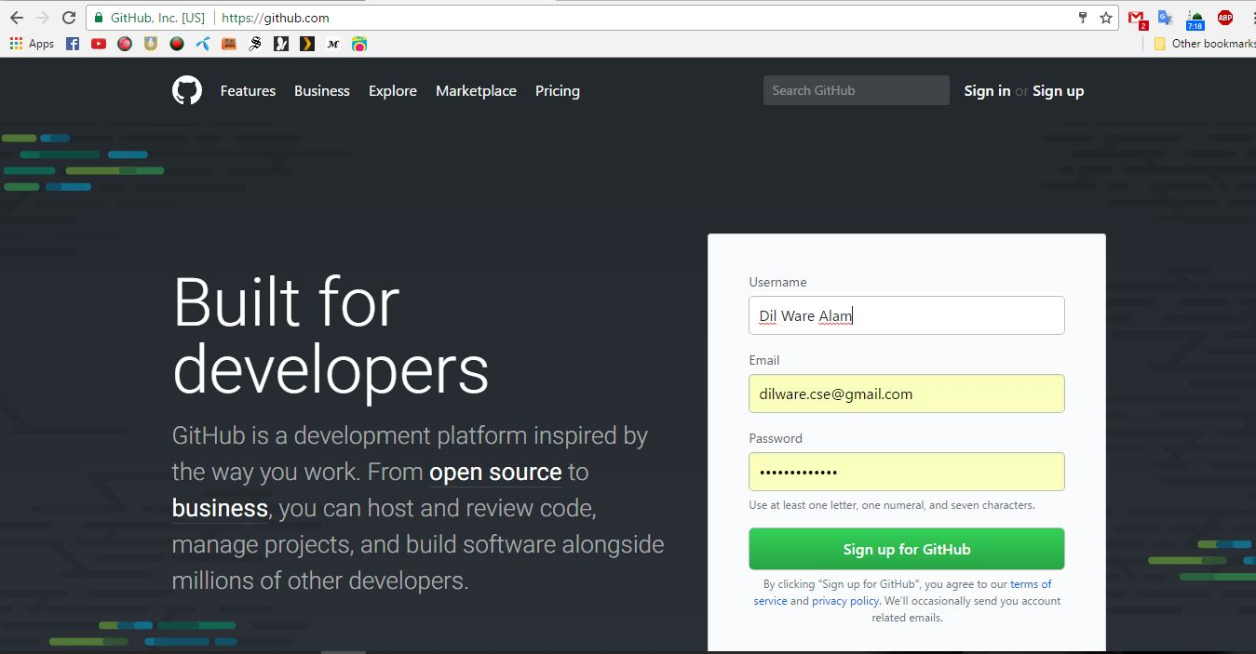

Slide 10
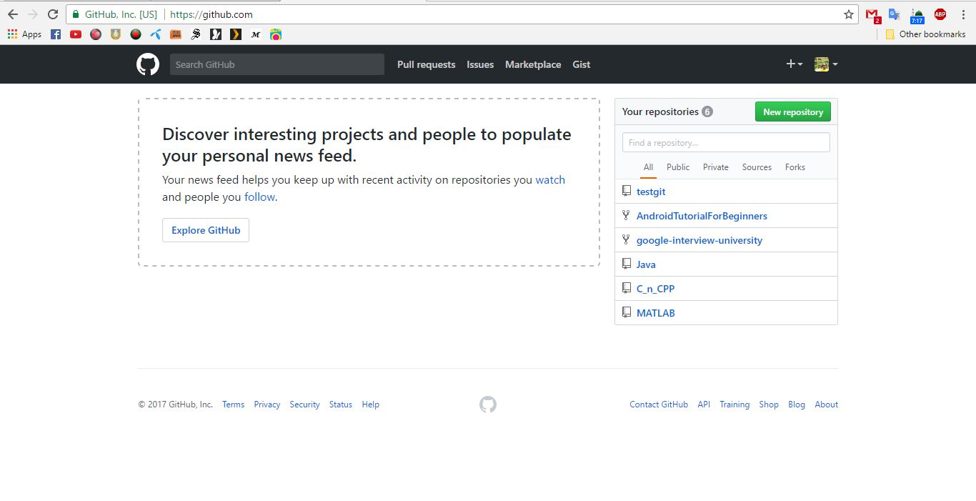

Slide 11
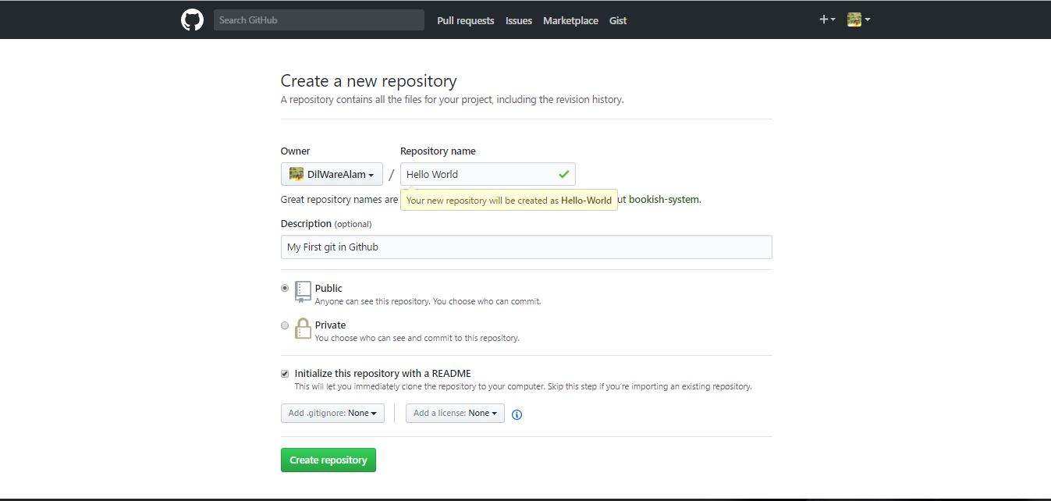
Important Concepts for Github Users
Creating a repository

Slide 12
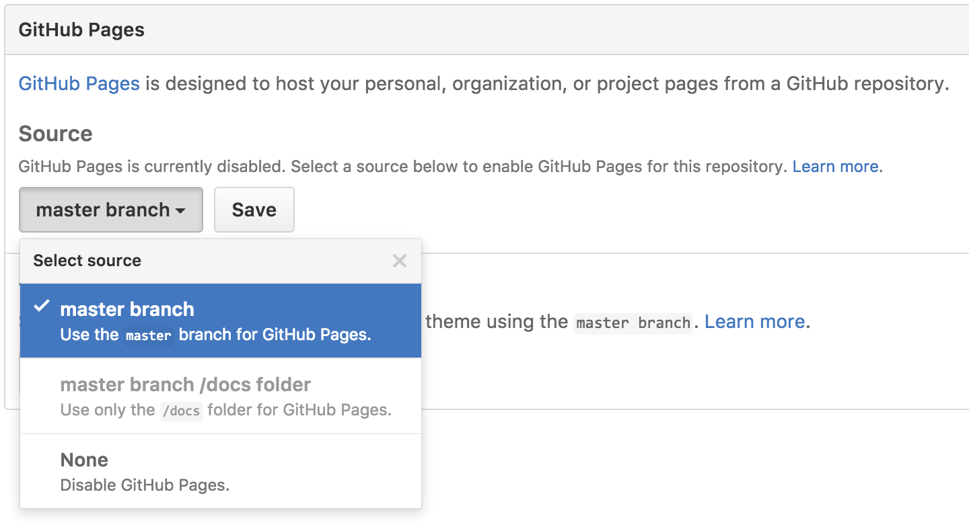
Master in a repository

Slide 13
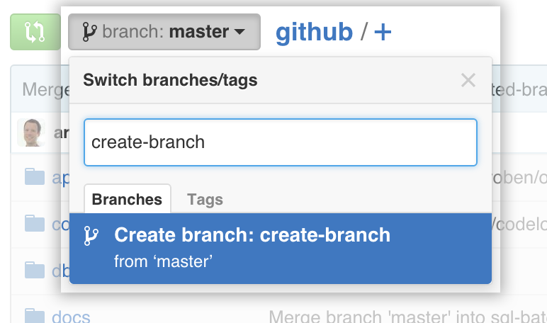
Creating a Branch

Slide 14
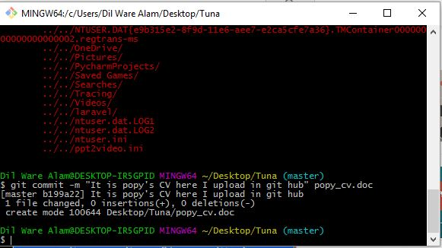
Adding Commits

Slide 15
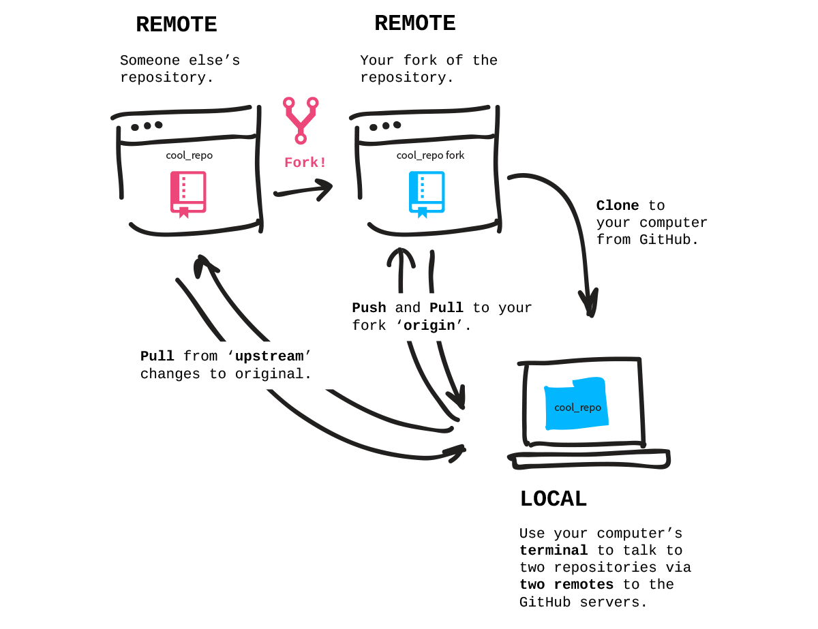
Forking a repository

Slide 16
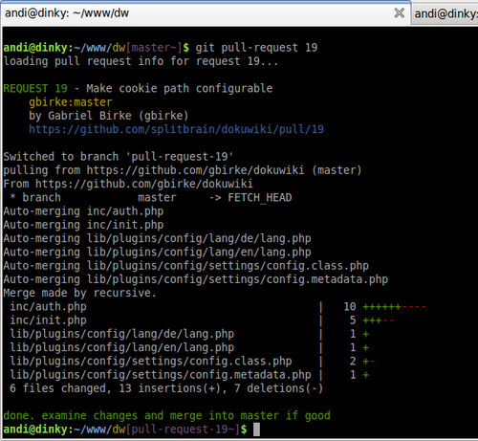
Pull requests

Slide 17
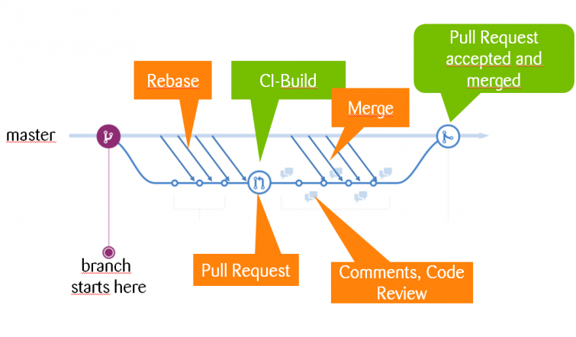
Understanding Github Workflow

Slide 18


