Slide 1
Kickstarter Success Prediction
Neeharika Yeluri - 016680508
Bhavana Gangula - 016003416
Mohamed Shafeeq Usman - 015232529

Slide 2
Outline
What is Kickstarter?
Kickstarter is a popular online platform for raising funds for innovative projects and ideas.
How does it work?
People make a pledge to support a project, you don't pay anything unless the project meets it funding goal by its deadline. Backers receive rewards based on their pledged amount.
The dataset contains information on over 20,000 Kickstarter campaigns, including their name, description, target, type, location, length, and backers.
The dataset contains 20632 rows and 68 columns. There are 39 numerical features and 29 categorical features present in the dataset with no duplicate or null values.

Slide 3
Problem Statement
Kickstarter's "all or nothing" fundraising strategy
The data can be explored to identify factors that contribute to campaign success, such as project type, campaign duration, and marketing tactics.
Understanding these success factors can help creators improve their chances of achieving their fundraising goals and bringing their projects to life.

Slide 4
Motivation
Developing a machine learning model that can predict the success of a Kickstarter project with high accuracy.
The ability to accurately predict Kickstarter success can also be valuable to investors and backers, as it can help them identify promising projects and allocate their resources more efficiently.
To understand the data by visual means to identify how the variables are related to the Success/Failure of the projects.
Our aim is to employ different methods to generate various samples of data. And explore techniques to experiment with to provide best possible prediction.
Also, analyze from post processing using SHAP to know how each feature has impact on whether the process leads to success or failure for a project.

Slide 5
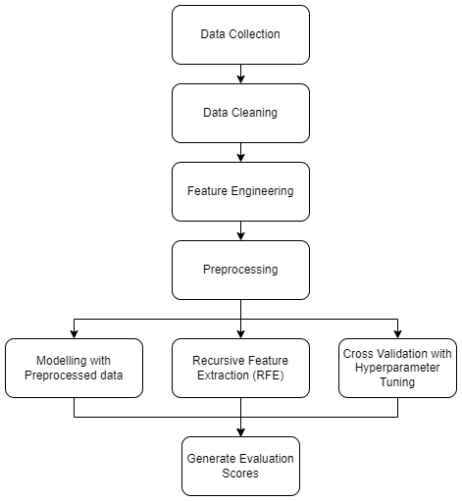
Pipeline
Data Preprocessing - NaNs, duplicates and Irrelevant columns removed
New data columns are created such as totals days from launch to deadline, date and month of launch date, etc.,
Trained 6 different models to perform model validation and compare on evaluation metrics such as Precision, Recall, and F1 score,
Post processing include, using SHAP to understand impact of features on scale and direction of impact(positive or negative).

Slide 6
Methodology Framework
Data Preprocessing
Duplicates & NaNs | EDA | Feature Engineering | RFE
Data Preprocessing
Cross Validation
GridSearchCV
Model Training
Model Training
Logistic
KNN
Decision Tree
Random Forest
XGboost
Model Evaluation
Performance Analysis
Accuracy | Precision | Recall | F1-Score

Slide 7
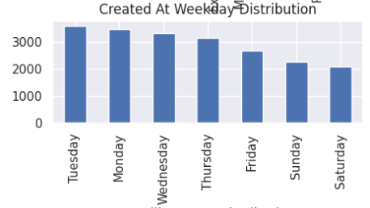
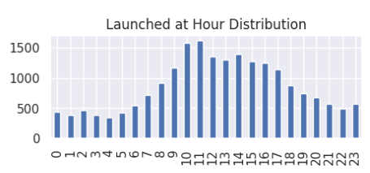
Exploratory Data Analysis
Based on EDA performed on dataset, below are the insights obtained:
Majority of the campaigns had a funding goal not more than $20,000.
The campaign on Tuesday has higher success rates.
Majority of the campaigns failed to reach their funding goals. Target countries with higher success rates such as the US, UK, and Canada.
Most campaigns lasted between 20 and 30 days.
Launch the campaign during the optimal hours between 12 pm and 6 pm UTC to increase the chances of success.

Slide 8
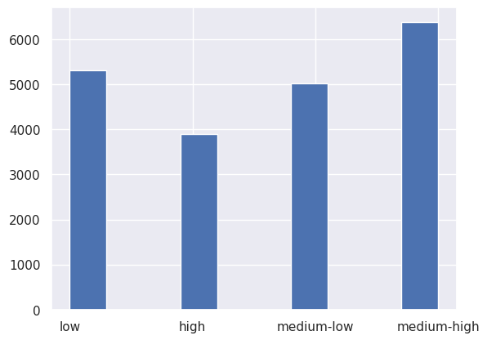
Categorized the funding goals into
four classes
Most projects fell into the low and
medium-high categories.

Slide 9
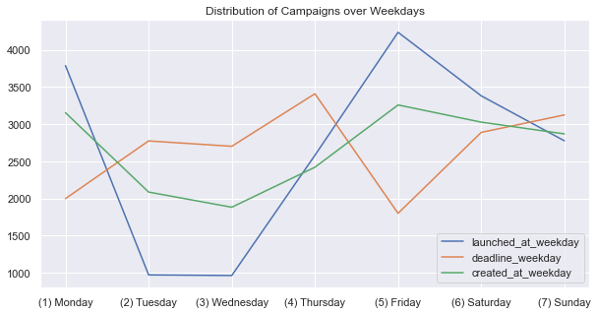
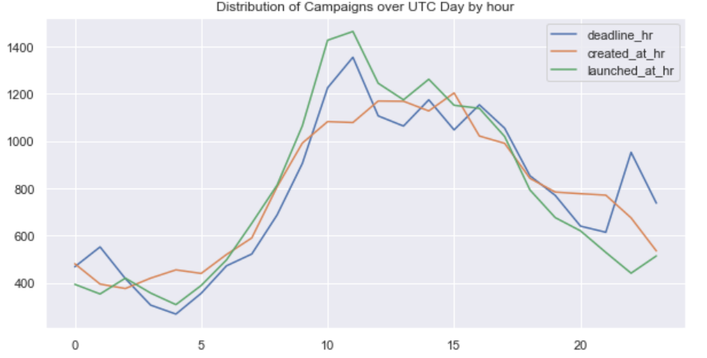

Slide 10
Data Preprocessing
Feature engineering involves preprocessing the Kickstarter dataset by dropping unnecessary columns.
The pipeline creates several binary columns indicating the success of the campaign, whether it was based in the US or UK, whether it was launched on a Tuesday, whether the deadline was on a weekend day, and whether it was based in one of the top 15 countries.
After preprocessing the data, the next step is feature selection to identify the most relevant features for predicting the success or failure of a Kickstarter campaign.
The top 25 features selected by RFE are then used to subset the training and testing sets for model training and evaluation.

Slide 11
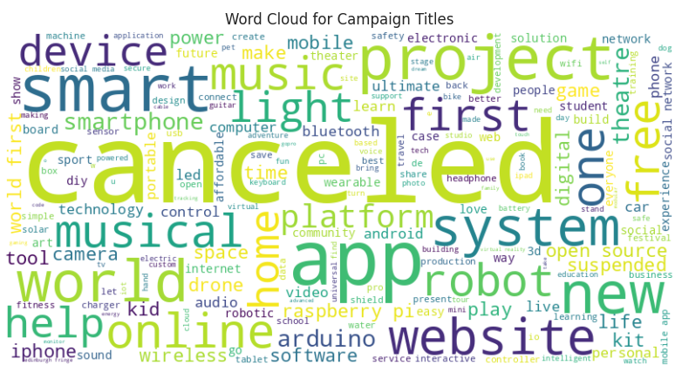
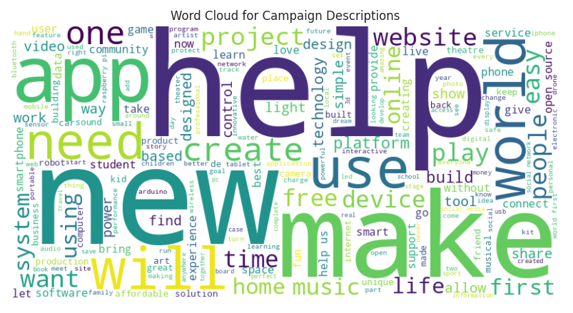
Text Column Analysis
Title Wordcloud
Description Wordcloud

Slide 12
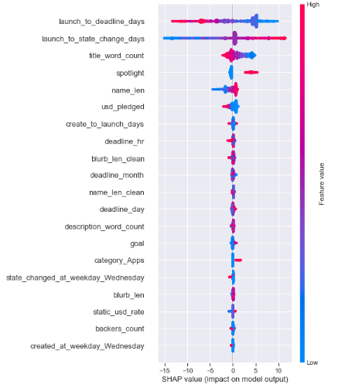
Impact of features on model output using SHAP values.
Launch_to_deadline_days, launch_to_state_change_days, title_wordcount, spotlight etc have larger impact whether startup will be success or not.
Based on plot, we can get few insights such as
Positive impact features based on feature value - launch_to_deadline_days(low), launch_to_state_change_days(high), title word count(low), spotlight(high), usd_pledged(high)
Negative impact features - title word count(high), name_len(low), launch_to_state_change_days(low)
No impact - deadline_month, deadline_day, blurb_len.

Slide 13
Modelling
Initial Modelling:
List of classification algorithms used: Logistic Regression, XGBoost, SVC, Random Forest, Decision Tree, KNN.
Models were trained on the preprocessed data without any feature selection.
Feature Extraction with RFE:
RFE is a feature selection method that recursively removes features and builds models on the remaining features until the desired number of features is reached.
Used Recursive Feature Elimination (RFE) technique to extract the most relevant features from the dataset.
Re-trained the same models on the dataset obtained after feature extraction.
Cross Validation with Hyperparameter Tuning:
Used 5-fold cross-validation to evaluate the performance of each model.
Best hyperparameters identified using GridSearchCV were used for each model during cross-validation.

Slide 14
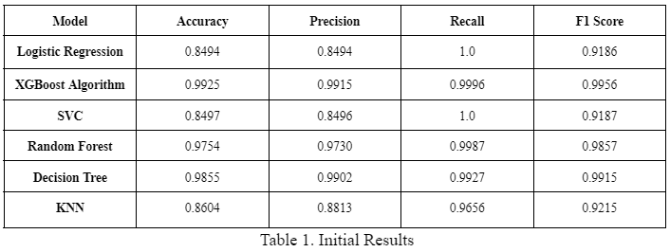
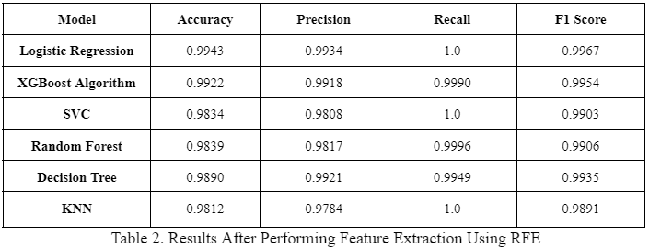
Results
Initial Modelling:
Top performing models are XGBoost (99.25%), Decision Tree (98.55%) and Random Forest (97.54%).
Post RFE:
Top Performing Models are Logistic Regression (99.43%) and XGBoost (99.22%).
Other models increased accuracy from ~85% to ~98%.

Slide 15
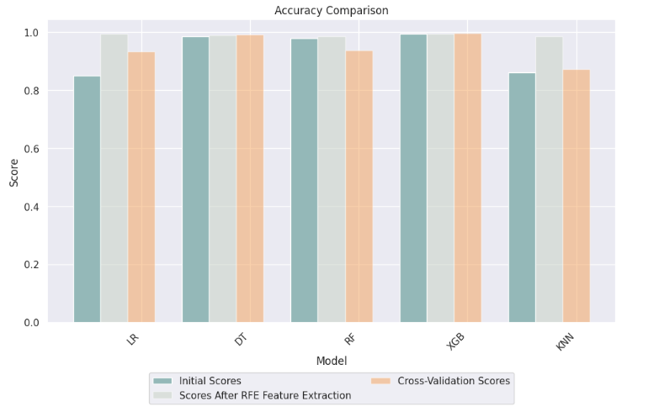
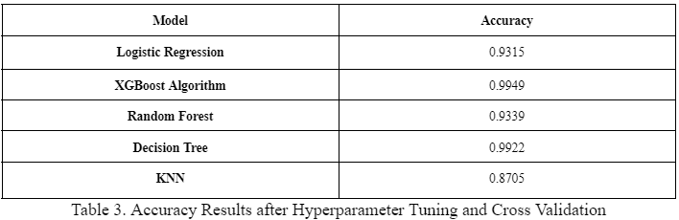
Results Contd.
Post Cross Validation:
XGBoost generated the highest accuracy(99.49%), followed by Decision Tree (99.22%).
Best hyperparameters for XGBoost are ‘learning_rate’: 0.1, ‘max_depth’: 5 and ‘n_estimators’: 500.
Best hyperparameters for Decision Tree are 'max_depth': 5 and 'min_samples_leaf': 10.
Rest of the models performed low than previous results.

Slide 16
Conclusion
The highest accuracy achieved was 99.49% by XGBoost with cross validation and hyperparameter tuning.
Models were fitting well with feature selected data through RFE with accuracies ranging around 98% and 99%.
Few models performed comparatively low in cross validation technique.
It was also analyzed that the cross validation step took longer processing times than the rest modelling techniques.

Slide 17
References
https://github.com/rileypredum/Kickstarter-Campaign-Success-Prediction/blob/master/kickstarter.ipynb
https://towardsdatascience.com/kickstarter-projects-walk-through-simple-data-exploration-in-python-c2302a997789

Slide 18
THANK YOU

