Slide 1
AI Agent for Smart Farming Advice
IBM CAPSTONE PROJECT
Presented By:
Student name : Mohammad Sohail Ali
College Name & Department : Arya College of Engineering – Computer Science & Engineering

Slide 2
OUTLINE
Problem Statement
Technology used
Wow factor
End users
Result
Conclusion
Git-hub Link
Future scope
IBM Certifications
Proposed Solution

Slide 3
Problem Statement
Small-scale farmers in India often lack timely access to reliable agricultural information such as weather forecasts, soil conditions, crop selection guidance, pest control strategies, and current market prices. This lack of localized and actionable knowledge leads to poor decision-making, reduced yields, and financial losses.
Despite the availability of data across various government and agri-tech platforms, farmers struggle to access or understand it due to language barriers, technical complexity, or lack of digital literacy.
“The challenge is to build an AI-powered agent that can understand farmer queries in their local language and provide them with real-time, trusted agricultural advice tailored to their region and context.”

Slide 4
PROPOSED SOLUTION
To address the challenges faced by small-scale farmers in accessing localized and actionable farming information, the proposed solution is an AI-powered agent, FarmFriend, built using IBM Cloud Lite services and enhanced with Retrieval-Augmented Generation (RAG) architecture.
Solution Components:
User Interaction Layer- A multilingual chatbot interface.
Backend Logic (IBM Cloud Functions)- Managing authentication and integration with APIs.
Retriever Module- Searches trusted external sources using APIs and local databases.
Generator Module- Uses a Large Language Model (LLM) such as Granite-3-8b-instruct.
Language Support- Multiple Language Support.
Feedback Loop- The system logs feedback to improve model prompts or retrieval sources over time.

Slide 5
Technology used
AI/ML Models:
Llama-3-3-70b-instruct (WatsonX Agent Lab)
Retrieval-Augmented Generation (RAG) architecture
IBM Cloud Lite Services
Natural Language Processing (NLP):
Watson Natural Language Understanding (NLU)
APIs & Data Sources:
AgriMarket API (for market prices)
Weather API (for real-time weather)

Slide 6
IBM cloud services used
IBM Cloud Agent Lab
Llama-3-3-70b-instruct Model (watsonx Agent Lab)
WatsonX Deployment Space
IBM Cloud Lite Services:
IBM watsonx.ai Studio
IBM watsonx.ai Runtime
IBM Cloud Object Storage

Slide 7
Wow factors
AI-Powered Decision Support: -Delivers smart, contextual farming advice using Granite / LLaMA-3 LLMs.
Multilingual Support: -Farmers can interact in their local language for maximum accessibility.
RAG-Based Intelligence: -Combines real-time data retrieval with AI-generated responses.
Real-Time Agri Insights: -Live weather, mandi prices, pest control tips & crop suggestions.
Built on IBM Cloud Lite: -Fully cloud-native with zero deployment cost using IBM Lite services.
Trusted Government Data: -Uses APIs from IMD, AgriMarket, Soil Health Card, etc.
Interactive UI & Chat Flow: -Visual chatbot interface designed for ease of use and clarity.
Feedback Loop for Accuracy: -Continuously improves via farmer feedback & conversation logs.

Slide 8
End users
Small-Scale & Marginal Farmers
Farmer Producer Organizations (FPOs)
Agricultural Extension Officers
AgriTech Mobile App Developers
Government & NGOs in Agriculture
Agricultural Students & Researchers

Slide 9
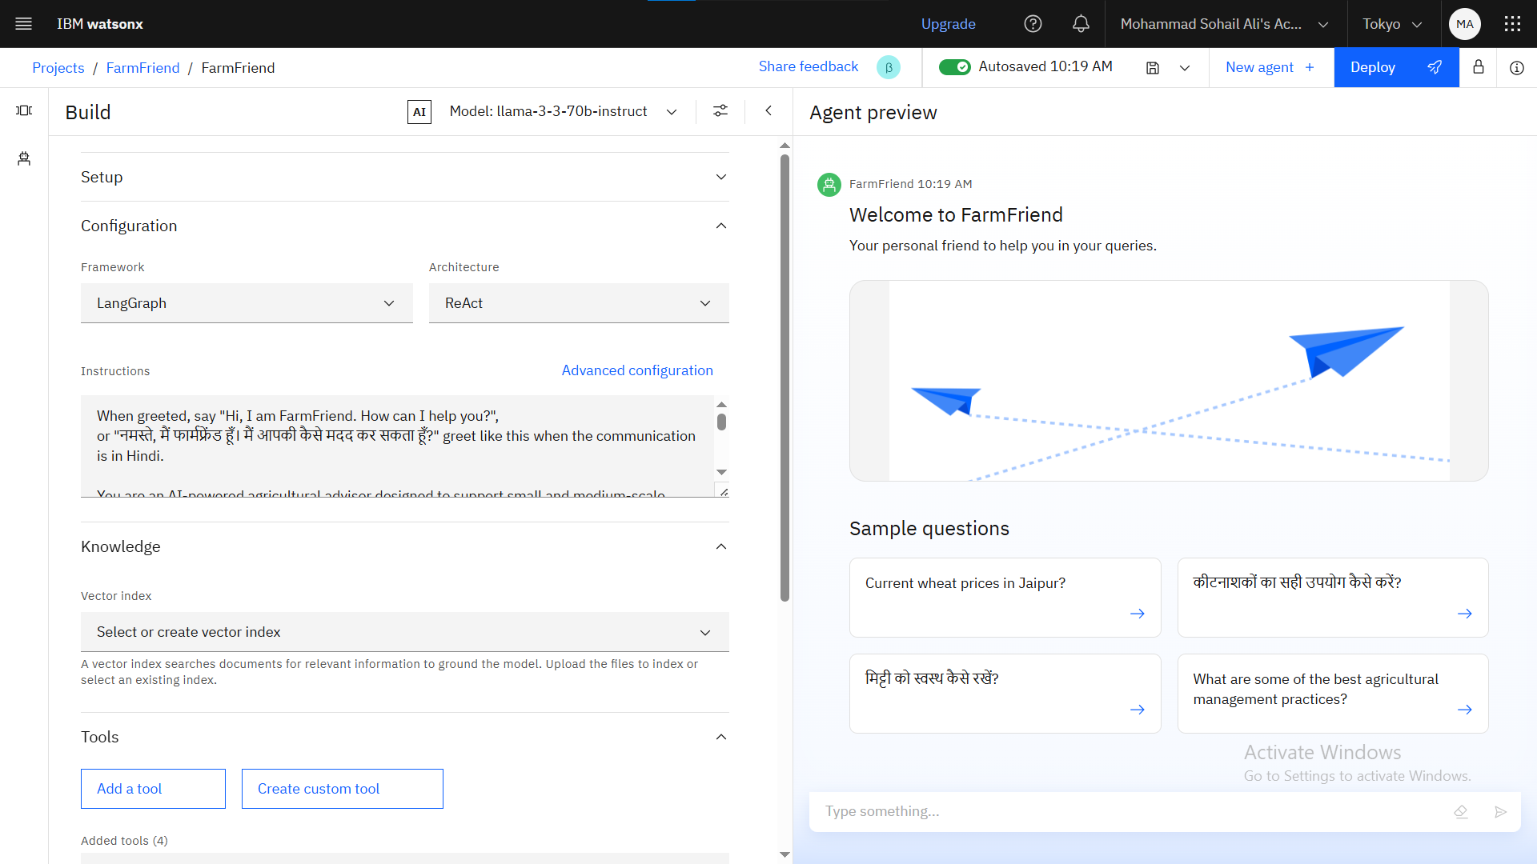
Results

Slide 10
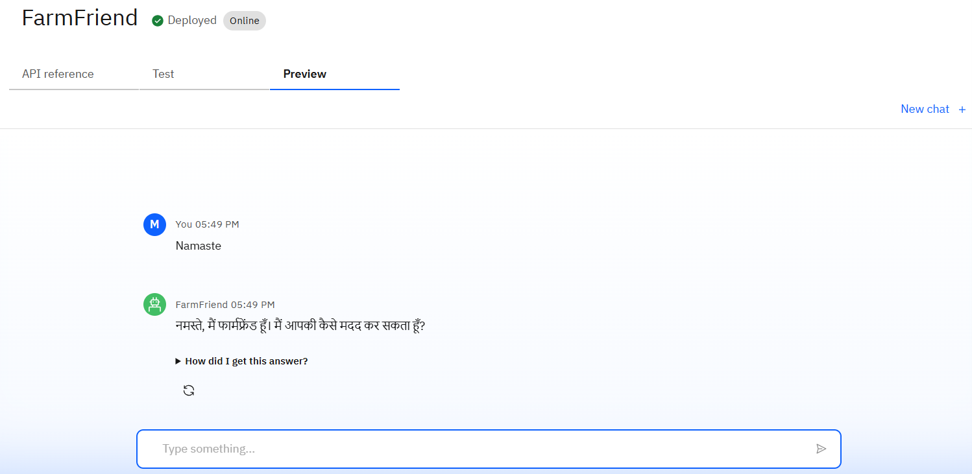
Results

Slide 11
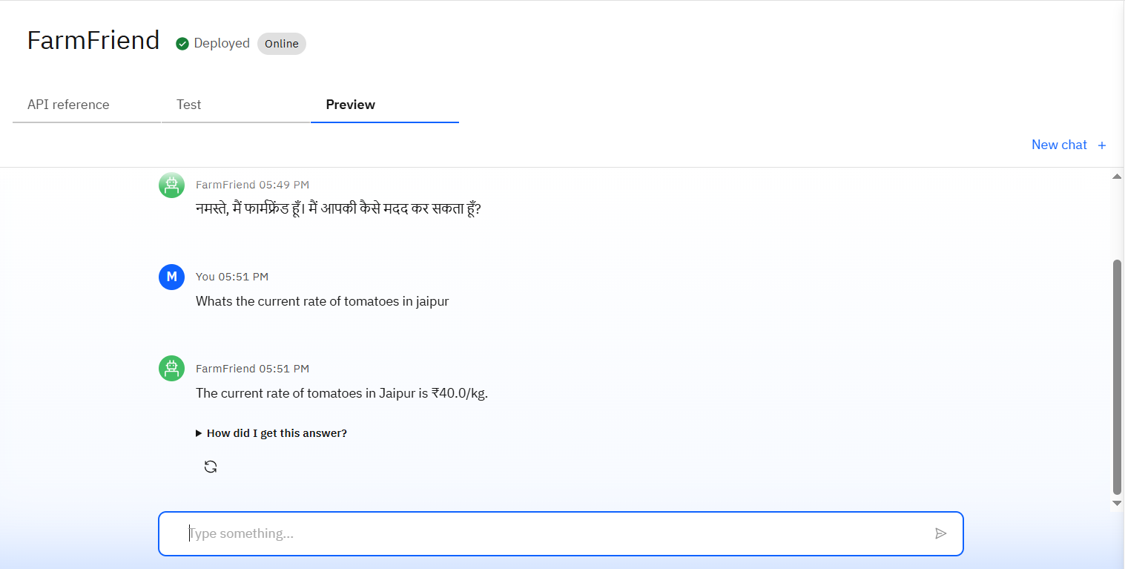
Results

Slide 12
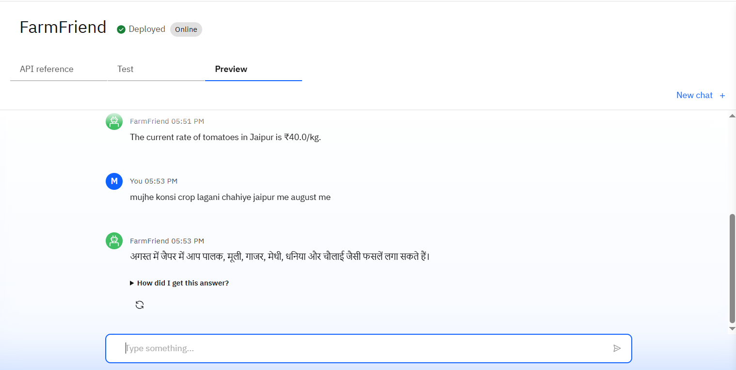
Results

Slide 13
Conclusion
FarmFriend demonstrates how cutting-edge AI, when combined with reliable data and cloud technology, can empower farmers with real-time, personalized agricultural guidance.
By integrating Retrieval-Augmented Generation (RAG), multilingual support, and trusted data sources, the agent bridges the knowledge gap between farmers and modern farming practices.
This solution not only promotes smart farming at the grassroots level but also showcases the power of AI to drive sustainable agriculture and rural innovation.

Slide 14

GitHub Link
https://github.com/MdSohailAli3/FarmFriend-AI-Agent

Slide 15
Future scope
Mobile App Integration: -Launch FarmFriend as a multilingual mobile app for wider rural adoption.
Geo-Aware Recommendations: -Use GPS data to deliver hyper-localized crop, soil, and weather insights.
Visual Recognition Features: -Allow farmers to upload plant/pest images for AI-based diagnosis.
Voice-Based Interaction: -Enable voice input/output for illiterate users or those with limited tech skills.
Personalized Crop Planning: -Recommend entire crop cycles based on land, season, and soil data.
IoT Integration: -Connect with smart sensors for real-time soil moisture, temperature, and irrigation feedback.
Continuous Learning Loop: -Improve model responses over time through user feedback and updated datasets.

Slide 16
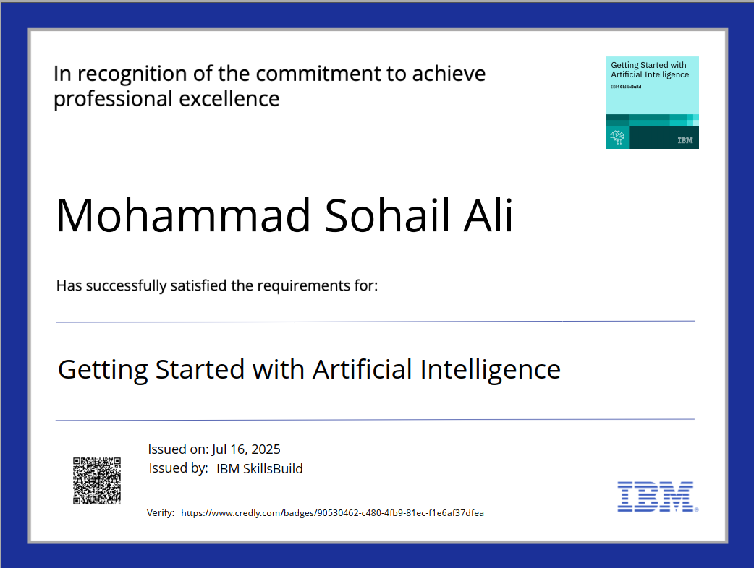
IBM Certifications

Slide 17
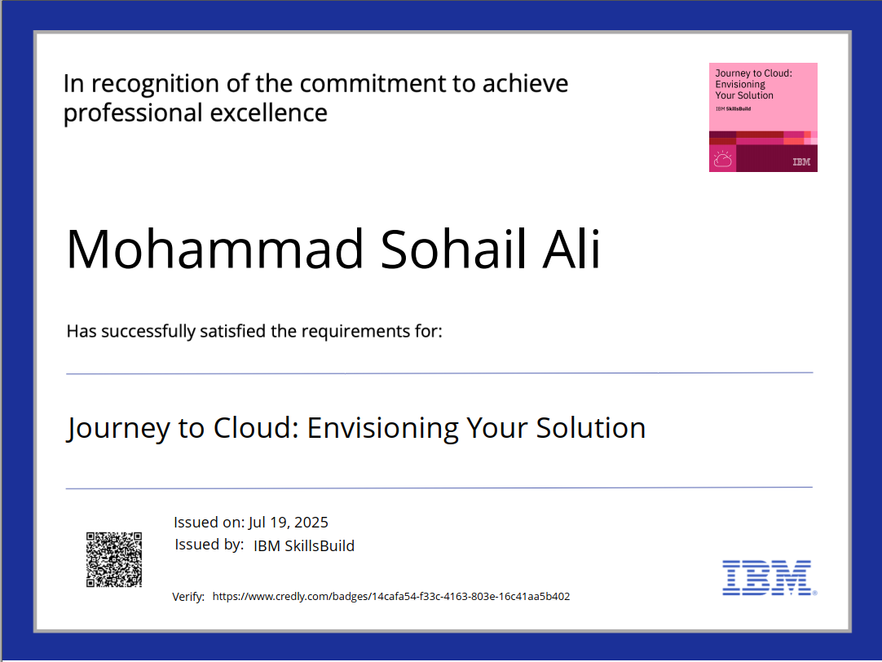
IBM Certifications

Slide 18
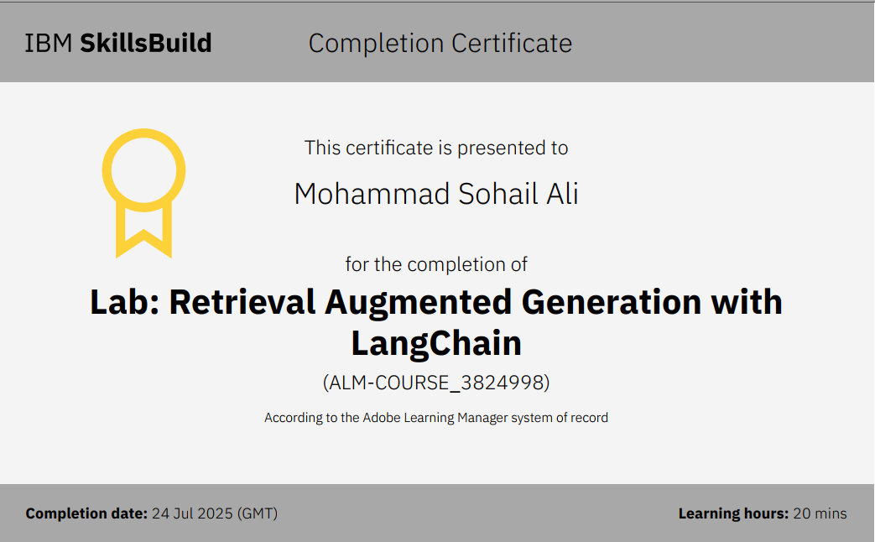
IBM Certifications

Slide 19
THANK YOU

