Slide 1
WINTERNTHON
TITLE PAGE
Problem Statement Title:
“WIN15 ManaTyping – Feel the Rhythm of Real Writing”
Theme - Ethical analysis
Team Name - DevSquad
Team Members - Mohammad Sohail Ali, Tejas Jain, Aaditya Sinha and Chaitra Choudhary

Slide 2
IDEA TITLE
Dev-Squad
Proposed Solution
Detailed explanation of the proposed solution
ManaTyping is a role-based writing platform where students and teachers log in separately; students write in a calm editor while the system tracks typing behavior only during active writing and pauses tracking after 5 seconds of inactivity (thinking mode).
Each writing session is analyzed using keystroke timing and text length changes, and students receive graphical analysis and encouraging feedback, while teachers can view session summaries without accessing written content.
How the Solution Addresses the Problem
The system reduces reliance on shortcuts and distractions by focusing on writing behavior rather than written content, while respecting natural thinking pauses.
By pausing tracking during inactivity and resuming only when typing continues, the analysis reflects genuine effort and avoids misinterpreting thoughtful pauses as disengagement.
Innovation and uniqueness of the solution
Introduces an automatic thinking mode that pauses tracking after inactivity, making behavior analysis more accurate and ethically sound.
Combines privacy-safe keystroke dynamics with role-based dashboards and graphical feedback to support learning without content surveillance.

Slide 3
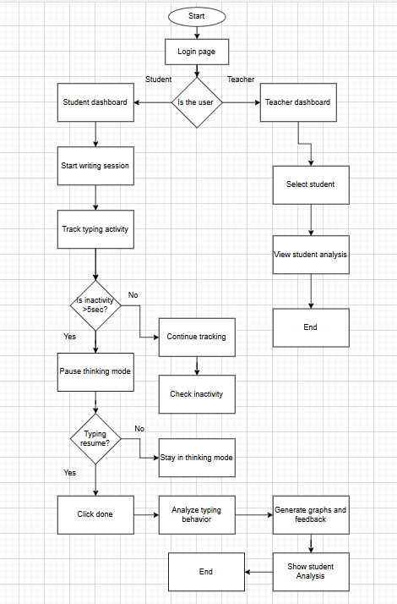
TECHNICAL APPROACH
Dev-Squad
Technologies to be used
Frontend: React.js for building a writing interface and dashboards for students and teachers.
Backend & Database: Node.js with Express.js and mongodb
Methodology and process for implementation
What the System Analyzes After Writing
Active typing time and thinking time (pauses > 5 seconds)
Typing continuity and writing rhythm
Sudden text insertion events (copy–paste detection)
Metrics Computed by the System
Total session duration, Number and duration of thinking pauses, Length of continuous typing bursts, Consistency of typing over time, Count of sudden text insertions
Graphical Analysis Shown to Students
Writing activity timeline (typing vs thinking)
Typing continuity graph showing flow and interruptions
Session summary chart comparing active writing time and thinking time
Constructive Feedback Provided
Feedback is supportive and non-judgmental
Highlights mixed or disrupted writing patterns when detected

Slide 4
FEASIBILITY AND VIABILITY
Dev-Squad
Analysis of the feasibility of the idea
Feasible using the MERN stack with simple keystroke tracking and rule-based analysis.
Privacy-first design makes it suitable for academic use.
Potential challenges and risks
Possible misinterpretation of typing behavior.
Gaining student trust may be challenging if users misunderstand how typing data is collected and analyzed.
Strategies for overcoming these challenges
Adaptive typing thresholds, session-based opt-in design, and transparent privacy-first communication.

Slide 5
IMPACT AND BENEFITS
Dev-Squad
Potential impact on the target audience
Encourages genuine writing habits by supporting focus and reflection without monitoring written content.
Helps teachers understand student engagement through privacy-safe behavioral insights.
Benefits of the solution
Social: Reduces writing anxiety and promotes ethical, inclusive learning.
Economic & Environmental: Low-cost web solution with minimal resources, reducing reliance on paper and expensive tools.

Slide 6
RESEARCH AND REFERENCES
Dev-Squad
Research:
Writing & Cognition:
Educational psychology shows that writing pauses often reflect thinking, planning, and reflection, not disengagement.
Keystroke Dynamics:
Typing rhythm and inter-key timing can indicate effort and authenticity without analyzing content.
References:
Flower, L., & Hayes, J. (1981)
A Cognitive Process Theory of Writing — Writing pauses and planning behavior

