Slide 1
Presentation On
AUTHENTICATION

Slide 2

Presented To
Falguni Roy
Assistant Professor
Institute of Information Technology
Noakhali Science and Technology University

Slide 3
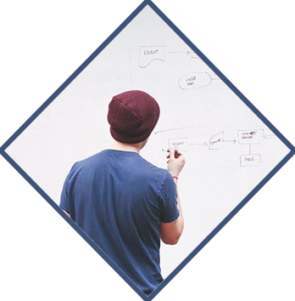


Presented By
Roichuddin Rana
Roll: ASH1925003M
Institute of Information Technology
Noakhali Science & Technology University
Md. Redwan Hossain Polash
Roll: ASH1925007M
Institute of Information Technology
Noakhali Science & Technology University

Slide 4
Topic Outlines
Introduction
Passwords
Biometrics
Conclusion

Slide 5

What is Authentication???

Slide 6
Authentication is the process of verifying the identity of a person or device.
A common example is entering a username and password when we log in to a website.

Slide 7
Authentication Method
Password-based authentication
Single-Factor/Primary Authentication
Two-Factor Authentication (2FA)
Multi-factor authentication
Certificate-based authentication
Biometric authentication
Token-based authentication

Slide 8



PASSWORDS

Slide 9


A password is a string of characters used to verify the identity of a user during the authentication process.

Slide 10
Keys VS Passwords
A key is data that is used to lock and unlock cryptographic functions such as encryption, authentication and authorization. A password is a user created secret phrase.
Keys are created by algorithm that are designed to make them difficult to understand.On the other hand, passwords are created by user.
Suppose, key is 64 bits, then 2⁶⁴ possible keys. Choose key at random,Then attacker must try about 2⁶³ keys. Suppose, passwords are 8 characters, and 256 different choices for 1 character Then 256⁸ = 2⁶⁴ passwords. Users do not select passwords at random. Attacker has far less than 2⁶³ passwords to try (dictionary attack).

Slide 11
Choosing Passwords
Bad passwords
frank
Fido
password
4444
Pikachu
102560
AustinStamp
Good Passwords
jfIej,43j-EmmL+y
09864376537263
P0kem0N
FSa7Yago
0nceuP0nAt1m8
PokeGCTall150

Slide 12
Attacking Systems via Passwords
Phishing
Man-in-the-middle attack
Brute force attack
Dictionary attack
Credential stuffing
Keyloggers
Attacker could
Target one particular account
Target any account on system
Target any account on any system
Attempt denial of service (DoS) attack
Common attack path
Outsider → normal user → administrator
May only require one weak password!

Slide 13

Password Verification
Way to verify passwords
Store passwords in a file
Store passwords in a file after hashing
Store passwords in a file after salt hashing
Bad idea to store passwords in a file

Slide 14
Math of Password Cracking
Assumptions
Pwds are 8 chars, 128 choices per character
Then 128⁸ = 2⁵⁶ possible passwords
There is a password file with 2¹⁰ hashed passwordds
Attacker has dictionary of 2²⁰ common passwords (hashed)
For experience, Probability of 1/4 that a pwd is in dictionary
Work is measured by number of hashes
Comparisons are free

Slide 15
Case I
Attacker want to find Alice’s password without using the dictionary
Case II
Attacker want to find Alice’s password using the dictionary
Case III
Attacker want to find any one password in the hashed password file without using the dictionary

Slide 16
Case I: password without dictionary
Must try 2⁵⁶/2 = 2⁵⁵ on average
Just like exhaustive key search
Case II: password with dictionary
Expected work is about
1/4 (2¹⁹) + 3/4 (2⁵⁵) ≈ 2^{54.6}
But in practice, try all in dictionary and quit if not found ⎯ work is at most 2²⁰ and probability of success is ¼
Case III: Attack any of 1024(2¹⁰) passwords in file without dictionary
Assume all 2¹⁰ passwords are distinct
Need 2⁵⁵ comparisons before expect to find password
If no salt, each hash computation gives 2¹⁰ comparisons ⇒ the expected work (number of hashes) is 2⁵⁵/2¹⁰ = 2⁴⁵
If salt is used, expected work is 2⁵⁵ since each comparison requires a new hash computation

Slide 17



BIOMETRICS

Slide 18
You are your key
Schneier

Slide 19
Why Biometrics?
Biometrics seen as desirable replacement for passwords
Cheap and reliable biometrics needed
Today, a very active area of research
Biometrics are used in security today
Thumbprint mouse
Palm print for secure entry
Fingerprint to unlock car door, etc.
Examples
Fingerprint
Handwritten signature
Facial recognition
Speech recognition
Gait (walking) recognition
“Digital doggie” (odor recognition)
Many more!

Slide 20
THE DARK SIDE
Social acceptance: Perceived as invasive;
People liked facial scans less as fingerprints as a substitute for a PIN in ATM.
Easy to forge:
Biometric measurements are easy to forge.
It's easy to steal a biometric after the measurement is taken.
Impossible to revoke:
It can not be revoked…Once someone steals your biometric, it remains stolen for life.
Privacy issues:
Biometrics are personal

Slide 21
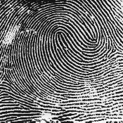
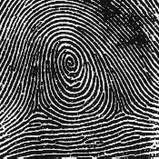
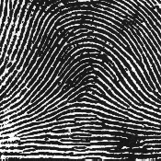
Fingerprints
Three types of fingerprints
The three types of fingerprints are Whorls, loops, and arches
The most common one was the loops with sixty to sixty five percent
Whirls is the next common fingerprint with thirty to thirty five percent.
The least common would be arches or ridges with five percent.
Loop (double)
Whorl
Arch

Slide 22
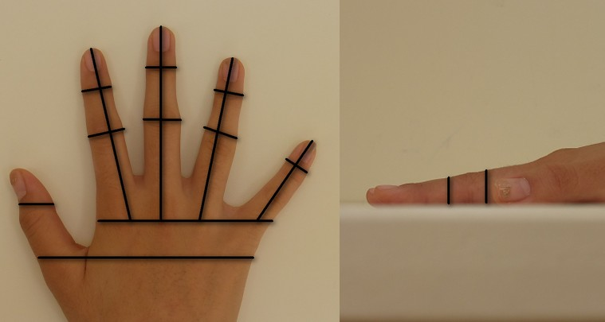
Hand geometry
Popular form of biometric
Measures shape of hand
Width of hand, fingers
Length of fingers, etc.
Human hands not unique
Hand geometry sufficient for many situations
Suitable for authentication

Slide 23
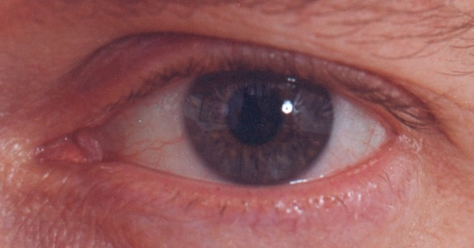
Iris Scan
Scanner locates iris
Take black/white photo
Use polar coordinates
The image is processed using 2-D wavelet transform
Get 256(2048bits) byte iris code

Slide 24
Biometric Error Rates
Equal error rate (EER):
fraud rate == insult rate
Fingerprint bio has EER of about 5%
Hand geometry has EER of about 10⁻³
Iris scan has EER of about 10⁻⁶
But in practice, hard to achieve
Enrollment phase must be extremely accurate
In practice, most biometrics much worse than fingerprint!

Slide 25
Smart Card
Smartcards can be used for authentication based on “something you have”
Examples include
Car key
Laptop computer
Or specific MAC address
Password generator
We’ll look at this next
ATM card, smartcard, etc.

Slide 26
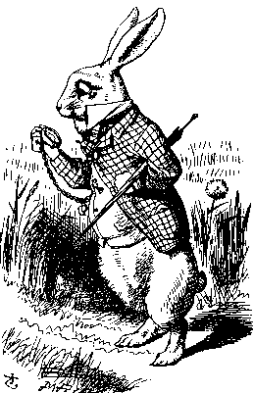
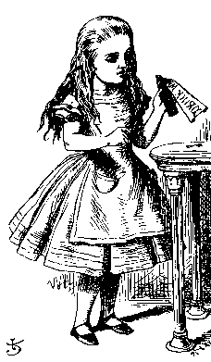
Password Generator
1. “I’m Alice”
3. PIN, R
2. R
4. F(R)
5. F(R)
Alice
Bob
Alice gets “challenge” R from Bob
Alice enters R into password generator
Alice sends “response” back to Bob
Alice has pwd generator and knows PIN
26

Slide 27
2-factor Authentication
Requires 2 out of 3 of
Something you know
Something you have
Something you are
Examples
ATM: Card and PIN
Credit card: Card and signature
Password generator: Device and PIN
Smartcard with password/PIN

Slide 28
Web Cookies
Cookie is provided by a Website and stored on user’s machine
Cookie indexes a database at Website
Cookies maintain state across sessions
Web uses a stateless protocol: HTTP
Cookies also maintain state within a session
Like a single sign-on for a website
Though a very weak form of authentication
Cookies and privacy concerns

Slide 29



