Slide 1
Microprocessor Interfacing and Embedded System
Course Number: CSE331/EEE332/EEE453 Section 8 & 9
Prerequisites: CSE 332, Computer Organization & Architecture
Dr. Dihan Md. Nurudddin Hasan (dmh)
Room Number: SAC 1046B
Office Number: TBA, Ext: TBA
Email: dihan.hasan@northsouth.edu
Office Hours: Please click the appointment calendar (strictly by online appointment)

Slide 2
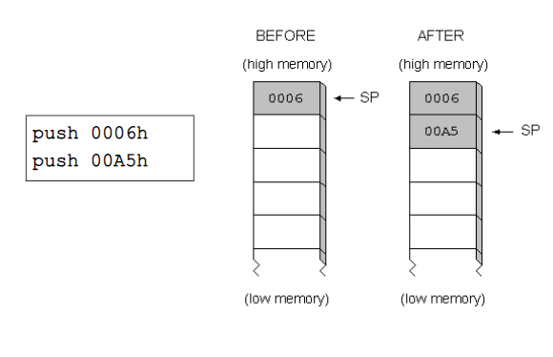
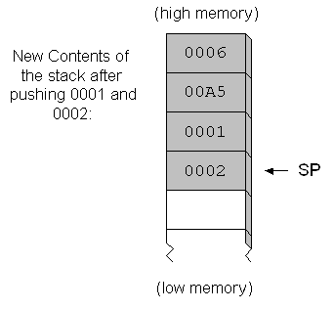
PUSH POP operation
−
Stack segment
Stack segment

Slide 3
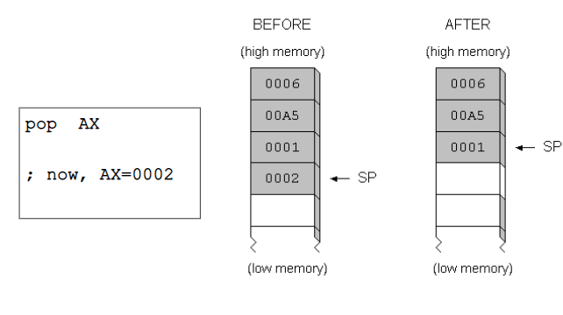
PUSH POP operation
−
Stack segment

Slide 4
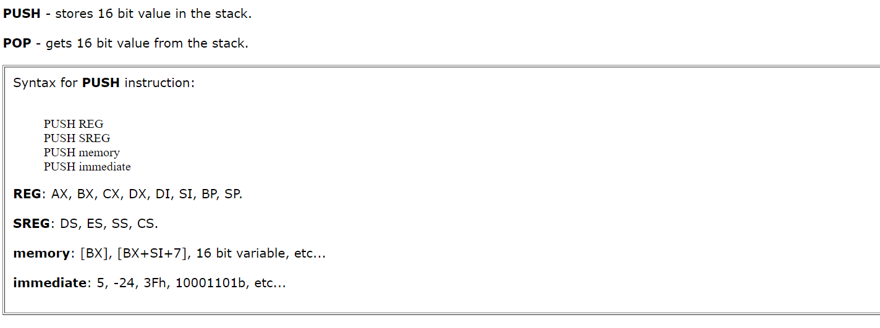
PUSH POP operation
−

Slide 5
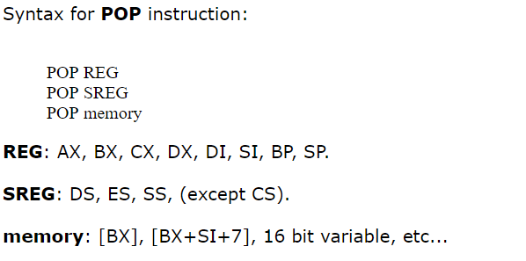
PUSH POP operation
−

Slide 6
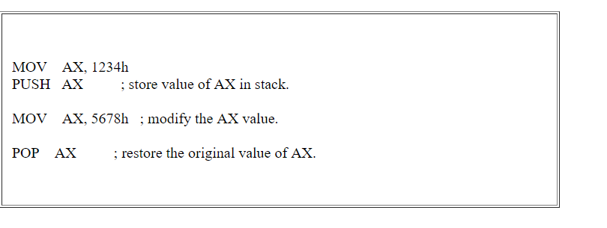
PUSH POP operation
Example
−

Slide 7
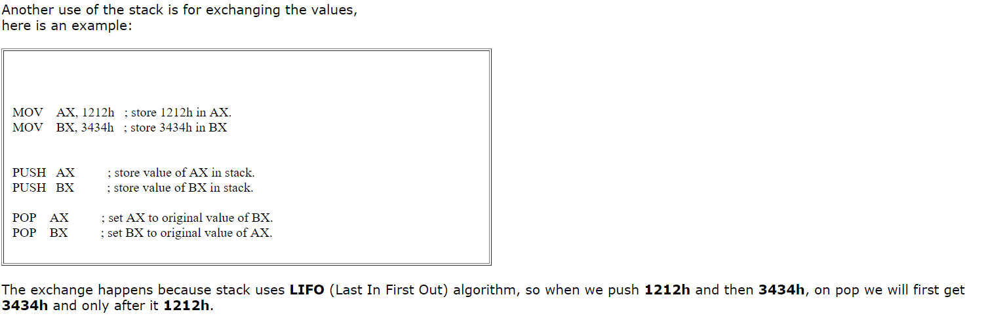
PUSH POP operation
Example : Swapping value : Last in fast out or fast in fast out ?
−

