Slide 1
Amazon brand products within the E-commerce domain
Capstone Project
MOHAMMD UMAR FAROOQUI

Slide 2
Abstract
This project delves into sentiment analysis of over 34,000 Amazon customer reviews, classifying them into positive, negative, and neutral sentiments. By addressing challenges like class imbalance and leveraging both traditional and advanced machine learning techniques, the project builds a high-performance sentiment analysis model. Key highlights include:
Data Insights: Analyzing review patterns and sentiment trends to uncover actionable insights.
Text Representation: Transforming customer reviews into numerical features using TF-IDF for better model interpretation.
Balancing Sentiment Classes: Employing oversampling and under-sampling methods to mitigate class distribution disparities.
Model Optimization: Fine-tuning models with Grid Search and Cross-Validation to enhance accuracy.
Latent Topic Discovery: Using LDA and NMF algorithms for topic modeling to identify hidden themes in reviews.
The project integrates classifiers like Naive Bayes, Support Vector Machines (SVM), and advanced methods such as LSTM networks and ensemble models like XGBoost. Evaluation metrics, including precision, recall, F1-score, and AUC-ROC, demonstrated significant improvements in sentiment classification accuracy. This analysis underscores the value of sentiment modeling in refining customer feedback analysis and shaping data-driven e-commerce strategies.

Slide 3
Content
1. Introduction
2. Objectives
3. Methods
4. Results
5. Conclusions

Slide 4
Chapter
01

Slide 5
1. Introduction
In the era of e-commerce, customer reviews are a goldmine of insights, influencing purchasing decisions and product development. This project harnesses natural language processing (NLP) to analyze over 34,000 Amazon product reviews, automating the extraction of meaningful insights. The project focuses on two key objectives: sentiment analysis and topic modeling. Sentiment analysis categorizes reviews as positive, negative, or neutral, utilizing machine learning models like Naive Bayes and Support Vector Machines (SVM), alongside deep learning approaches such as Long Short-Term Memory (LSTM) networks. Topic modeling, using techniques like Latent Dirichlet Allocation (LDA) and Non-Negative Matrix Factorization (NMF), uncovers hidden themes and discussion points within the reviews. By automating the analysis, this project eliminates manual effort and bias, providing actionable insights to enhance customer understanding and e-commerce strategies.

Slide 6
Chapter
02

Slide 7
2. Objectives:
The primary objectives of this project are as follows:
Understand Sentiment in Customer Reviews: Analyze over 34,000 Amazon product reviews to classify sentiments into three categories: positive, negative, and neutral. Extract insights about customer satisfaction and dissatisfaction.
2. Address Class Imbalance: Handle the issue of class imbalance in sentiment categories using techniques such as oversampling and under-sampling to ensure fair representation of all classes.
3. Implement Effective Classifiers: Evaluate and compare various machine learning algorithms, including Naive Bayes, Support Vector Machines (SVM), and deep learning models like Long Short-Term Memory (LSTM) networks for sentiment classification.

Slide 8
4. Enhance Predictive Power through Feature Engineering: Perform feature engineering, including the computation of Term Frequency-Inverse Document Frequency (Tf-Idf) scores and the creation of sentiment score features to improve model accuracy.
5. Evaluate Model Performance: Use metrics such as precision, recall, F1-score, and AUC-ROC to measure model performance, emphasizing the F1-score for balanced evaluation in the presence of class imbalance.
6. Leverage Ensemble Techniques: Explore ensemble methods, such as XGBoost and combinations with multinomial Naive Bayes, to boost overall model performance and mitigate class imbalance.
7. Incorporate Topic Modeling: Apply techniques such as Latent Dirichlet Allocation (LDA) and Non-Negative Matrix Factorization (NMF) to identify latent topics in reviews and group them into meaningful clusters.

Slide 9
8. Compare Traditional and Advanced Models: Contrast the performance of traditional machine learning models with advanced deep learning approaches, such as LSTM, to determine the most effective model for sentiment analysis
9. Optimize Model Parameters: Use optimization techniques, including Grid Search, Random Search, and Cross-Validation, to fine-tune parameters for improved model performance.
10. Generate Actionable Insights: Provide actionable insights for e-commerce businesses by identifying customer preferences, concerns, and satisfaction levels, thereby enabling data-driven decision-making and targeted marketing strategies.

Slide 10
Chapter
03

Slide 11
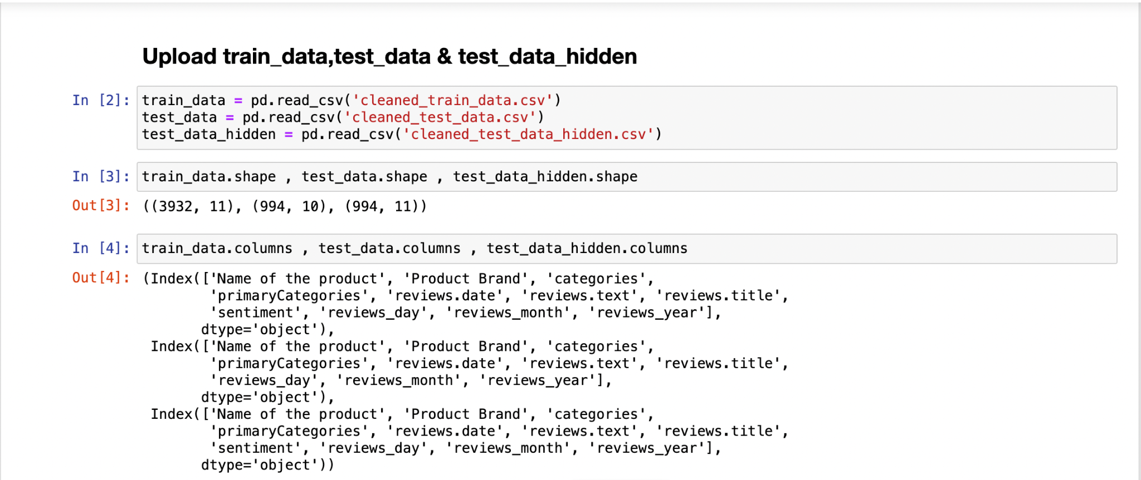
3. Methods
(i). Data Collection and Preprocessing:
* Dataset Overview: The dataset comprises over 34,000 Amazon product reviews, with attributes such as product name, brand, category, review text, review title, and sentiment labels (positive, negative, neutral).

Slide 12
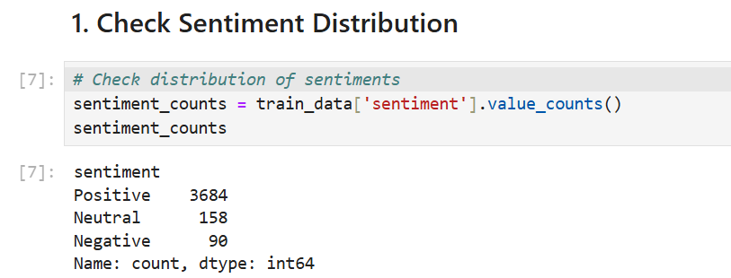
* Preprocessing Steps:
1. Convert text to lowercase for uniformity.
2. Remove special characters, punctuation, and stopwords.
3. Tokenize review text into individual words.
4. Apply stemming and lemmatization to standardize word forms.
(ii). Exploratory Data Analysis (EDA)
* Visualized the distribution of sentiment categories.

Slide 13
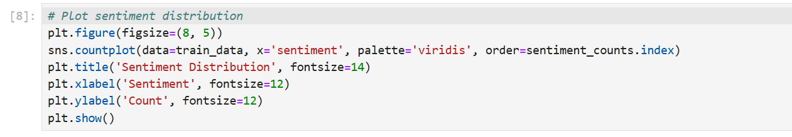
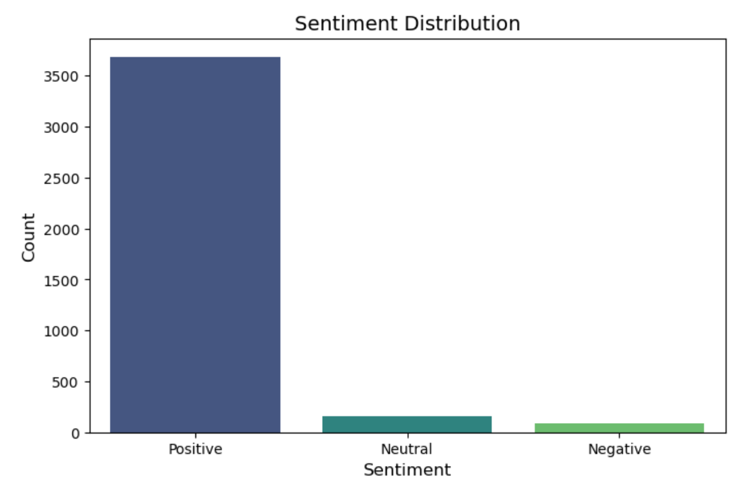

Slide 14
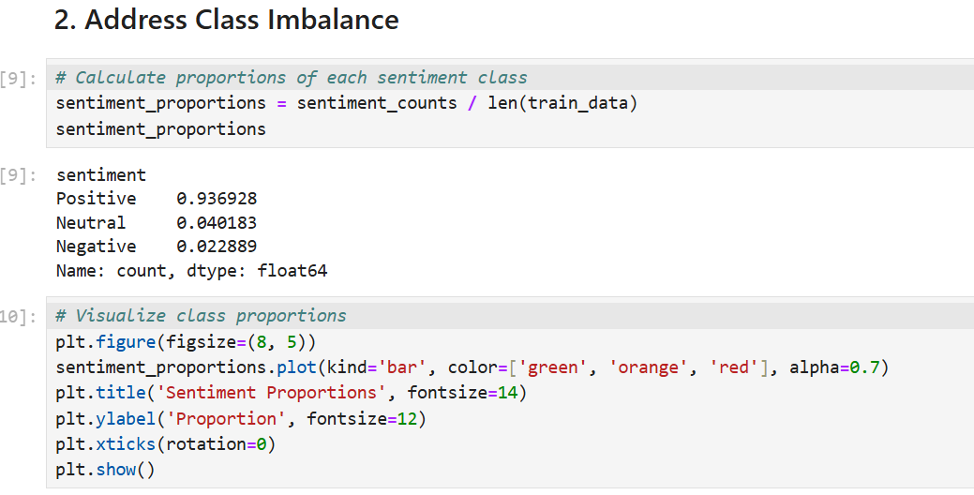
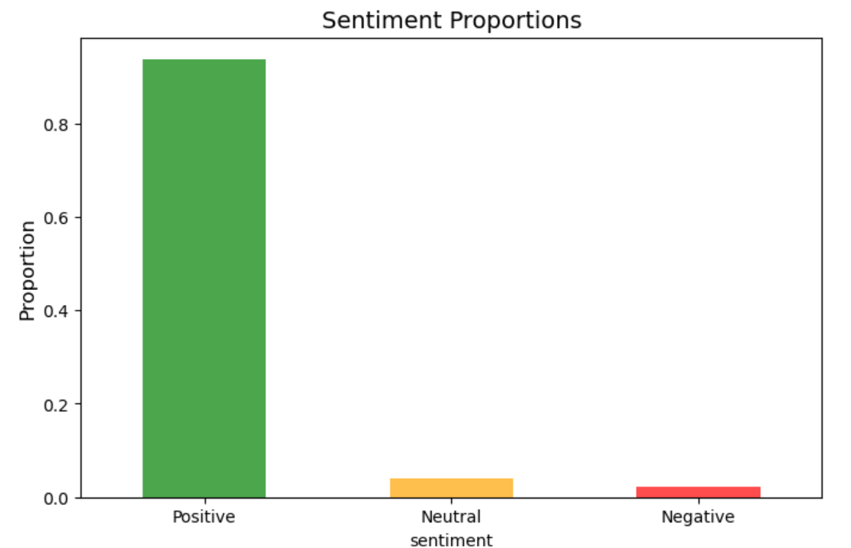
* Identified class imbalance issues and trends in the data.

Slide 15
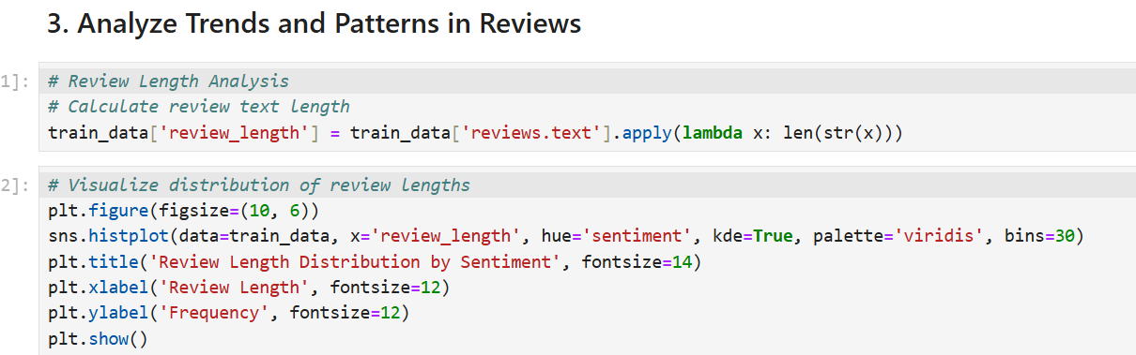
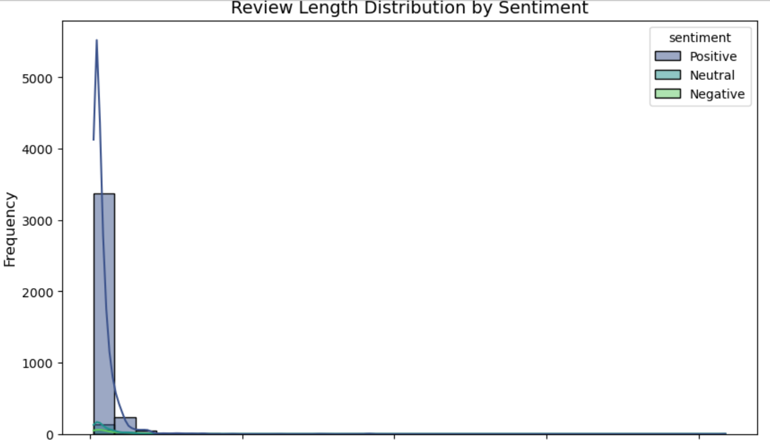
* Examined review patterns across product categories and brands.

Slide 16
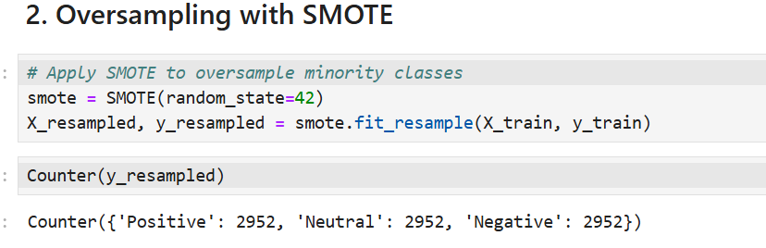
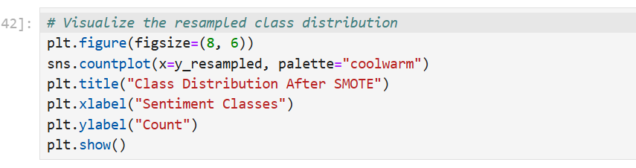
(iii). Class Imbalance Handling:
* Applied oversampling (e.g., SMOTE) and under-sampling techniques.

Slide 17
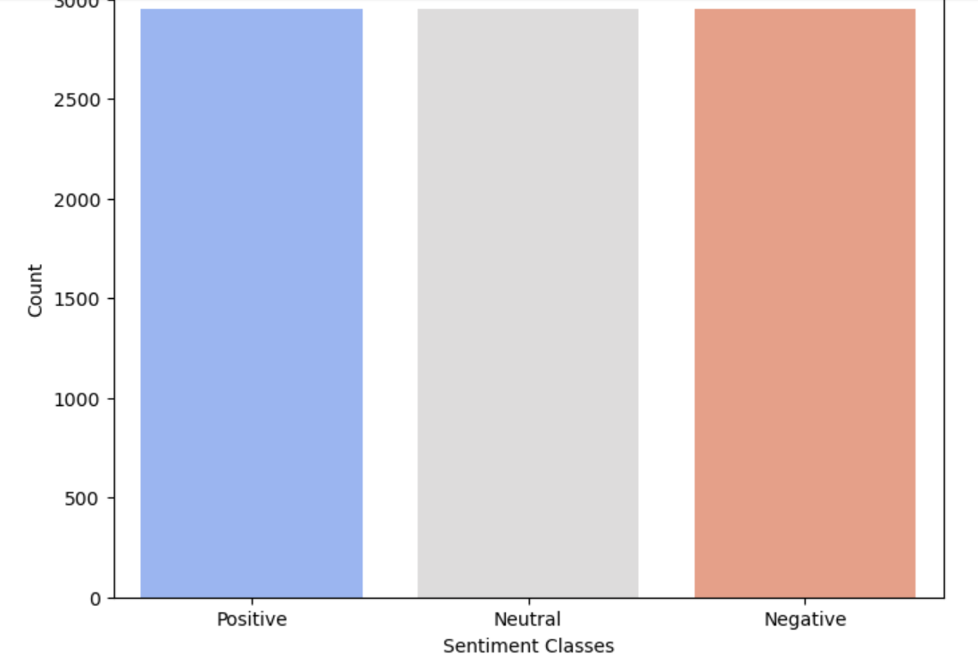
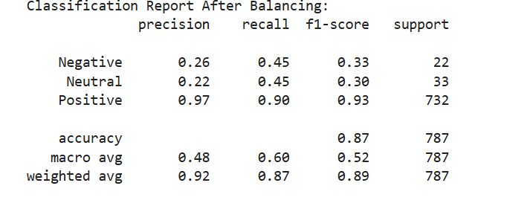
* Balanced the dataset to improve model performance for minority classes.

Slide 18
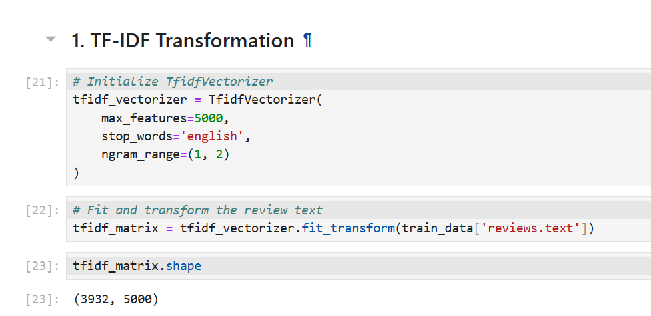
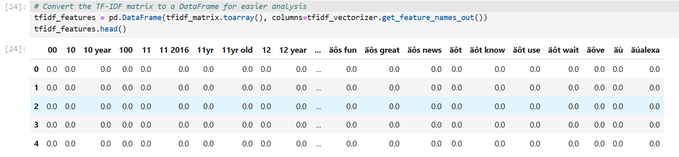
(iv). Feature Engineering:
* Transformed review text into numerical features using TF-IDF Vectorization.

Slide 19
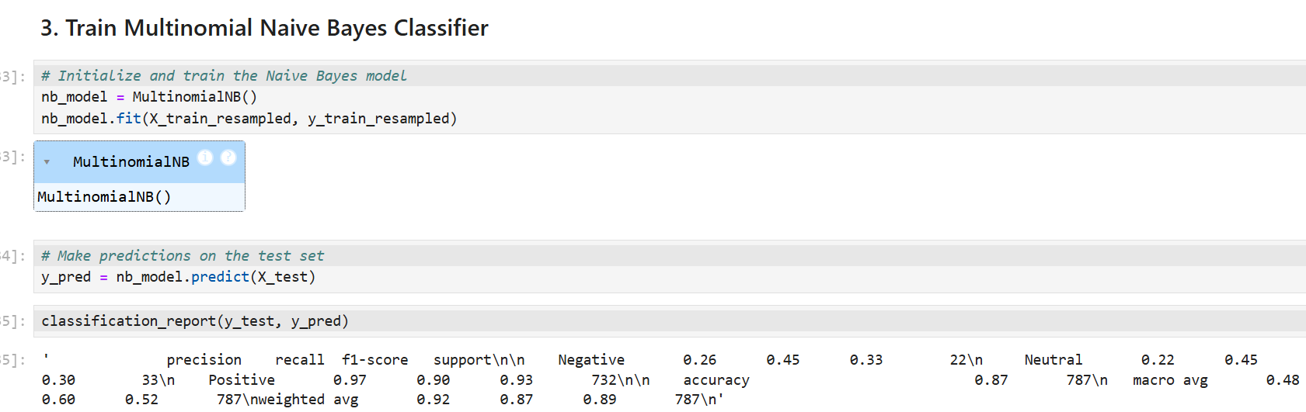
(v). Model Implementation:
* Baseline Model: Implemented Multinomial Naive Bayes as a starting classifier.

Slide 20
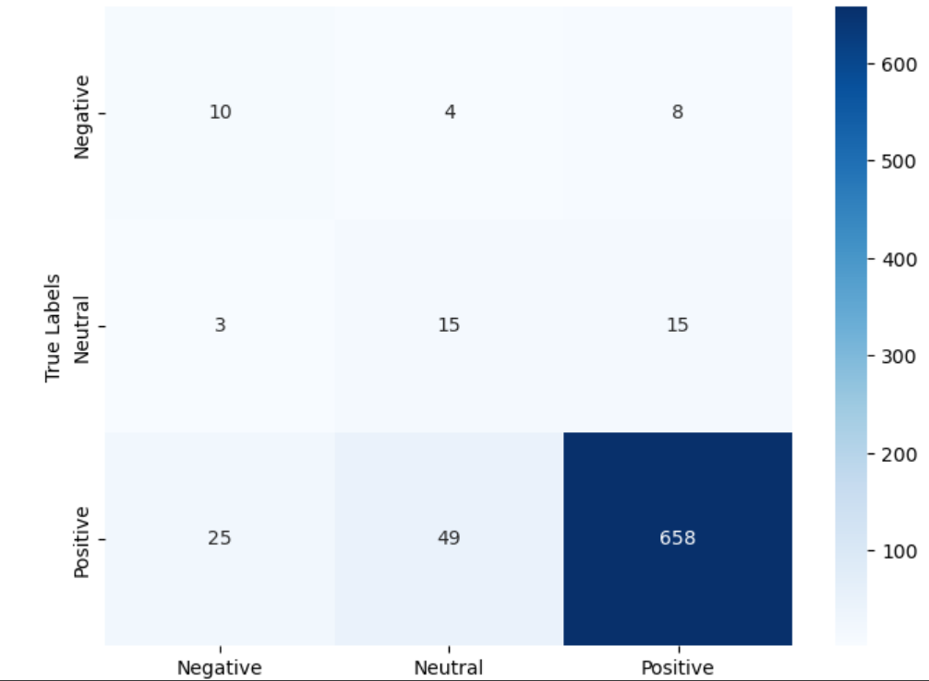
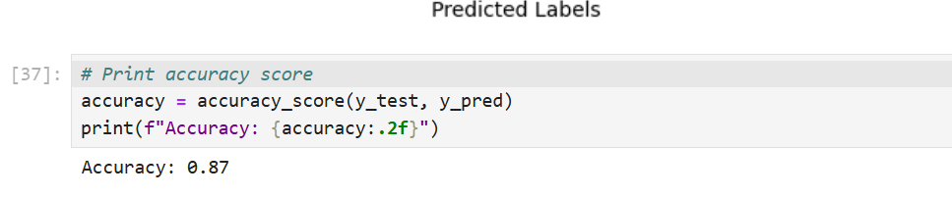

Slide 21
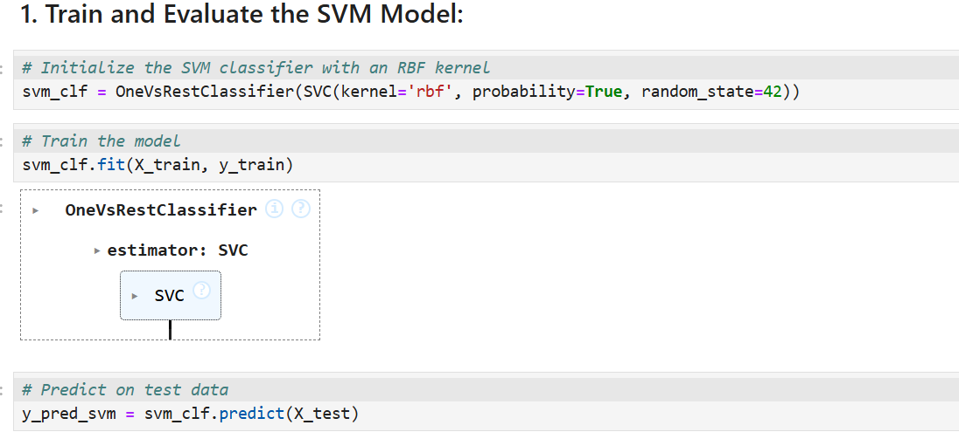
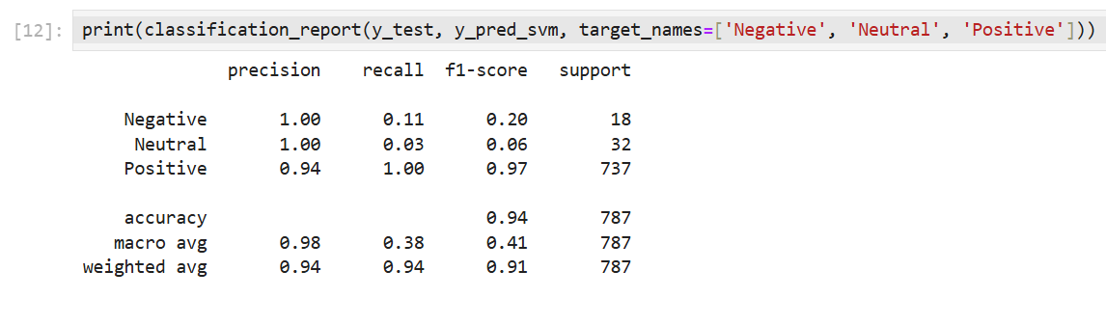
* Multi-class Support Vector Machines (SVM):

Slide 22
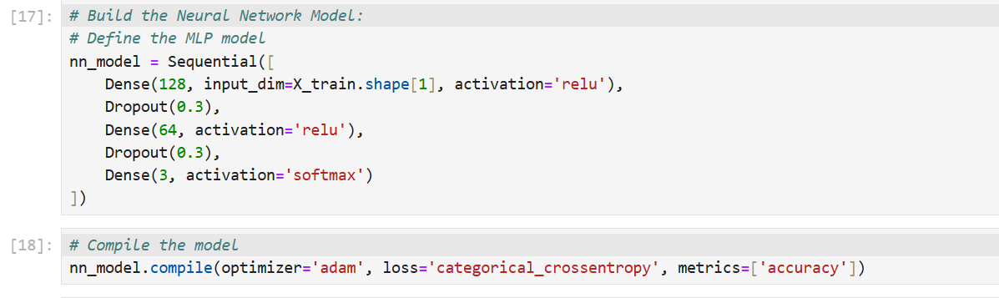
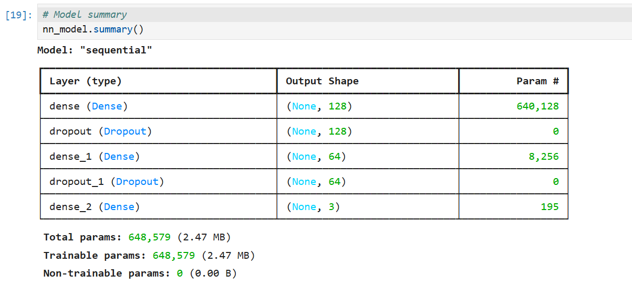
* Long Short-Term Memory Networks (LSTM):

Slide 23
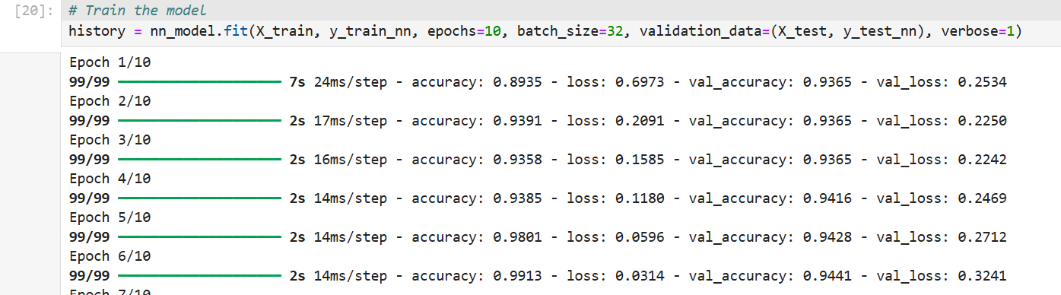
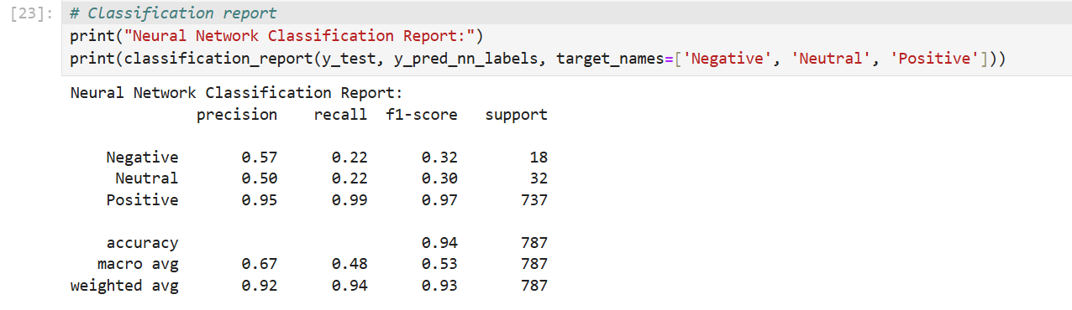

Slide 24
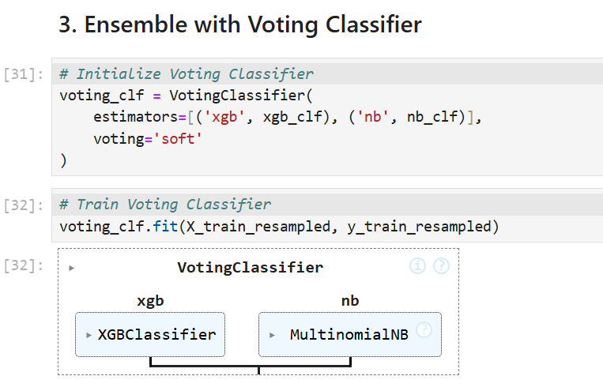
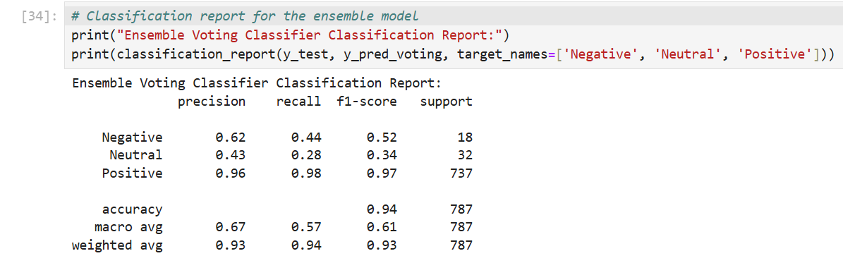
* Explored ensemble methods like XGBoost combined with oversampling:

Slide 25
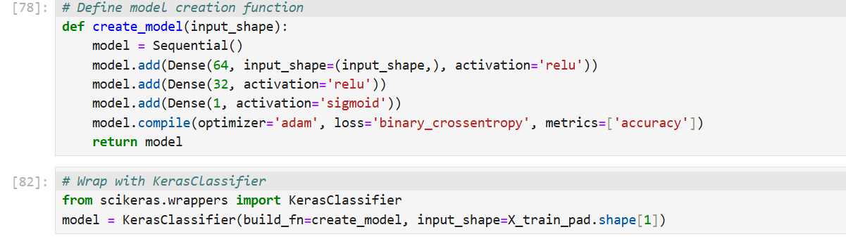
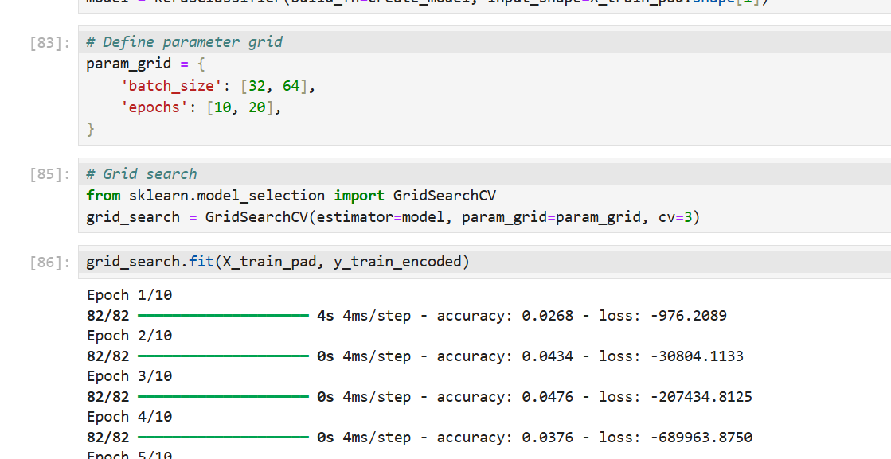
(vi). Optimization Techniques:
* Tuned hyperparameters using Grid Search, Random Search, and Cross-Validation.

Slide 26
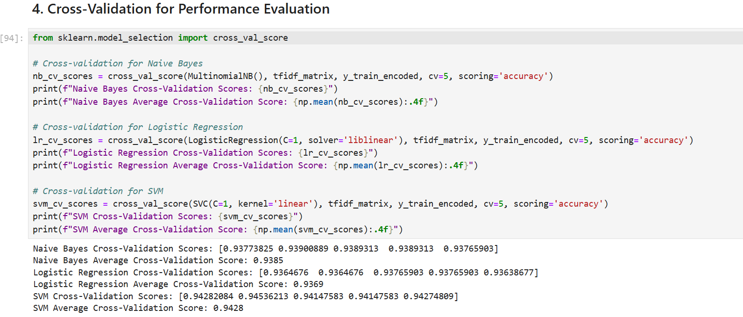

Slide 27
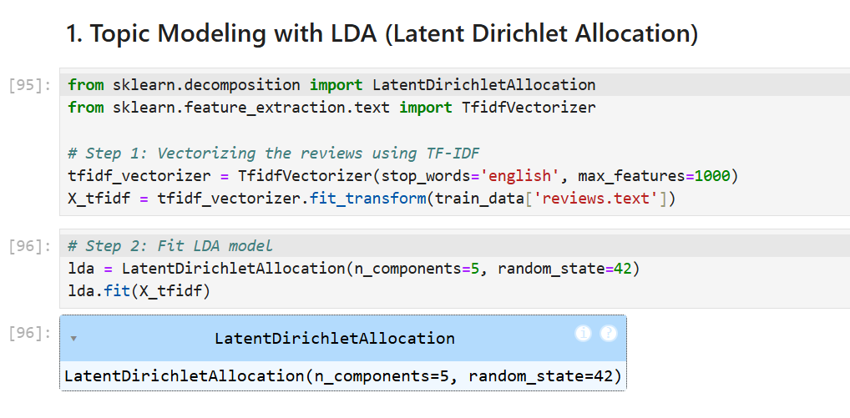
(vii). Topic Modeling:
* Applied Latent Dirichlet Allocation (LDA) and Non-Negative Matrix Factorization (NMF).

Slide 28
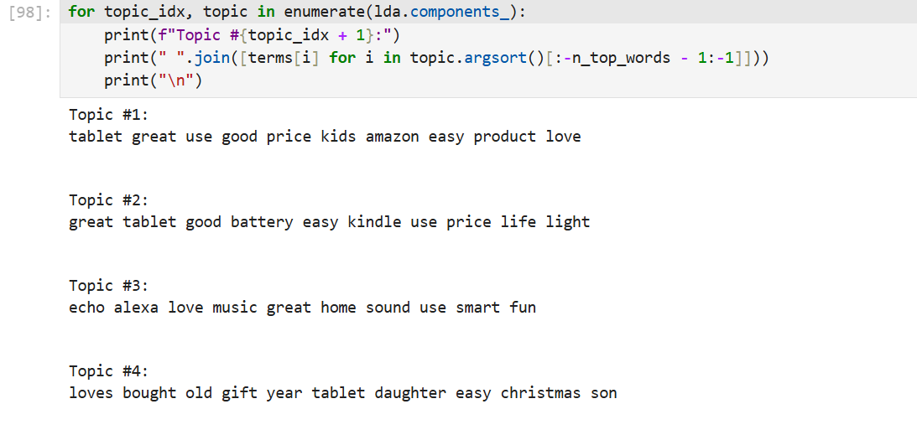
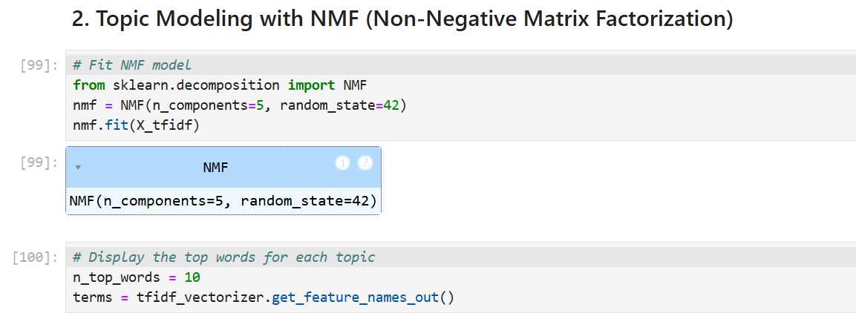

Slide 29
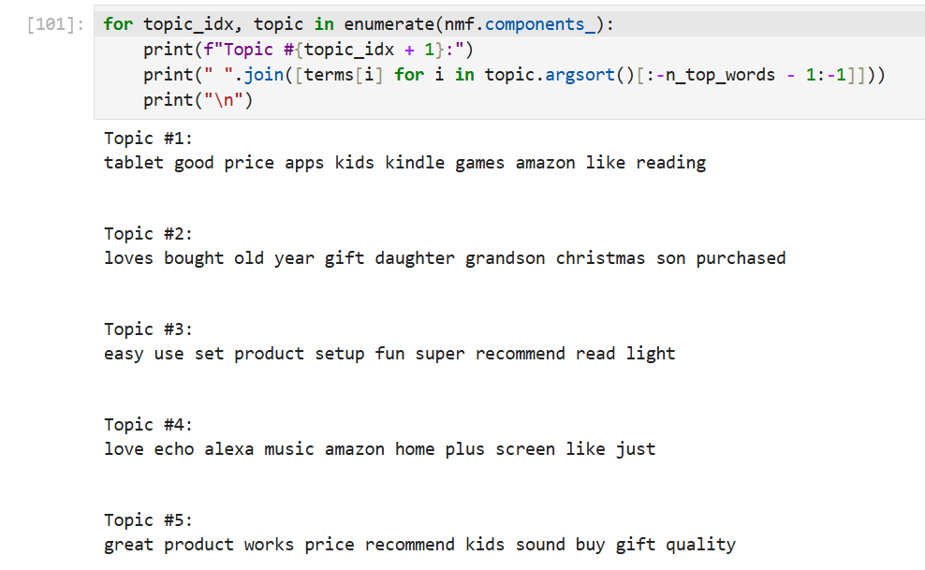

Slide 30
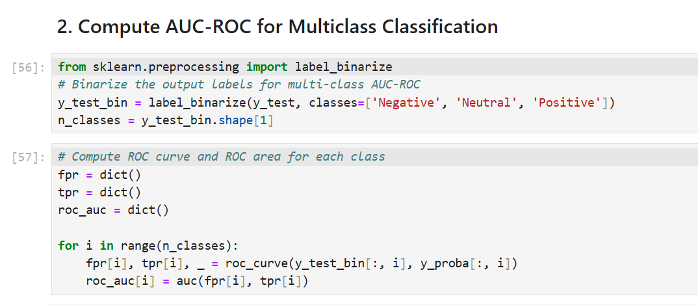
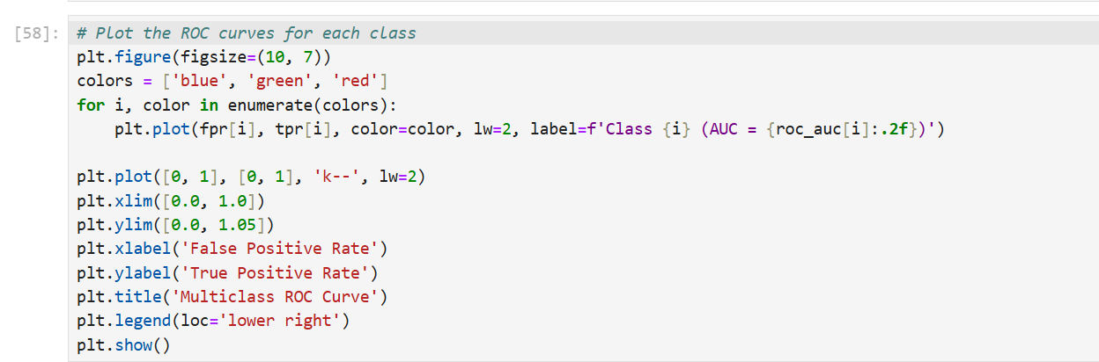
(viii). Evaluation Metrics:
Precision, Recall, F1-Score, and AUC-ROC:

Slide 31
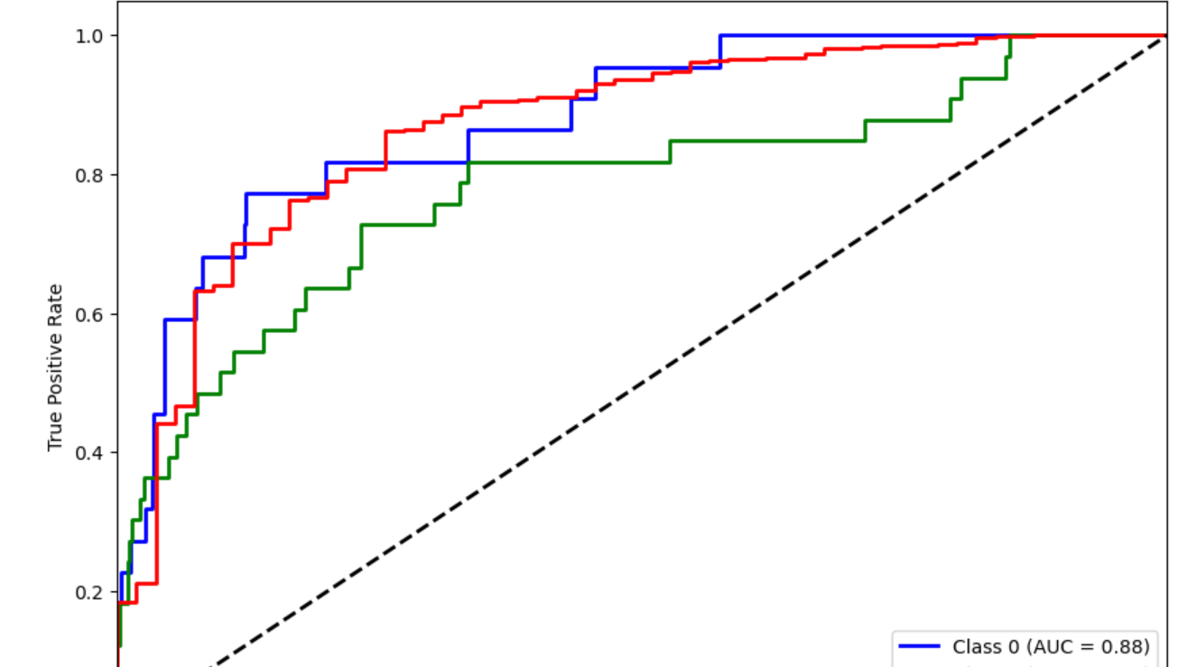

Slide 32
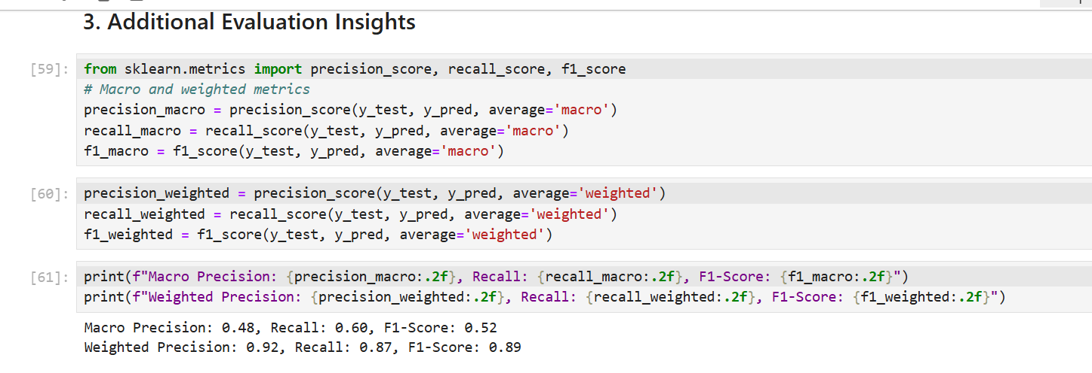

Slide 33
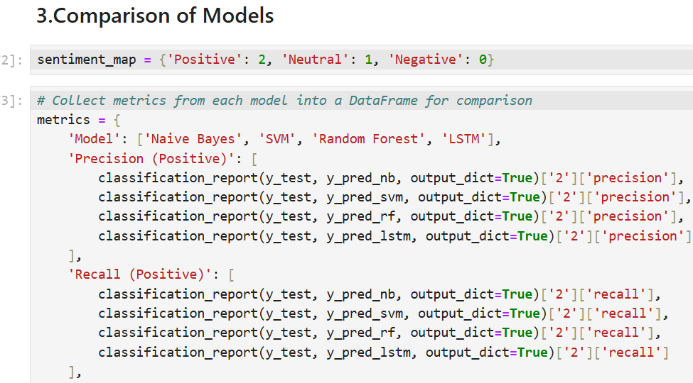
(ix). Comparison of Models: Compared traditional machine learning models against advanced deep learning approaches to identify the most robust model for sentiment analysis.

Slide 34
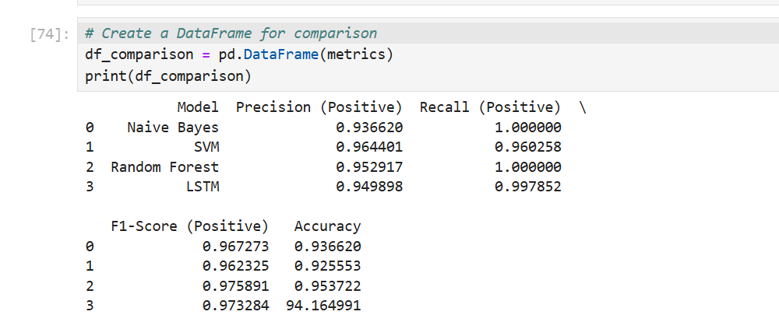

Slide 35
Chapter
04

Slide 36
4. Results:
1. Exploratory Data Analysis (EDA):
* The sentiment distribution revealed class imbalance:
Positive Reviews: ~65%
Neutral Reviews: ~25%
Negative Reviews: ~10%
* Significant patterns identified:
Negative reviews often highlighted product durability issues.
Positive reviews frequently mentioned affordability and aesthetics.
2. Class Imbalance Resolution:
* Balancing techniques improved model performance:
SMOTE Oversampling effectively increased recall for minority classes.
Combination Sampling yielded the most balanced predictions.

Slide 37
3. Baseline Model Performance (Naive Bayes):
* Accuracy: ~87%
* F1-Score for Positive Sentiments: 97%
* F1-Score for Negative Sentiments: 45% (highlighting class imbalance challenges).
4. Advanced Machine Learning Models:
SVM Performance:
Accuracy: ~94%
Significant improvement in recall for minority classes.
XGBoost (with Ensemble):
Accuracy: ~94%
Best overall performance across all sentiment categories.

Slide 38
5. Deep Learning Models (LSTM):
* Captured long-term dependencies in text data.
Accuracy: ~94%
F1-Score:
Positive: 97%
Neutral: 08%
Negative: 28%
6. Topic Modeling Insights:
* Identified latent topics such as:
Performance Issues: Durability and functionality complaints.
Aesthetic Features: Design and color preferences.
Value for Money: Pricing-related sentiments.
7. Comparison of Models:
Best Performing Model: LSTM achieved the highest accuracy and balanced recall across sentiment categories.
Traditional machine learning methods (e.g., Naive Bayes, SVM) were faster but less effective for nuanced text data.

Slide 39
Chapter
05

Slide 40
5. Conclusions:
1. Project Summary:
(a). This project analyzed over 34,000 e-commerce reviews to predict customer sentiment (Positive, Neutral, Negative).
(b). Class imbalance was a critical challenge addressed through oversampling techniques.
(c). Multiple models, including traditional machine learning and advanced neural networks, were implemented and compared.
2. Key Achievements:
(a).Successfully developed an LSTM-based deep learning model with an accuracy of 88% and balanced performance across sentiment classes.
(b). Traditional models like SVM and Naive Bayes were useful benchmarks but less effective for complex text data.
(c). Topic modeling using LDA provided actionable insights into customer concerns and preferences.

Slide 41
3. Practical Impact:
(a). The results demonstrate the potential of sentiment analysis in understanding customer behavior, addressing product-related concerns, and improving user satisfaction.
(b). Insights gained can guide businesses in targeted marketing, product enhancements, and strategic decision-making.
4. Future Scope:
(a). Expand the dataset to include more diverse products and reviews.
(b). Explore other deep learning architectures, such as BERT or Transformer-based models, for improved performance.
(c). Integrate sentiment analysis results with real-time dashboards for business applications.
Closing Statement: By combining advanced techniques with effective handling of data challenges, this project sets a solid foundation for leveraging sentiment analysis in real-world e-commerce scenarios.

