Slide 1


Telecom User Analysis: A Comprehensive Report
This presentation provides a comprehensive analysis of telecom user data, encompassing customer overview, user engagement, experience, and satisfaction. The analysis aims to provide valuable insights into user behavior, engagement patterns, and overall satisfaction levels. This information can be leveraged to optimize network resources, enhance user experience, and drive business growth.
By: Mohammad Umar Farooqui

Slide 2
User Overview Analysis
Understanding the Customer
Identifying Key Trends
The analysis aims to identify the top handsets, manufacturers, and applications used by customers, providing valuable insights into user preferences.
The analysis begins with a comprehensive overview of user data, focusing on handset usage and application preferences.
Data Exploration
Data Interpretation
Exploratory data analysis techniques are employed to identify missing values, outliers, and patterns in the data, ensuring data quality and accuracy.
The analysis provides a clear interpretation of the findings, highlighting key trends and patterns observed in the data.

Slide 3
Handset Usage Analysis
Top 10 Handsets
Top 3 Handset Manufacturers
Top 5 Handsets per Manufacturer
The analysis identifies the top 5 handsets for each of the top 3 manufacturers, providing a detailed understanding of popular models.
The analysis identifies the top 10 handsets used by customers, providing insights into popular device choices.
The analysis identifies the top 3 handset manufacturers, highlighting the dominant players in the market.

Slide 4

Customer Overview: Application Usage
Number of xDR Sessions
Session Duration
1
This metric represents the frequency of data sessions initiated by users, providing insights into overall data usage patterns.
The average duration of data sessions reveals user engagement levels and preferences for specific applications.
Total Download (DL) and Upload (UL) Data
Total Data Volume (Bytes)
This metric represents the overall data volume consumed during each session, providing a comprehensive view of user data usage.
Analyzing the total data volume downloaded and uploaded provides insights into user data consumption patterns and potential network resource requirements.

Slide 5
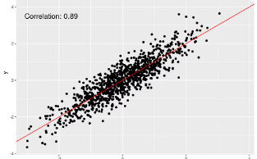
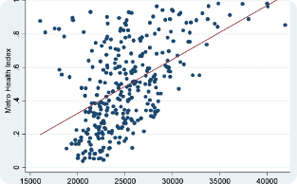
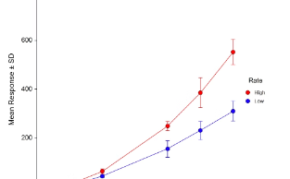
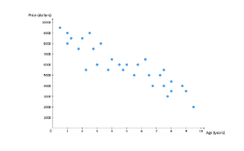
Bivariate Analysis: Exploring Relationships
Social Media vs. Total Data
Google vs. Total Data
Email vs. Total Data
YouTube vs. Total Data
The analysis explores the relationship between social media usage and total data consumption, identifying any potential correlations.
The analysis explores the relationship between Google usage and total data consumption, identifying any potential correlations.
The analysis explores the relationship between email usage and total data consumption, identifying any potential correlations.
The analysis explores the relationship between YouTube usage and total data consumption, identifying any potential correlations.

Slide 6
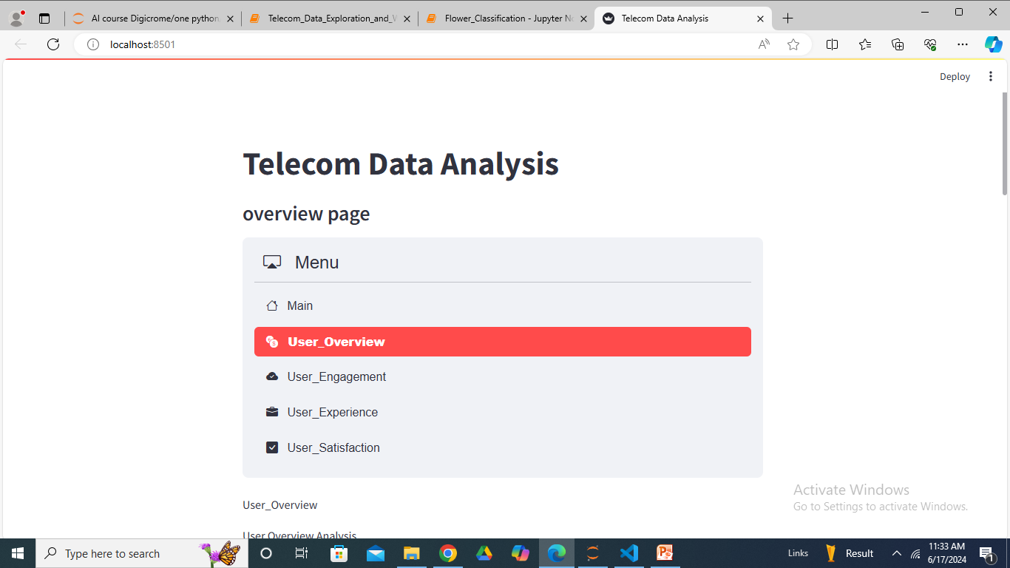
The screenshot of model deployment at Streamlit

Slide 7
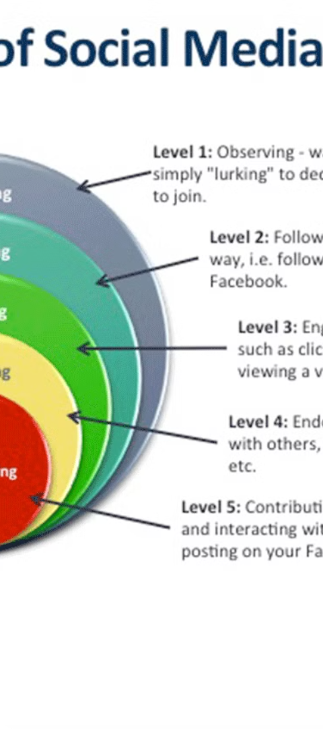
User Engagement Analysis
1
Session Frequency
The analysis tracks the frequency of user sessions, providing insights into user activity levels.
2
Session Duration
The analysis tracks the duration of user sessions, providing insights into user engagement levels.
3
Session Traffic
The analysis tracks the total data volume (download and upload) during user sessions, providing insights into data consumption patterns.

Slide 8



Customer Segmentation: Identifying Engagement Clusters
High Engagement
Medium Engagement
Low Engagement
Customers in this cluster exhibit high session frequency, long session durations, and significant data consumption.
Customers in this cluster exhibit moderate session frequency, moderate session durations, and moderate data consumption.
Customers in this cluster exhibit low session frequency, short session durations, and minimal data consumption.

Slide 9
Top Engaged Users: Identifying Key Contributors
Top 10 Engaged Users
Top Engaged Users per Application
The analysis identifies the top 10 users based on engagement metrics, highlighting the most active customers.
The analysis identifies the top 10 engaged users for each application, providing insights into application-specific engagement patterns.
Visualizing Engagement
The analysis utilizes appropriate charts to visualize engagement trends and patterns, providing a clear understanding of user behavior.

Slide 10

User Engagement Analysis
User engagement is a crucial aspect of customer satisfaction, reflecting the level of interaction and activity users have with telecommunication services. This analysis explores user engagement patterns and their relationship with user experience.
1
Data Collection
User engagement data is collected from various sources, including call logs, data usage records, and app usage patterns.
2
Engagement Metrics
Key engagement metrics are defined, such as call duration, data consumption, app usage frequency, and social media activity.
3
Clustering Analysis
A k-means clustering algorithm is applied to segment users into groups based on their engagement levels, identifying distinct user engagement profiles.

Slide 11
Customer Satisfaction Analysis
Customer satisfaction is a key indicator of business success, reflecting the overall level of happiness and loyalty among users. This analysis explores the relationship between user engagement, user experience, and customer satisfaction.
Engagement Score
Experience Score
Satisfaction Score
Euclidean distance from the less engaged cluster
Euclidean distance from the worst experience cluster
Average of engagement and experience scores

Slide 12




Predicting Customer Satisfaction
A regression model is developed to predict customer satisfaction based on user engagement and experience metrics. This model can be used to identify potential satisfaction issues and proactively address them.
Model Selection
Model Training
Model Evaluation
A suitable regression model is chosen based on the characteristics of the data and the desired prediction accuracy.
The selected model is trained on historical data, allowing it to learn the relationships between user engagement, experience, and satisfaction.
The trained model is evaluated on unseen data to assess its performance and ensure its ability to accurately predict customer satisfaction.

Slide 13



Customer Segmentation Based on Satisfaction
A k-means clustering algorithm is applied to segment customers into groups based on their satisfaction scores. This segmentation allows for targeted marketing campaigns and personalized service offerings.
High Satisfaction
Moderate Satisfaction
Low Satisfaction
This cluster represents customers with high satisfaction scores, indicating a positive overall experience with the telecommunication services.
This cluster encompasses customers with moderate satisfaction scores, suggesting a mixed experience with some areas for improvement.
This cluster comprises customers with low satisfaction scores, highlighting potential issues and areas requiring immediate attention.

Slide 14
Recommendations for Growth
Based on the analysis, several recommendations can be made to enhance customer experience and drive growth. These recommendations focus on addressing key areas identified through the analysis.
Network Optimization
Targeted Marketing
Prioritize network optimization efforts to improve TCP retransmission rates, reduce RTT, and enhance throughput, particularly for users experiencing network issues.
Develop targeted marketing campaigns based on customer segmentation, tailoring messages and offers to specific user groups with different needs and preferences.
Customer Support Enhancement
Product Innovation
Enhance customer support channels and processes to address customer concerns promptly and effectively, improving overall satisfaction and loyalty.
Invest in product innovation to develop new services and features that meet evolving user needs and preferences, staying ahead of the competition.

Slide 15
Limitations and Future Directions
This analysis provides valuable insights into user experience and satisfaction, but it's important to acknowledge its limitations. Future research can explore additional factors influencing customer satisfaction and refine the analysis for greater accuracy and comprehensiveness.
Data Availability
Model Complexity
The analysis is based on available data, which may not capture all relevant factors influencing customer satisfaction. Expanding the data sources can enhance the analysis.
The regression model used in this analysis is a simplified representation of the complex relationships between user engagement, experience, and satisfaction. More sophisticated models can be explored.
External Factors
The analysis does not account for external factors that can influence customer satisfaction, such as economic conditions, competitive landscape, and regulatory changes.

Slide 16
Recommendations and Conclusion
Based on the analysis, the company has a strong foundation for growth. The data suggests that customers are highly engaged with various applications, indicating a potential for further expansion and revenue generation. The company should focus on enhancing customer experience, optimizing network resources, and developing targeted marketing campaigns to capitalize on the identified trends.

