Slide 1



STU6797738f38f3a1737978767
EV Charging Demand Prediction
By Mohammed Anas Abrar
ID:STU6797738f38f3a1737978767

Slide 2

Learning Objectives
About:
Electric vehicles (EVs) can be categorized into several types, each with its own system architecture and operational characteristics.
Goal:
Build a machine learning pipeline to forecast electric vehicle (EV) growth and estimate future charging infrastructure needs based on county-level historical data.
Objectives:
Understand EV data trends and patterns across time and
geography
Implement supervised learning for forecasting
Deploy models using real-world frameworks (Joblib + Streamlit)
Gain experience in predictive sustainability projects.
GOAL
Source :
www.freepik.com/

Slide 3
Tools and Technology used
Languages:
Python == 3.12.8
Environment used: VS code, Jupyter Notebook.
Libraries:
Pandas == 1.5.3,
NumPy == 1.26.4,
Scikit-learn (sklearn) == 1.6.1
Scipy == 1.15.2
Statsmodels == 0.14.4
Streamlit == 1.44.1
Tensorflow == 2.19.0
Matplotlib & Seaborn for displaying historical data on a chart
ML Models: RandomForestRegressor, SVR (Support Vector Regressor)
Evaluation / Metrics: MAE, MSE, R²
Deployment: Streamlit, Flask
Version Control: GitHub
Serialization: Joblib
Data Source: Public CSV of EV population by county

Slide 4
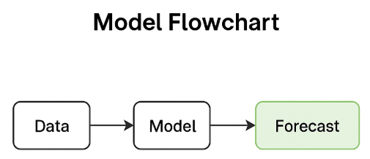
Methodology
1. Load raw EV data by county (CSV)
Clean and preprocess the data (missing values, format conversion)
Feature engineering: date parsing, time index
EDA & trend plotting (e.g., EV adoption vs time)
Model building: Random Forest, SVR
Hyperparameter tuning with RandomizedSearchCV
Model evaluation: MAE, MSE, R²
Charging demand estimation: 1 charger per 10 EVs (assumption-based)
Model saving using Joblib in a pickle file (forecasting_ev_model.pkl)
Web deployment using Streamlit (app.py)

Slide 5
Problem Statement:
As electric vehicles (EVs) become more popular, cities and states are struggling to answer:
"How many EVs will we have in the future?“
"Where should we install charging stations?“
Without data-driven forecasts, it's hard to plan infrastructure efficiently — leading to underprepared or overbuilt systems.

Slide 6
Solution:
Build a machine learning model that can:
Learn from historical EV data
Predict how many EVs will be registered in each county
Estimate how many charging stations will be needed
Provide quick answers through a simple web app
Algorithm used such as: Random forest regressor
This helps governments and planners make smarter, faster decisions.
You can have a look on my Code Repo:
https://github.com/Mdanas198957/EV_Vehicle_Demand_Prediction.git
And you can view the forecast here
Local URL: http://localhost:8501
You can also view this file from my github accessing app.py

Slide 7
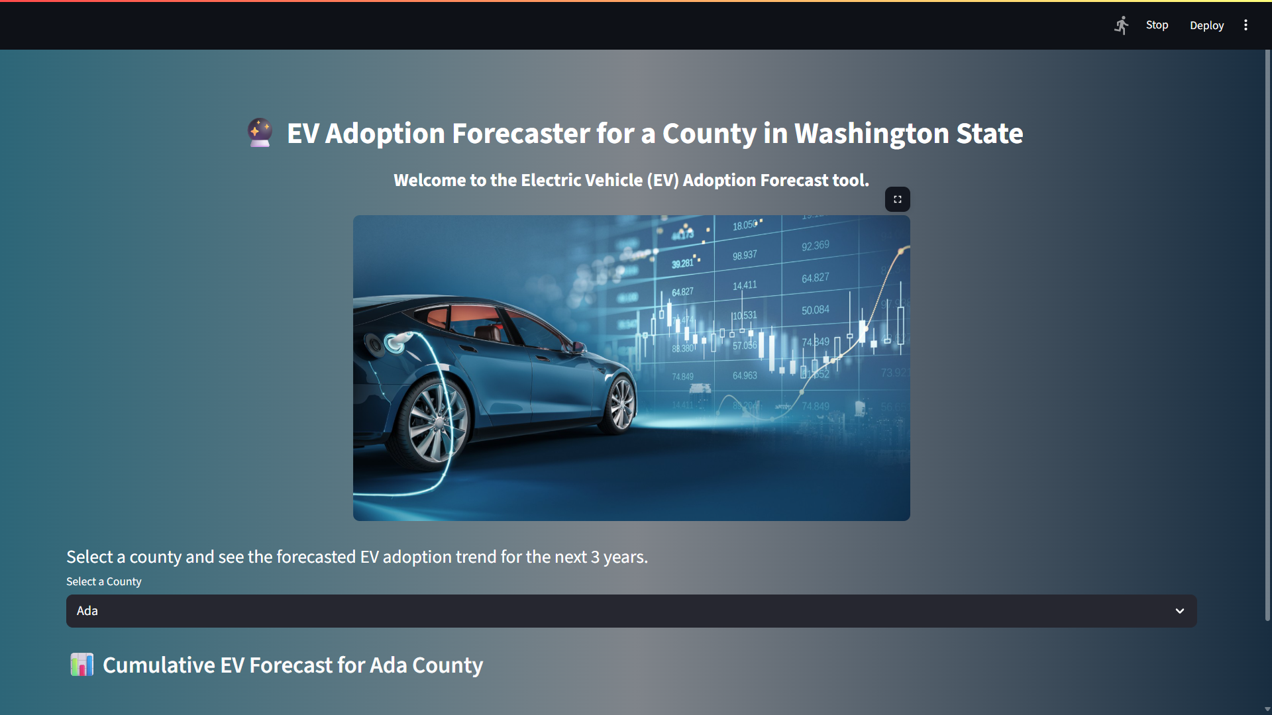
Screenshot of Output:
Once we click the live server it redirects to this app interface.

Slide 8
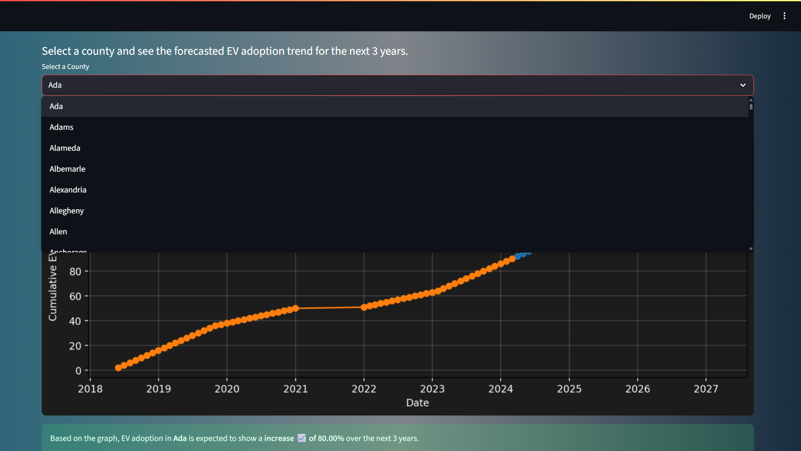
We try to forecast the adoption trend for required county for 3 years. It selects a default county.

Slide 9
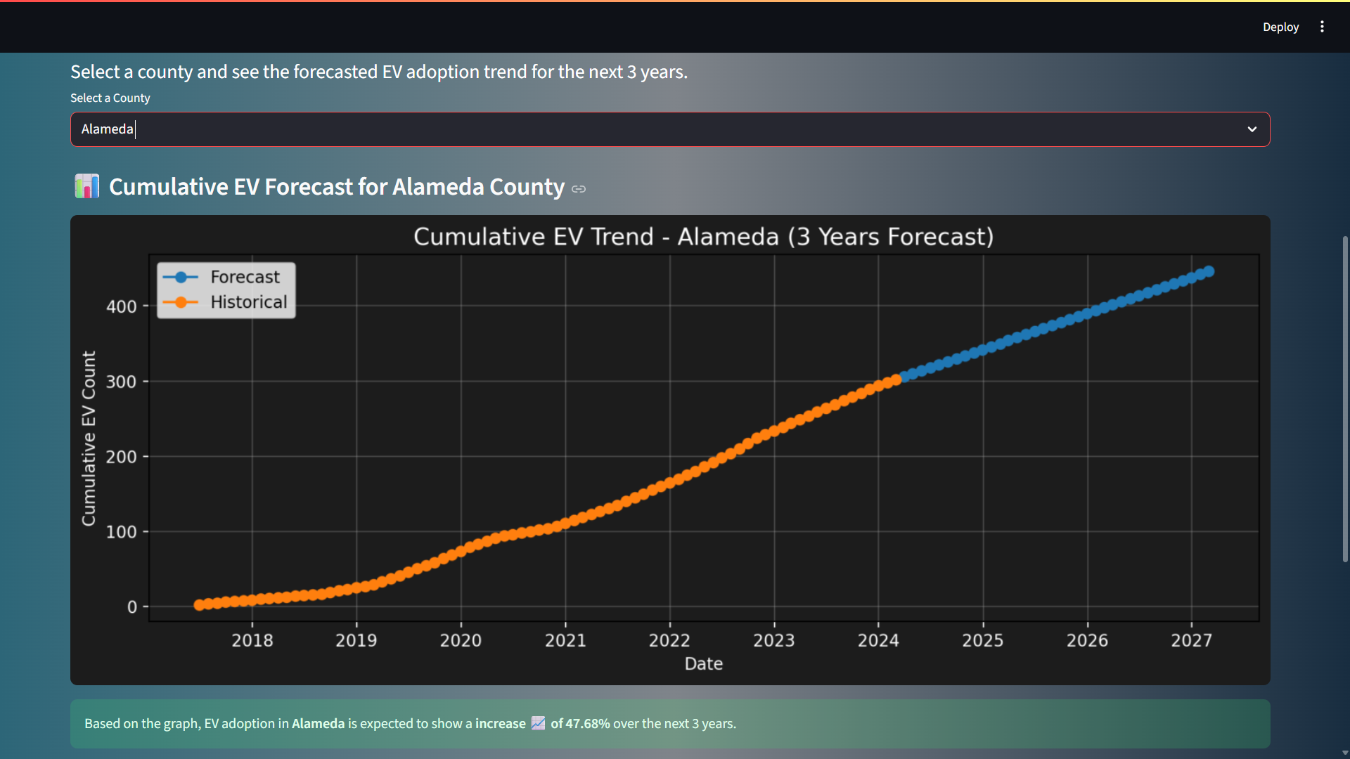
Once we select a county it gives a forecast.

Slide 10
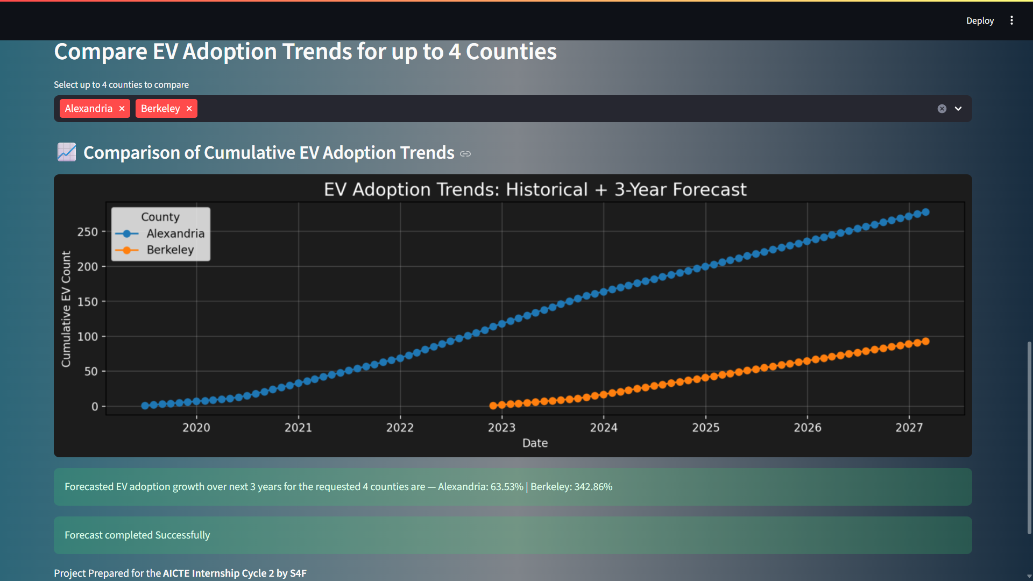
Here we compare counties and you can select upto 4 counties.

Slide 11
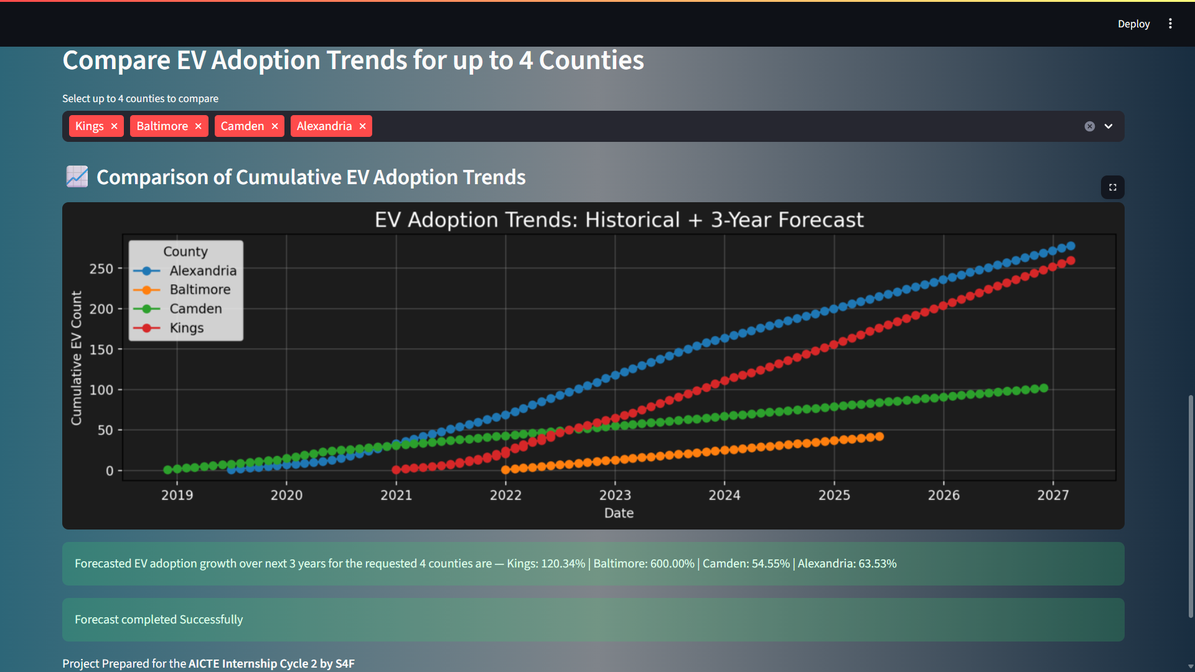

Slide 12
About the previous output:
I would like to explain about the graphs and what the percentages refer to.
In the graph and forecast summary:
->Alexandria shows 63.53% growth.
->Baltimore shows 600.00% growth in EV adoption.
So, numerically, 600% sounds way better. Alexandria shows a sharp rise and Baltimore seems flat.
But here's the catch:
If Baltimore started from a very low number (e.g., 5 EVs), then even a small increase will show a huge % growth.
On the other hand, Alexandria may already have a lot of EVs, so a 63% growth is big in volume, just not in %.
Why didn't they start at zero?
Because each county already had different EV counts before forecasting began. The graph includes historical data, not just the future forecast.

Slide 13
Conclusion:
I Built a complete data-to-deployment ML pipeline
Trained and tuned regression models (RF, SVR)
Estimated infrastructure demands using real-world assumptions
Deployed an interactive forecasting tool
Gained hands-on experience in clean-tech data science.
-> THAT’S ALL I GAVE TO THIS PROJECT AND HAD A BEST LEARNING IMPACT.

