Slide 1
Power Walker Using Kinetic energy form footsteps on pressure sensitive tiles to generate electricity.
Group tectonics:
Rakeya Rahim bhuiyan(16101127)
Humayra Tasnim Rahman (16101063)
Md. Asif Talukdar (17101305)
Syed Mahbubuz Zaman (16201017)

Slide 2
Purpose:
To generate sustainable & green energy from human footsteps.
Problem Statement:
Due to the rapid depletion of the main fossil source of energy (oil), it is vital to search for other sources of energy.
Also, the global pollution due to traditional sources of energy moves scientists to search for other sources of green energy.

Slide 3
Solution Statement:
This device may be used in all crowded spots with a big number of pedestrians such as mosques, churches, underground stations, theaters, stadiums, etc.
This technique of energy harvesting is suitable for such applications as street lighting, advertising billboards, and information displays.

Slide 4
Objective:
Our aim is to Fulfill SDG goal 7: which is affordable and clean energy.

Slide 5
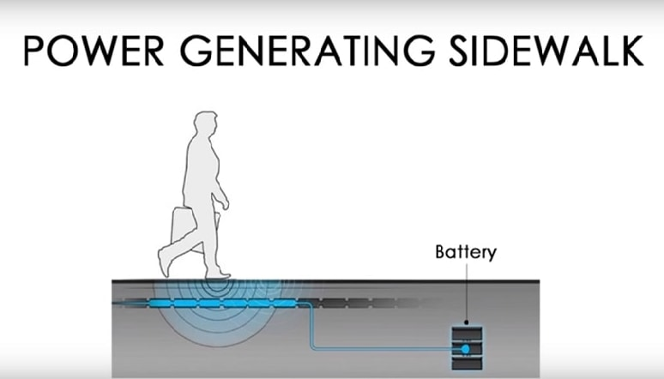
Product Description:

Slide 6
Block Diagram
Footstep Arrangement
Piezo-electric material
Alternator
Dc generator/Dynamo
Battery
Inverter
Load Light

Slide 7
Material Required & Budget:
Piezo electric transducer
Rectifier
Dynamo
Battery

Slide 8
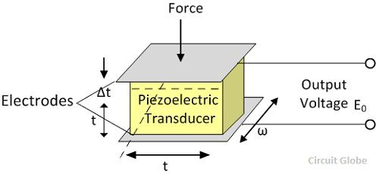
Technology Strategy
Rochelle salts, ammonium dehydration, phosphate, lithium sulphate, dipotassium tartrate

Slide 9
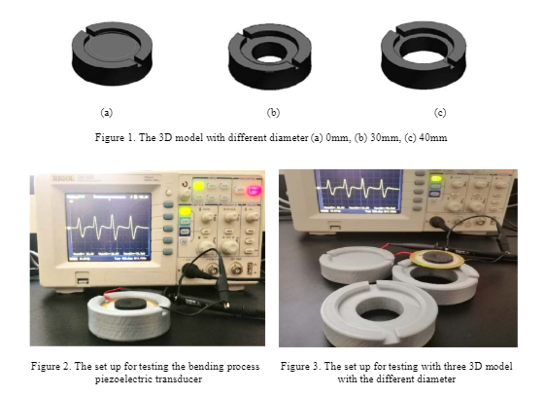
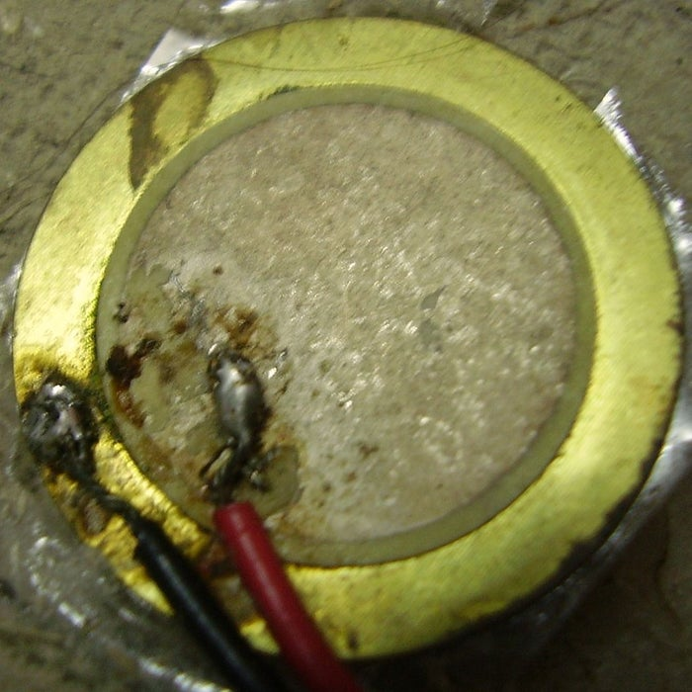
Technological Strategy:

Slide 10
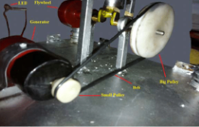
Literature Review:
Amel Farouk, and Ahmed F. Abdel Gawad form Cairo Egypt has done a mechanical version of this model to produce electricity from footsteps, primarily they used pistons, flywheel and belt pulley to generate power.

Slide 11
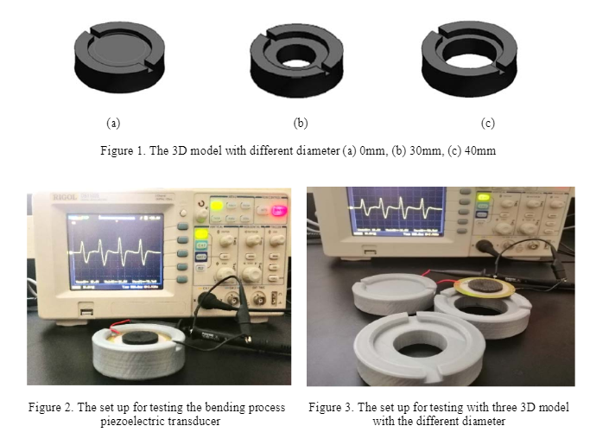
Literature Review:
Anis Maisarah Mohd Asry, Farahiyah Mustafa, Maizul Ishak, Aznizam Ahmad from Malaysia used a piezo electric transducer to produce electricity by using a 3D printed platform then from the AC current produced by piezo electric element is converted to DC current.

Slide 12

Market Analysis:
Our target market is the Power Cell division-Ministry of power energy and mineral resources.
This technology could be used for crowded places such as
airports, train and underground stations,
theaters, stadiums, universities, churches, and mosques.

Slide 13
Competitive Advantage:
In Bangladesh still now we don’t have any direct or indirect competitors because still now this technology is not familiar to us.
Internationally, Pavegen has come up with some prototypes which they implemented on streets of UK but their set up was quite expensive to implement.

Slide 14
Team Spirit:
Technical Duty – Syed and Asif are in charge of managing Footstep arrangement and combining with Piezo-electric material which will create DC current using dynamo.
Market analysis – Rakeya is in charge of feasibility analysis and marketing strategy.
Resource management and setup analysis- Humayra is responsible for analyze necessary equipment's and their functional efficiency.

Slide 15
Business Strategy:
According to power cell division of Bangladesh there are a total of 71,276 street lamps in the city with a combined power demand of 7MW per hour, the two hours of extra service on an average costs 14MW per day and 420MW per month.
The report assumes that the current cost of generating each unit of power is Tk6.5.
So, the renewable energy that we are producing can be used for powering street lights in cities.

Slide 16
Financial Strategy:
Power cell- Ministry of power energy and mineral resources will the funding for the project for large scale implementation.
Funding will be used to further develop the prototype and field test the existing prototype; then afterwards will include the developed model.
As this is a clean and green source of energy, there is no carbon emission (no fossil fuel), although the setup cost is high in the long run the sustainability is guaranteed.

Slide 17
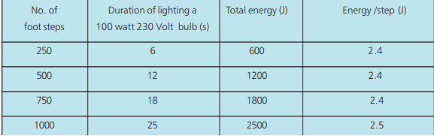
Power vs Steps

Slide 18
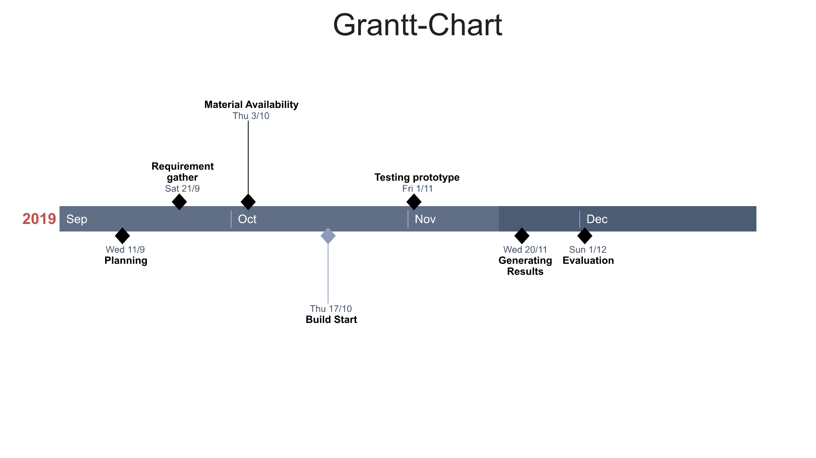
Implementation Plan:

Slide 19
Progress:
We are working on procuring necessary resources, also a finding a way to amplify the generated current from piezo element. We are working on developing a prototype which can be scaled up for real life usage.

Slide 20
References:
https://www.researchgate.net/publication/282704862_Utilization_of_Human_Footsteps_for_Power_Generation
https://www.researchgate.net/figure/Block-Diagram-of-Power-Generation-by-applying-Footstep-pressure_fig2_329758714
https://www.instructables.com/id/Electricity-from-walking/
https://www.researchgate.net/publication/331444786_Power_generation_by_using_piezoelectric_transducer_with_bending_mechanism_support
https://www.researchgate.net/publication/329758714_Power_Generation_from_Piezoelectric_Footstep_Technique

