Slide 1
Maze Generation & Solving
Using Javascript and <canvas>
Ethan Ross

Slide 2
Concept
Single page static site
Maze generation and maze solution using plain, browser Javascript
  No libraries
Canvas API for 2D graphics
  Uses Javascript and HTML <canvas> element
  Used to draw maze and maze solution path
URLs
  https://github.com/MdeVillefort/mazes
  https://mdevillefort.github.io/mazes/

Slide 3
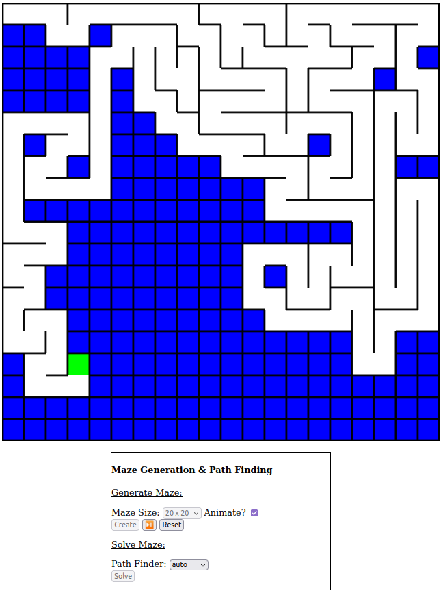
Maze Generation

Slide 4
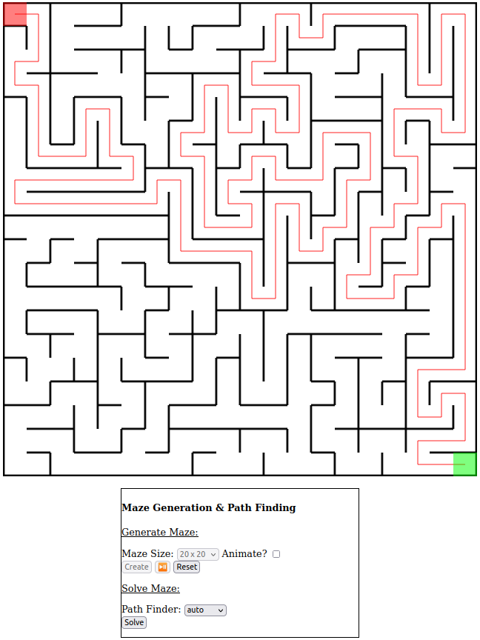
Maze Solution

Slide 5
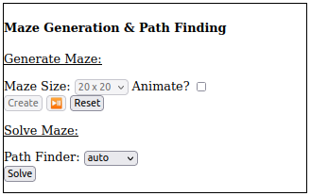
UI
Controls maze grid size
  10x10, 20x20, or 40x40 mazes
Randomly generates mazes
  Optionally animate maze generation
  Play/pause maze animation
Solves mazes
  User selects endpoints
  Only one path finder implemented
A little ugly right now

Slide 6
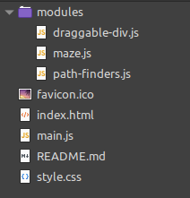
Project Layout
modules/
  maze.js
    A Maze class that
  draggable-div.js
    A DraggableDiv class that
  path-finders.js
    Path-finding functions
/
  main.js
    UI logic

Slide 7
Maze Generating Algorithm
Randomized depth-first search
  Iterative vs. recursive
  Stack-based
Pseudo-code
  Start at top left cell, mark it as visited, push it onto the stack
  Repeat until all cells have been visited
    Pop cell from stack and make current cell
    If current cell has neighbors that have not been visited
      Push current cell onto stack
      Choose one of the unvisited neighbors randomly
      Remove wall between current cell and chosen cell
      Mark chosen cell as visited and push on to the stack

Slide 8
Maze Solving Algorithm

Slide 9
Future Work
Make the UI pretty
Implement other maze generation algorithms
  Examples
Implement other path finding algorithms
  Examples
Animate the maze solution as user drags around endpoints

Slide 10
Questions?

