Slide 1
First checkpoint

Slide 2
How does the web work?
The web is composed of Web servers and web browsers that communicate via HTTP which ensures that all parts of the web page are delivered

Slide 3
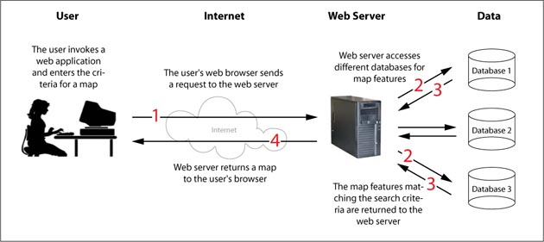
To simplify:

Slide 4
What do you need to be a web developer
A developer needs to know how to use :
HTML
CSS
Java script
DOM
React

Slide 5
Why did you choose to learn web development
Since I was a child I found web is very complicated and interesting thing to learn about it is a very big world that I love to discover it .
Plus in now a days web development is the future, it is something that growing really fast and becoming more and more complicated so I guess it’s time to learn about it .

