Slide 1



Department of Computer Science & Engineering
“IMAGE-STEGANOGRAPHY”
SPONSORED BY
“Karnataka State Council for Science and Technology”
Student Project Programme (SPP- 47th SERIES: 2023 - 2024)
KSCST REF NO: 47S_BE_1324
By
MD JUNAID ALI(3GN20CS040)
SYED JUNAID ALI(3GN20CS126)
Under the Guidance of
Prof. REEBA RANI
Presentation for Academic Year 2023-24

Slide 2
OBJECTIVES
Aim is to design and implement a robust image steganography system that ensures secure and imperceptible embedding of data within digital images, enabling confidential communication. The project aims to develop a practical, secure, and user-friendly image steganography system that aligns with ethical standards and addresses real-world needs for secure communication and data concealment within digital images.
The primary objectives of the steganography are as follows:
Developing a method to encode data into a cipher text.
Developing a method to encode data into a cover image and decode the data from the stego- image.
Combining these both to form a secured communication system.
Algorithm implementation
Capacity analysis
Quality assessment
Robustness testing
Security analysis
Performance optimization

Slide 3
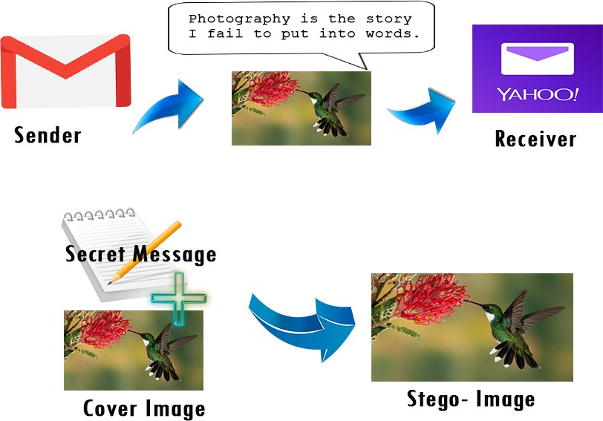
Image-Steganography
Steganography is a method in which you hide the message intended to send to someone in an image. The image might look the same after using steganography but a point to remember is that it has the message. Steganography hides the identity of the message in the cover.
The confidential data is taken as input from the user along with the cover image in which the data is to be hidden.
These act as an input for the Steganographic Encoder which encodes the given message into the cover file, resulting the output as the STEGO-IMAGE,Now the receiver is provided with stego-image which he/she decodes it with the Steganographic Decoder and finally gets the intended message.

Slide 4
The implementation has been done majorly in two phases here that is, cryptography implementation and steganography implementation.
These two major phases have more sub- phases in them for implementation.
A GUI is developed using python pysimplegui. Which includes four layouts namely: encrypt, decrypt,keys,mail.
There are 4 modules used in the model:
Encryption Module
Encode Module
Decode Module
Decryption Module
SMTP
METHODOLOGY

Slide 5
ALGORITHMS
AES
LSB
RSA
AES is a symmetric encryption algorithm widely used to secure sensitive data.
Strong security
Efficiency
Symmetric encryption: As a symmetric algorithm, AES uses the same key for both encryption and decryption
1. Simple implementation
2. LSB steganography is a technique used to hide information within digital media (like images or audio) by replacing the least significant bit of each byte with the bits of the hidden message.
RSA is an asymmetric encryption algorithm widely used for secure data transmission, digital signatures, and key exchange.
Public key cryptography
Security

Slide 6
ARCHITECTURE
MODULE DESCRIPTION
ENCRYPTION MODULE
DECRYPTION MODULE
This module encrypts plain text to cipher text. In this model we have used the AES and RSA encryption algorithm
This module performs AES/RSA decryption by using the private key and extracts the plain text from the cipher text.
ENCODING MODULE
DECODING MODULE
This module is responsible for hiding the cipher text to the cover image by the use of steganography techniques
This module extracts the hidden cipher text from the stego image which is sent by the sender.

Slide 7
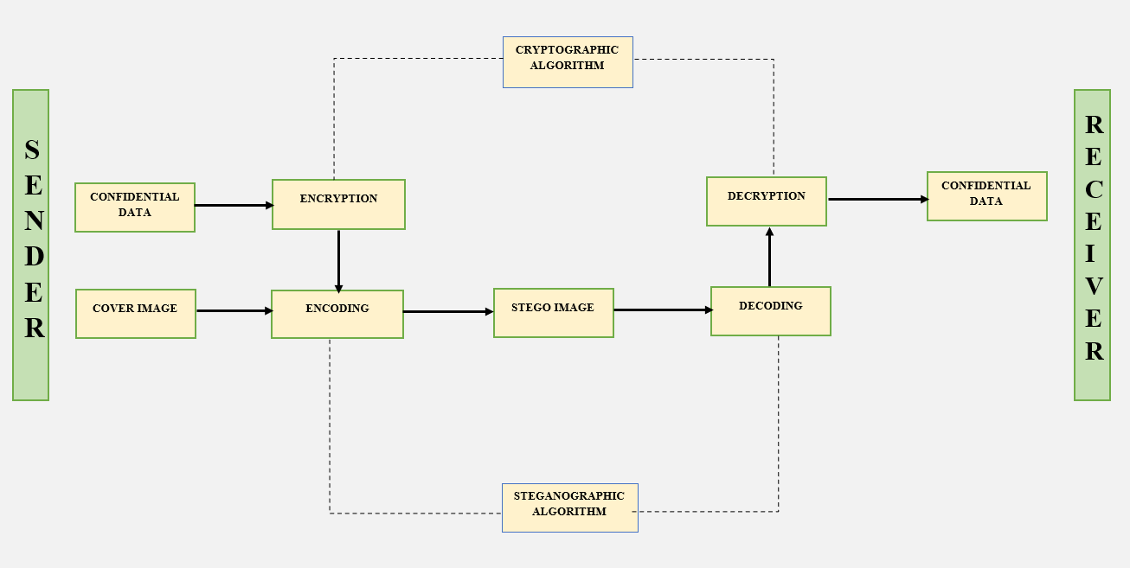
ARCHITECTURE DIAGRAM

Slide 8
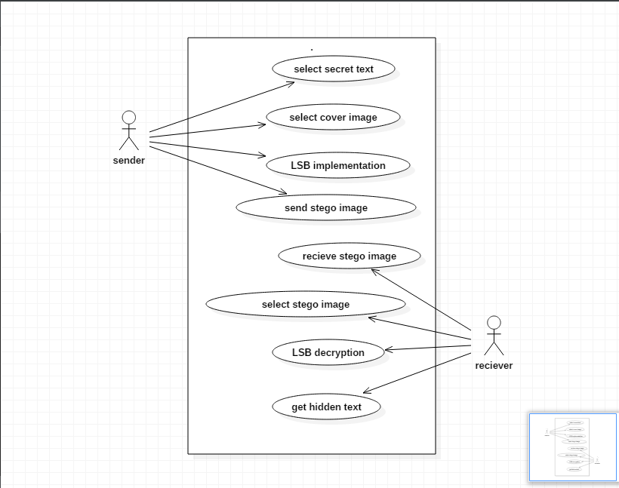
USE CASE DIAGRAM

Slide 9
Advantages
The main advantages of this system is Security that it provides security to your messages without knowing to third party.
Number of bits have been replaced according to user or sender, therefore third party can not quess password.
Normal network user cant guess image.
In steganography anyone cant jump on suspect by looking images.
It is Reliable.
Easy to use.
Easy Maintenance.
System have been secured by password authentication

Slide 10
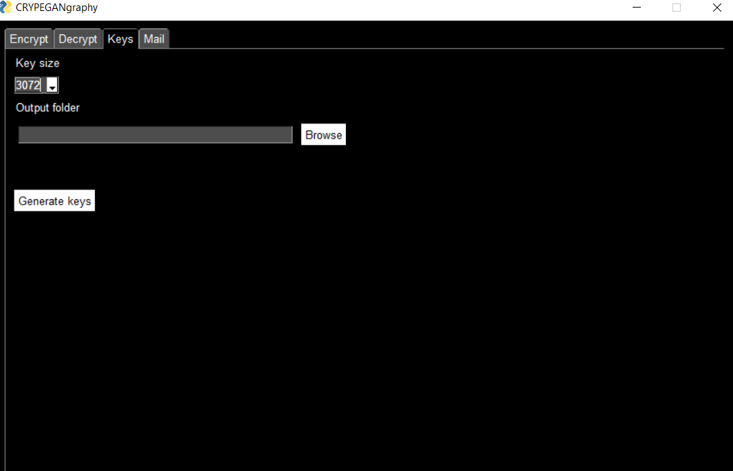
Results

Slide 11
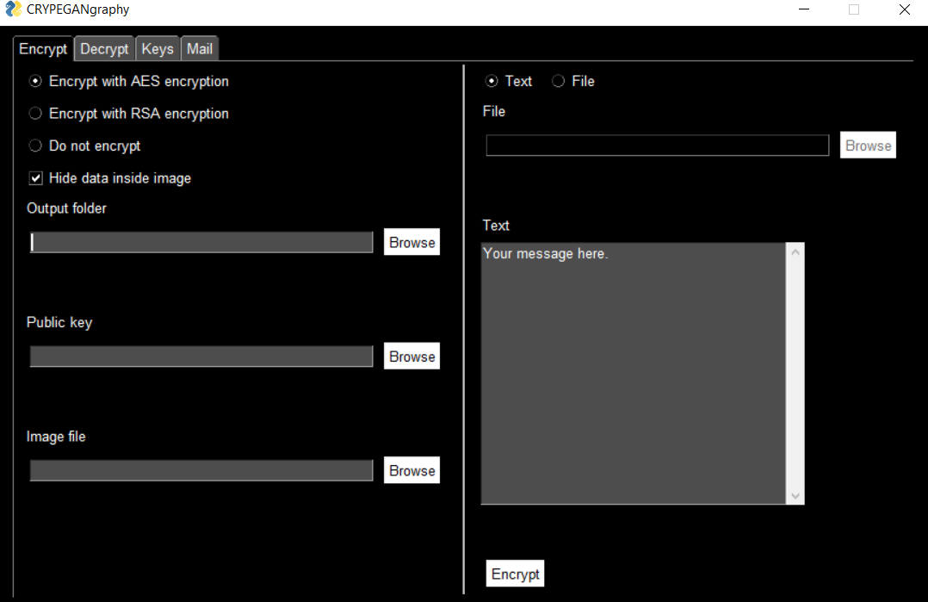

Slide 12

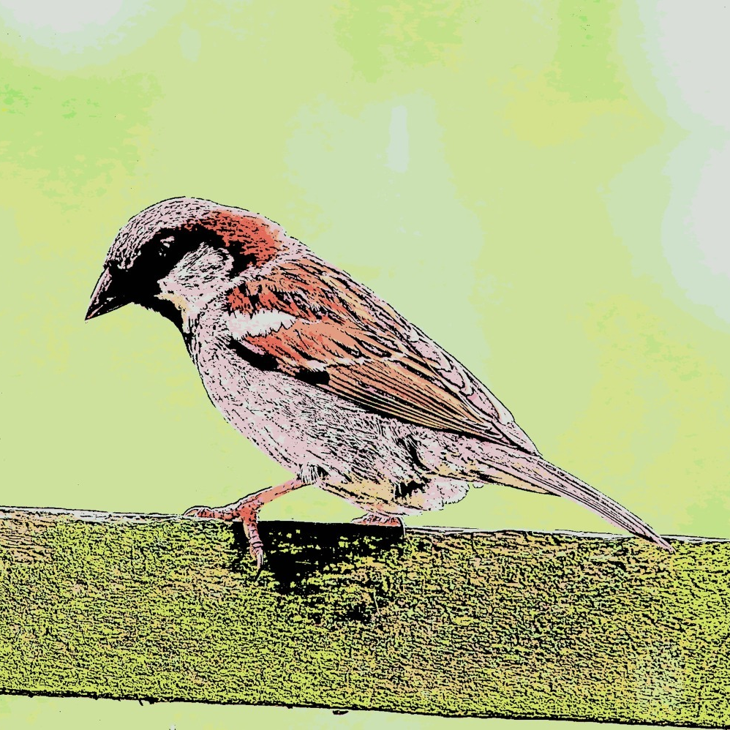
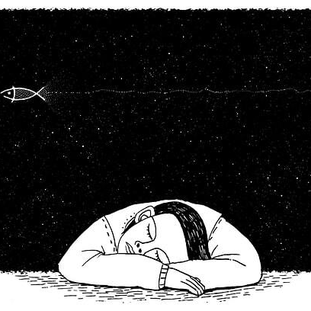
TESTING PICS
PIC1
ORIGINAL IMAGE
PIC3
ORIGINAL IMAGE
PIC2
ORIGINAL IMAGE
ENCRYPTED
ENCRYPTED IMAGE
ENCRYPTED
ENCRYPTED IMAGE
ENCRYPTED
ENCRYPTED IMAGE

Slide 13
NOVELTY OF THE PROJECT
FUTURE SCOPE FOR FURTHER DEVELOPMENT
we conclude that using both steganography and cryptography together refers to secure information and communication technique. The model states that the data to be passed on is input for the encryption process and the output of the it is the input for encoding purpose that is the steganography process. While to the other end, the decoding is done first via the steganographic techniques and then the decryption.
This brings an extra security to the whole system for secure communication and transfer. The GUI implementation for the whole system giving choice to the user to choose his preferable technique for secure communication is added as a part of innovative idea to it.
Considering the future work, the application can be further improved by adding some more utilities and designing a better UI. Some features like providing more crypto algorithms like DES, Blowfish, SA etc. for encryption of the message can provide more utilities to the application.
Overall, the present application is very handy, secured and interactive providing sufficient utilities to the users.

Slide 14
THANK YOU ☺

