Slide 1
Exercise 1
Radiative transfer modelling
Return the exercises by 25 October as a pdf file.
The analysis of the spectra is best done with a programming environment such as python, R, matlab,…

Slide 2

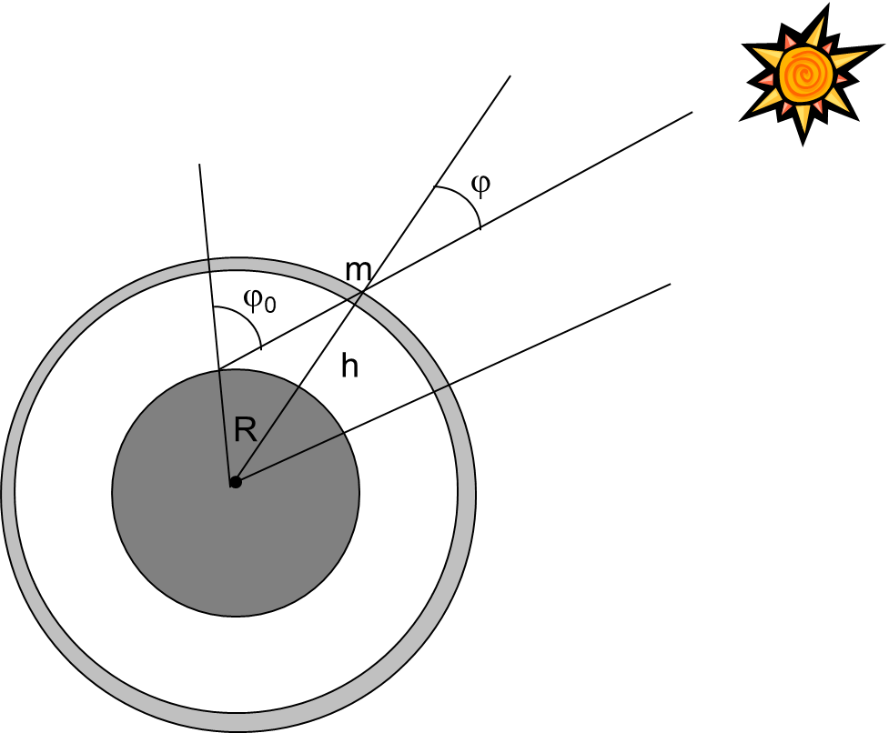

Impact of airmass on remote sensing retrievals?
plane-parallel atmosphere (the earth is flat)
But the earth is not flat
θ
$$m=\frac{1}{\cos{Θ}}$$
m
m=1
Calculate the airmass for a Solar Zenith Angle of 45°, 80°, 85°,
at elevations of 1 km, 5 km, 20 km, above the surface and compare to the flat Earth case.
What is the impact of the plane parallel atmosphere assumption on the retrieval of AOD? Assume that there is an aerosol layer situated at 5 km in the troposphere.

Slide 3

Sensitivity studies to understand the impact of the atmosphere and surface on solar radiation.
Pre-requisites:
Install libRadtran, easiest via docker container:
Install docker. Follow installation instructions from web-site.
2) Test system using default input file working-test.inp
docker run -i siarhei/libradtran uvspec < working-test.inp >out
Compare with test.out
3) Choose 2 out of 4 of the following questions.

Slide 4
1) Sensitivity to total column ozone
Calculate solar spectra for different amounts of ozone and determine the changes of global solar irradiance between 280 nm and 1000 nm with respect to ozone amount.
Additional parameters that have an effect on the calculation:
Solar zenith angle
Questions
Which spectral ranges are affected?
Radiation Amplification factor: Quantify the change in erythemally weighted global irradiance with respect to a change of 1% in ozone amount: % change in ozone yields xx% change in irradiance
Plot graphically and discuss the results.

Slide 5
2) Sensitivity to Surface albedo
Calculate solar spectra from 300 nm to 1000 nm for values of surface albedo between 0 and 1 and ozone column of 300 DU and determine the spectral changes of direct and global solar irradiance with respect to albedo (use albedo=0 as reference).
Questions to address:
Spectral dependence of irradiance changes to changes in albedo
Why is the effect on direct and global radiation different? Is it expected?
3) Repeat calculations with an ozone amount of 500 DU. What do you observe and why?
Plot graphically and discuss the results.

Slide 6
3) Sensitivity to precipitable water vapour
Precipitable water vapour (PWV) is the vertically integrated amount of water vapor in the atmosphere. Calculate solar spectra from 300 nm to 2000 nm for varying amounts of precipitable water vapour from very dry to humid conditions.
Very dry , PWV=1 mm, very humid, PWV=40 mm
Questions to address:
In which spectral ranges do changes occur?
Which spectral region is the most suitable one to retrieve PWV from solar irradiance measurements?

Slide 7
4) Sensitivity to Aerosol Optical Depth and Single Scattering Albedo
Solar radiation is absorbed and scattered by aerosols in the atmosphere. The two most important parameters describing the impact of aerosols on solar radiation are the aerosol optical depth (AOD) and the Aerosol single scatter albedo (SSA).
Calculate direct and global solar spectra for varying amounts of aod and ssa. Suggested ranges:
Spectral range: 300 nm to 1600 nm.
AOD : 0.05 to 1.0
SSA : 0.65 to 0.95
Solar zenith angle : SZA=45
Questions to address:
Sensitivity of direct and global solar irradiance to AOD at several wavelengths.
What is the impact of SSA on direct and global irradiance?

