Slide 1
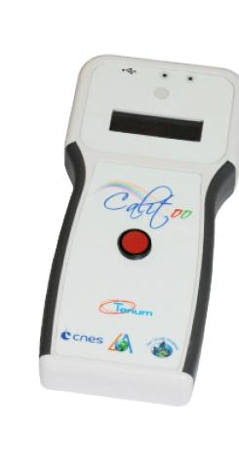
Calitoo Measurements
Intermediate Findings Valerie, Mathis, Dhrona, Nathalie

Slide 2
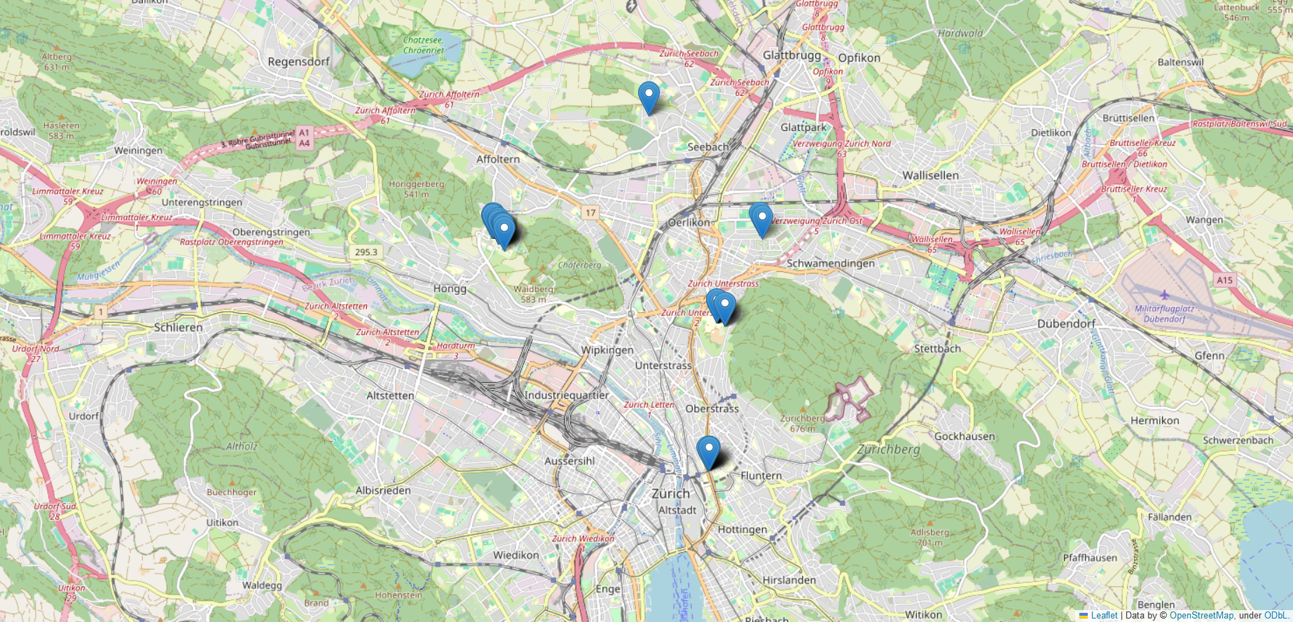

Slide 3
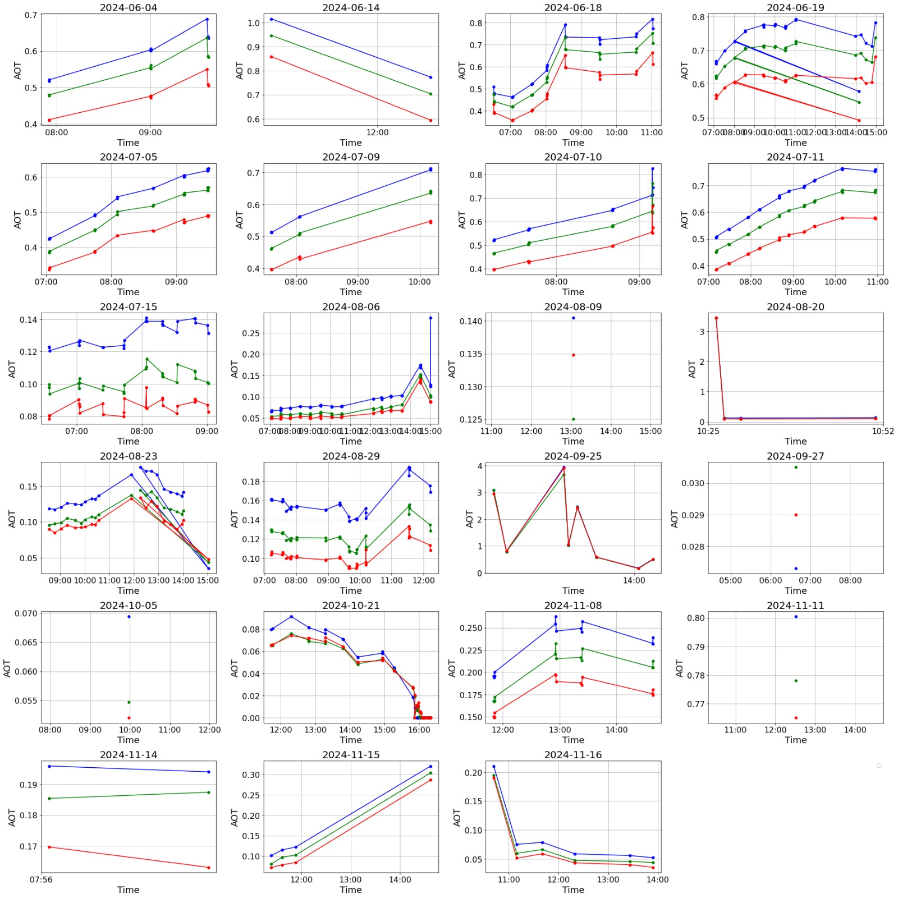

Slide 4
