Slide 1
https://miro.com/app/board/uXjVHza7hfM=/

Slide 2
Prototype premiss
Some type of backstory//player searching for missing person for intel or something
Explores environment (walks the intended route and will find cabins)
Will faintly hear woman shouting for help , will see smoke and fire coming from generator
Will realise that the generator broke , trapping someone inside
Fix generator and retrieve female

Slide 3
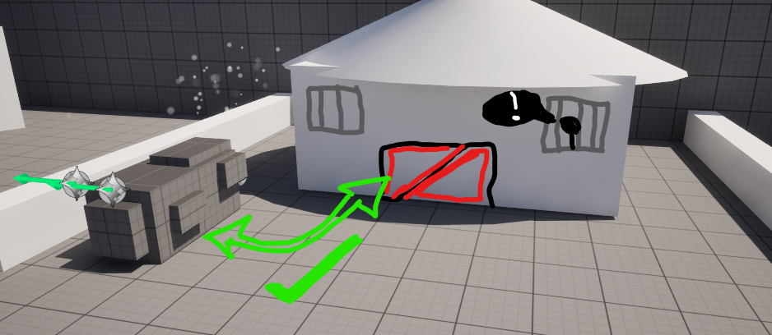

Slide 4
Forks
“Forks” (Decisions)
I need to test guidance and for that I will need a few “forks”
If there are no decisions to make than the user will eventually reach the generator regardless of the lighting, because of this I need to include decisions that I can also utilise lighting in to help guide the player to the correct choice
Example
The correct path has warm light, brighter environment, light spilling over wall
The dead end has no visual interest, darker, no emitting lights

Slide 5
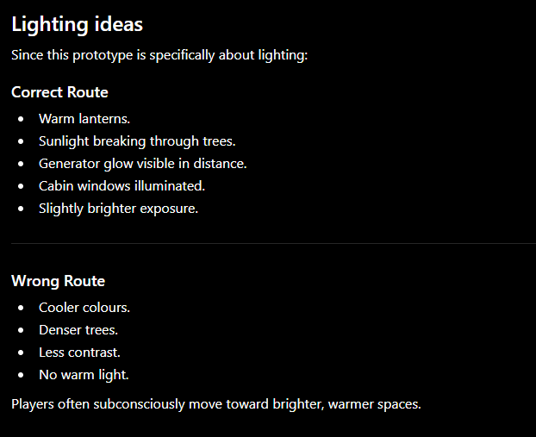

Slide 6
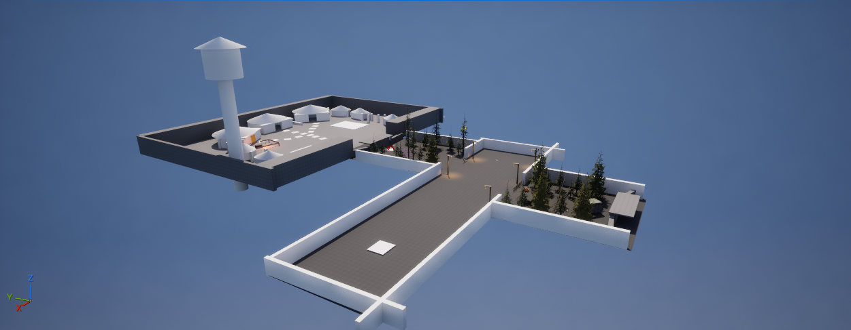
1. Grey box in light

Slide 7
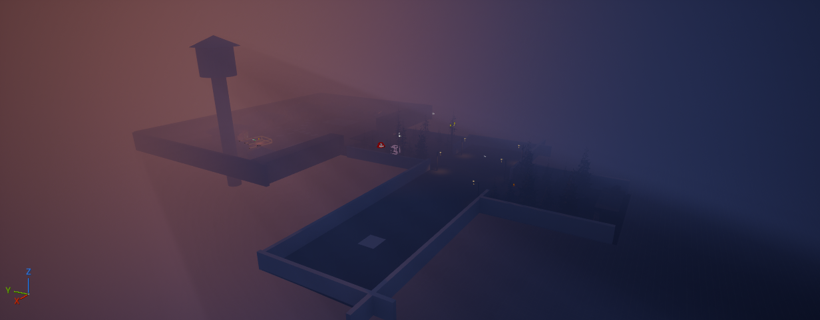
2. Dusk/Night before guidance lights

Slide 8
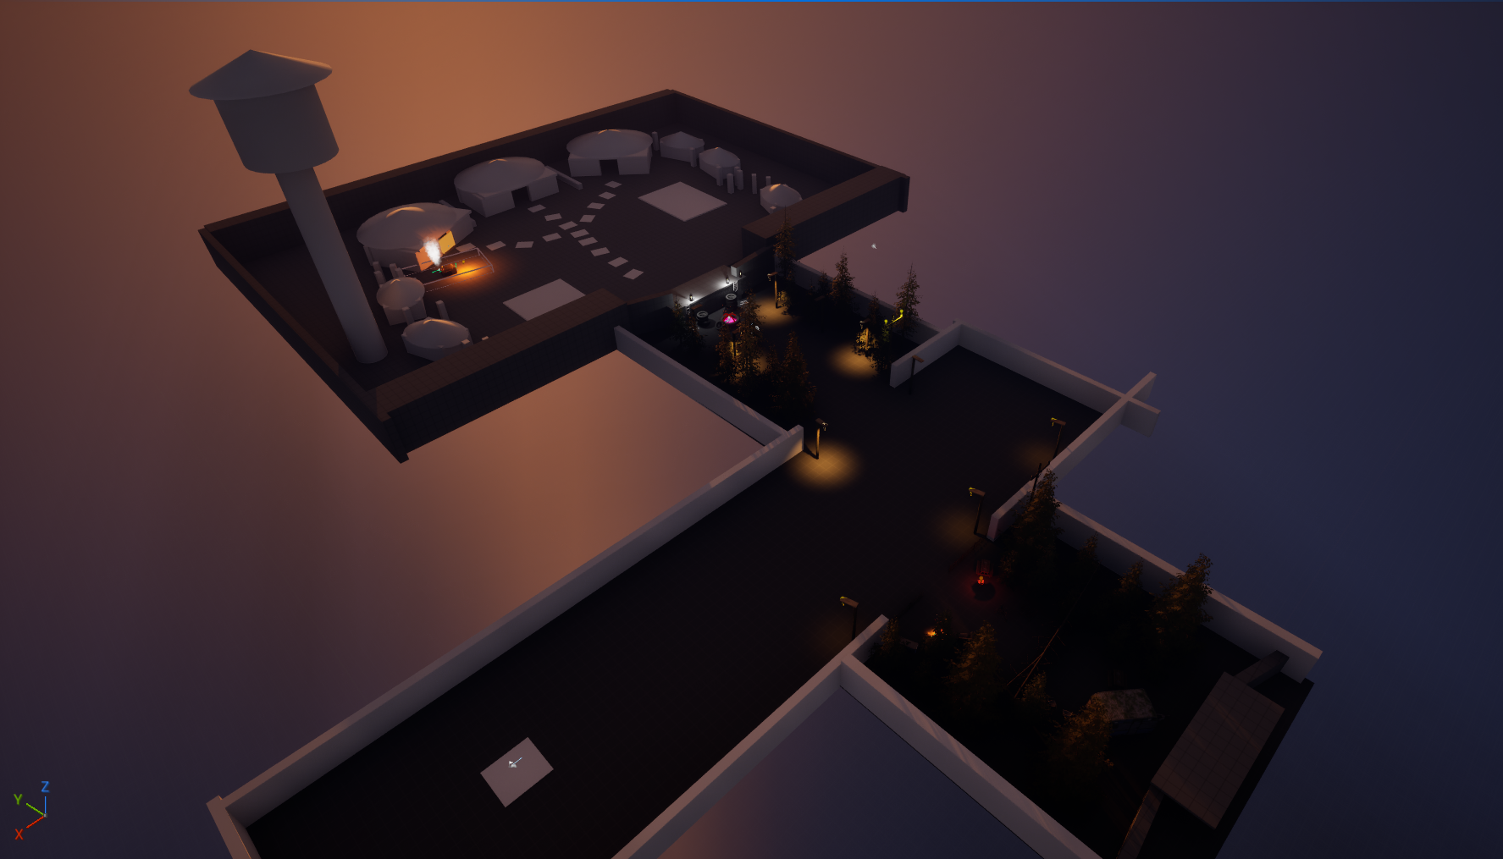
3. Final version with guidance lighting

Slide 9
Devlog Prototype 1
Link –

Slide 10
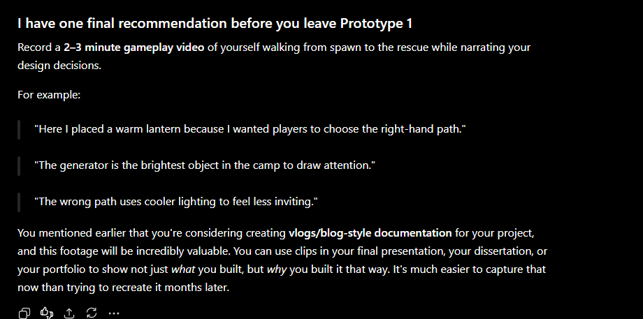
Once E to free player – Black Screen – Next Prortype level loads

Slide 11
Prototype 2: Architectural Guidance
Path Width –
Framing – Using Architecture to frame the objective
Occlusion – Hide things until the right moment
Natural Funnels –
Gateways – Doorways psychologically tell players to continue
Curved Paths – Straight lines reveal everything , curves create curiosity

Slide 12
Changes to test
The map layout had to change slightly as this focuses on the architectural guidance techniques, so changes had to be made in order to demonstrate architectural guidance
To keep the study fair, I have tried to keep it as similar to the other prototypes as possible, keeping the same objectives, themes and environment models

Slide 13
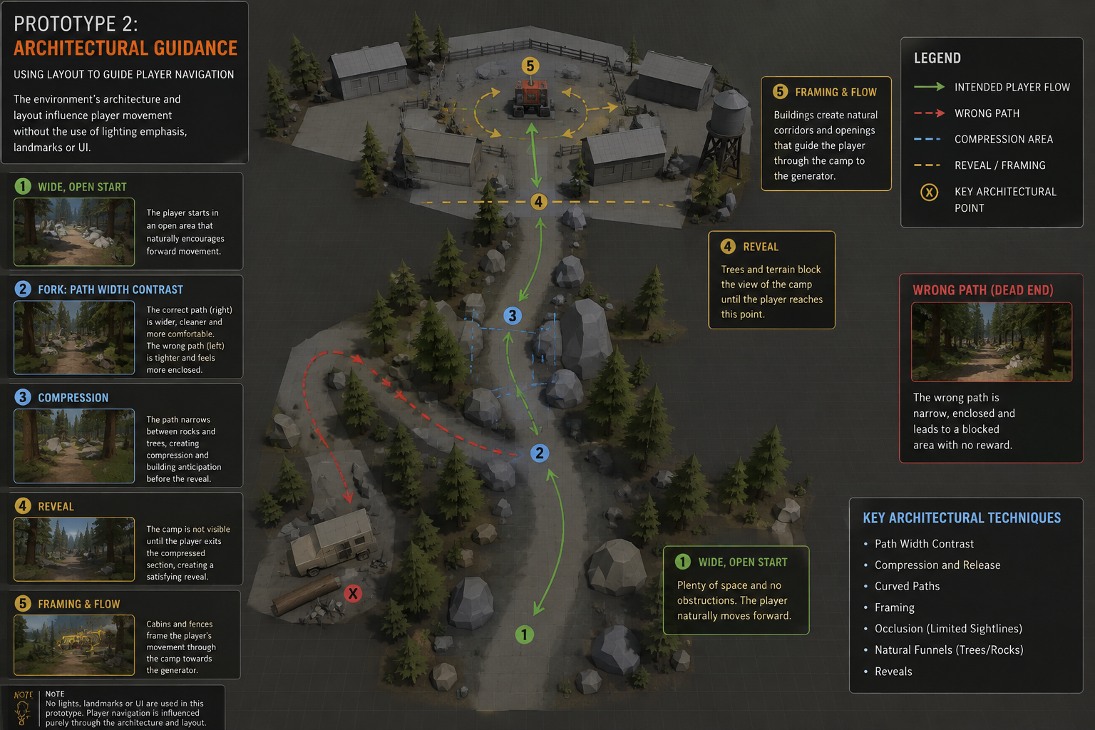
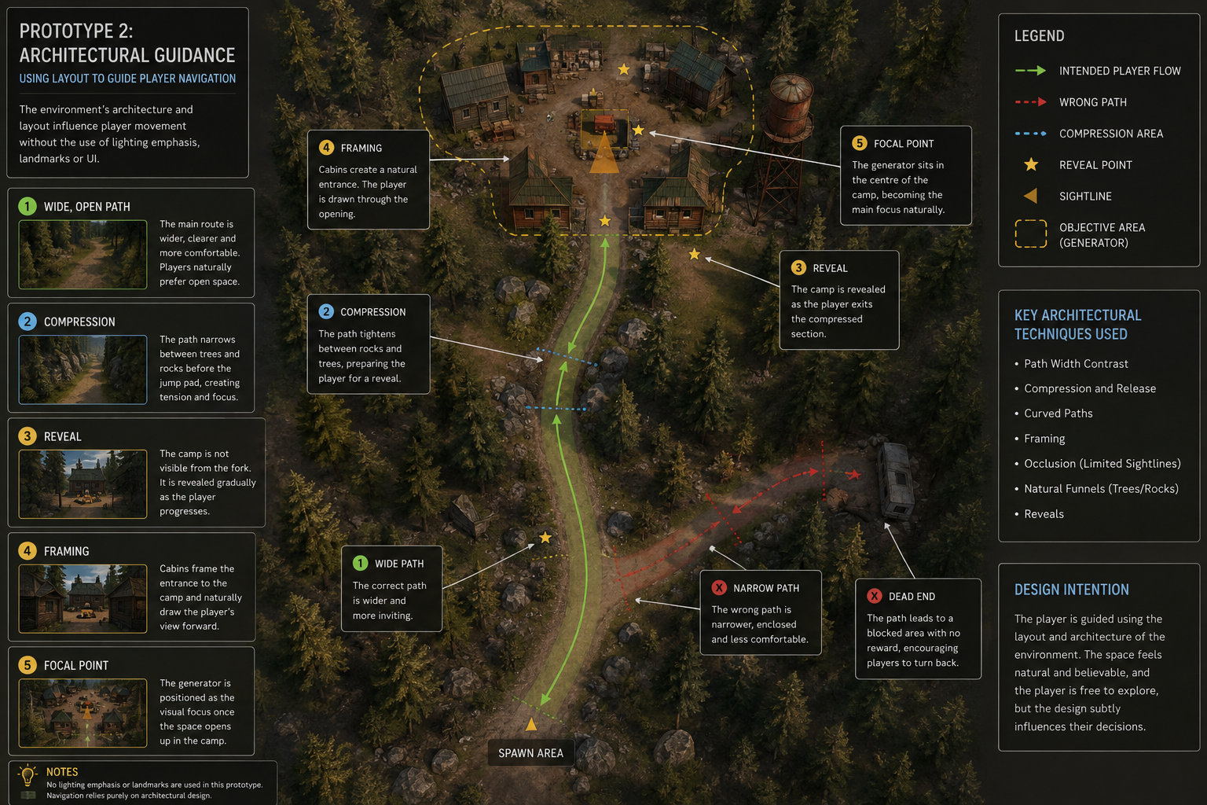
Copy and re do this

Slide 14
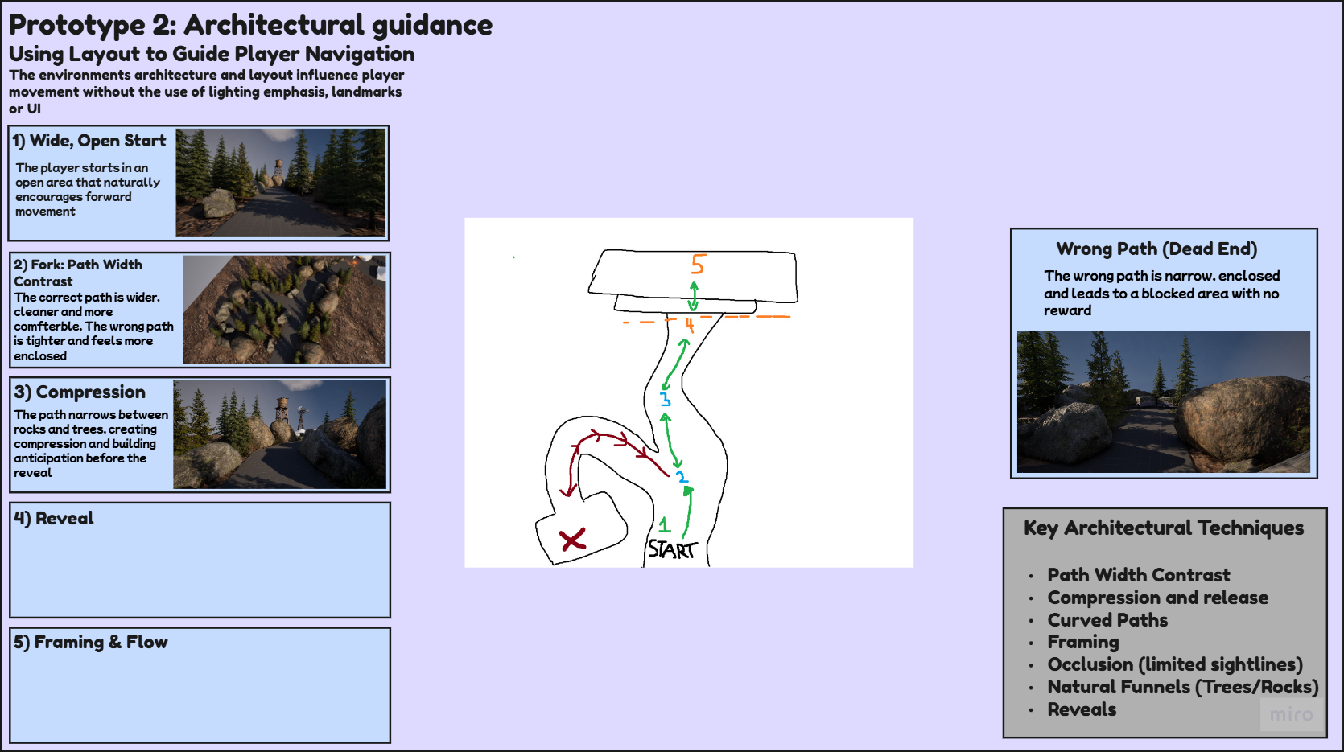

Slide 15
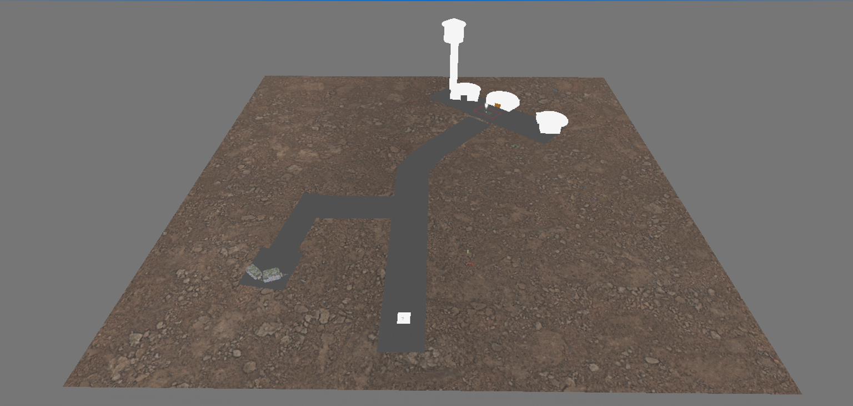
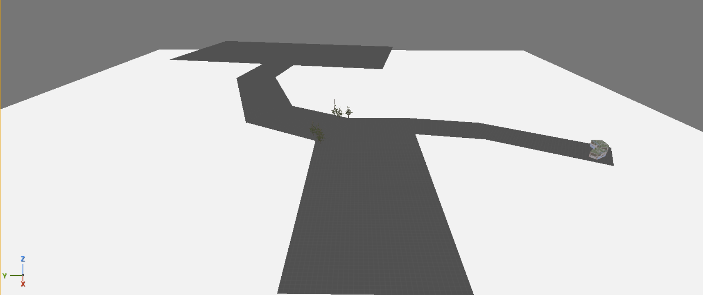
1

Slide 16
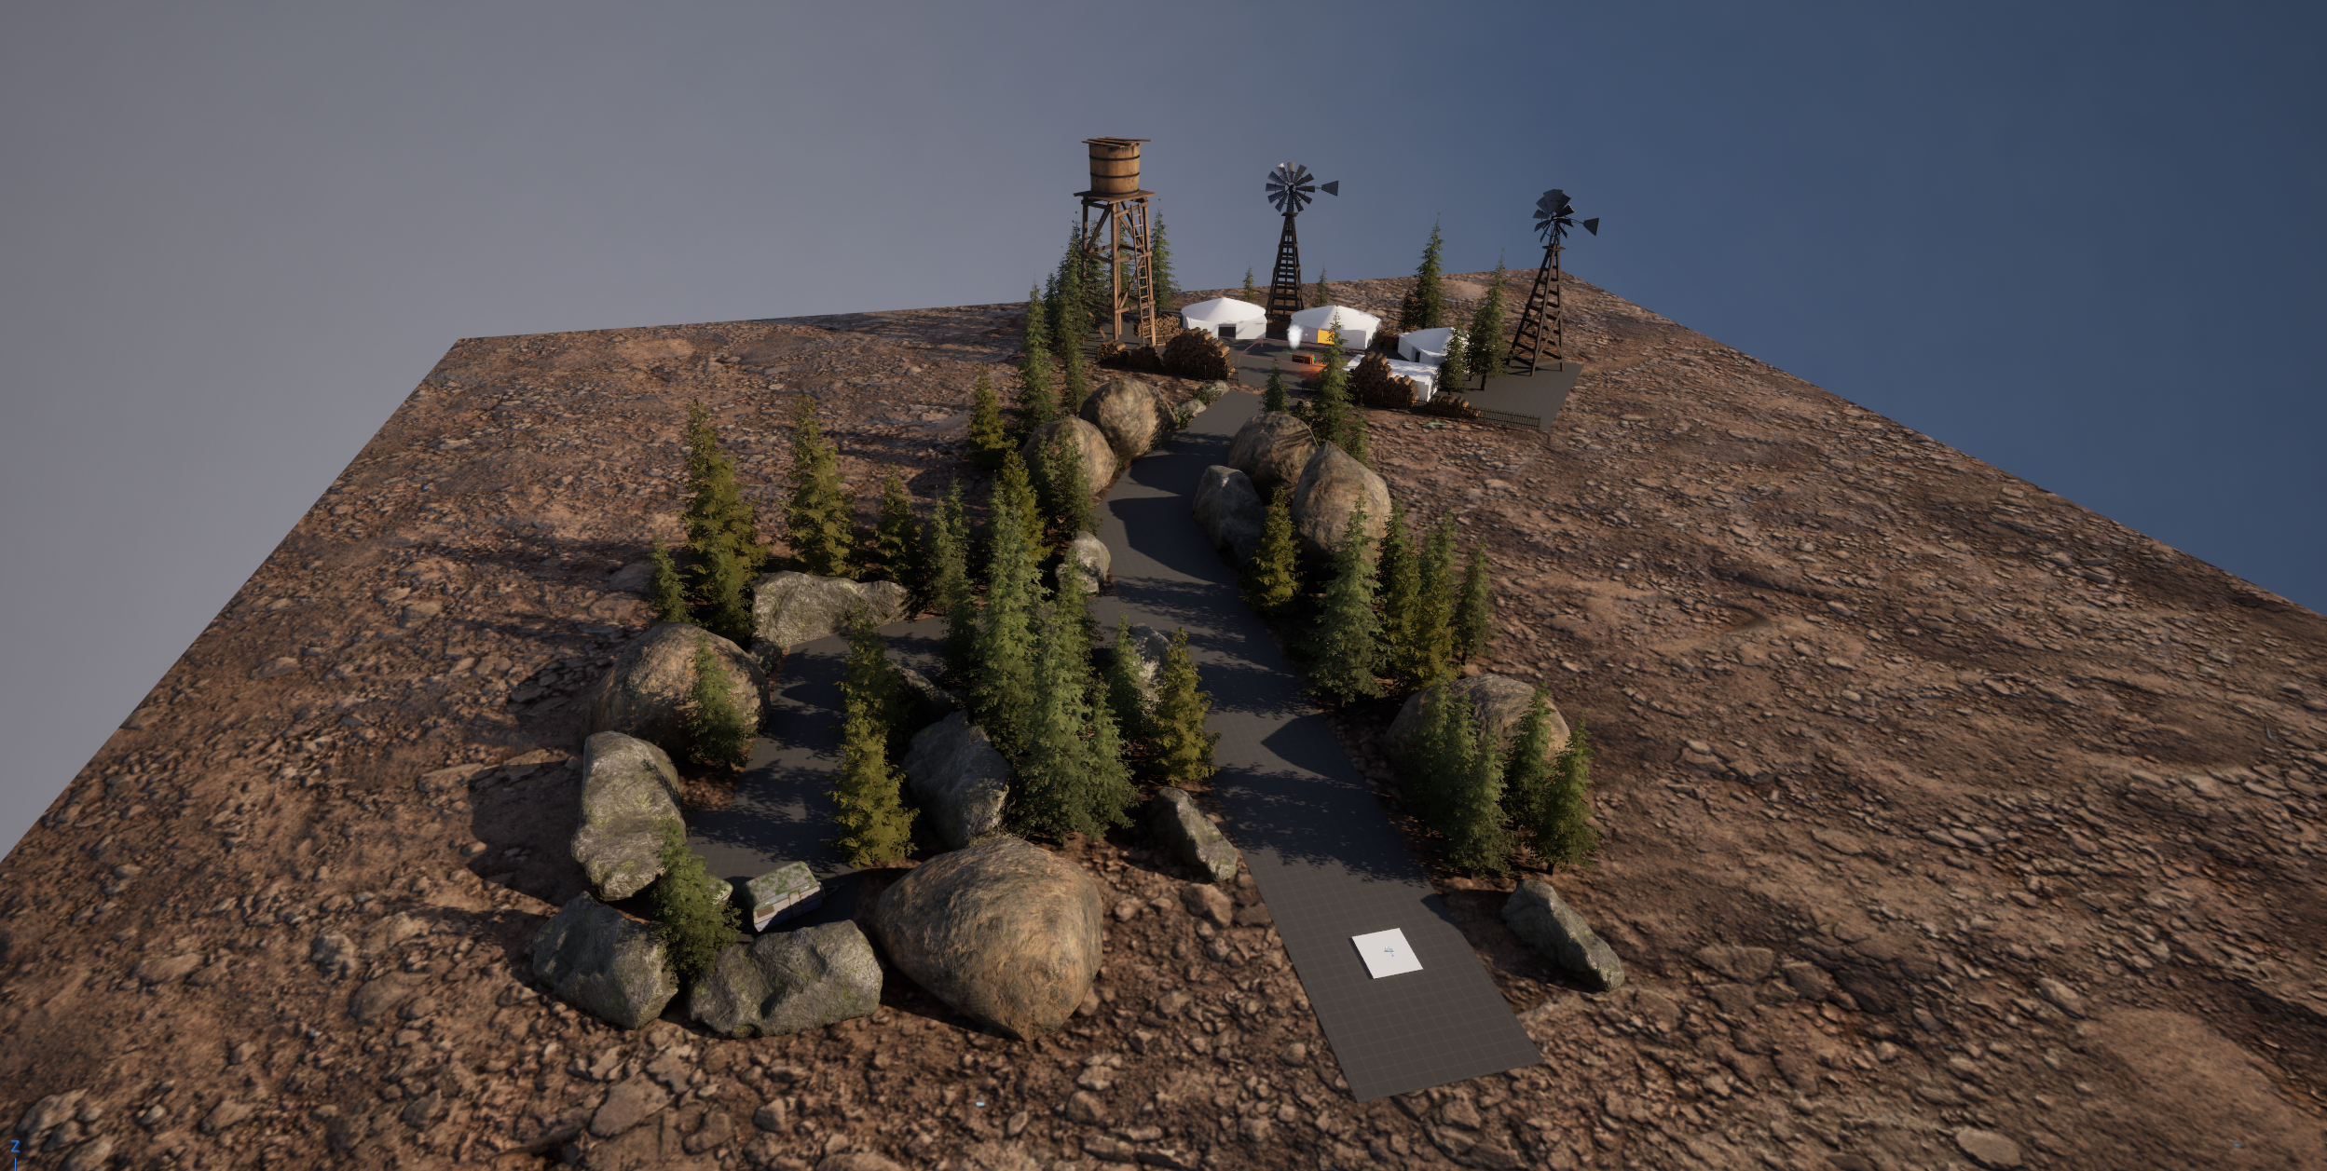

Slide 17
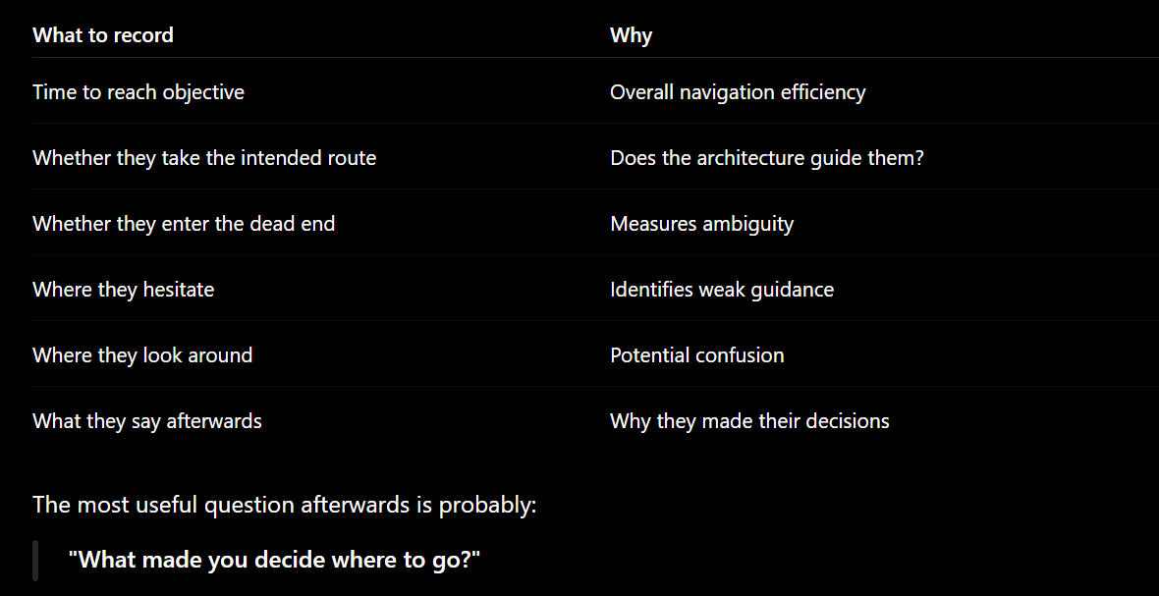
How to test
If players say things like
I just Followed the Path
It felt like the obvious way
Ask questions like:
Which path did you choose first?
Why did you choose it?
Did any part of the environment influence your decision?
Did you ever feel lost?
Did the layout naturally guide you?
If people answer:
"It just felt like the correct path."
then your architectural guidance worked.

Slide 18
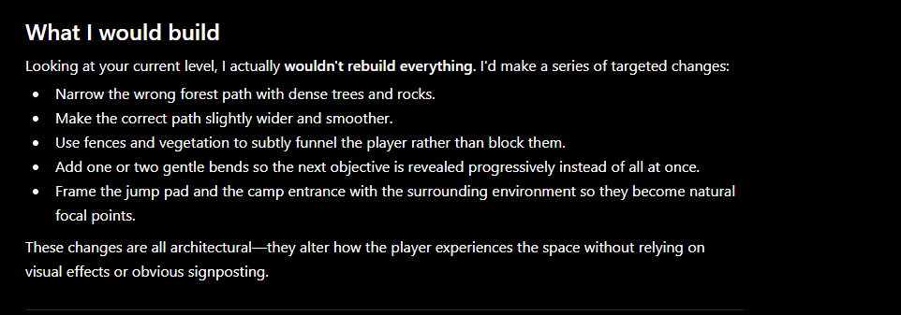
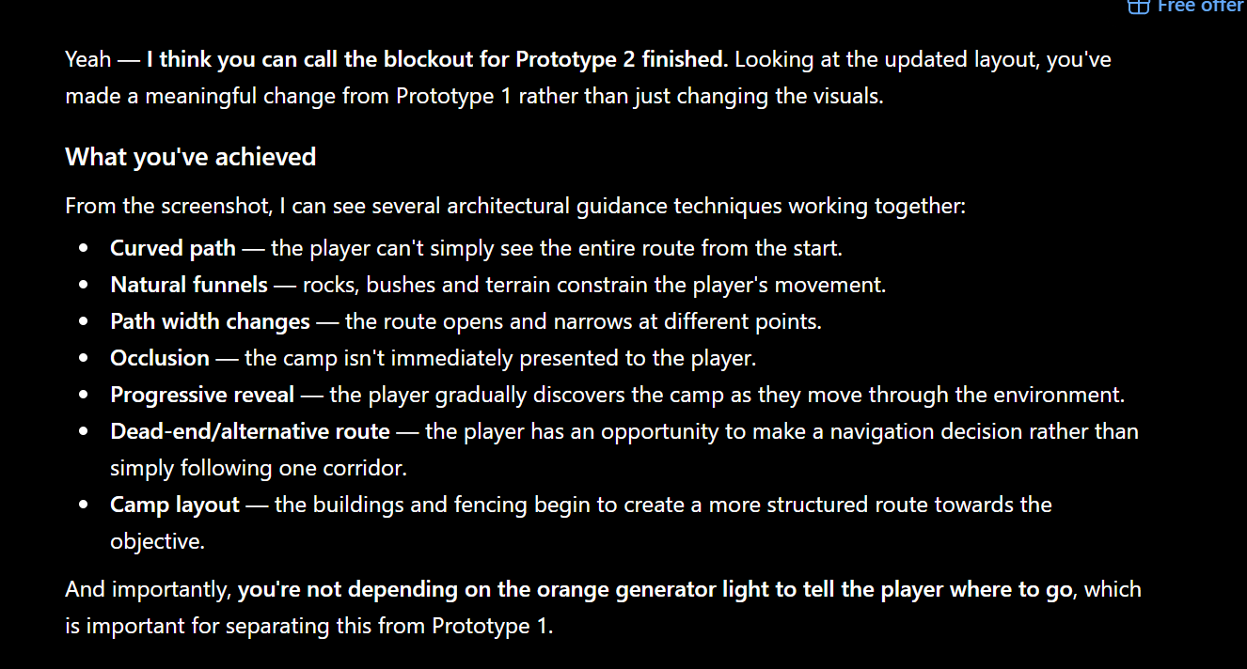

Slide 19
Prototype 3 -

