Slide 1
Environmental Guidance in Digital Games: Influencing Player Navigation Without Explicit Instruction
Morgan Hodge
MA Game Design
Research Question:
Which environmental design techniques are most effective at influencing player navigation and decision making without explicit guidance systems?
Project Overview:
Prototype 1 - Lighting
Existing Guidance Techniques
Research
Research Question
Prototype 2 - Architecture
User testing
Analysis & Findings
Prototype 3 - Landmarks

Slide 2
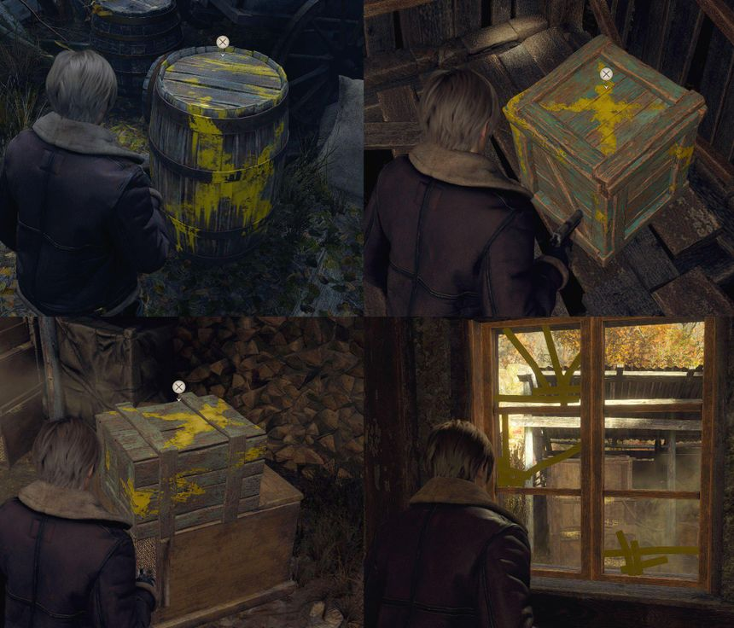
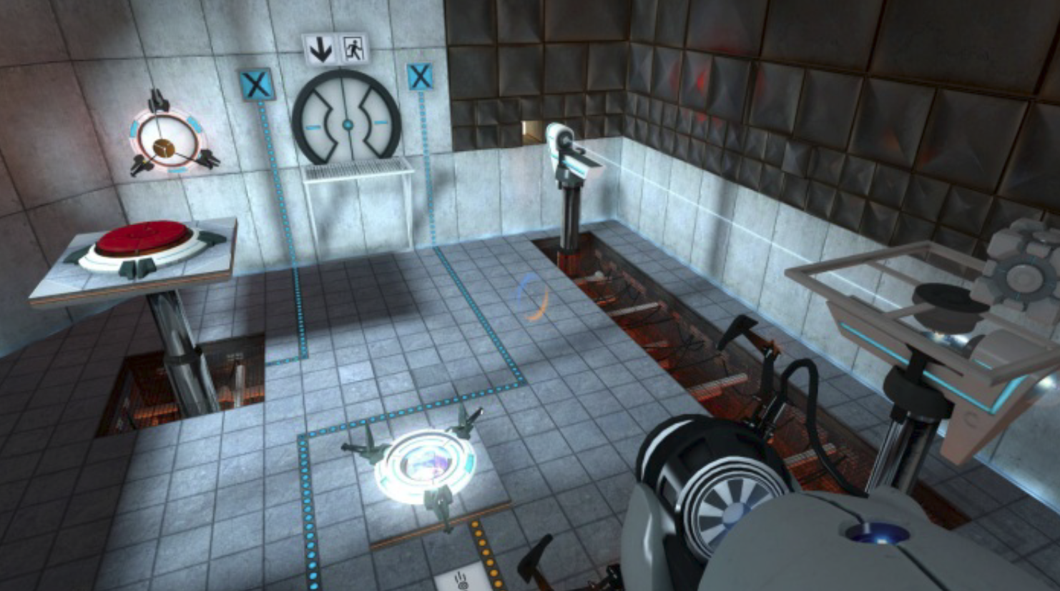
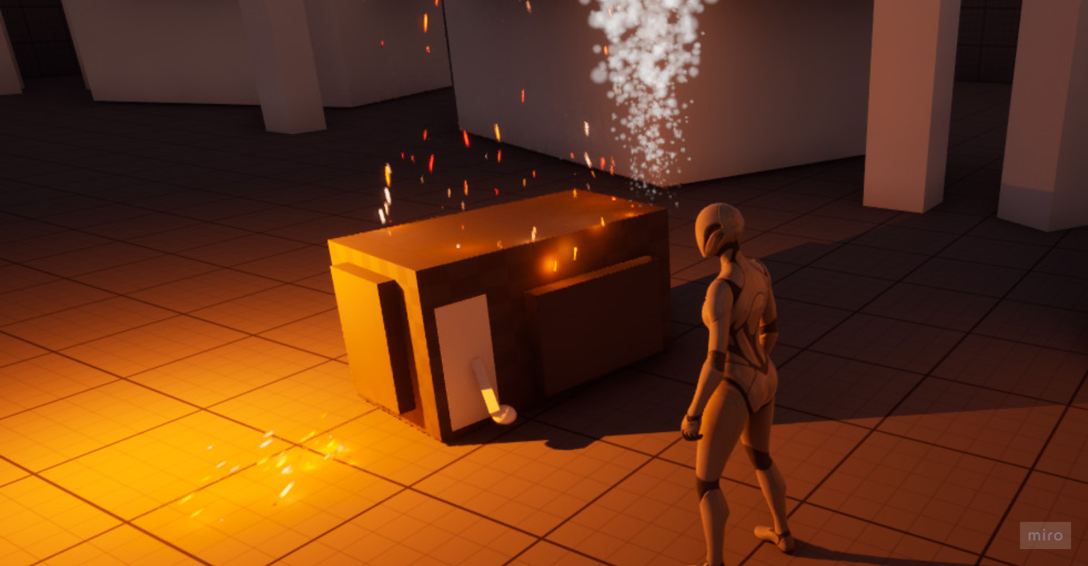
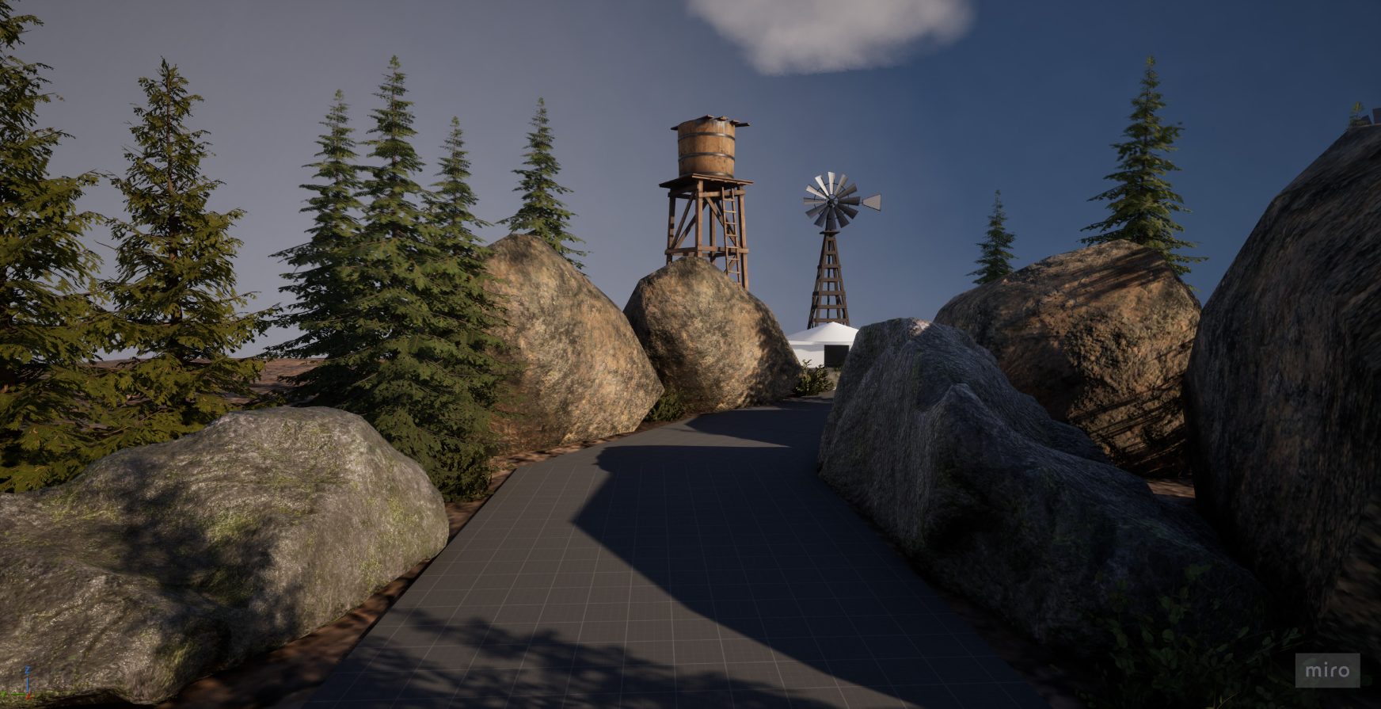
Context
Player Navigation is a fundamental part of level design
Players are constantly making decisions about where to go, what to investigate and which route to take
Many games support this through explicit systems such as:
Objective markers
Waypoints
Arrows
Mini Maps
However, these systems can reduce the need for the players to interpret the environment themselves
This project explores whether environmental design can communicate direction and influence player decision without relying on explicit guidance
Explicit Guidance
Environmental Guidance
Notes:
Navigation is an important part of level design because players are constantly making decisions about where to go and what to investigate.
Games often make this easier through explicit guidance systems, such as objective markers, waypoints, arrows or mini-maps. While these are effective, they can reduce the amount of interpretation required from the player.
This led me to become interested in how much guidance can instead be communicated through the environment itself.
Rather than directly telling the player where to go, I wanted to investigate whether elements such as lighting, architecture and landmarks could influence their decisions while still allowing them to feel like they were navigating the world themselves.

Slide 3
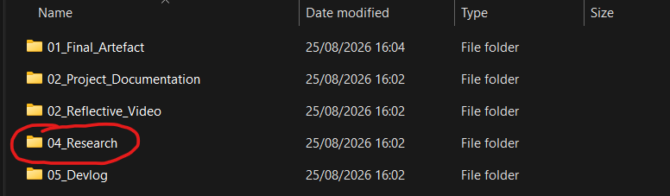
Research and Development Approach
Research
Literature & Contextual research
Analysis
Existing games + Guidance techniques
Development
Three Unreal Engine 5 Prototypes
Testing
Player testing & observation
Iteration
Analysis -> design changes -> retesting
Notes:
I approached the project as an iterative design investigation, combining research with practical experimentation.
I began with literature and contextual research into player navigation and environmental guidance, alongside analysing how existing games guide players through their environments.
I used this research to create a matrix of existing guidance techniques and identify three that I could investigate through practical prototypes.
I then developed the three prototypes in Unreal Engine 5, with each one focusing on lighting, architecture or landmarks.
After development, I carried out player testing to observe how people actually navigated the environments, rather than relying only on my own assumptions about whether the guidance worked.
The results were then used to identify problems and make changes to the prototypes. The clearest example of this was the landmark prototype, which I redesigned after testing showed that players were still relying heavily on the environmental paths.

Slide 4
Prototype 1: Lighting
What I investigated – Can lighting influence player direction and attract attention towards the intended route
What I built – Video Walkthrough
How it guides the player:
Contrast between light and dark areas
Brightness draws attention
Lighting creates a visual priority
Player is encouraged to investigate the illuminated area
What I learned
Lighting successfully attracted player attention, but its effectiveness was affected by the number and clarity of alternative routes
Notes:
The first prototype investigated lighting as a method of environmental guidance.
I wanted to see whether simply creating a visual point of interest through lighting could influence where a player chose to move, without giving them an explicit instruction.
I created a dark woodland environment and used lighting to create a visual priority towards the intended area of the level.
The testing suggested that this was effective at attracting attention. One tester specifically described being drawn towards the light first.
However, the test also highlighted a limitation. Because the prototype had relatively few alternative routes, players did not necessarily experience much uncertainty about where to go.
This showed me that the effectiveness of a guidance technique isn't just determined by the strength of the cue itself, but also by the environment surrounding it.

Slide 5
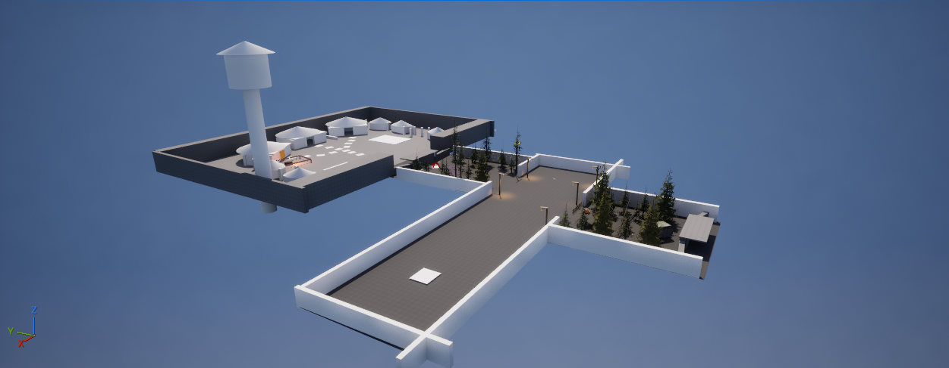
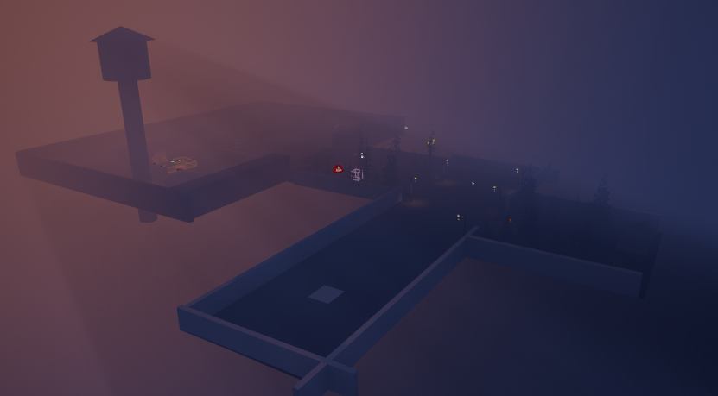
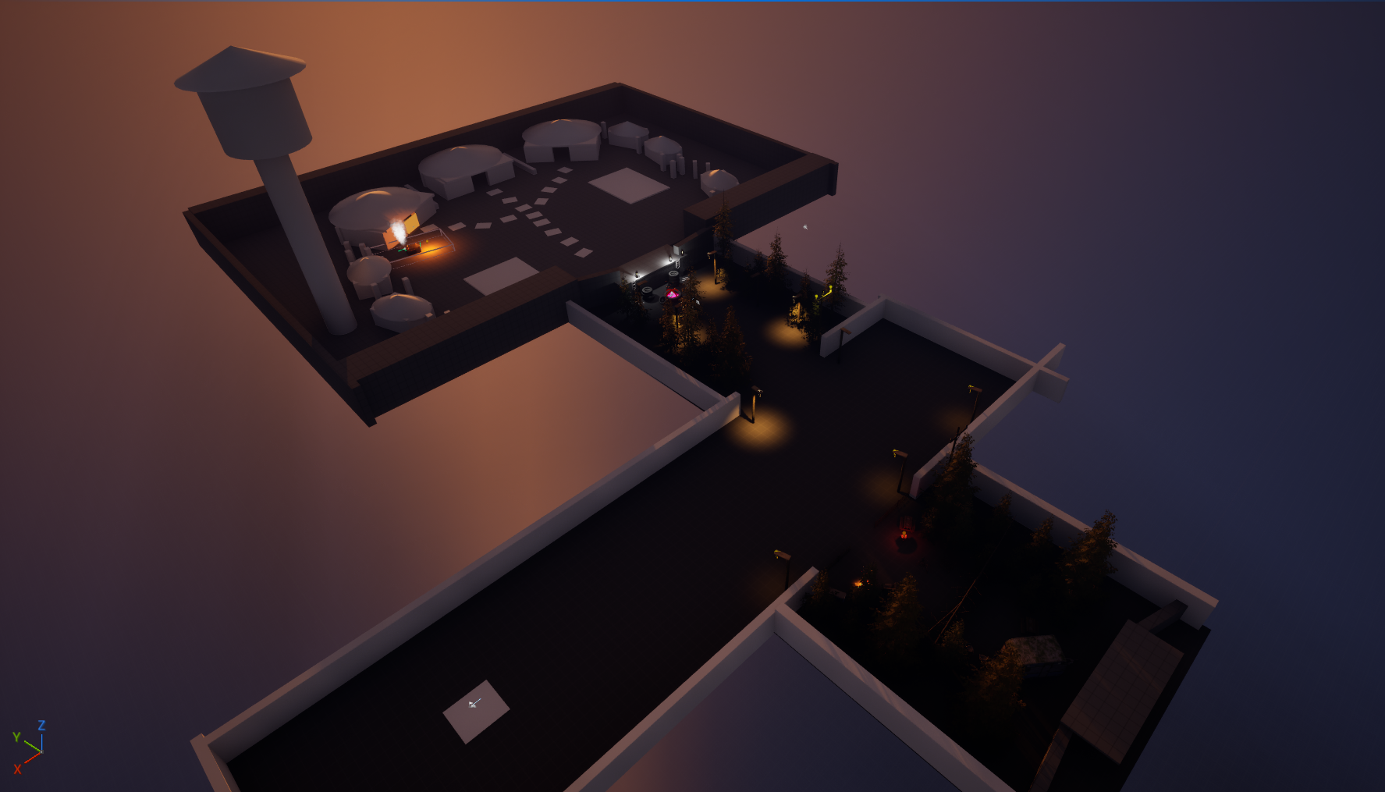

Slide 6
Prototype 2 – Architectural guidance
Can the Structure and layout of an environment influence which route a player chooses?
Approach:
Path width – making one route feel more significant
Framing – drawing attention towards areas of interest
Visibility & Reveals – Controlling what the player can see
Finding:
Architectural design successfully influenced route choice without explicitly telling players where to go
However, architectural cues can become strong enough to function as an obvious path
Notes:
The second prototype focused on architectural guidance, looking at whether the structure and layout of an environment could influence player route choice.
I used techniques such as differences in path width, compression and release, framing, and controlling what the player could see through the environment.
The aim was to make certain routes feel more natural or significant without explicitly telling the player which direction to take.
This prototype was particularly effective during testing. All of the recorded testers reached the objective, and the recorded completion time was also lower than the lighting prototype.
However, I also found that these techniques can become quite obvious. If the environment creates a very clear road or path, the player may simply follow that structure rather than actively interpreting other environmental cues.
This became particularly important when developing the landmark prototype.

Slide 7
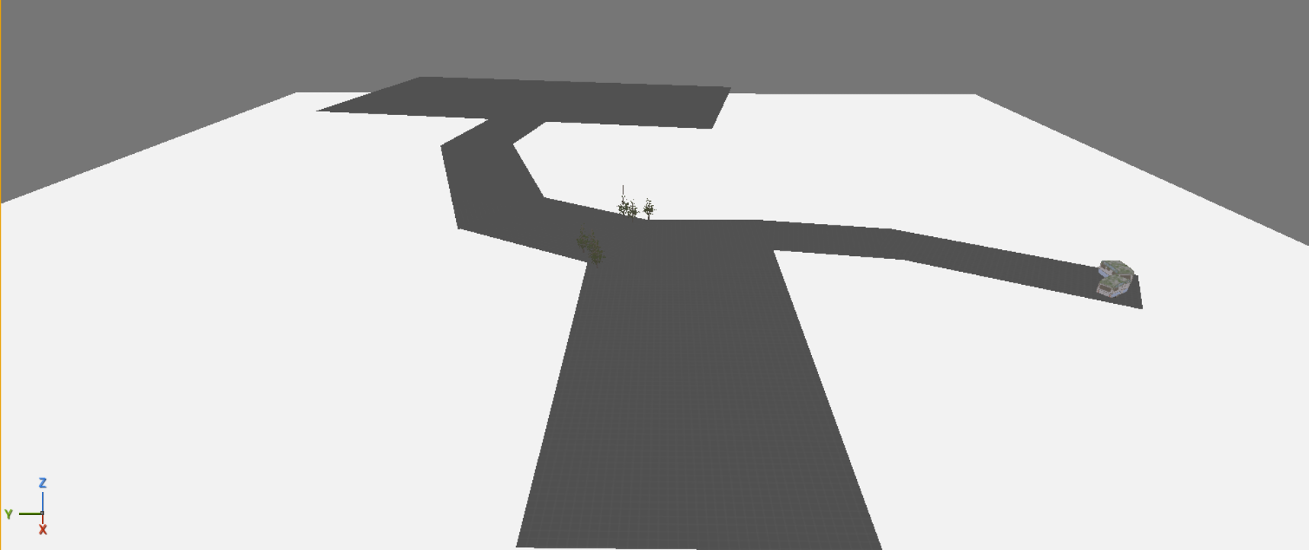
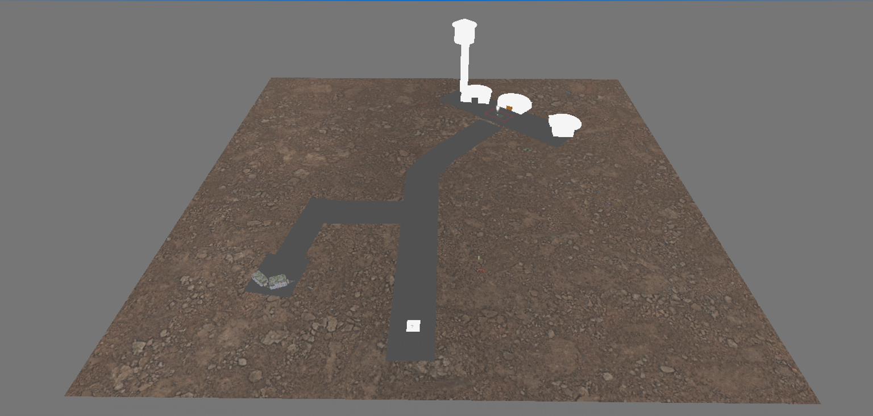
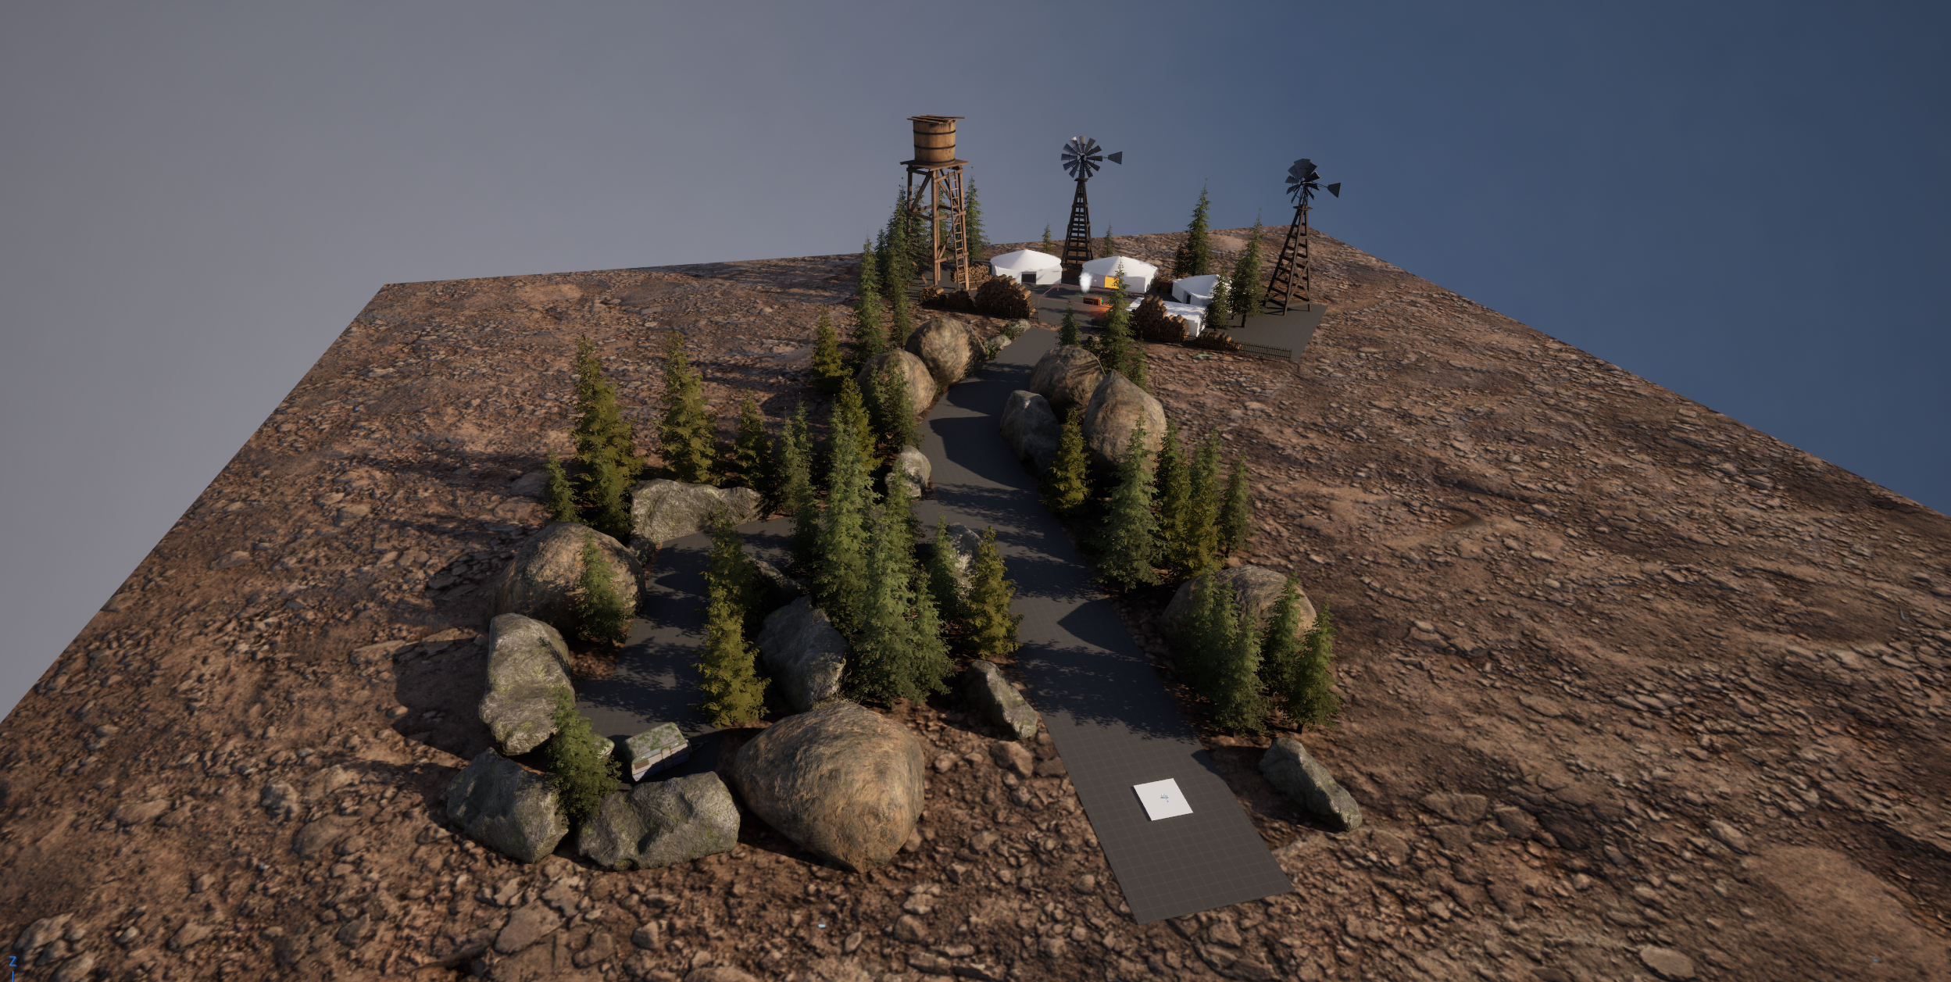

Slide 8
Prototype 3 - Landmarks
Can distinctive environmental landmarks help players navigate and maintain orientation without defined routes?
Initial Approach:
Large, recognisable landmarks
Water tower as visual reference
Players could use the landmark to understand direction and position
What I discovered from testing was the initial environment still contained strong architectural guidance
Iteration after testing:
Redesigned entire environment
Open terrain
Reduced routes
Added more environmental landmarks (Rivers, hills)
Retested
As a result, players were able to now use the water tower as a reference point for orientation
Notes:
The third prototype investigated landmarks as a way of helping players navigate and maintain a sense of orientation.
I initially created an environment where players could use recognisable landmarks, particularly the water tower, to understand where they were and where they might want to go.
However, the first round of testing exposed a problem with my design. Players were still able to rely heavily on the roads and paths within the environment. This meant I couldn't confidently say that the landmark was responsible for their navigation, because there were still strong architectural cues competing with it.
Rather than treating this as a failed prototype, I used the feedback to redesign it. I removed the obvious routes and created a much more open environment, with the water tower acting as the primary visual reference.
When I retested the prototype, players were able to use the water tower to orient themselves, suggesting that removing competing cues made the landmark guidance much more apparent.

Slide 9
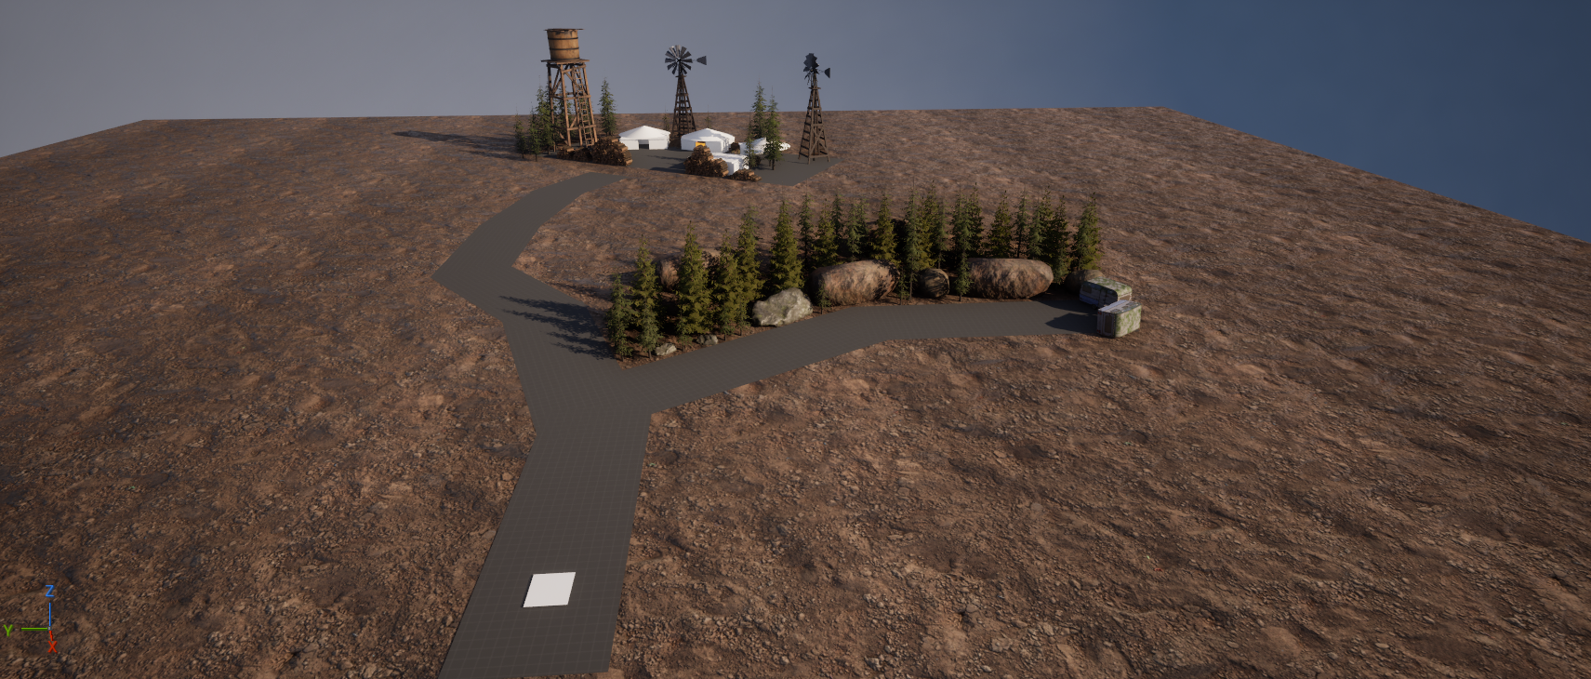
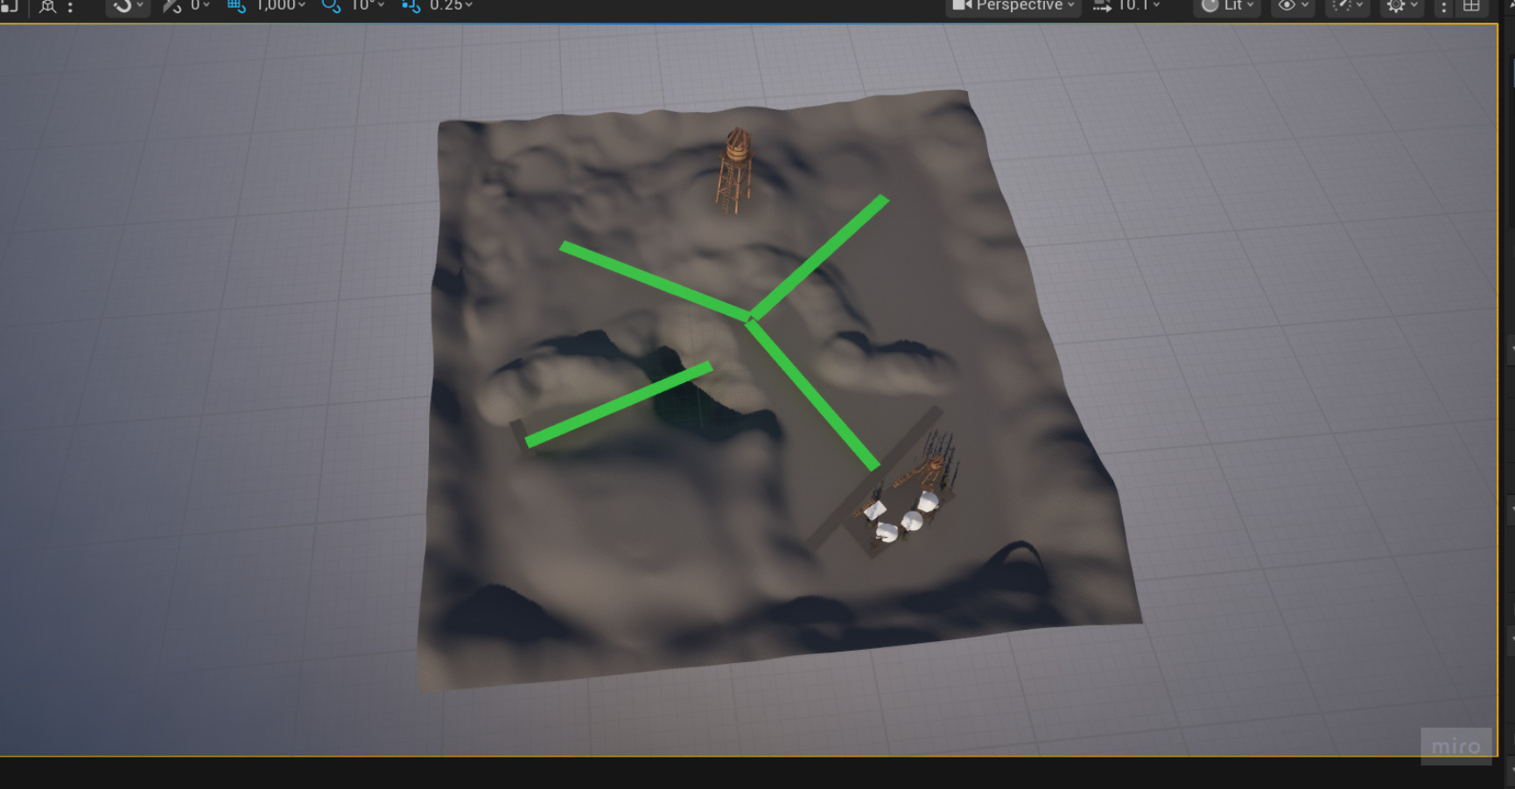
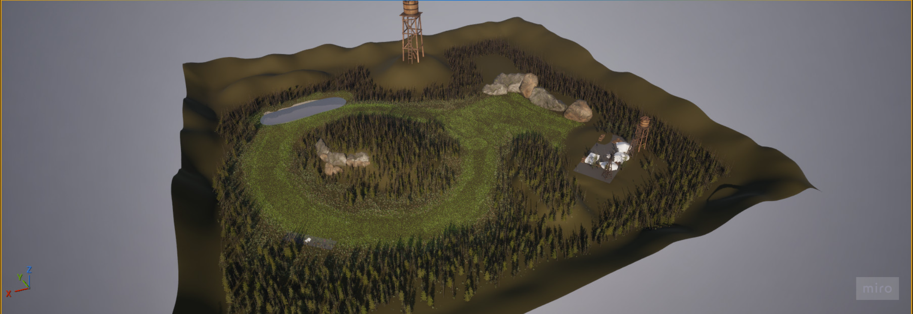

Slide 10
Testing and Findings
4 Recorded testers played the prototypes and were asked to navigate to the objective without explicit directional instructions
What was measured:
Objective completion
Completion time
Navigation confidence
Wrong turns/hesitation
Player Feedback
Recorded Results
Key Findings
Lighting – Successfully attracted player attention
Architecture – Strongest and most direct route influence
Landmarks – Initially difficult to isolate, but became more effective after removing competing routes
The environment influenced navigation, but competing environmental cues could change how players interpreted the intended guidance
Notes:
I tested the prototypes by asking players to navigate through each environment and reach the same type of objective, without giving them explicit directions.
I recorded whether they reached the objective, their completion time, navigation confidence, and any wrong turns, hesitation or feedback they provided.
The lighting and architecture prototypes both had full completion among the recorded testers. The architecture prototype had the fastest average recorded completion time at 28 seconds, compared with 52.7 seconds for lighting.
The landmark prototype initially produced very different results. Testers were often relying on the roads and paths rather than the landmark itself, which led me to redesign the environment.
After removing those competing routes, players were able to use the water tower as a reference point for orientation.
Overall, the testing suggested that environmental guidance can influence navigation, but its effectiveness depends on the other cues present within the environment.

Slide 11
Research Findings
Lighting
Visual contrast and lighting can attract attention and influence where players look and move
Architecture
Spatial configuration, paths, openness and enclose can influence how players interpret possible routes
Landmarks
Distinctive environmental features can provide reference points that help players orient themselves and build an understanding of the space
Effective environmental guidance should communicate direction without explicitly telling the player where to go
Notes:
My research identified three areas that I felt were particularly relevant to testing environmental guidance.
The first was lighting. Lighting and visual contrast can be used to attract attention and make certain areas stand out from their surroundings, which led to my first prototype.
The second was architecture and spatial configuration. Research into wayfinding suggests that the arrangement of paths, spaces and environmental elements affects how people interpret and navigate an environment. This informed my second prototype, where I focused on techniques such as path width, compression, framing and reveals.
The third area was landmarks. Distinctive environmental features can act as reference points, helping players understand their position and build a mental representation of an environment. This became the focus of my third prototype.
A key idea running through all three was that the environment should communicate direction without explicitly instructing the player where to go.

Slide 12
Audience and Value
For Level Design:
Demonstrates how environmental elements can communicate direction without explicit navigation UI
For Design Practice:
Shows the importance of controlling competing environmental cues when testing guidance techniques
For My Personal Practice: Developed my ability to
Prototype level design ideas
Learn Guidance techniques
Analyse player behaviour
Iterate from evidence
Work with Unreal Engine
Notes:
I think the wider value of the project is both practical and personal.
For level design, the project demonstrates how environmental elements can communicate information without directly instructing the player through UI.
For design practice, one of the most useful findings is the importance of considering competing cues. A technique may appear effective during development, but player testing can reveal that players are actually responding to something else in the environment.
For my own professional practice, the project has also developed my ability to take a design question, turn it into a practical prototype, test it with players and then make design decisions based on evidence.
This is particularly relevant to the type of level and technical design work I want to pursue after the course.

Slide 13
Reflection and Future work
With More Time I would
Increase the amount of play testers
Test combinations – investigate how lighting, architecture and landmarks work together
Expand navigation scenarios – test different environments, routes and objectives
Get Insights from industry professionals – Reach out to veteran designers for their opinions and feedback on the matter
The project showed me that effective player guidance is not simply about adding cues – it's about designing the entire environment around how those cues are interpreted
Notes:
If I continued the project, the first improvement would be increasing the number of testers so that I could gather stronger comparative evidence.
I would also improve the experimental control of the prototypes. The landmark prototype demonstrated how easily other environmental cues can affect the results, so I would spend more time controlling variables between each test.
Another area I'd like to investigate is how these techniques work together. In a real game, lighting, architecture and landmarks would rarely exist independently, so testing combinations could provide a more realistic understanding of environmental guidance.
Finally, I would expand the testing into different environments and navigation scenarios to see whether the findings remain consistent.
The biggest thing I have taken from the project is that effective guidance isn't simply about adding a visual or environmental cue. It is about designing the entire environment around how players interpret those cues.
The testing process changed my understanding of that, particularly through the problems I encountered with the landmark prototype.

