Slide 1
Project definition & planning (10%) –
TRELLO , MEETINGS , WRITTEN STUFF, VIDEOS
Context review & subject knowledge (15%)
GAMES LIKE ZOMBIES, LEVEL DESIGN BOOKS, ETC
Project methodology and implementation (50%)
Idk yet
Critical evaluation & conclusions (15%)
Testing conducted multiple times (proof) and the testing doc and forum
Structure and presentation (10%)
Figures, images, graphs with correct lables etc

Slide 2
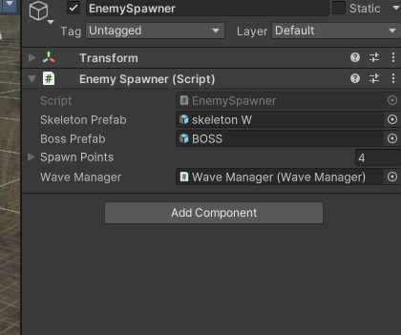
How the round works – Script

Slide 3
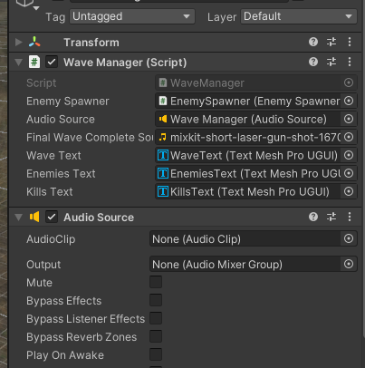
Wave Manager – Script

Slide 4
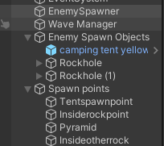
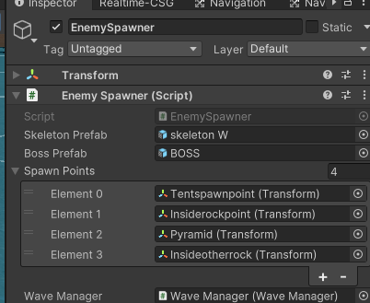
Enemy Spawn Points – Create empty gameobject

Slide 5
Scene Flow
MainMenu → Level1 → Loading → Level2 → Loading → Level3 → EndScreen → MainMenu

Slide 6
I THINK RN
Going to get all levels working , enemies , boss , part , next level
Then , Audio, Power Ups, Animations
NEW MOVEMENT IS GOOD BUT JUMP NOT WORK (GROUNDCHECK) AND ENEMIES ARENT ATTACKINGBUT DO FOLLOW WHAT THE FUCK
Fuck alla that I need to finish polishing 1 and 2 cuz jj doesn’t like it

Slide 7
What I have polished from 1
Walking / Foot clipping thro floor (Still need to fuckking move everything else down)
Weapons (Anubis’ Staff ) , Bullet (Fire Energy Blasts) – I think some errors are still occurring so need to fix this and then add sound

Slide 8
1 Enemy Model / Animation
FUCK
Moving the floor down seemed to fix this but so did turning off APPLY ROOOT MOTION , I reverted the floor space back to normall so I can focus on the fix , if I do choose this option I will need to move all models down too lol long
Think im going to stick to the Floor being moved down

Slide 9
JJ MEETINGS
Implementaiton – GDD, DESIGN LIKE THE MAP THINGS
Methodology is how I created it like the design implemnation
How I used user testing for feedback to make iterations and yh
Analysis

Slide 10
MOVEMENT 2
JUMP ONLY WORKS WHEN HELD
KINDA BUGGY WHEN PLAYER IS BEING PUSHED
https://www.youtube.com/watch?v=_QajrabyTJc&t=848s
Can always revert back to old as I saved them as prefabs and old movement in separate folder
Make sure to change movement in lvl1 aswel

Slide 11
If I need to revert the z\ombie animiaton then delete links to attack and
using UnityEngine;
public class ZombieAttack : MonoBehaviour
{
public int damage = 10; // Damage per hit
public float attackRate = 1.5f; // Attack every X seconds
private float nextAttackTime = 0f;
private void OnCollisionStay(Collision collision)
{
if (collision.gameObject.CompareTag("Player"))
{
if (Time.time >= nextAttackTime)
{
HealthManager playerHealth = collision.gameObject.GetComponent<HealthManager>();
DamageOverlay screenEffect = collision.gameObject.GetComponent<DamageOverlay>(); // Get the red pulse effect
if (playerHealth != null)
{
playerHealth.TakeDamage(damage);
Debug.Log("Zombie dealt " + damage + " damage to player.");
}
if (screenEffect != null)
{
screenEffect.ShowDamageEffect(); // Trigger red screen pulse
}
nextAttackTime = Time.time + attackRate;
}
}
}
}

Slide 12
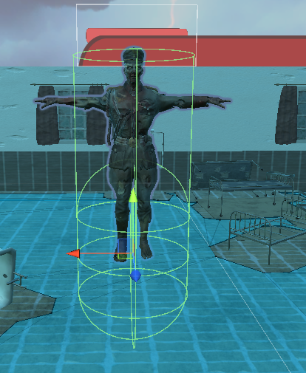
ISSUES
Small issue but the bullets weren’t damaging the player and then I realised the collider was too low so I made hight bigger and collider bigger

Slide 13
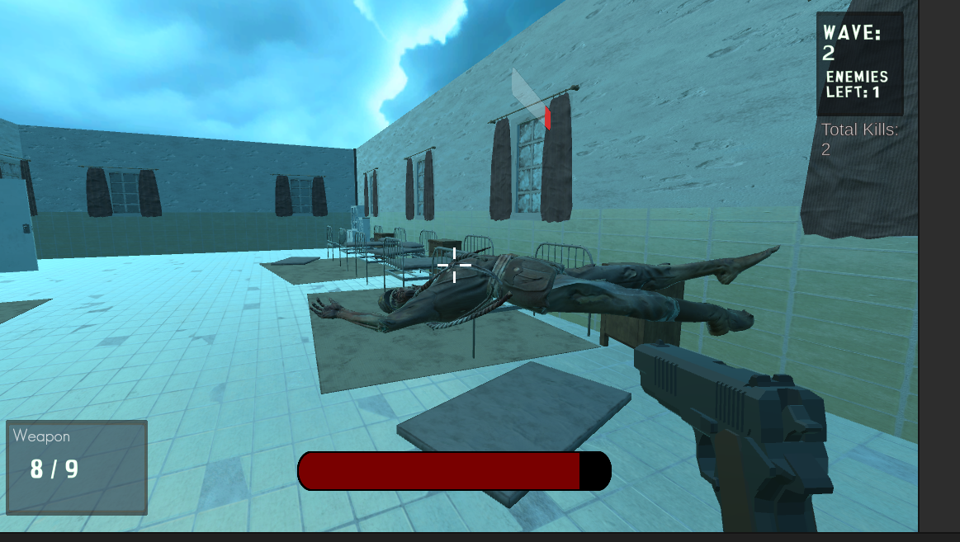
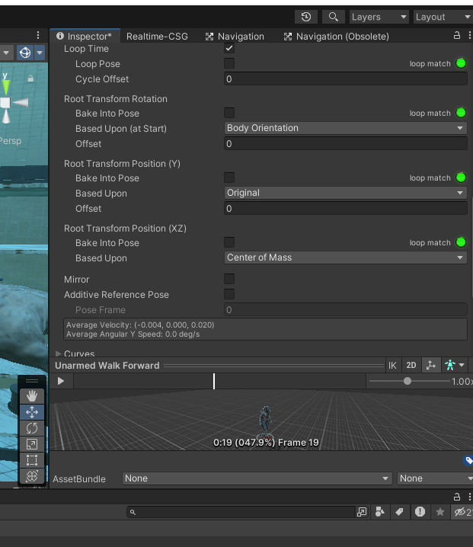
A big issue was enemy death and them hovering above the ground when the death animation played
Fixed by:

Slide 14
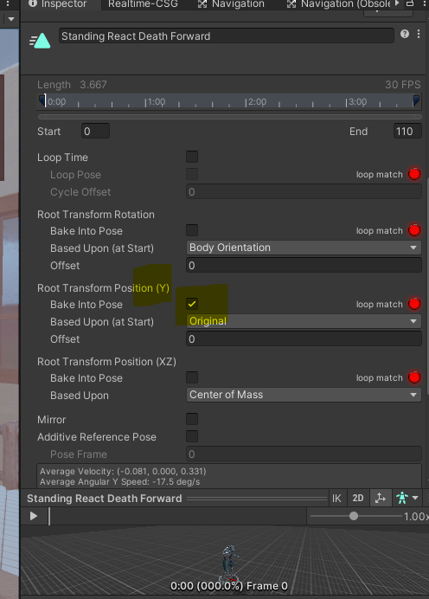
FIX
The fix was going onto the animation file and baking into pose the root transformation of position Y

Slide 15
References
1. https://parents.actionforchildren.org.uk/home-family-life/technology/video-game-age-restrictions/
2. https://openr.co/unveiling-the-demographics-of-call-of-dutys-target-audience/

