Slide 2
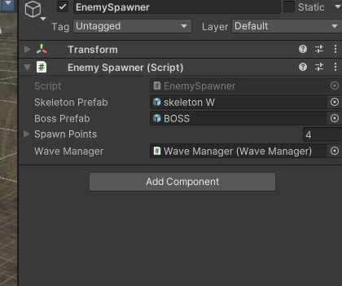
How the round works – Script

Slide 3
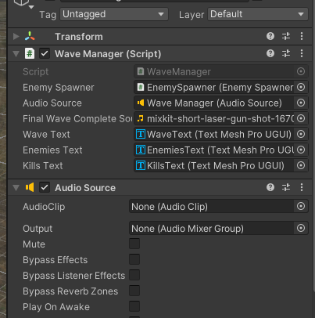
Wave Manager – Script

Slide 4
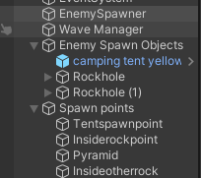
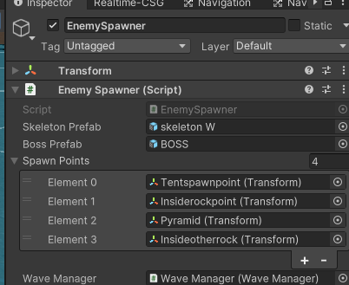
Enemy Spawn Points – Create empty gameobject

Slide 5
I THINK RN
Going to get all levels working , enemies , boss , part , next level
Then , Audio, Power Ups, Animations

Slide 6
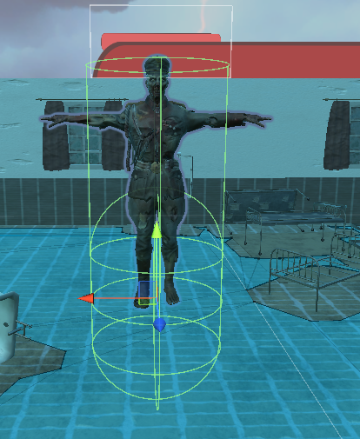
ISSUES
Small issue but the bullets weren’t damaging the player and then I realised the collider was too low so I made hight bigger and collider bigger

Slide 7
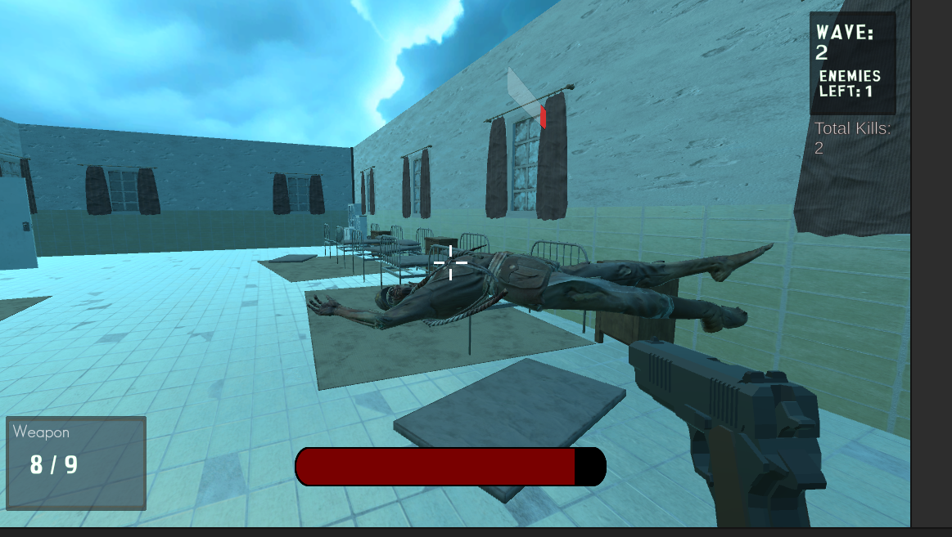
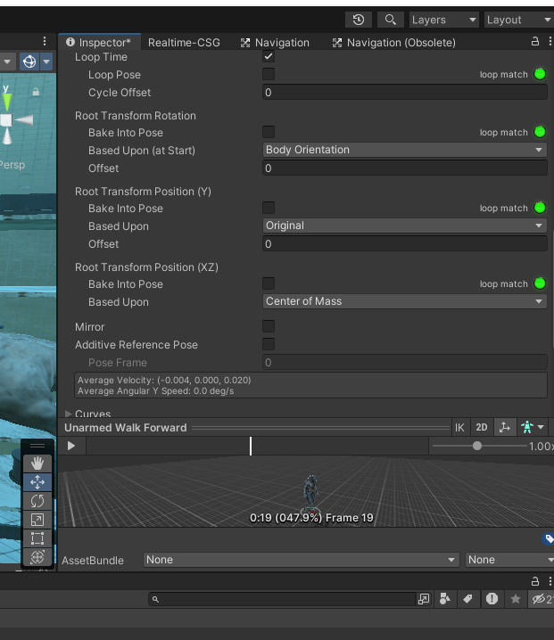
A big issue was enemy death and them hovering above the ground when the death animation played
Fixed by:

Slide 8
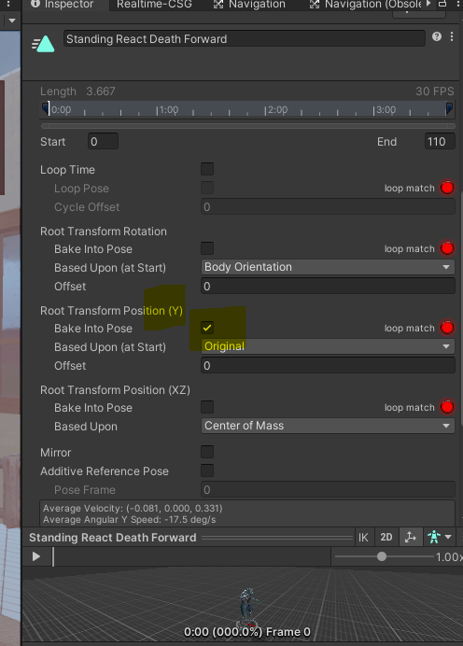
FIX
The fix was going onto the animation file and baking into pose the root transformation of position Y

