Slide 2
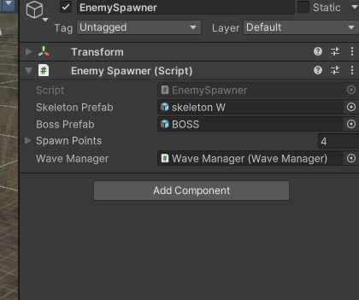
How the round works – Script

Slide 3
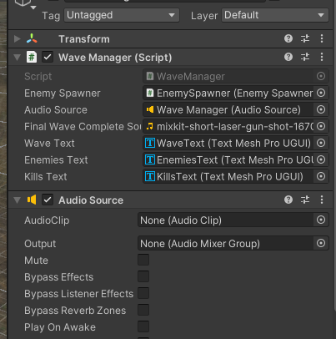
Wave Manager – Script

Slide 4
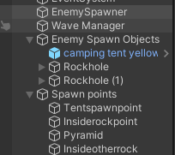
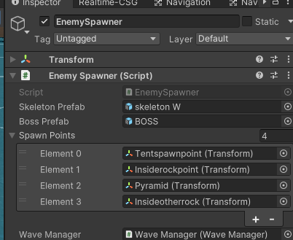
Enemy Spawn Points – Create empty gameobject

Slide 6
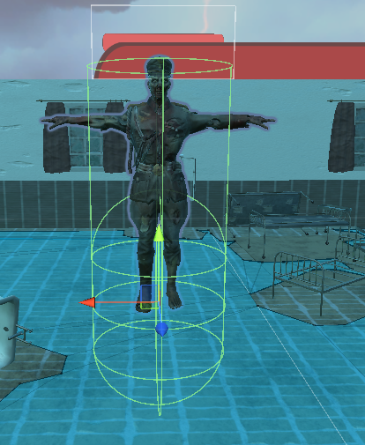
ISSUES
Small issue but the bullets weren’t damaging the player and then I realised the collider was too low so I made hight bigger and collider bigger

Slide 7
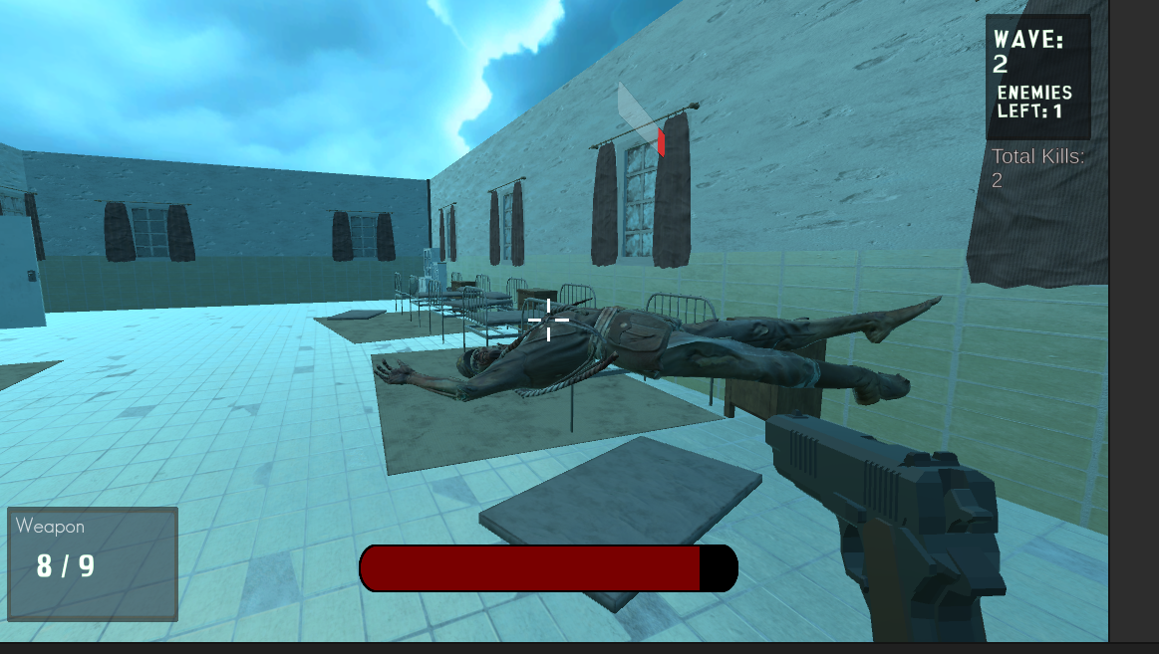
A big issue was enemy death and them hovering above the ground when the death animation played
Fixed by:

