Slide 1
Project definition & planning (10%) –
TRELLO , MEETINGS , WRITTEN STUFF, VIDEOS
Context review & subject knowledge (15%)
GAMES LIKE ZOMBIES, LEVEL DESIGN BOOKS, ETC
Project methodology and implementation (50%)
Idk yet
Critical evaluation & conclusions (15%)
Testing conducted multiple times (proof) and the testing doc and forum
Structure and presentation (10%)
Figures, images, graphs with correct lables etc

Slide 2
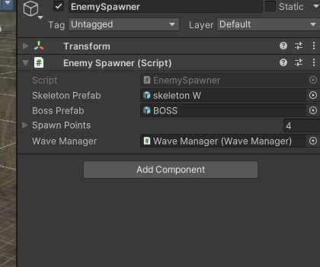
How the round works – Script

Slide 3
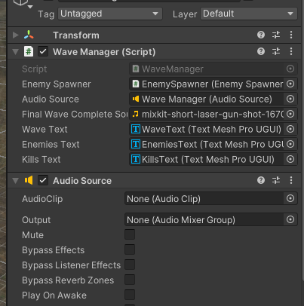
Wave Manager – Script

Slide 4
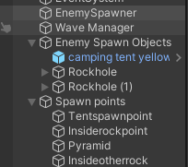
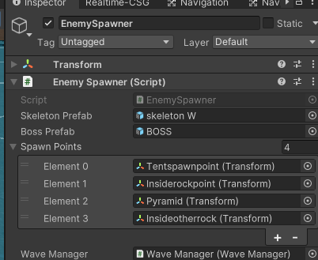
Enemy Spawn Points – Create empty gameobject

Slide 5
I THINK RN
Going to get all levels working , enemies , boss , part , next level
Then , Audio, Power Ups, Animations
NEW MOVEMENT IS GOOD BUT JUMP NOT WORK (GROUNDCHECK) AND ENEMIES ARENT ATTACKINGBUT DO FOLLOW WHAT THE FUCK
Fuck alla that I need to finish polishing 1 and 2 cuz jj doesn’t like it

Slide 6
Boss
Model
Animation
Attack
Ok so the Boss Spawns in when there is not bullet script attached
Looks like there is just a huge issue in enemy bullets
Ok I HAVE NO FUCKING IDEA IT JUST BREAKS

Slide 7
What I have polished from 1
Walking / Foot clipping thro floor (Still need to fuckking move everything else down)
Weapons (Anubis’ Staff ) , Bullet (Fire Energy Blasts) – I think some errors are still occurring so need to fix this and then add sound
Now - Enemy Animations (cant fix the drop , maybe cut time )

Slide 8
1 Enemy Model / Animation
FUCK
Moving the floor down seemed to fix this but so did turning off APPLY ROOOT MOTION , I reverted the floor space back to normall so I can focus on the fix , if I do choose this option I will need to move all models down too lol long
Think im going to stick to the Floor being moved down

Slide 9
Enemy Shoot
Seems to be shooting bent left, also seems as the ememies damage themselves
I actual don’t know it just de spawns

Slide 10
L2 Polish - AUDIO
Audio https://pixabay.com/sound-effects/building-happy-dreams-251941/
Metal drilling in the morgue -https://pixabay.com/sound-effects/eerie-metalic-noise-75420/
Background audio across whole ting -https://pixabay.com/sound-effects/eerie-background-54412/
Zombie https://pixabay.com/sound-effects/zombie-1-22336/

Slide 11
Power Ups (if I get this working it can be used on all)
Health (Put health to max) Done
Infanite ammo (30 sec) Not Done
Doubble Speed? Done – If I want in L1 I need to update the movement
Invinicability (15 sec) DONE
Deleteed a script from player or canvus idk , deleted a lot , make sure all works on l2 before messing w scene 1
UI AND COLOUR MAYBE SFX
SFX / Timer

Slide 12
Scene Flow
MainMenu → Level1 → Loading → Level2 → Loading → Level3 → EndScreen → MainMenu
Flo is good, works, maybe change some buttons ? Or the background music if time
Enable cursor on the screens so buttons can be pressed
Pause button is not working

Slide 13
Gamelogic
Wavemanager proper spawn DONE
Start Screen – Lore – Maybe I can get a vid in there
Takehealth bars off
Moveemnt ask to polish it
Game Over (btn to go back 2 start screen tho)
Pause works?

Slide 14
Layout of report
yourself repeating some of the material from your abstract in your introduction (don’t worry about this).
Think carefully about your reader: they know nothing about your project, so don’t dive straight into the details. In general terms think about
Who is the client (if you have one)
What are their needs/objectives?
What are your primary objectives of the project? How do these relate to the objectives of the client? This is not intended to be your definitive, precise statement of needs and objectives: you can give these in a subsequent chapter.
Start Of Report:
Acknowledgements
Abstract
Table of contents
Word Count
Code Link

Slide 15
Layout of report
Example
Introduction
Background, objectives & deliverables
Literature review (if applicable. Most usually found in a research project)
Method of approach (or Methodology if a research project)
Legal, social, ethical and professional issues
Project management
End-project report
Project reflections
Conclusions
Reference list and bibliography
Main Body
Introduction
Chapters
End Project Report
Reflections
Conclusions
References / Bibliography

Slide 16
Chapters
Background , Objectives & Deliverables (gdd)
Lit review
Method of approach
Legal social ethical professional
User Testing (change this to here in report )
Project Management
Implementation

Slide 17
Chapters
Background , Objectives & Deliverables
Project background, competitor Analysis , Project objectives and deliverables
Lit review
Method of Approach
Methodologies (How I created the design implementation) , Technologies, Project Management Approach ( Trello ) , Supervisor meetings

Slide 18
Issues and Considerations ?
Legal
Social
Ethical
PEGI rating
Project Management tools
Project Management (Devlogs ) (Trello)
Version Control (Github ?)
Weekly meetings

Slide 19
Implementation
IDK IF I do a planning section but if so
Planning – GDD – DESIGNS
Sprints
User Testing (how I used feedback to refine)
Minimum Viable Product
Minimum Awsome Product

Slide 20
JJ MEETINGS
Implementaiton – GDD, DESIGN LIKE THE MAP THINGS
Methodology is how I created it like the design implemnation
How I used user testing for feedback to make iterations and yh
Analysis
Talk about abience sound in those games and how I added
Also methodology, research? Books I got
Show UI drafts by the paper based shit

Slide 21
Testing
anonymous is best, coz if you get their PI then you have to be careful about GDPR and what you want to do with it
I can say I chose ananamys as I just wanted feedback purely for the game
I asked if they had a gaming background to see if non gamers could easily pick up the game
Include Photos of testing commensing
Turn results into graph or whtever u

Slide 22
MOVEMENT 2
JUMP ONLY WORKS WHEN HELD
KINDA BUGGY WHEN PLAYER IS BEING PUSHED
https://www.youtube.com/watch?v=_QajrabyTJc&t=848s
Can always revert back to old as I saved them as prefabs and old movement in separate folder
Make sure to change movement in lvl1 aswel

Slide 23
If I need to revert the z\ombie animiaton then delete links to attack and
using UnityEngine;
public class ZombieAttack : MonoBehaviour
{
public int damage = 10; // Damage per hit
public float attackRate = 1.5f; // Attack every X seconds
private float nextAttackTime = 0f;
private void OnCollisionStay(Collision collision)
{
if (collision.gameObject.CompareTag("Player"))
{
if (Time.time >= nextAttackTime)
{
HealthManager playerHealth = collision.gameObject.GetComponent<HealthManager>();
DamageOverlay screenEffect = collision.gameObject.GetComponent<DamageOverlay>(); // Get the red pulse effect
if (playerHealth != null)
{
playerHealth.TakeDamage(damage);
Debug.Log("Zombie dealt " + damage + " damage to player.");
}
if (screenEffect != null)
{
screenEffect.ShowDamageEffect(); // Trigger red screen pulse
}
nextAttackTime = Time.time + attackRate;
}
}
}
}

Slide 24
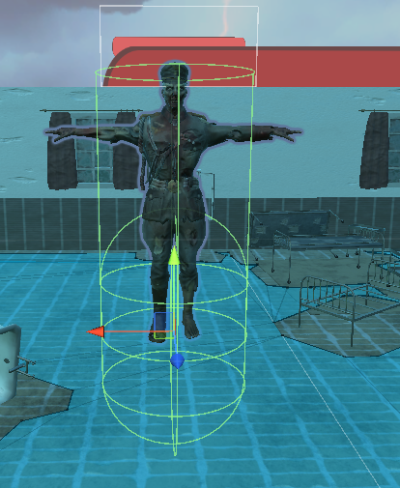
ISSUES
Small issue but the bullets weren’t damaging the player and then I realised the collider was too low so I made hight bigger and collider bigger

Slide 25
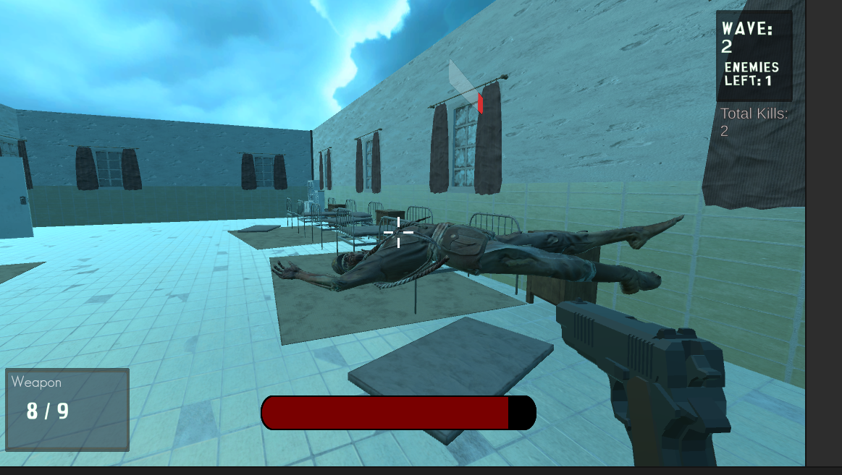
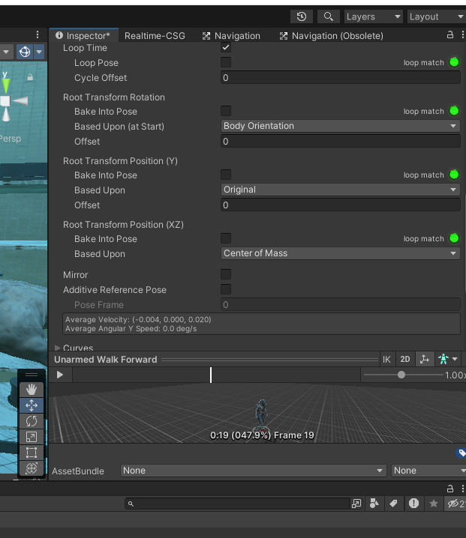
A big issue was enemy death and them hovering above the ground when the death animation played
Fixed by:

Slide 26
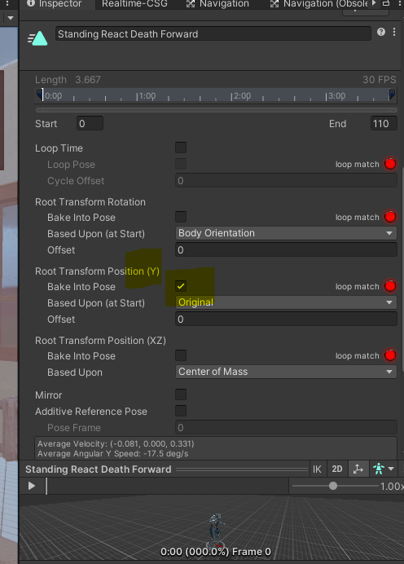
FIX
The fix was going onto the animation file and baking into pose the root transformation of position Y

Slide 27
References
1. https://parents.actionforchildren.org.uk/home-family-life/technology/video-game-age-restrictions/
2. https://openr.co/unveiling-the-demographics-of-call-of-dutys-target-audience/

Slide 28
Game
Itch
Video
Report
Testing
JUST WANT TO POLISH OFF GAME NOW
Rent
Bampy card

