Slide 1
Soccer Recruitment System
Identifying Undervalued Talent Through Machine Learning
Md Rafiul Islam Rafi
CISC 6080 - Capstone Project | Dr. Gary Weiss
Fordham University
Notes:
“My capstone builds a machine-learning system that predicts soccer player market values, finds undervalued talent, suggests like-for-like replacements, and explains its own reasoning

Slide 2
MY INSPIRATION
A Lifelong Soccer Fan and A Liverpool Supporter
I have followed soccer for years and I'm a lifelong Liverpool supporter. Over the past decade Liverpool has been one of the most successful clubs in the world and one of the most data-driven clubs in world football
$13.08 Billons
24,558
international transfer fees in 2025
International player transfers 2025
52 %
Analytics at the core
Since Fenway Sports Group bought Liverpool in 2010, the club has relied on data to make smarter transfer decisions.
Increase in transfer spending compared to 2024
How they use data for player ppurchases:
Identify undervalued talent
System compatibility
The final filter
Liverpool's 2025 summer transfer window, they spent:
£446 million ($600 million USD) on new signings
making it the largest transfer spend in Liverpool's history
Source: FIFA Global Transfer Report 2025
Notes:
This is your personal hook — speak from the heart for a moment. You're a lifelong Liverpool fan; the club is famous for using data (under FSG since 2010) to sign undervalued players like Salah and Robertson before the market caught on. Say that THIS is what inspired your project: you wanted to build a smaller version of what Liverpool's analytics team does. It makes the whole talk feel motivated and personal. ~90 seconds.
Source: https://cdn.fifa.sportsagentinstitute.com/wp-content/uploads/2026/02/26175053/Global-Transfer-Report-2025-1.pdf

Slide 3
THE PROBLEM
Why Soccer Recruitment Needs Data
Clubs spend billions of dollars on player transfers each year, yet recruitment is still largely subjective, often driven by scouting opinions, player reputation, and media hype.
The old way - gut feeling
Recruitment based primarily by opinion, reputation, and hype. The result: overpaying for hyped names and missing undervalued players.
Overpaying for hyped players is common and costly
Promising undervalued players can be overlooked
Recruitment decisions are often influenced by subjective judgment
Smaller clubs must rely on smart recruitment rather than large transfer budgets
▼
The Modern way - Data-Driven Recruitment
Combines traditional scouting with data analytics and machine learning. Removing bias and spotting bargains before rivals do. This is the goal of this project.
Can data find undervalued players before the market does?
Notes:
"Before building the model, I first looked at the problem that clubs face today.
Every year, football clubs spend billions of dollars on player transfers. However, recruitment decisions are still heavily influenced by factors such as scouting opinions, player reputation, and media hype.
This often leads to two major problems. First, clubs sometimes overpay for highly hyped players. Second, they miss talented players who are undervalued by the market.
This is especially challenging for smaller clubs because they don't have the financial resources to compete with the biggest clubs. Instead of outspending their competitors, they need to outsmart them.
Traditionally, recruitment relied mainly on human judgment. Today, many clubs combine traditional scouting with data analytics and machine learning to make more objective and informed recruitment decisions.
My project follows this modern approach by using machine learning to identify undervalued players before the market recognizes their true value.

Slide 4
PROJECT GOAL
Key Features of the System
The Goal is to build a data-driven soccer recruitment system that uses machine learning to identify undervalued players
whose on-field performance suggests they are worth more than their current market value.
The system performs Four main tasks:
Player Market Value Prediction
Undervalued Talent Identification
Player Similarity Analysis
predict a player's market value from performance statistics, age, position, league, and playing time using regression
compare each player's predicted market value with their actual market value to identify and rank potentially undervalued players
identify similar players using Cosine Similarity, with K-Means clustering and PCA visualization to identify potential lower-cost alternatives
Model Explainability
explains why the model values each player using SHAP, revealing the key factors behind every prediction
Notes:
First, it predicts a player's market value using features such as age, position, league, playing time, and performance statistics.
Second, it compares the predicted market value with the player's actual market value to identify potentially undervalued players in the transfer market.
Third, it performs player similarity analysis using Cosine Similarity, K-Means clustering, and PCA to recommend statistically similar, lower-cost alternatives.
Finally, I used SHAP(SHapley Additive exPlanations) to explain the model's predictions, allowing us to understand which features had the greatest influence on each player's estimated value.
Together, these four components provide clubs with a more objective and data-driven approach to player recruitment."

Slide 5
PROJECT PIPELINE
From Raw Data to Recruitment Insights
Data Sources
▶
Cleaning and
Feature Eng
▶
Exploratory
Analysis
▶
Machine
Learning
▶
Undervalued
Talent Identification
▶
Player
Similarity
▶
Model
Explainability
Notes:
"This slide summarizes the complete pipeline of my project, from collecting raw data to generating recruitment insights.
I started by collecting data from FBref and Transfermarkt, then cleaned and merged the datasets into one unified dataset.
Next, I performed exploratory data analysis and trained machine learning models to predict player market values.
Using those predictions, I identified undervalued players, recommended similar lower-cost alternatives, and used SHAP to explain the model's predictions.
In the next few slides, I'll walk through each step in more detail."

Slide 6
DATA
Where the Data Comes From
FBref Dataset 24-25
Transfermarkt Dataset
goals, assists, shots, tackles, interceptions, crosses, minutes, team goals on pitch and more
per-90 statistics for 2,839 players
53 performance features per player
Market value, highest-ever value, contract expiry, position, club, citizenship, preferred foot, and height.
48,380 players
796 clubs (32 leagues covered)
17,551 transfers with a real fee attached
Merging the two sources
Matched on name + birth year to ensure accurate record linkage between datasets
Validated matched records manually to minimize duplicate or incorrect player mappings
Selected a single season of data to maintain consistency and fair comparisons across all players
Created one unified dataset by combining player performance statistics with market valuation data
~88%
2,514
match rate
players with market value
Notes:
FBref tells you how a player performs;
Transfermarkt tells you what he's worth and his situation. That two-source combination is the core of your dataset.
Since these datasets don't share a common player ID, I merged them using player name and birth year. I also manually validated the matches to reduce incorrect mappings and duplicate records.
After the merge, I achieved an approximately 88% match rate, resulting in a final dataset of 2,514 players with both performance statistics and market values.
transfers.csv (this is your validation data)
Transfer records: 1993 to 2030
88.6% of your merged players successfully got a market value attached from Transfermarkt
2,514 ÷ 2,839 = 88.6%

Slide 7
DATA
Making the Data Ready
Three scripts turn two raw sources into one clean dataset
▶
▶
1
Merge
2
Clean
3
Rename
join_data.py
clean_data.py
rename_cols.py
Matched FBref performance stats to Transfermarkt market values
(~88% matched)
Dropped duplicate and unused columns, unnecessary columns then ordered them logically
identity → stats → market value
Converted cryptic FBref codes into readable labels (Gls → Goals, PPM → Points per Match)
Result: player_valuation_dataset.csv
2,839 players · 71 columns · performance + market value in one place · clean dataset
Notes:
I created three Python scripts to automate the data preparation process.
First, I merged the FBref and Transfermarkt datasets by matching players using their name and birth year, achieving an approximately 88% match rate.
Second, I cleaned the merged dataset by removing duplicate and unnecessary columns, handling missing values, and organizing the columns into a logical structure.
Finally, I renamed abbreviated column names from FBref into more descriptive labels. For example, 'Gls' became 'Goals' and 'PPM' became 'Points per Match', making the dataset easier to understand and analyze.
The final output was a clean dataset containing 2,839 players and 71 columns, combining both performance statistics and market value information in a single file ready for machine learning."

Slide 8
EXPLORATORY DATA ANALYSIS (EDA)
What the Data tells Us
Understand the data first and how they corelates each other.
What the script does
Loads the merged dataset
converts the market value into proper numbers, and it creates a log-transformed version of market value
Log-transforms market value (it's heavily skewed).
Generates 12 charts across three themes:
What it revealed
•
Values are lopsided - most players are worth under €5M, a few reach €200M. Used log-transform to balance it
•
Value peaks in the mid 20s - climbs to €25M around age 24–26, then falls, age is a major driver
Distribution
How player values are spread
•
Premier League (2.4×) - PL players average €24M vs €10M in other top leagues
Relationships
Value vs. age, goals, position, and leagues
•
Contract length matters - average value rises from ~€6M (0 years left) to ~€36M (5 years left)
•
Players who plays for successful teams are valued more highly.
Values
Correlation ranking, heatmap, age curves, league premium, contract length.
Notes:
Before building the machine learning model, I performed Exploratory Data Analysis, or EDA, to better understand the dataset and identify the factors that influence player market value.
During this step, I loaded the merged dataset, converted market values into numerical values, and applied a log transformation because market values are highly skewed. A few players are worth hundreds of millions of euros, while most players are valued much lower.
I then generated 12 visualizations to explore the data from three different perspectives: the distribution of player values, relationships between variables, and correlations among features.
The analysis revealed several important insights.
First, market value peaks around ages 24 to 26, then gradually declines, showing that age is one of the strongest factors influencing value.
Second, players in the Premier League generally have much higher market values than players in other leagues.
Third, players with longer contracts tend to have higher market values because clubs have greater negotiating power.
Finally, players who perform well and play for successful teams are generally valued more highly.
These insights helped me select meaningful features and better understand the patterns

Slide 9
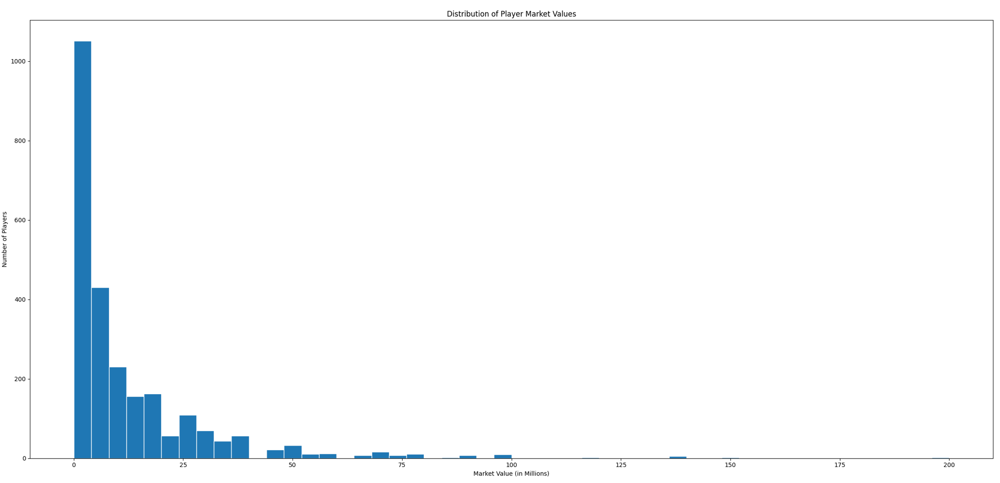
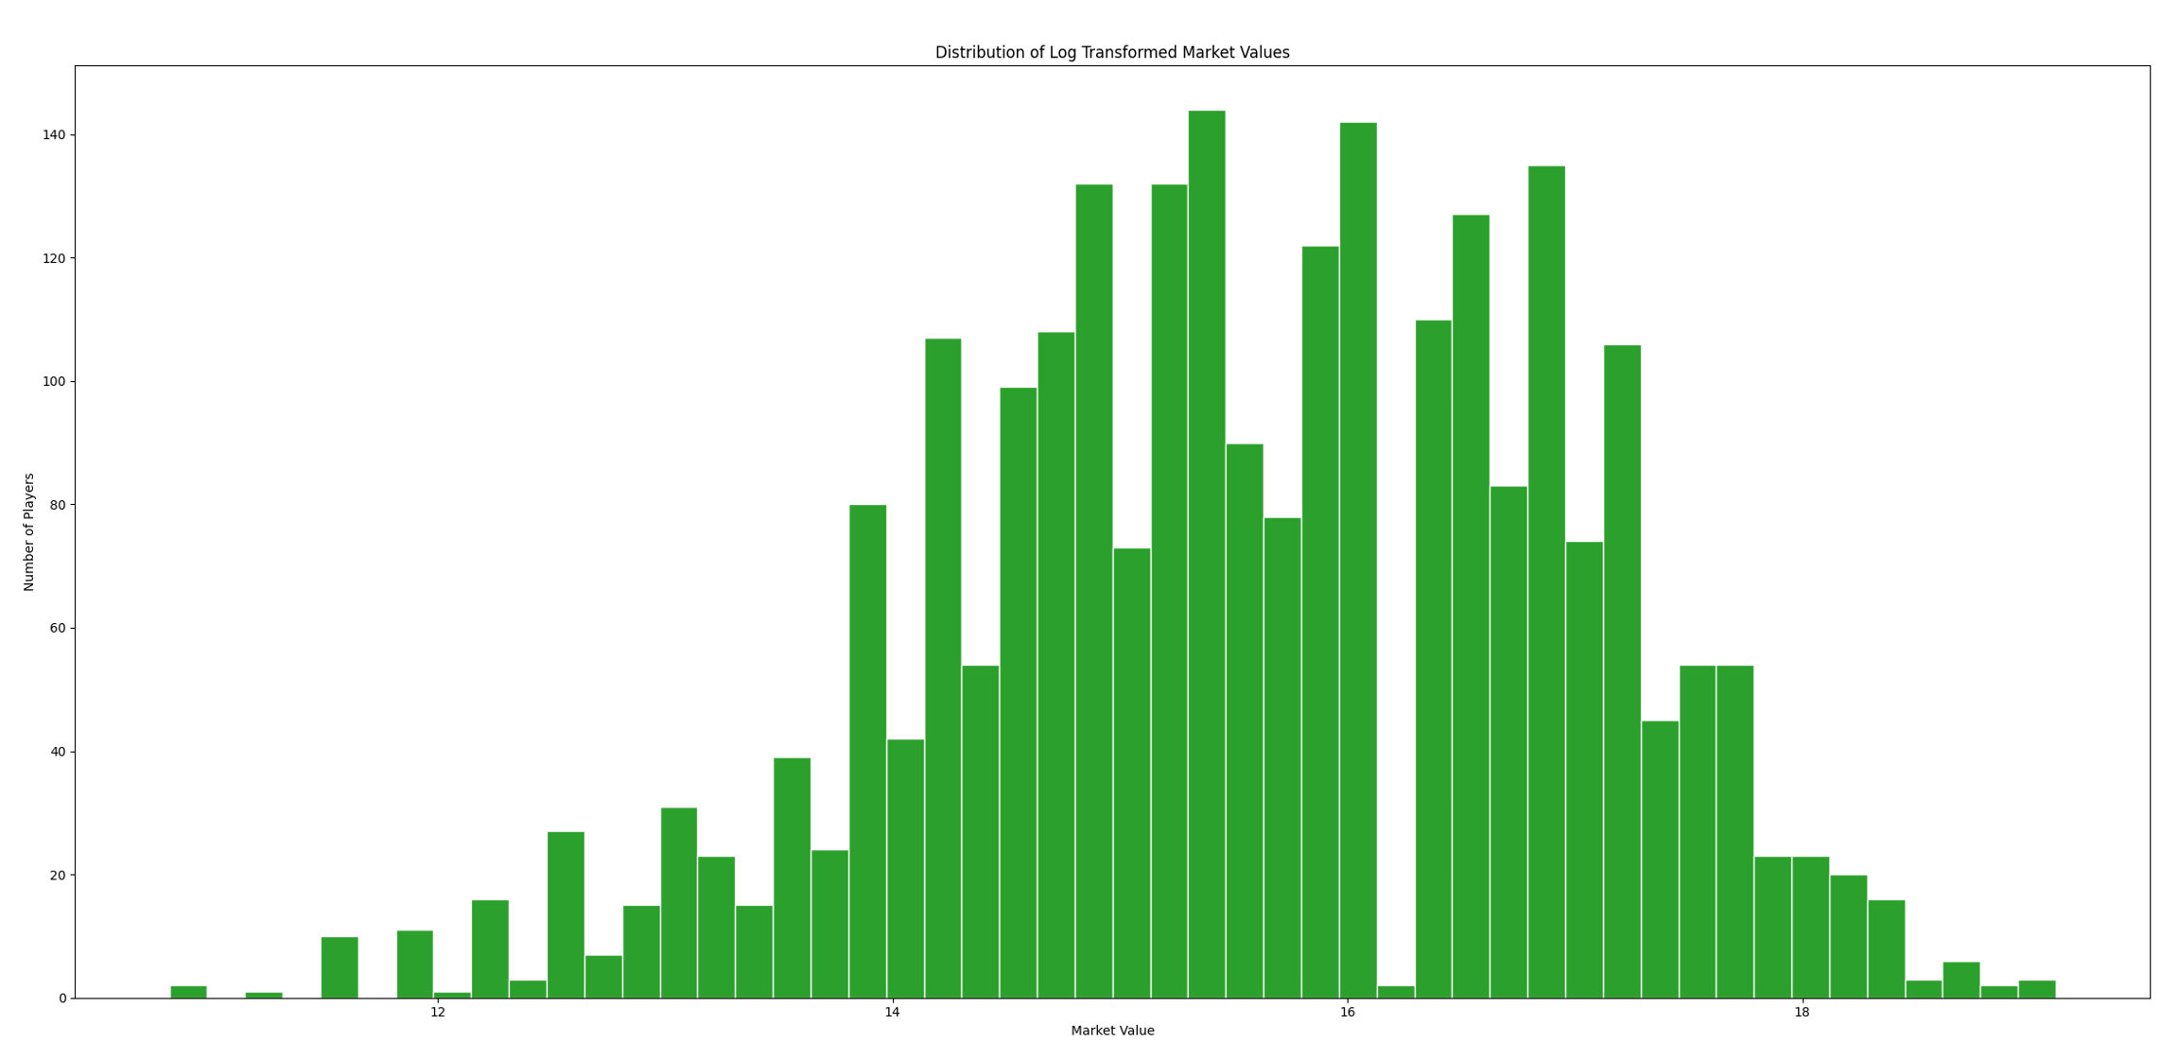
EXPLORATORY DATA ANALYSIS
Values are heavily skewed
After the log transform, a balanced the model can learn from.
Log-transform market values
Raw market values ~1,050 players under €5M, a thin tail out to €200M.
Heavily skewed.
Applied log transform
Notes:
One important finding from my exploratory analysis was that player market values were highly skewed.
As you can see in the graph on the left, most players were valued below €5 million, while only a small number of players were worth over €100 million or even €200 million.
This type of distribution can make it difficult for a machine learning model to learn because the extremely high values dominate the training process.
To address this, I applied a log transformation to the market values.
As shown in the graph on the right, the distribution became much more balanced and closer to a normal distribution.
This allowed the model to learn the underlying patterns more effectively and improved the stability and accuracy of the predictions.

Slide 10
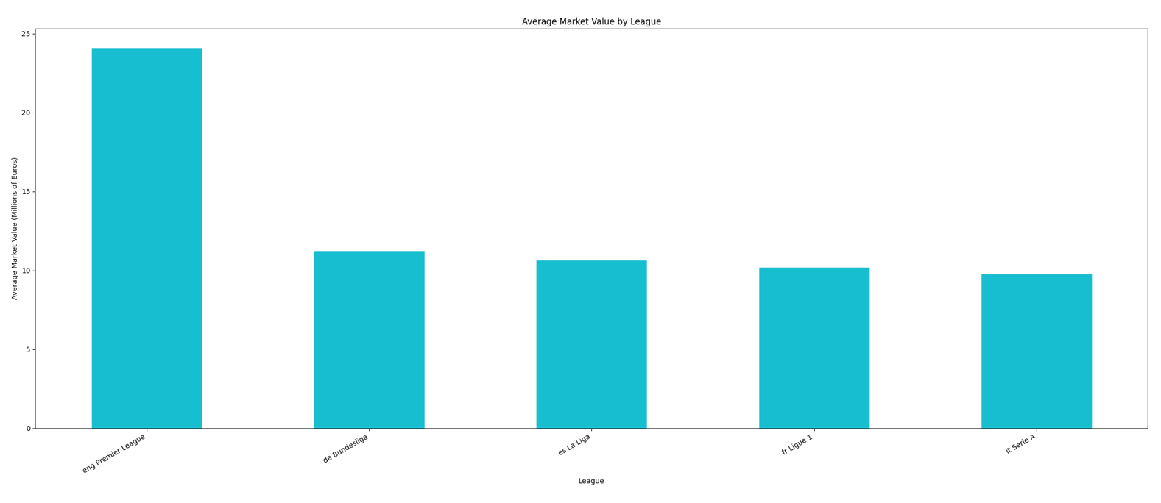
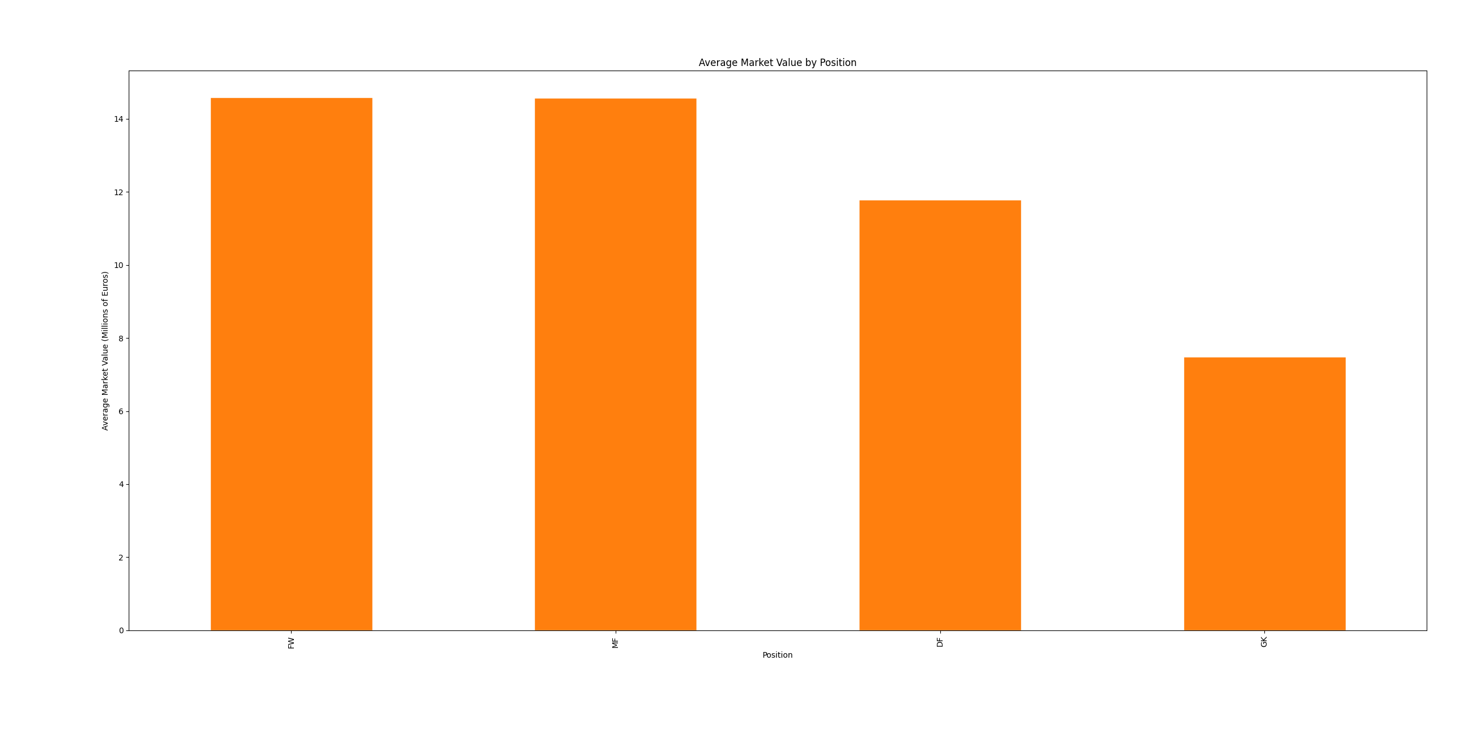
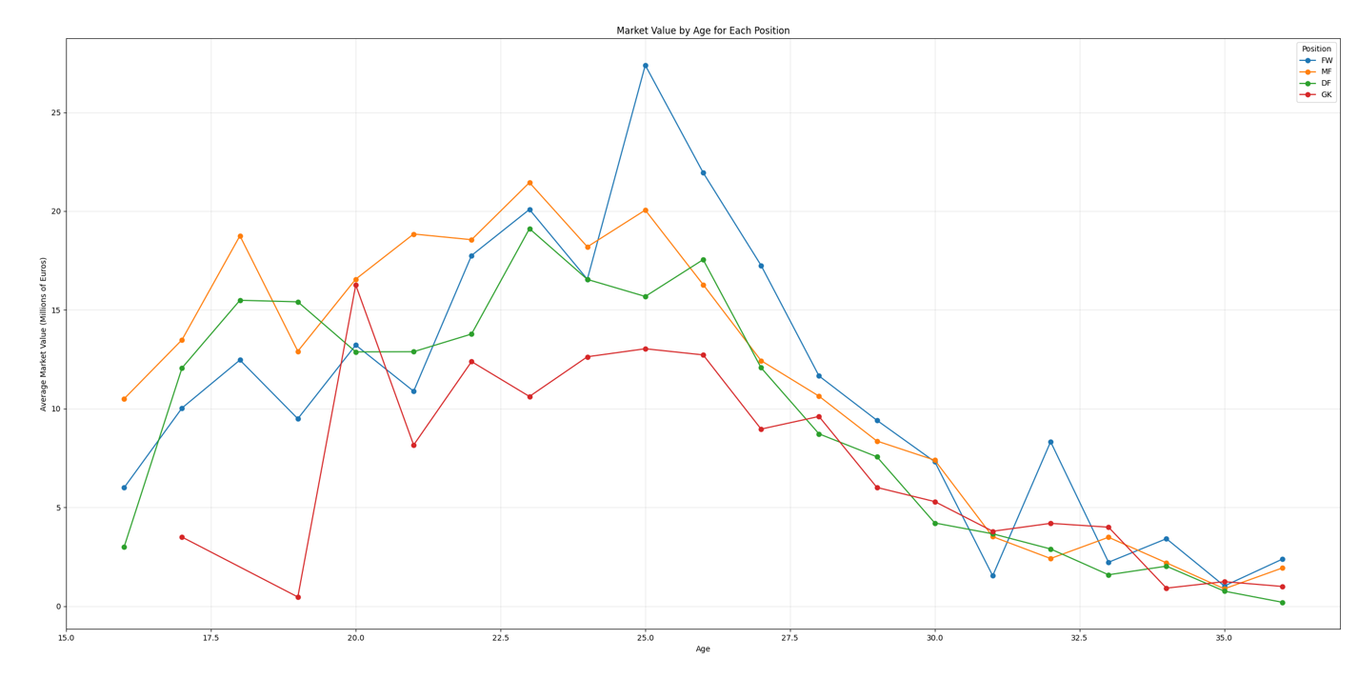
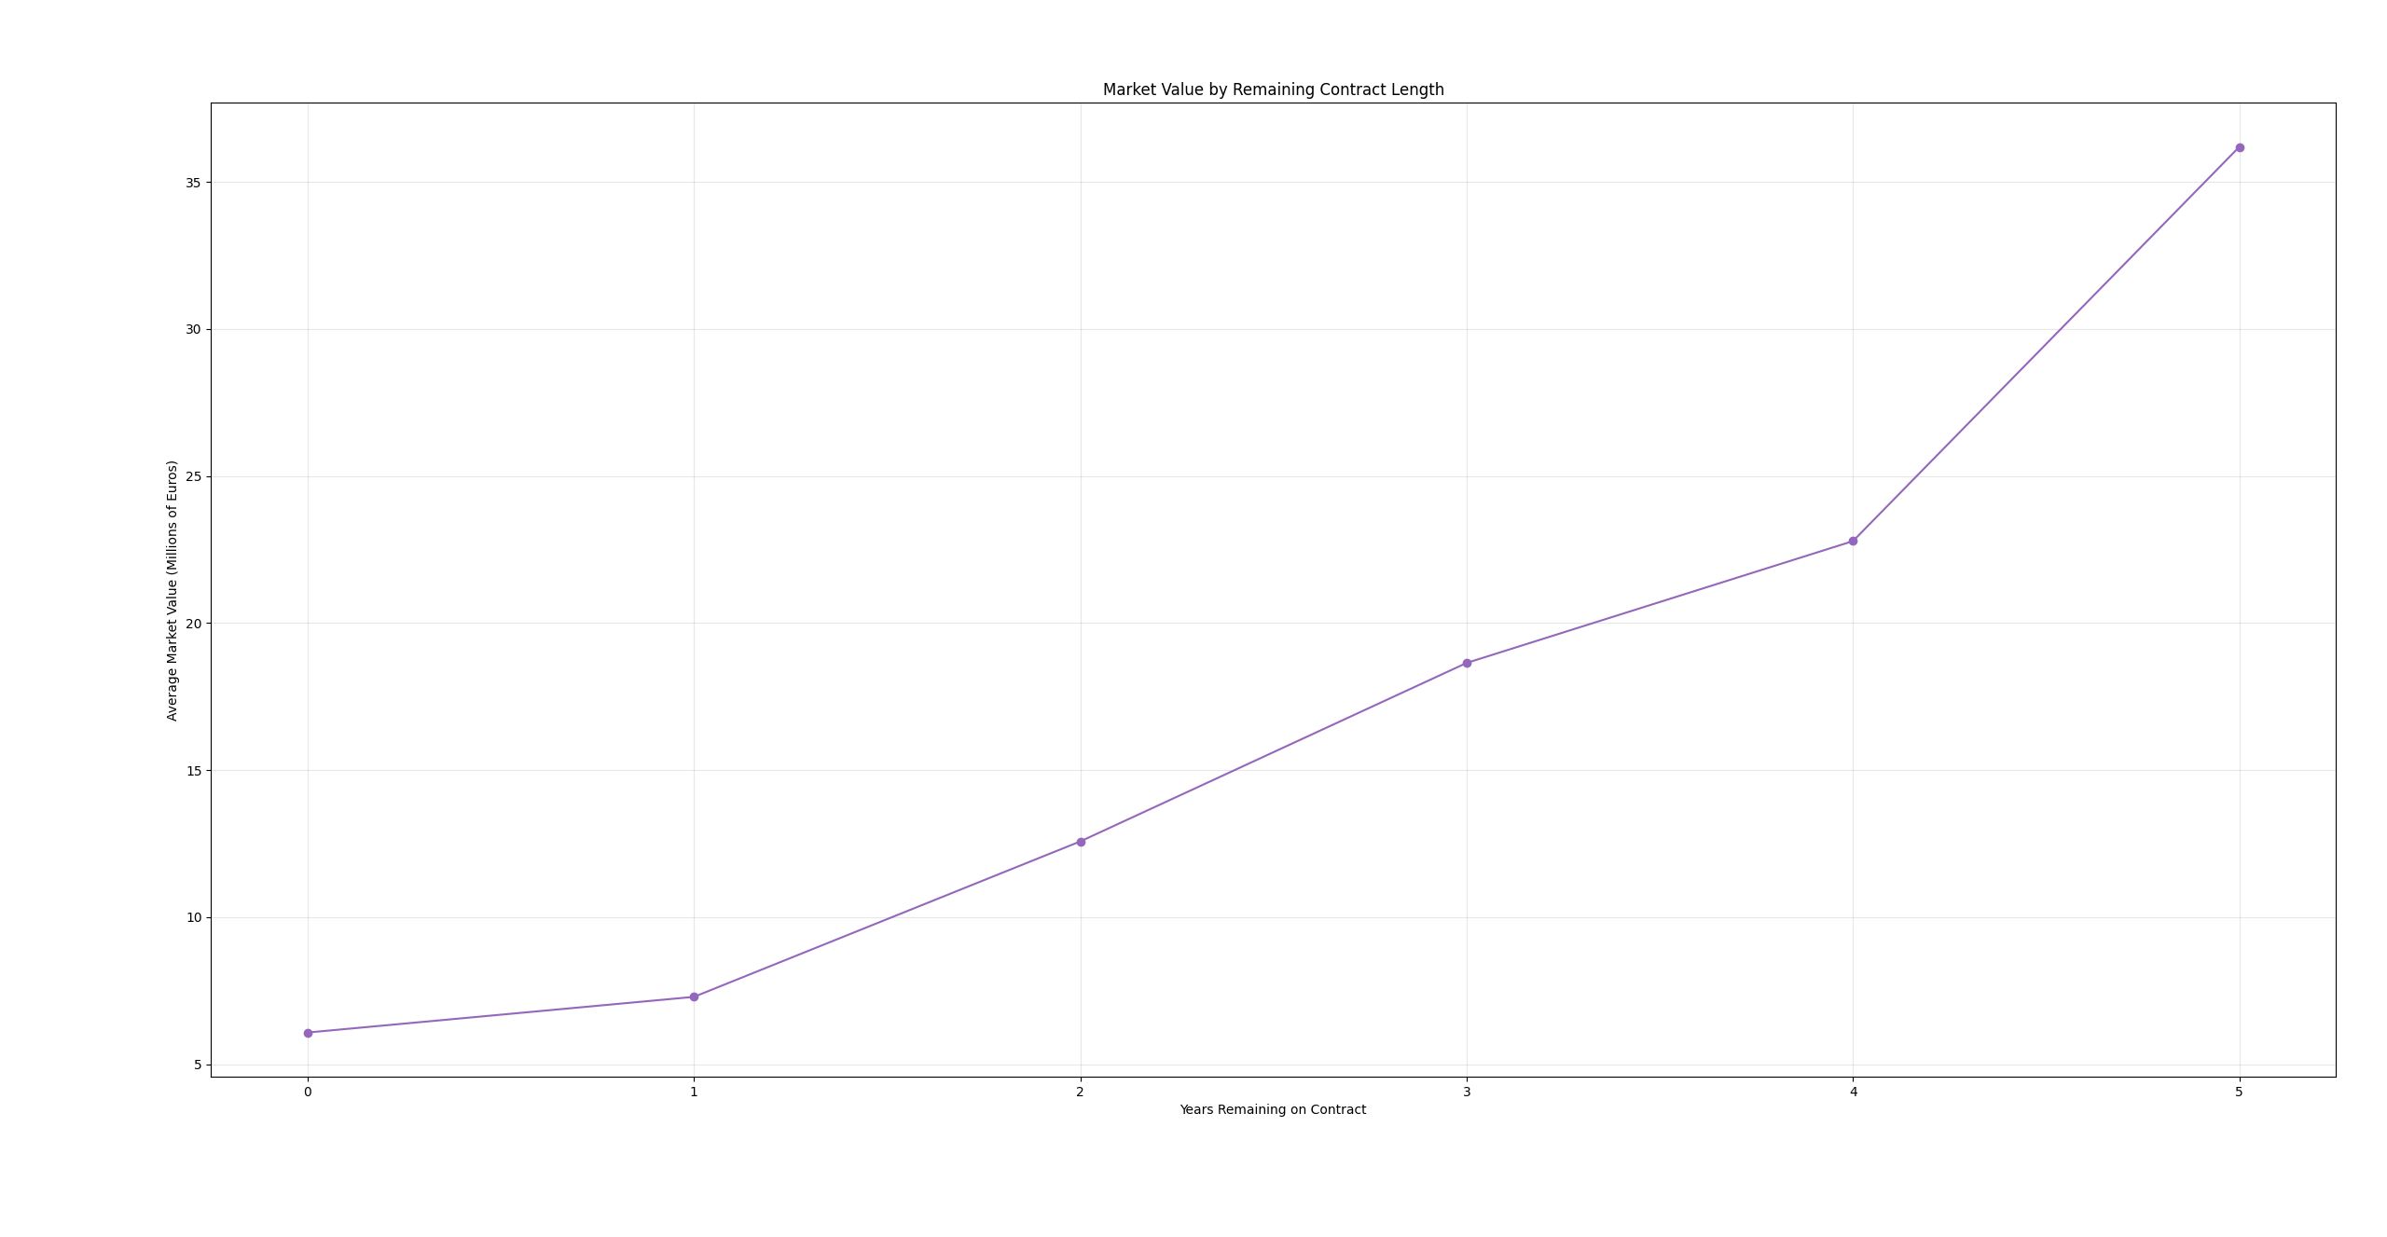
EXPLORATORY DATA ANALYSIS
What the Data Revealed
League wise market value (Top 5 League)
Player Position value
INSERT CHART
Value distribution (raw + log-transformed)
INSERT CHART
Average market value by league
Market Value by Age on each position
Longer contract means higher value
INSERT CHART
Market value by age
INSERT CHART
Market value by remaining contract length
Notes:
Forwards (blue) peak the highest — spiking to ~€27M around age 25. Attackers command the biggest values in their prime.
Midfielders (orange) peak early — high value already by 18–23 (~€19–21M), reflecting how much young creative midfielders are prized.
Defenders (green) follow a similar hill, peaking ~€19M around 23.
Goalkeepers (red) are lowest and flattest — they peak later and lower (~€13M), and their value holds up better into their 30s

Slide 11
FEATURE ENGINEERING
Turning Raw Stats into Features
Log Transformed Target
Contract years-left
Train on log(value) instead of raw values. It fixes the skew so a few superstars don't distort the model
Years until the contract expires
Age²
League and position encoding
Captures the rise-then-fall shape of the age curve
Let's the model learn league premiums and positional value. Converts text categories into 0/1 columns
Primary position
Handle missing + leakage
Extract role (FW / MF / DF / GK)
Fill gaps with 0; drop leaked value columns.
Notes:
"After cleaning the data, the next step was feature engineering, where I created and transformed variables to improve the model's ability to predict player market values.
First, I trained the model on the log-transformed market value instead of the raw value. This reduced the effect of extremely expensive players and created a more balanced target variable.
I then created a feature representing the number of years remaining on a player's contract, since players with longer contracts are generally more valuable.
Next, I created an Age Squared feature. From my exploratory analysis, I found that a player's value increases during the early years of their career, peaks around the mid-20s, and then declines. Adding Age Squared allows the model to learn this curved relationship instead of assuming a straight line.
I also extracted each player's primary position and used league and position encoding to convert positions and leagues into numerical features that machine learning models can understand.
Finally, I handled missing values and removed any columns that could cause data leakage.
These engineered features gave the model more meaningful information and improved its predictive performance."

Slide 12
MACHINE LEARNING — SETUP
How the Model Was Built
Predict a player's market value from his stats (regression)
Target: log(1 + value), because value is highly skewed.
Three models compared: Linear Regression, Random Forest, XGBoost.
5-fold cross-validation for reliability
Tuned each model's settings to find its best version (RandomizedSearchCV)
80/20 train-test split, using 64 features
- Tests the model on multiple data splits
- Produces more reliable performance estimates
- Reduces the risk of overfitting
Why cross-validation?
Notes:
"Next, I built the machine learning models to predict a player's market value based on their performance statistics.
Since this is a continuous value, I used regression and compared three models: Linear Regression, Random Forest, and XGBoost.
I used an 80/20 train-test split, 5-fold cross-validation to ensure reliable performance, and hyperparameter tuning to find the best settings for each model. trained using 64 input features."
Why cross-validation?
Tests the model on multiple data splits.
Produces more reliable performance estimates.
Reduces the risk of overfitting.

Slide 13
MACHINE LEARNING
Cross-Validation: Testing the Models Fairly
5-Fold Cross-Validation (R²)
A single train/test split could be lucky or unlucky, and one split isn't enough to trust a score.
I split the data into 5 parts, trained on 4 and tested on the 5th, then rotated until every part had been the test set.
The final score is the average of all 5
The small ± values show the results are stable across
Linear Regression
0.698
± 0.017
Random Forest
0.725
± 0.014
XGBoost
0.757
± 0.012
XGBoost – approx. 76% of the variation in market value, and every model was stable across all 5 folds.
Notes:
"To make the evaluation more reliable, I used 5-fold cross-validation instead of relying on a single train-test split.
As shown on the right, XGBoost achieved the highest average R²(R-squared) score of 0.757, outperforming Random Forest and Linear Regression. The small standard deviations also indicate that the models performed consistently across all five folds."
Explainable artificial intelligence model for identifying Market Value in Professional Soccer Players
https://arxiv.org/html/2311.04599

Slide 14

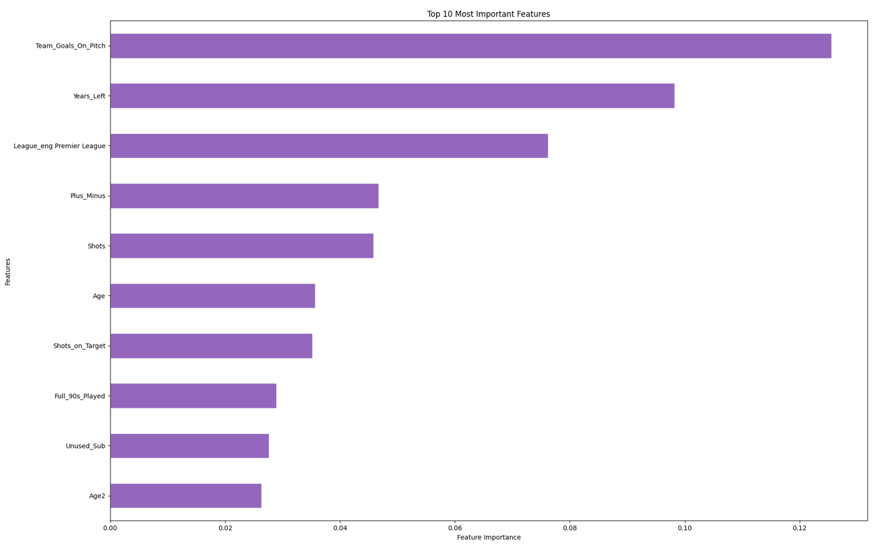
MACHINE LEARNING — RESULTS
0.75
XGBoost wins on all three metrics. It is most accurate and fewest big misses.
XGBoost R² (best model)
≈ €4.9M
average error (MAE)
5-fold
cross-validated
XGBoost explained ~75% of the variation in player market value a strong result, consistent with published valuation studies.
Notes:
"After comparing the three models, XGBoost produced the best overall performance.
It achieved an R² score of 0.75, meaning the model was able to explain about 75% of the variation in player market values.
Market value prediction is a challenging regression problem because player values depend on many factors beyond performance, such as reputation, transfer demand, and contract negotiations. Explaining about 75% of the variation using only performance statistics and player attributes is a strong result
It also achieved the lowest Mean Absolute Error, or MAE, of approximately €4.9 million, meaning that, on average, the predicted market value was about €4.9 million away from the actual market value.
MAE = average error. XGBoost is off by ~€4.96M on average compared to the ACTUAL value
RMSE = error that punishes big misses more. XGBoost is lowest here too.
This chart shows the top 10 features the XGBoost model relied on most when predicting value
The biggest driver is Team Goals On Pitch — how many goals a player's team scores while he's on the field
Two things stand out. First, these are all football-sensible factors — team success, contracts, league, output, age — which tells me the model learned real patterns, Second, two of my engineered features — Years-Left and Age-squared — show up right here in the top 10, which confirms the feature engineering was worthwhile.

Slide 15
UNDERVALUED TALENT
Finding Undervalued Talent
Value gap = Predicted value − Listed value.
A large positive gap means the model thinks a player is worth far more than his price.
How it works
Top bargains flagged
Predict every player's value with the XGBoost model (via cross-validation).
Compute the gap: predicted minus actual value
Rank players by the biggest positive gaps
Only keep players with real minutes (≥ 5 full 90s) so it isn't noise
Dani Olmo €60M → €99.5M +€39.5M
Marcus Tavernier €25M → €55.6M +€30.6M
Amad Diallo €45M → €74.2M +€29.2M
Maximilian Beier €40M → €65.1M +€25.1M
Mostly young players at strong clubs whose output outstrips their price.
Notes:
"After building the prediction model, I used it to identify undervalued players.
For every player, the model predicts what their market value should be based on their performance.
I then compare the predicted market value with the actual market value.
If the predicted value is significantly higher than the listed value, it suggests the player may be undervalued and could represent a good transfer opportunity.
To improve reliability, I only included players who had played the equivalent of at least five full matches, reducing noise from very small sample sizes.
The table on the right shows some of the players with the largest positive value gaps. For example, the model estimated Dani Olmo to be worth about €99.5 million, while his market value was €60 million, creating a positive gap of nearly €40 million.
These are the types of players that the system flags as potential bargains for club
Dani Olmo → the player's name.
€60M → his listed (actual) market value on Transfermarkt — what he's currently valued at.
→ €99.5M → the value your model predicted for him — what the model thinks he's really worth based on his performance, age, league, and contract.
+€39.5M → the gap between the two (€99.5M − €60M = €39.5M). This is how much more the model thinks he's worth than his listed price.

Slide 16
UNDERVALUED TALENT
Why I Rank by Euro Gap, Not Ratio
Two ways to measure how undervalued a player is - one of them is misleading.
Euro gap
Ratio
Predicted − Listed in euros
Predicted ÷ Listed — how many times bigger
Dani Olmo: €99.5M − €60M = +€39.5M
Dani Olmo: €99.5M ÷ €60M = 1.66×
Not distorted by tiny values → gives credible bargains.
Blows up when a listed value is tiny → fake bargains
Nicolás Paz
Listed €0.4M (outdated) Predicted €60.5M
Ratio = 151× (bad data) Euro gap = €60.1M (big, but sensible)
Notes:
I ranked players by Euro gap instead of ratio because it's more reliable.
The Euro gap measures the actual difference between the predicted and listed market value, while the ratio can be misleading when a player's listed value is very small.
As shown with Nicolás Paz, the ratio suggests a 151× bargain, which isn't realistic. The €60.1 million Euro gap provides a much more meaningful measure of undervaluation.
That's why I used the Euro gap to rank potential bargains.

Slide 17
THE KEY RESULT
Validated Against Real Transfers
Do the flagged players sell for more? I checked every pick against real completed transfer fees.
▶
42.6%
57.5%
of ALL transfers sold
above market value
(baseline)
of the model's TOP-100 picks
sold above market value
67 of the top-100 picks appear in real transfer records · median premium 1.15× market value
Notes:
"To validate the model, I compared its recommendations with real completed transfers.
Across all transfers, 42.6% were sold above their market value.
However, among the top 100 players flagged by my model, 57.5% were sold above their market value.
This shows that the model was better at identifying players who later commanded higher transfer fees, suggesting it can help clubs spot undervalued talent before the market catches up."

Slide 18
PLAYER SIMILARITY
Finding Replacements
“Salah leaves — who plays like him, and who's cheaper?”
How I find a replacement
Most similar player to Mohamed Salah
Build a per-90 stats for every player - goals, shots, tackles, crosses etc. per 90 minutes
Scale all stats (StandardScaler) so no single stat dominates.
Compare fingerprints with cosine similarity but only against players in the same position
Rank the closest matches, show a match % + rating, and flag the cheaper ones as bargain replacements
Player
Match
Value
Cheaper
Harry Wilson
91.3%
€25M
Marcus Rashford
90.8%
€40M
Jamie Leweling
87.6%
€40M
Chris Fuhrich
86.3%
€12M
✓
Samuel Chukwueze
84.1%
€18M
✓
Florian Thauvin
84.0%
€5M
✓
Closest to Salah: Harry Wilson (91.3%) — most alike in shots, shots on target, and plus-minus per 90.
Jarrod Bowen
82.1%
€30M
Cheaper look-alikes (Chukwueze, Fuhrich, Thauvin) = like-for-like replacements at a lower price.
Notes:
StandardScaler — Rescales every stat to the same range so big-numbered stats (like passes) don't dominate small ones (like goals). Makes the comparison fair.
Cosine similarity — Measures how alike two players' fingerprints are; a score near 100% means they play almost the same way. PCA -

Slide 19
PLAYER SIMILARITY
Why Is It a Match?
Closest match to Salah
Harry Wilson 91.3%
Excellent Match
Most alike in these stats:
✓
Shots per 90
✓
Shots on Target per 90
✓
Shots on Target %
✓
Plus-Minus per 90
✓
Fouls Committed per 90
Notes:
The tool doesn't just give a score — it shows which stats make two players alike, so the match is explainable.

Slide 20
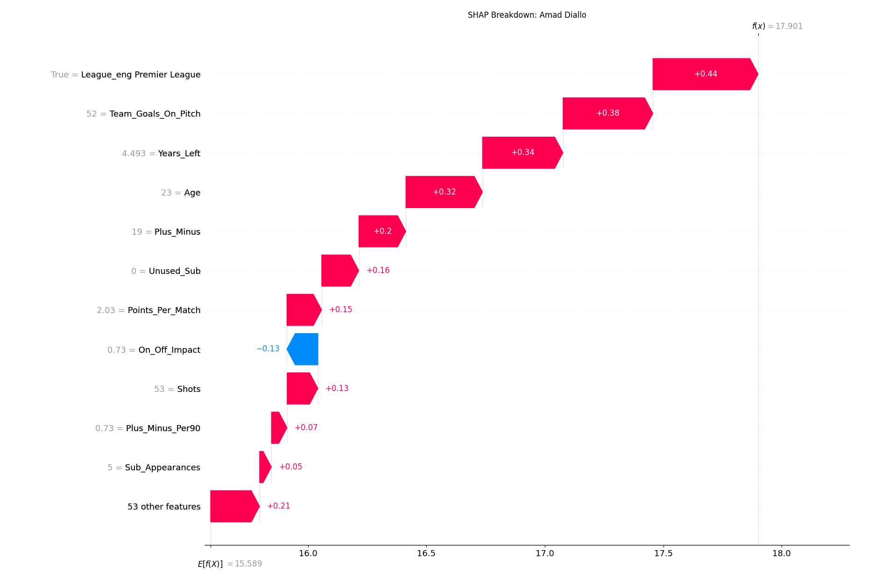
MODEL EXPLAINABILITY
Explaining the Model (SHAP)
SHAP shows how each stat pushed a player's predicted value up or down. SHAP explains the model in 2 ways:
Global view what drives player value overall
Per-player receipt — Amad Diallo
Age
Predicted €59.4M vs listed €45M → UNDERVALUED by €14.4M
Team Goals On Pitch
Factor
Effect on value
Premier League
▲ Premier League
+0.44
Contract Years-Left
▲ Team Goals On Pitch
+0.38
Points Per Match
▲ Contract Years-Left
+0.34
▲ Age
+0.32
▲ Plus-Minus
+0.20
▲ Points Per Match
+0.15
▼ On-Off Impact
−0.13
Notes:
SHAP is a tool that explains why a machine-learning model made a specific prediction
Waterfall diagram
On the left, we can see the most important features overall, such as age, team performance, league, and contract length.
On the right, SHAP explains an individual player's prediction. In this example, it shows why the model believes Amad Diallo is worth €59.4 million instead of his listed €45 million, making him undervalued by €14.4 million.
The numbers on the right are SHAP values. They show how much each feature influenced this player's predicted market value.

Slide 21
FUTURE WORK
Where I can do more upgrade
Multiple seasons
Advanced metrics
Smooths out one-off form and reveals a player's true trajectory.
Add xG, progressive passes, defensive actions for a sharper signal
Interactive dashboard
Wages & injuries
Let scouts filter and explore picks in a live tool
Factor in total cost and availability, not just transfer fee.
Notes:
Keep this brief and forward-looking. It shows you understand the path to a production-grade tool. Multiple seasons and advanced metrics are the natural next steps and directly address the limitations you just listed.

Slide 22
Conclusion
Developed an XGBoost model that predicts player market value (R² = 0.75)
Finds undervalued talent
Suggests like-for-like replacements at lower cost
Explains why the player is valued on that price
Thank you!
Notes:
Recap the four things the system does, land the tagline, and invite questions. Remind them of the validation number if you want a strong closing beat. Thank the audience.

