Slide 1

FUTURE

Slide 2
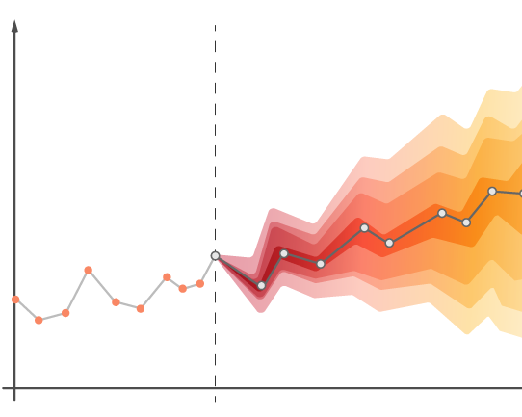
Introduction
Predicting future sales is a crucial task for businesses across various industries. It involves forecasting the quantity of products or services a company is expected to sell in the coming days, weeks, months, or years. Accurate sales predictions are essential for several reasons.

Slide 3
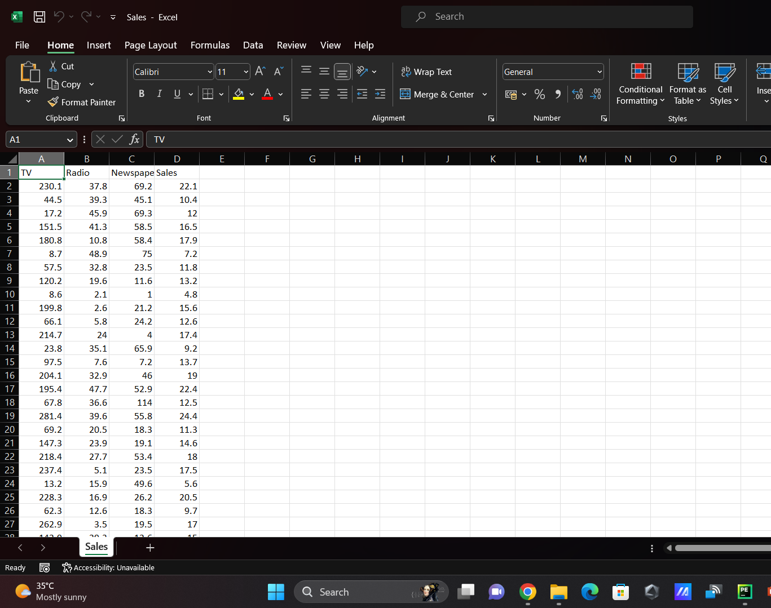
Problem Statement
The objective of this project is to develop a predictive model that can forecast future sales for each product in each store over the next quarter (three months). The prediction should be at a granular level, providing daily forecasts.

Slide 4
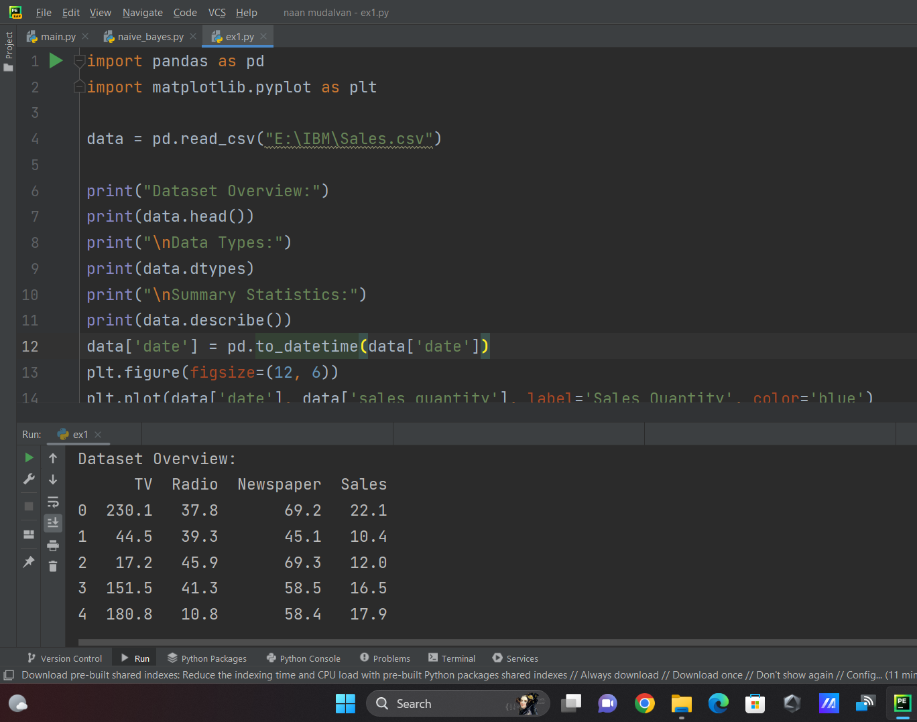
Analysing the Data
Analyzing data in a dataset is a crucial step in extracting meaningful insights, patterns, and knowledge from the raw information contained within it.

Slide 5
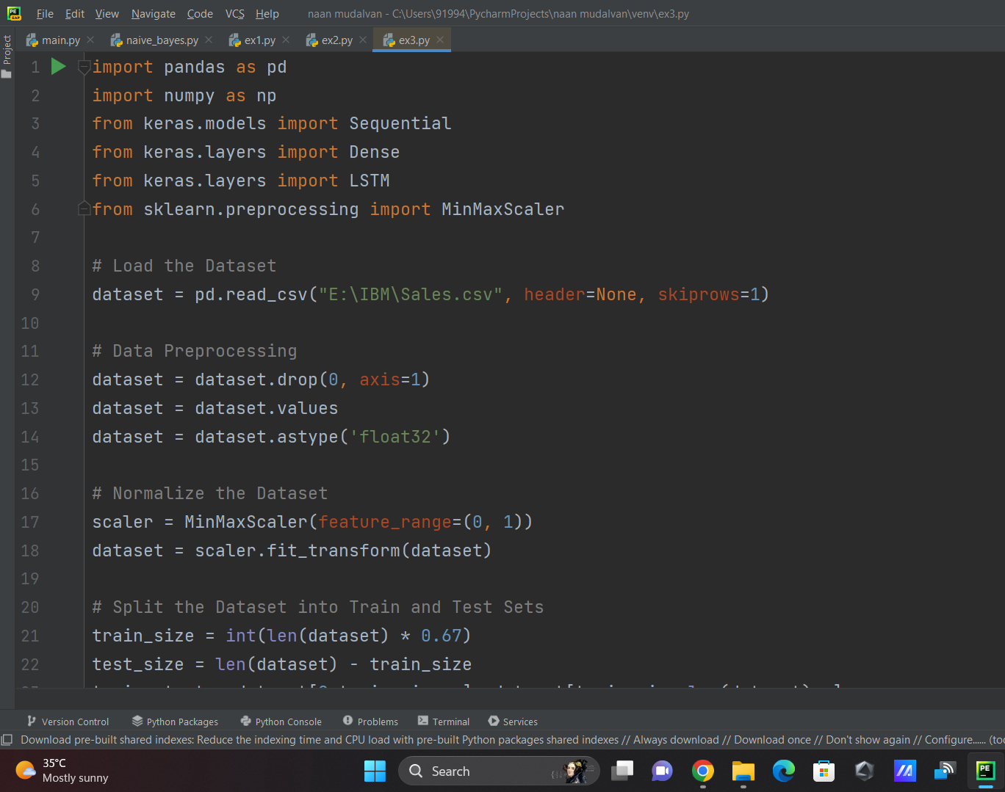
Predicting accurate values using LSTM network
To implement an LSTM (Long Short-Term Memory) network for predicting accurate values using a dataset. We'll use the Keras or TensorFlow library.
We are using LSTM network for this problem statement.

Slide 6

Team Leader: SALMAN AHMED S M I
Team Member: MOHAMMED SUFIYAN S
Team Member: MOHAMMED SAAD A
Team Member: MOHAMMED SAAD G
Team Member: MOHAMED RASEEF RAYYAAN I
GITHUB: salman-smi
GITHUB: Mohammed-Sufiyan
GITHUB: Saadtech-07
GITHUB: Mdsaad-07
GITHUB: Raseef-Rayyaan

