Slide 1
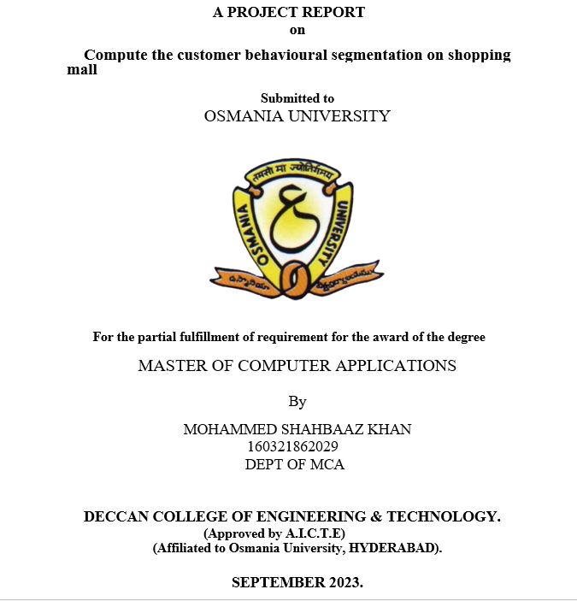

Slide 2
Compute the customer behavioural segmentation on shopping mall
MOHAMMEDSHAHBAAZKHAN
Roll no.:160321862029

Slide 3
Abstract:
The use of machine learning can be seen almost everywhere around us, be it Facebook recognizing you or your friends, or YouTube recommending you a video or two based on your history — Machine Learning is everywhere!However, the ‘magic’ of machine learning is not just limited to only these areas.Machine Learning is broadly categorized as Supervised and Unsupervised Learning.

Slide 4
Existing System:
Supervised algorithms has already implemented for our data but the results was not to the satisfied level.
Disadvantages:-
Accuracy level is not good
Time consumption is more

Slide 5
Proposed System:
In the proposed model of system , we are about to implement the k-means clustering algorithm and check the best accurate results with this approach.
Advantages:
Accuracy level is good .
Time consumption is less .
Comparison of different algorithms can be observed .

Slide 6
System Requirements:
Hardware:
Operating system of windows 7 , 8, 10 (32-bit or 64-bit ).
RAM-4GB
Software:
Anaconda navigator software tool ,
jupyter notebook editor window ,
in python language.

Slide 7
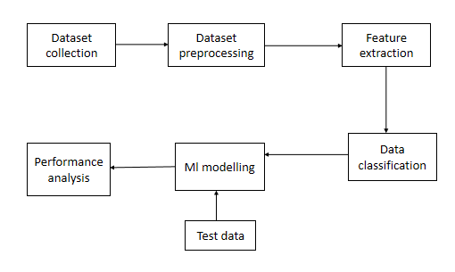
System Architecture:

Slide 8
Introduction:
Machine Learning techniques are broadly divided into two parts :
Supervised Machine Learning.
Unsupervised Machine Learning.
In Supervised Machine Learning, the data is labelled and the algorithm learns from labelled training data.In Unsupervised Machine Learning, we do not need to supervise the model. Such a method deals with unlabelled data.

Slide 9
Literature Survey:
Author: Amit Bhatnagar, Sanjoy Ghose.
Abstract:
We apply a latent class modeling approach to segment web shoppers, based on their purchase behaviour across several product categories. We then profile the segments along the twin dimensions of demographics and benefits sought.

Slide 10
Title : Data mining for the online retail industry: A case study of RFM model-based customer segmentation using data mining
Author: Daqing Chen, Sai Laing Sain
Abstract:
Many small online retailers and new entrants to the online retail sector are keen to practice data mining and consumer-centric marketing in their businesses yet technically lack the necessary knowledge and expertise to do so. In this article a case study of using data mining techniques in customer-centric business intelligence for an online retailer is presented. The main purpose of this analysis is to help the business better understand its customers and therefore conduct customer-centric marketing more effectively.

Slide 11
Title : A Comparative Study of Divisive and Agglomerative Hierarchical Clustering.
Algorithms
Author: Maurice Roux
Abstract:
A general scheme for divisive hierarchical clustering algorithms is proposed. It is made of three main steps: first a splitting procedure for the subdivision of clusters into two subclusters, second a local evaluation of the bipartitions resulting from the tentative splits and, third, a formula for determining the node levels of the resulting dendrogram. A set of 12 such algorithms is presented and compared to their agglomerative counterpart (when available).

Slide 12
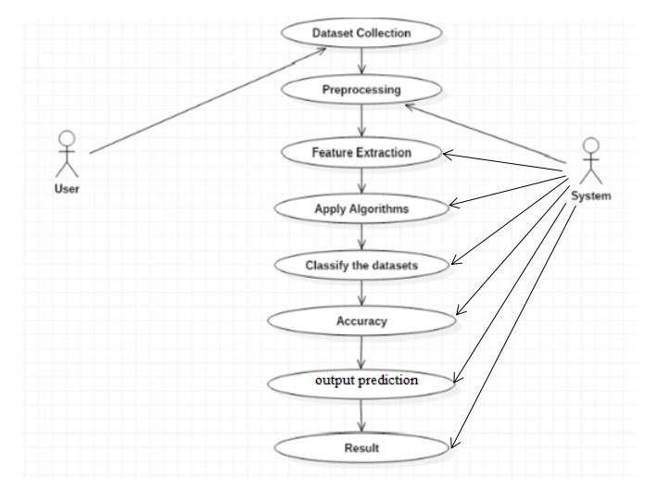
System Design: UML DIAGRAMS:
Fig: Use Case Daigram

Slide 13
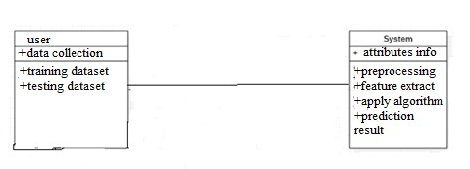
Fig:Class Diagram

Slide 14
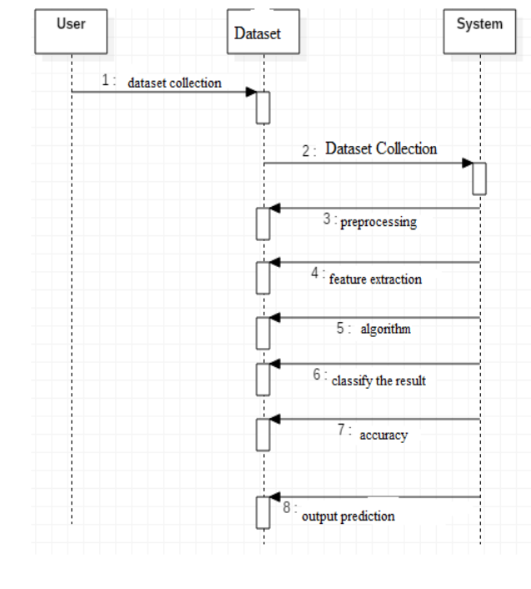
Fig: Sequence Diagram

Slide 15
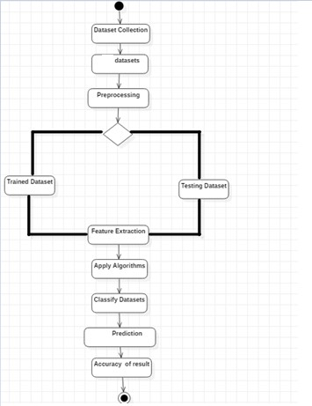
Fig: Activity Diagram:

Slide 16
System Methodology
RANDOM FOREST(ALGORITHM)
Random forest is a type of supervised machine learning algorithm based on ensemble learning. Ensemble learning is a type of learning where you join different types of algorithms or same algorithm multiple times to form a more powerful prediction model. It is based on the concept of ensemble learning, which is a process of combining multiple classifiers to solve a complex problem and to improve the performance of the model.

Slide 17
Linear regression(Algorithm ):
Linear regression analysis is used to predict the value of a variable based on the value of another variable. The variable you want to predict is called the dependent variable. The variable you are using to predict the other variable's value is called the independent variable.

Slide 18
LSTM:
LSTM stands for long short-term memory networks, used in the field of Deep Learning. It is a variety of recurrent neural networks (RNNs) that are capable of learning long-term dependencies, especially in sequence prediction problems. LSTM has feedback connections, i.e., it is capable of processing the entire sequence of data, apart from single data points such as images. This finds application in speech recognition, machine translation, etc.

Slide 19
Deep Learning
Deep learning is a computer software that mimics the network of neurons in a brain. It is a subset of machine learning and is called deep learning because it makes use of deep neural networks. The machine uses different layers to learn from the data. The depth of the model is represented by the number of layers in the model. Deep learning is the new state of the art in term of AI. In deep learning, the learning phase is done through a neural network.

Slide 20
Reinforcement Learning
Reinforcement learning is a subfield of machine learning in which systems are trained by receiving virtual "rewards" or "punishments," essentially learning by trial and error. Google's DeepMind has used reinforcement learning to beat a human champion in the Go games. Reinforcement learning is also used in video games to improve the gaming experience by providing smarter bot.

Slide 21
ANACONDA NAVIGATOR
Anaconda Navigator is a desktop graphical user interface (GUI) included in Anaconda distribution that allows you to launch applications and easily manage conda packages, environments and channels without using command-line commands. It is available for Windows, mac OS and Linux.

Slide 22
History of Python:
Python was developed by Guido van Rossum in the late eighties and early nineties at the National Research Institute for Mathematics and Computer Science in the Netherlands.It was first released on February 20,1991.
Python’s standard library
Pandas
Numpy
Sklearn
seaborn
matplotlib
Importing Datasets

Slide 23
Pandas
Pandas is an open source What’s cool about Pandas is that it takes data (like a CSV or TSV file, or a SQL database) and creates a Python object with rows and columns called data frame that looks very similar to table in a statistical software (think Excel or SPSS for example.It comes to analyse the data with python.
There are different commands to each of these options, but when you open a file, they would look like this:
pd.read_filetype()
pd.DataFrame()
df.to_filetype(filename)

Slide 24
It is also possible to get statistics on the entire data frame or a series (a column etc):
df.isnull()To check null values
df.mean() Returns the mean of all columns
df.corr() Returns the correlation between columns in a data frame
df.count() Returns the number of non-null values in each data frame column
df.max() Returns the highest value in each column
df.min()Returns the lowest value in each column
df.median()Returns the median of each column
df.std() Returns the standard deviation of each column

Slide 25
NUMPY
Numpy is one such powerful library for array processing along with a large collection of high-level mathematical functions to operate on these arrays. These functions fall into categories like Linear Algebra, Trigonometry, Statistics, Matrix manipulation, etc.
Importing NumPy
NumPy is imported using the following command. Note here np is the convention followed for the alias so that we don't need to write numpy every time.
➢ import numpy as np

Slide 26
SEABORN
Data Visualization in Python
Data visualization is the discipline of trying to understand data by placing it in a visual context. Matplotlib
Matplotlib is the most popular python plotting library. It is a low level library with a Matlab like interface which offers lots of freedom at the cost of having to write more code.
import matplotlib.pyplot as plt
import seaborn as sns

Slide 27
SOFTWARE TESTING
Software testing is an investigation conducted to provide stakeholders with information about the quality of the product or service under test. . Software Testing also provides an objective, independent view of the software to allow the business to appreciate and understand the risks at implementation of the software. Test techniques include, but are not limited to, the process of executing a program or application with the intent of finding software bugs.
TESTING METHODS:
Functional Testing and Integration Testing

Slide 28
Functional tests:
Functional tests provide systematic demonstrations that functions tested are available as specified by the business and technical requirements, system documentation, and user manuals.
Integration Testing:
Software integration testing is the incremental integration testing of two or more integrated software components on a single platform to produce failures caused by interface defects.
Test Case for Excel Sheet Verification:
Here in machine learning we are dealing with dataset which is in excel sheet format so if any test case we need means we need to check excel file. Later on classification will work on the respective columns of dataset.

Slide 29
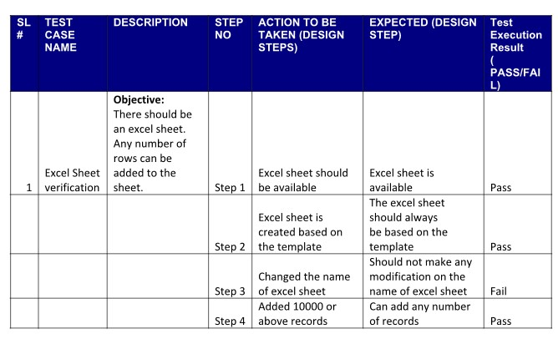
Test Case 1:

Slide 30
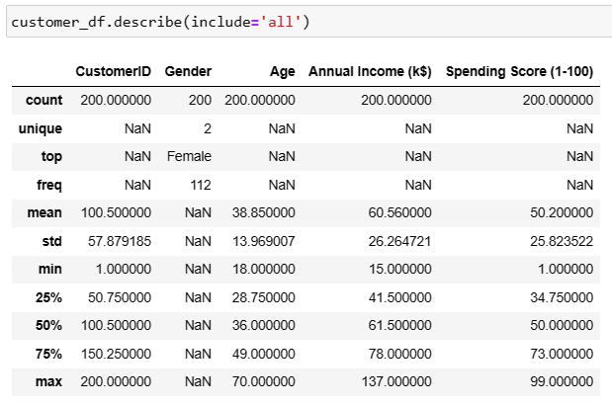
Result and Analysis
Fig:Describing customer features

Slide 31
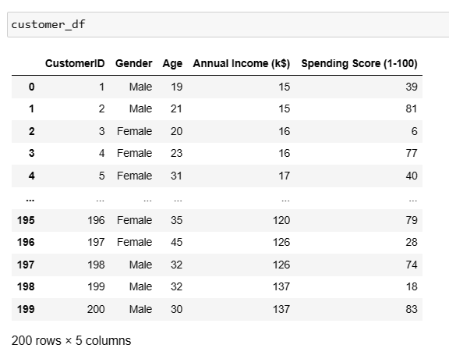
Fig: Number of Rows and Columns

Slide 32
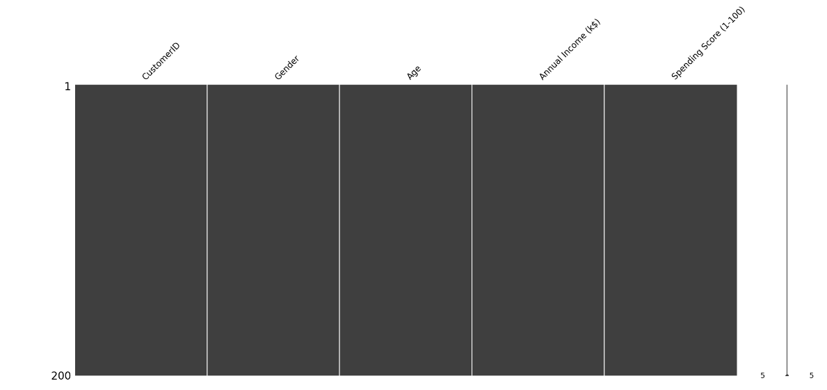
Fig:Matrices of Customer features

Slide 33
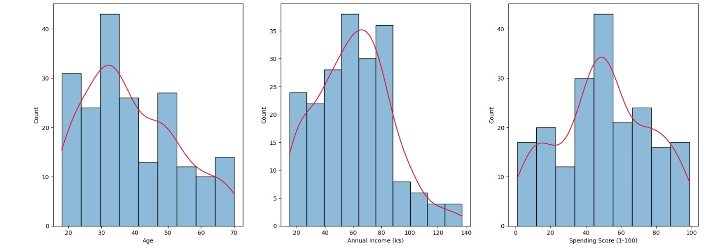
Fig:Histogram of Customer Age, Annual Income, Spending Score

Slide 34
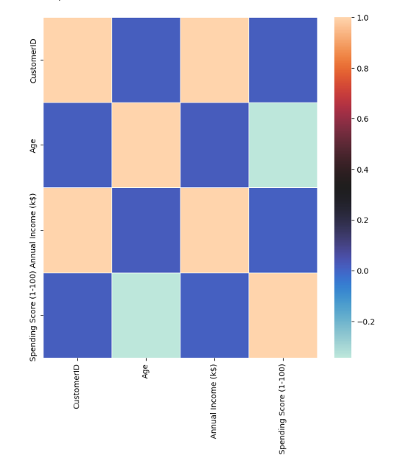
Fig: Heatmap

Slide 35
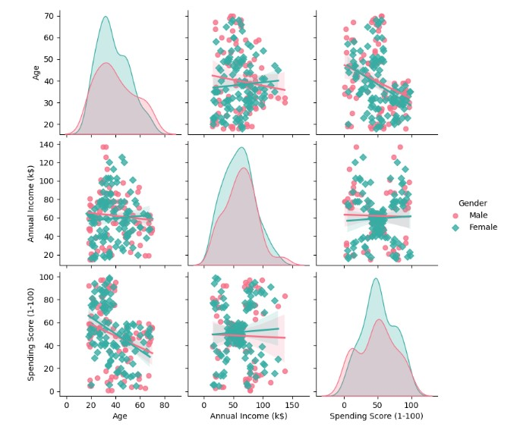
Fig: Pairplot Age, Annual Income, Spending Score

Slide 36
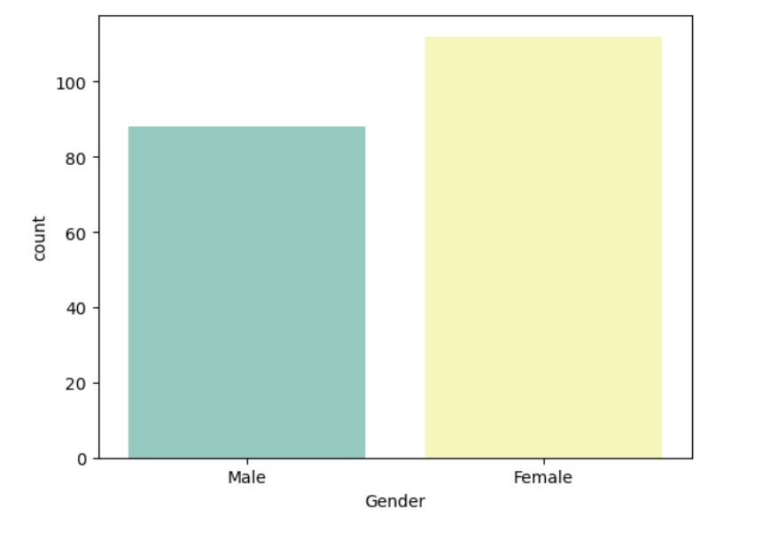
Fig:Countplot

Slide 37
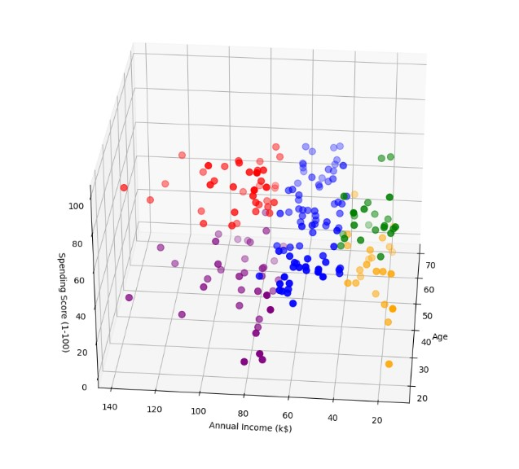
Fig: Scatterplot

Slide 38
CONCLUSION:
we minimize the amount of time that phishing pages can remain active before we protect our users from them. Even with a perfect classifier and a robust system, we recognize that our blacklist approach keeps us perpetually a step behind the phishers. We can only identify a phishing URL and normal URL using machine learning algorithm. Result we got in terms of accuracy metric.
FUTURE SCOPE
As shopping culture increase day by day, some features may be included or replaced with new ones to detect people mindset them.

Slide 39
REFERENCE
1.Muhammad A, Nabil AM, Ariff LS, Abdullah A-M (2019) Customer relationship management and big data enabled: Personalization & customization of services. Appl Comput Inf 15(2):94–101
2.Beheshtian-Ardakani A, Fathian M, Gholamian M (2018) A novel model for product bundling and direct marketing in e-commerce based on market segmentation.
Lett 7(1):39–54
3. Yoshua B, Aaron C, Pascal V (2013) Representation learning: a review and new perspectives. IEEE Trans Pattern Anal Mach Intell 35(8):1798–1828

