Slide 1



GHOST_DEVELOPERS
A HYBRID STATIC-DYNAMIC FRAMEWORK FOR RESILIENT MOBILE MALWARE DETECTION USING TOOLKIT MOBSF
Md.Shazzad Hossain Jiku- 011221073
Rudro Kumer Bandhapadhay- 011221118
Mridul Kanti Paul- 011221265
Mezbah Uddin Ahammed Emon- 011221433
Start It Now

Slide 2

TAKEAWAYS
GHOST_DEVELOPERS
A Free and Open Source Security Tool for Mobile App Security Assessment.
Mobile App Pentesters/Mobile Malware Analysts- How to make your job easier with MobSF.
Developers- Build secure mobile Apps identifying vulnerabilities at all stages of development. (SDLC Integration)
Web Pentesters- REST API Fuzzer capable of detecting vulnerabilities like SSRF, XXE, IDOR etc.

Slide 3

Agenda
What is MobSF?
MobSF Architecture -
Static Analyzer
Dynamic Analyzer
Web API Fuzzer
Static Analysis
Static Analysis & some Statistics
Top Bangladeshi Bank Mobile Apps
Observations
Dynamic Analysis
Dynamic SSL Testing
Exported Activity Tester
Challenges in Dynamic Analysis
Dynamic Analysis on Custom VM/Rooted Android
device
Conclusion
AGENDA
GHOST_DEVELOPERS

Slide 4

WHAT IS MOBSF?
Mobile Security Framework is an open source mobile application (Android/OS) automated pentesting framework capable of performing end to end security testing of mobile Apps. Hosted in your environment. Your application and data is never send to the cloud.
GHOST_DEVELOPERS

Slide 5
INSTALLATION METHOD
Install Docker
Pull the Image: Open your terminal or command prompt and run (docker pull opensecurity/mobile-security-framework-mobsf:latest)
Run MobSF: Execute the following command to start the container (docker run -it --rm -p 8000:8000 opensecurity/mobile-security-framework-mobsf:latest)
Access: Open your browser and go to http://localhost:8000
GHOST_DEVELOPERS

Slide 6
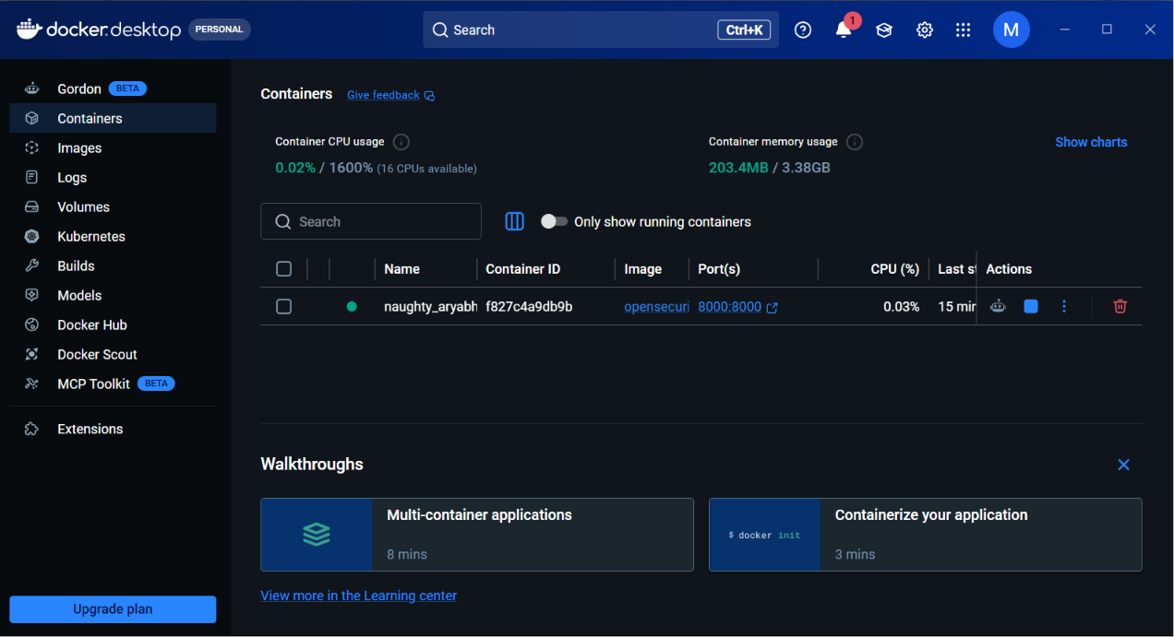
SNAPSHOTS
GHOST_DEVELOPERS

Slide 7
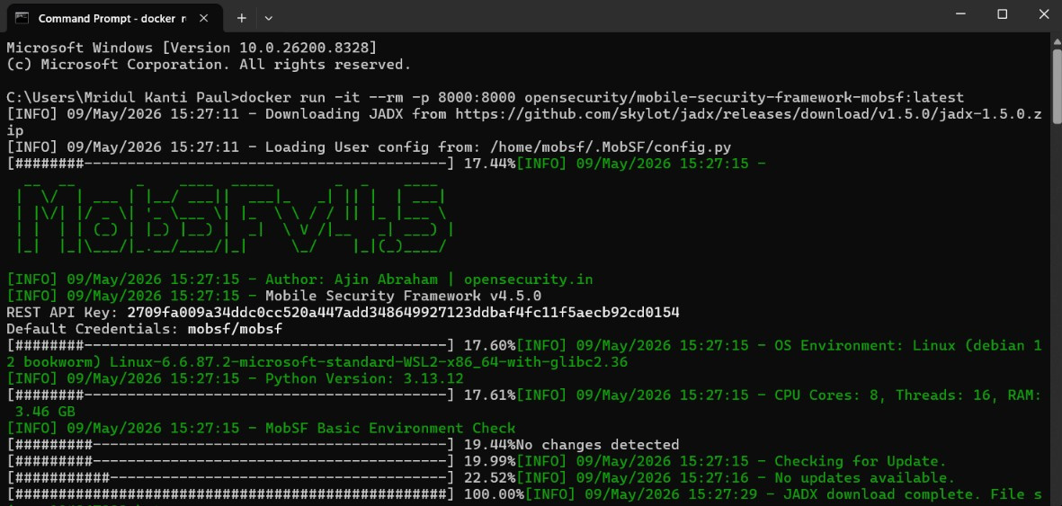
SNAPSHOTS
GHOST_DEVELOPERS

Slide 8
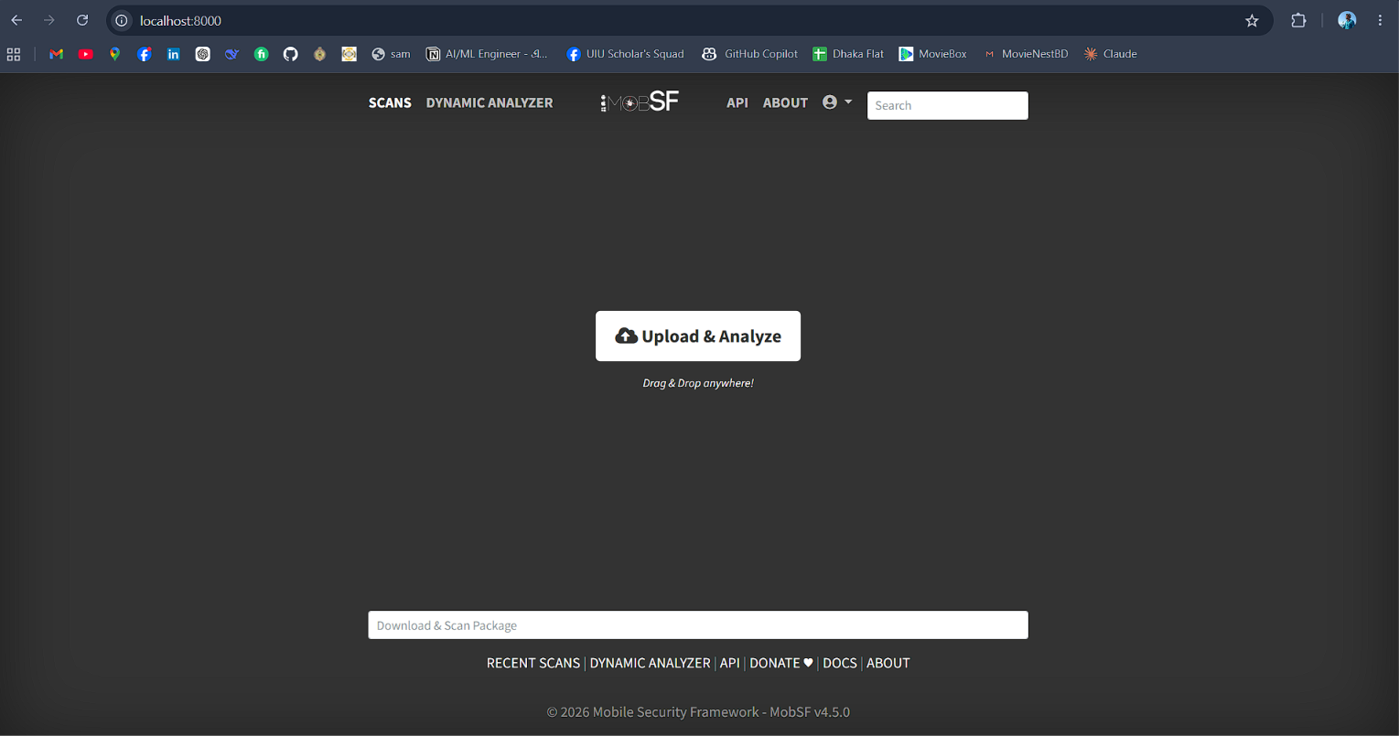
SNAPSHOTS
GHOST_DEVELOPERS

Slide 9

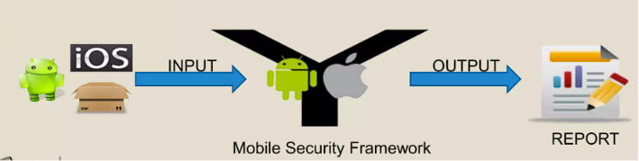
GHOST_DEVELOPERS
STATIC ANALYZER

Slide 10
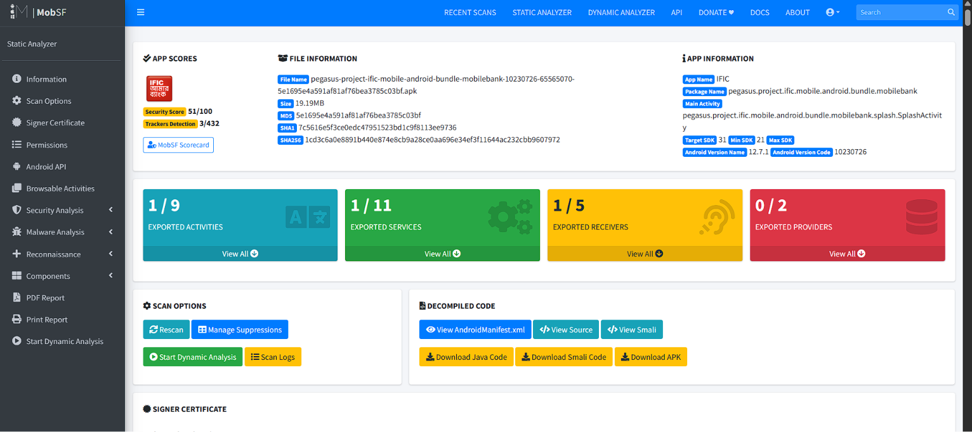
SNAPSHOTS
GHOST_DEVELOPERS

Slide 11
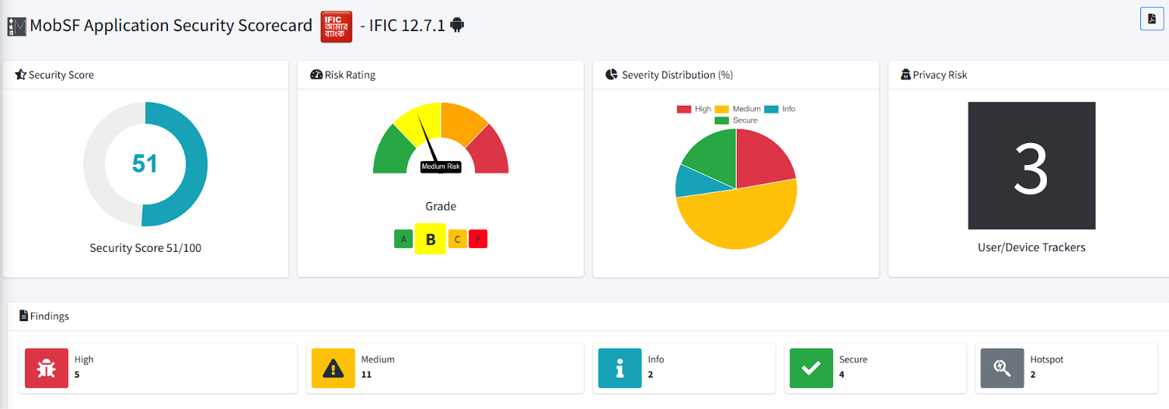
SNAPSHOTS
GHOST_DEVELOPERS

Slide 12

Static Analysis on top Financial Apps-
Criteria
SSL bypass in Native Code
SSL bypass in WebView
Weak Crypto
Remote Web View Debugging
Hardcoded Secrets
STATIC ANALYSIS & SOME STATISTICS
GHOST_DEVELOPERS

Slide 13

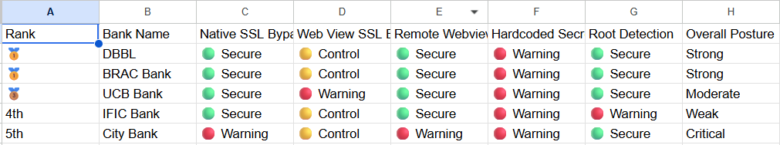
BENCHMARK ANALYSIS
GHOST_DEVELOPERS

Slide 14


GHOST_DEVELOPERS
The benchmark reveals a systemic vulnerability across the Bangladeshi banking sector regarding secure coding practices, as all five banks failed the "Hardcoded Secrets" check. This means every application is potentially exposing sensitive keys or tokens directly within its source code, leaving them highly vulnerable to reverse-engineering attacks.
While DBBL and BRAC Bank demonstrate a strong security baseline by effectively locking down network traffic (Native SSL), debugging, and device integrity (Root Detection), the lower-ranking apps present severe risks. City Bank stands out as critically vulnerable due to failing basic network encryption and remote debugging checks, and IFIC Bank's failure to implement proper Root Detection leaves its users highly susceptible to device-level malware.
OBSERVATIONS

Slide 15

GHOST_DEVELOPERS
CONCLUSION
Our research demonstrates that while mobile security frameworks like MobSF provide powerful, automated end-to-end testing for both Android and iOS , their true value lies in revealing systemic coding failures that manual reviews might miss.
Key Findings & Future Outlook
Systemic Vulnerabilities
The Power of Hybrid Analysis
A Shift to DevSecOps
Ultimately, the objective is to move beyond isolated defenses by proving that a unified, cross-layer verification approach significantly reduces the success rate of adversarial breaches.

Slide 16

GHOST_DEVELOPERS
THANK YOU

