Slide 1

Abstracted Relation DaaS
Mitchell Stemm

Slide 2
Goals for this project
Secure encryption and diffusion for a multi-cloud solution.
Brute force protection, the system is resistant to a malicious cloud’s attempts to decrypt sensitive data.
User friendly, the protections added dose not or minimally affects a user's ability to query the database.

Slide 3
Assumptions
Communication is secure.
Achieved via HTTPS, AES, etc.
Encryption is secure
Standard encrypted is protected from most brute force attacks
User has sufficient computing power
This system relies on a capable user(no Chromebooks)

Slide 4
System overview
User
Cloud service 1
Database 1
Raw data
(encrypted)
Owns/maintains
Decision Forwarder
(Only needed for ABE)
Local software
Cloud service 2
Database 2
Relational
schema
Owns/maintains

Slide 5
How it works(With DF):
Generally, a query will follow this process:
The user writes query in their local software
Software securely sends the query to the Decision Forwarder
Decision forwarder requests relevant tables from cloud service 2
Cloud service 2 will return a column of encrypted data of said tables
Decision forwarder uses response from CS2 and requests that info from DB1 with noise
User receives the query result from the Decision forwarder

Slide 6
How it works(Without DF):
Generally, a query will follow this process:
The user writes query in their local software
Software processes query and requests relevant tables from cloud service 2
Cloud service 2 will return a column of encrypted data of said tables
Local software uses response from CS2 and requests that info from DB1 with noise
User receives the query result from software

Slide 7
So, what’s in these databases?

Slide 8
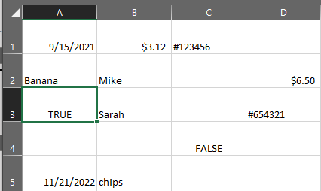
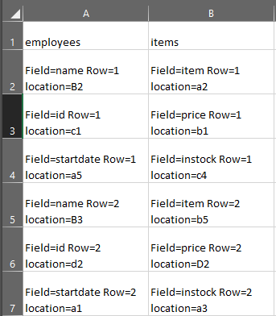
What’s in these databases?
Un-encrypted CS1
Un-encrypted CS2

Slide 9
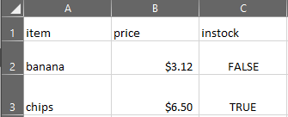
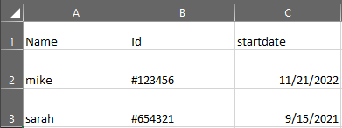
Completed tables:
Employee
items

Slide 10
Scalability
This design allows for different user groups to have distinct levels of security.
For a lower level of security, the encryption is a single key that can decrypt all items of a cloud service.
More security would have 2 or more keys for items spread across a random pattern.
In the most advanced security role-based encryption would be implemented into a database.
The unused requests to CS1 can also be scaled in exchange for throughput.

Slide 11
Other security measures
Collusion resistant
CS1 and 2 can’t work together to learn anything they don’t already know
Pattern resistant
CS1 can’t identify tables based on repeated queries

Slide 12
Limitations
Diffusion free encryption
Because CS2 relies on data location of CS1 encryption loses diffusion
User/Decision forwarder load
This system puts more load on to users and the decision forwarder than a standard cloud system

