Slide 1

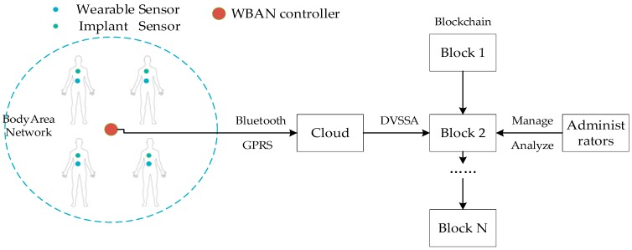
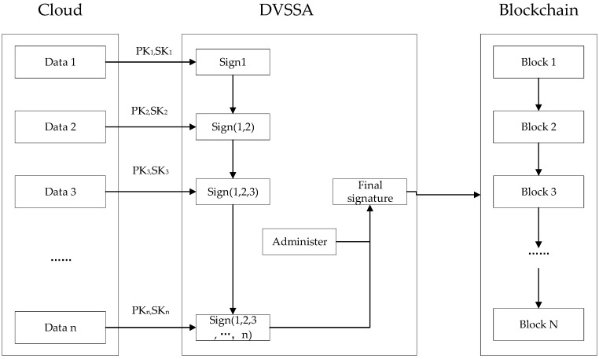
WIRELESS BODY AREA NETWORK SECURITY USING BLOCKCHAIN
ABSTRACT
INTRODUCTION
RESULTS
Wireless body area networks (WBANs) are expected to play a vital role in the field of patient-health monitoring shortly. They provide a convenient way to collect patient data, but they also bring serious problems which are mainly reflected in the safe storage of the collected data. Therefore, we analysed various techniques dealing with the security problems of WBAN and found out the proper solution to the addressed security issue i.e., by adopting blockchain technology to store and improve the security of the collected data and a sequential aggregate signature scheme with a designated verifier (DVSSA) to ensure authorized access and also to overcome the shortcomings of blockchain.
Wireless body area network (WBAN) is an underlying technology that can monitor and record human health signals for a long time. Its application is mainly used to continuously monitor and record health parameters of patients with chronic diseases (such as diabetes, asthma, and heart disease) and provide some form of automatic therapy control and immediately inform the doctor about the condition.
As WBAN stores and processes personal health information (e.g., health, history, vital signs, etc.), it raises several privacy and safety concerns like :
Unauthorized access: The unauthorized attackers hack into the WBAN and steal user data. Such attacks will violate users’ privacy.
Tampering with the messages: The attacker modifies signals in the WBAN so that the data collector receives fake users’ data. This will affect the safety of users.
Using the Blockchain Technology, the data becomes tamper resistant.
The sequential aggregate signature scheme with a designated verifier ensured the user’s data can only be viewed by the administrator.
DVSSA compresses the size of the blockchain storage space.
MODULES AND METHODS
CONCLUSIONS
Blockchain: Blockchain, which is an appended database, maintained by a peer-to-peer network node can be used to store the WBAN user’s data which can prevent the data from being tampered with.
DVSSA: Then a sequential aggregate signature scheme with a designated verifier should be implemented. It ensures that the user’s data can only be viewed by the administrator, and in other hands it can be compressed to the size of the blockchain storage space, which solves the illegal access problem.
In this project, we have been able to reach all the objectives of the problem statement. Through the tamper resistance characteristic of the blockchain, the integrity of the user data is guaranteed. Using this signature can compress the storage space of the block chain. After the completion, this project can be a good asset in the Medical Field.
Figure 1. WBAN System Model.
REFERENCES
https://ieeexplore.ieee.org/document/7987943
https://arxiv.org/ftp/arxiv/papers/1911/1911.04330.pdf
https://www.hindawi.com/journals/scn/2021/5580939/
Figure 2. Solution Architecture.

