Slide 1

Govt. E. Raghvendra Rao P. G. Science College Bilaspur (C. G.)
Department Of Computer Science
Session: 2024-25
A MAJOR PROJECT
ON
DIABETES PREDICTION USING MACHINE LEARNING TECHNIQUES
Submitted by
Kiran Sahu
(MSc. CS 4th Semester)
Roll No. 230708
Under the guidance of
Dr. Anamika Shukla Sharma
(Head of Department)

Slide 2
DIABETES PREDICTION USING MACHINE LEARNING TECHNIQUES
Kiran Sahu

Slide 3
Content
Introduction
Project Goal
Dataset Detail
Methodology:
Dataset Collection
Exploratory Data Analysis
Data Preprocessing
Introduction to Models
Model Performances
Metrics used
Flowchart
User Interface
Output
Conclusion
Future Work
References

Slide 4
INTRODUCTION
What is diabetes?
Diabetes is a chronic, metabolic disease characterized by elevated levels of blood glucose (sugar). This occurs when the body either doesn't produce enough insulin, a hormone that regulates blood sugar, or can't effectively use the insulin it does produce. Over time, high blood sugar can damage various organs, including the heart, blood vessels, eyes, kidneys, and nerves.
Why it’s detection is important?
Early detection of diabetes is crucial because it allows for timely intervention and management, significantly reducing the risk of serious complications like heart disease, kidney damage, vision loss, and nerve damage

Slide 5

INTRODUCTION
Use of Machine Learning in Diabetes Prediction:
Machine learning (ML) is being increasingly used to predict diabetes by analyzing various factors and patterns within patient data. Algorithms can identify individuals at risk, potentially enabling early intervention and improved management of the disease. Studies show that ML can improve the accuracy of diabetes prediction compared to traditional methods.

Slide 6
PROJECT GOAL
Accurate Early Detection of Diabetes
Develop and evaluate machine learning models that can accurately predict the presence of diabetes based on patient health data (such as glucose levels, BMI, age, etc.), enabling early intervention and better disease management.
Model Comparison and Optimization
Compare the performance of different machine learning algorithms (e.g., Logistic Regression, Decision Trees, Random Forest, XGBoost) using evaluation metrics like accuracy, precision, recall, and F1-score to determine the most effective model for diabetes prediction.

Slide 7

DATASET DETAILS
This dataset is originally from the National Institute of Diabetes and Digestive and Kidney Diseases. The objective is to predict based on diagnostic measurements whether a patient has diabetes.
Diabetes Dataset
Source: https://www.kaggle.com/datasets/mathchi/diabetes-data-set
This dataset allows us to predict if a patient is diabetic or not.

Slide 8
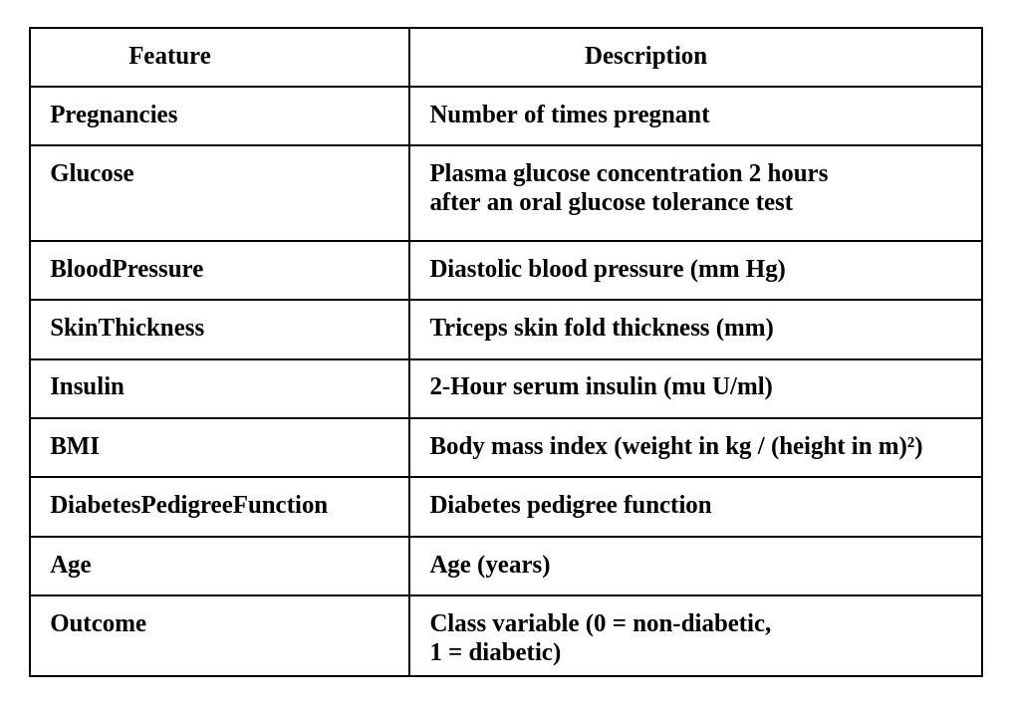
DATASET DETAILS
Several constraints were placed on the selection of these instances from a larger database. All patients here are females at least 21 years old of Pima Indian heritage.

Slide 9
Methodology

Slide 10
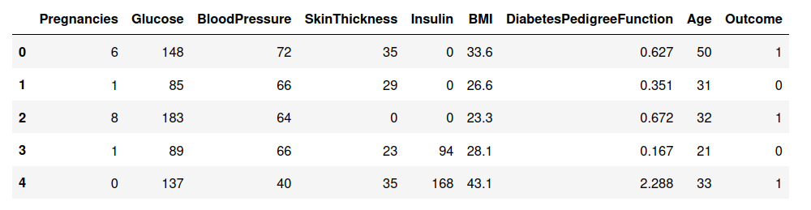
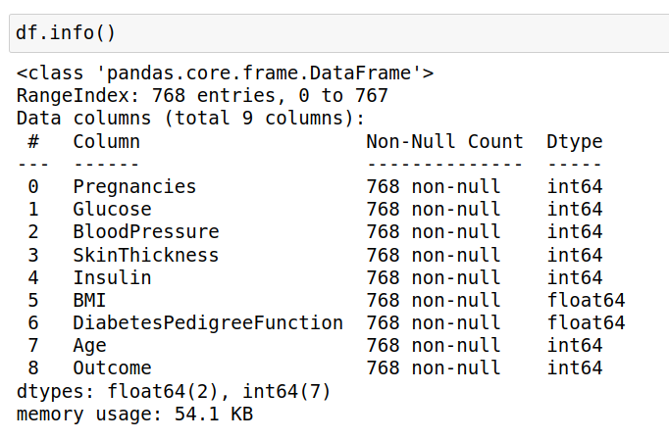
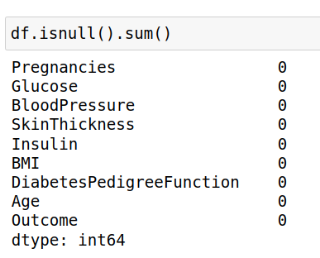
DATA COLLECTION
Importing the dataset:
Information regarding each column
The dataset is of dimension:
(768, 9)
Number of entries: 768
Number of features: 9

Slide 11
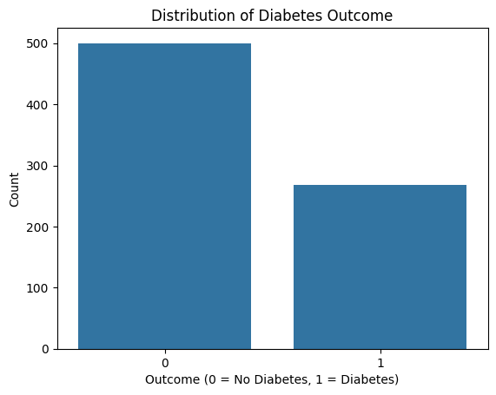
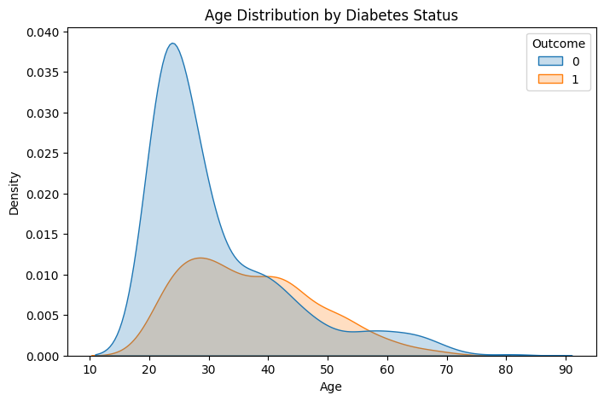
EXPLORATORY DATA ANALYSIS
Exploratory Data Analysis (EDA) is an approach to analyzing data set to summarize their main characteristics often using visual methods. It helps to understand the data, discover patterns, spot anomalies, test hypotheses, and check assumptions with the help of summary statistics and graphical representations.
Data is imbalanced.

Slide 12

DATA PREPROCESSING
Data preprocessing is essential for preparing raw input data for analysis. It involves cleaning the data by removing incorrect data, converting text data to numerical etc. These steps ensure that the data is consistent and suitable for building an effective fraud detection model, ultimately improving the model’s accuracy and performance.
Standard Scaling:
a feature scaling technique that transforms data to have a mean of 0 and a standard deviation of 1
Train test split:
a method used in machine learning to evaluate how well a model generalizes to new, unseen data

Slide 13

INTRODUCTION TO MODELS
Logistic Regression is a widely used statistical model for binary classification problems. It predicts the probability that a given input belongs to a particular class using the logistic (sigmoid) function. Unlike linear regression, which predicts continuous outcomes, logistic regression is designed for categorical outcomes (e.g., fraud or not fraud).
Key Points:
Works well with linearly separable data.
Easy to implement and interpret.
Output is a probability between 0 and 1.
Sensitive to multicollinearity and outliers.
Often used as a baseline model for classification problems.

Slide 14
INTRODUCTION TO MODELS
A Decision Tree is a non-parametric supervised learning algorithm that splits the data into subsets based on the value of input features. The tree is built by selecting features that result in the most significant information gain (e.g., using Gini impurity or entropy for classification).
Key Points:
Easy to understand and visualize.
Can handle both numerical and categorical data.
Prone to overfitting, especially with deep trees.
No need for data normalization or scaling.
Used as a base learner in ensemble models.

Slide 15
INTRODUCTION TO MODELS
Random Forest is an ensemble learning technique that combines multiple decision trees to create a more robust and accurate model. It uses a technique called bootstrap aggregating (bagging), where each tree is trained on a random subset of the data, and final predictions are made by averaging (regression) or voting (classification).
Key Points:
Handles large datasets with higher dimensionality well.
Reduces overfitting compared to individual decision trees.
Provides feature importance, aiding in feature selection.
Resistant to noise and outliers.
Slower to train with large number of trees.

Slide 16
INTRODUCTION TO MODELS
Support Vector Machine (SVM) is a powerful supervised machine learning algorithm primarily used for classification tasks, though it can also handle regression. SVM works by finding the optimal hyperplane that best separates data points of different classes in a high-dimensional space. The goal is to maximize the margin between the nearest data points of each class, known as support vectors,
to achieve robust classification.
Key Points:
Finds the best boundary (hyperplane) to separate classes.
Uses support vectors (important data points near the boundary).
Aims to maximize the margin between classes.
Can handle non-linear data using kernel functions.

Slide 17
INTRODUCTION TO MODELS
KNN is a simple, instance-based machine learning algorithm used for classification and regression. It predicts the output for a data point based on the majority class (or average value) of its K nearest neighbors in the feature space.
Key Points:
No training phase (lazy learner).
Based on distance (commonly Euclidean).
Works well with small datasets.
Sensitive to feature scaling.
Choice of K affects performance.

Slide 18
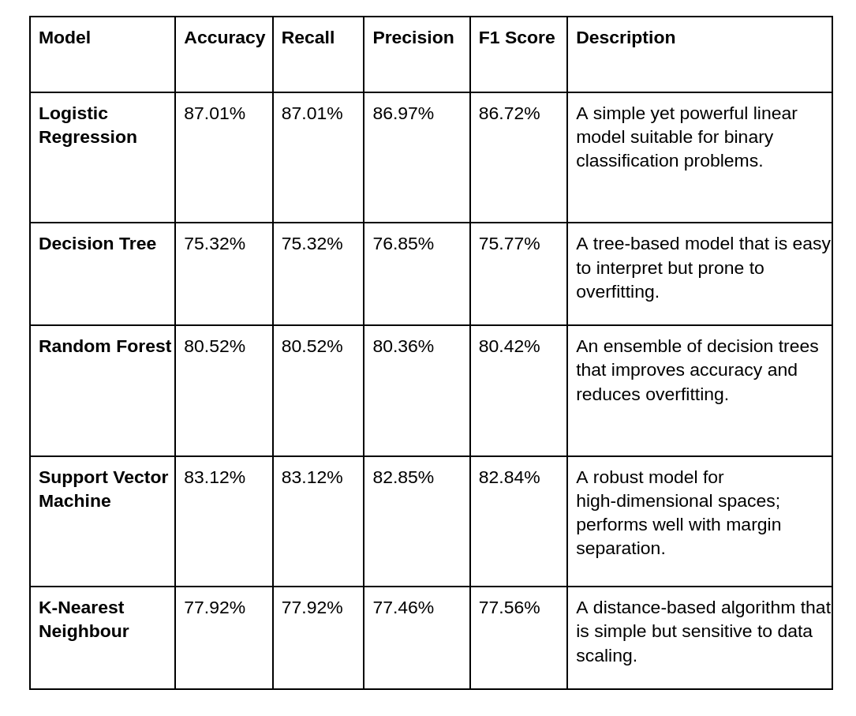
MODEL PERFORMANCES

Slide 19
Metrics Used in Diabetes Prediction
Accuracy Score:
The accuracy of the model is the proportion of correctly classified entries (both Diabetic and non-diabetic) out of the total. It is calculated as:
Accuracy = TP + TN/TP + TN + FP + FN
Using this model, the accuracy achieved is:
Accuracy = 0.87
This indicates that 87% of the records were correctly classified by the model.

Slide 20
Metrics Used in Diabetes Prediction
Precision Score:
Precision measures the proportion of correctly identified positive results (diabetic) out of all positive results predicted by the classifier. It is calculated as:
Precision = TP/TP + FP
Using this model, the precision achieved is:
Precision = 0.86
This means that every record predicted as diabetic are indeed diabetic, showing an exceptional score of 86%

Slide 21
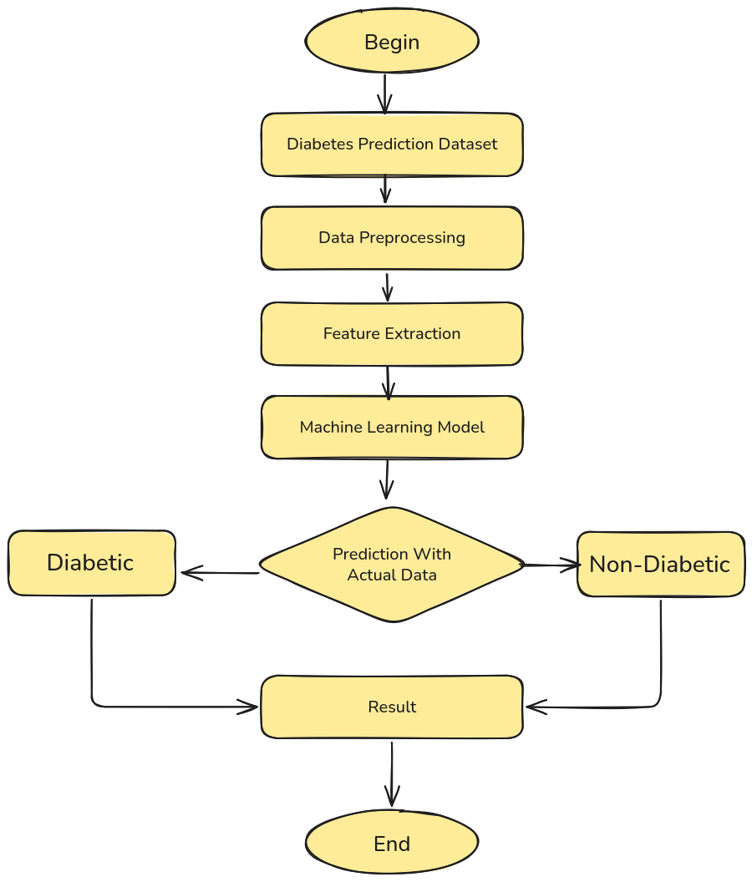
FLOWCHART

Slide 22
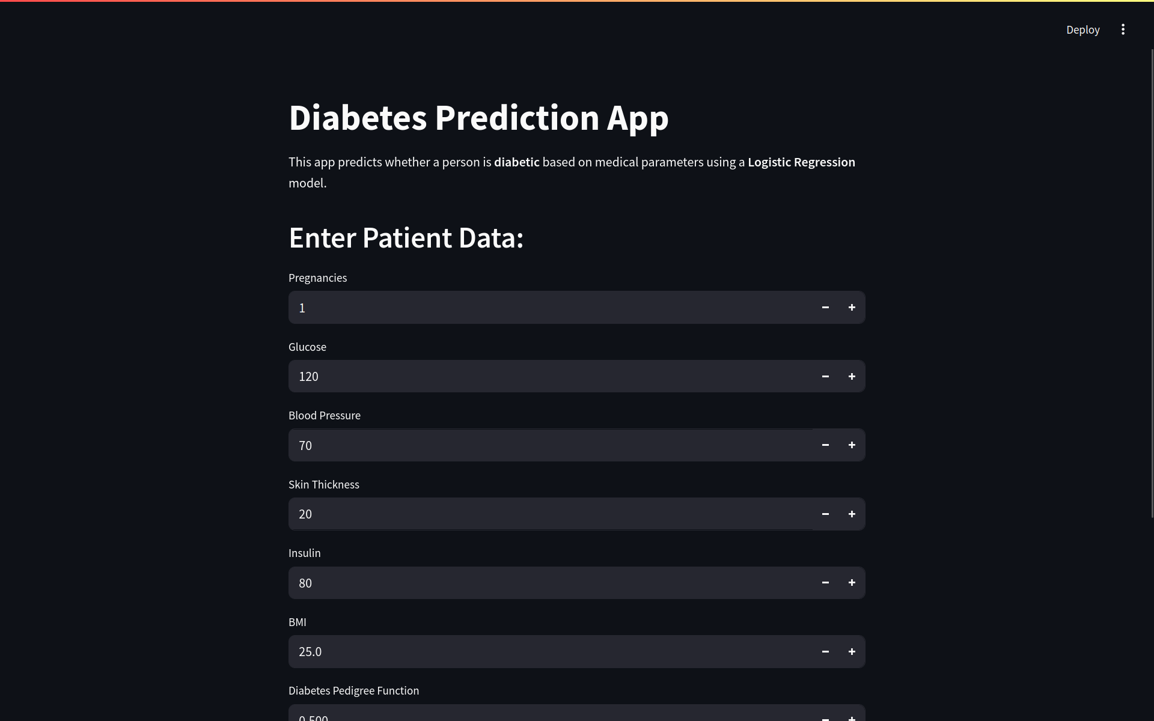
USER INTERFACE

Slide 23
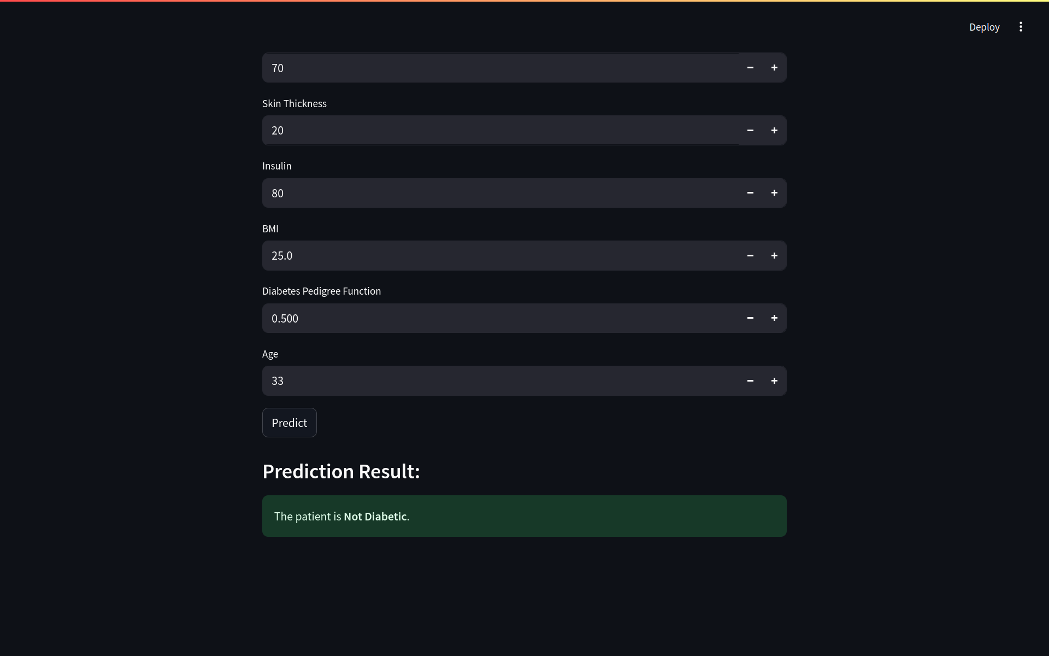
OUTPUT

Slide 24
CONCLUSION
In this project, we developed a robust Diabetes Disease Prediction system using a Logistic Regression classifier. The model was trained and tested on a dataset of diabetes patients, with a significant focus on achieving high accuracy of 87% and precision 86%.
Overall, the project demonstrates the potential of machine learning techniques, particularly Logistic Regression classifiers, in developing effective diabetes detection systems. The High performance metrics indicate that the model can be reliably used in real-world applications to filter out fraud transactions and improve communication efficiency.

Slide 25
FUTURE SCOPE
Integration with Other Classifiers: Exploring and integrating other machine learning classifiers, such as Boosting and Bagging, could further improve the model's accuracy and robustness.Combining multiple classifiers in an ensemble approach might yield better performance and reduce the likelihood of misclassifications.
Handling Imbalanced Data: Although the current model performs well, further techniques to handle imbalanced datasets, such as SMOTE (Synthetic Minority Over-sampling Technique) or cost-sensitive learning, could be implemented to ensure even better performance on datasets with a high imbalance ratio.
Real-time Disease Detection: Implementing the system in a real-time environment, such as integrating with messaging platforms or email services, to provide instant disease detection and filtering.Ensuring the system is scalable and can handle large volumes of messages with minimal latency.

Slide 26
REFERENCES
Kavakiotis, I., Tsave, O., Salifoglou, A., Maglaveras, N., Vlahavas, I., & Chouvarda, I. (2017). Machine learning and data mining methods in diabetes research. Computational and Structural Biotechnology Journal, 15, 104–116. https://doi.org/10.1016/j.csbj.2016.12.005
Smith, J. W., Everhart, J. E., Dickson, W. C., Knowler, W. C., & Johannes, R. S. (1988). Using the ADAP learning algorithm to forecast the onset of diabetes mellitus. Proceedings of the Annual Symposium on Computer Application in Medical Care, 261–265.
Sisodia, D., & Sisodia, D. S. (2018). Prediction of diabetes using classification algorithms. Procedia Computer Science, 132, 1578–1585. https://doi.org/10.1016/j.procs.2018.05.221
Jayanthi, A., Ramesh, D., & Sivakumar, S. (2017). Machine learning algorithms for diabetes diagnosis: A comparative study. International Journal of Engineering and Technology, 7(2.7), 223–226.
Kumar, A., & Vohra, R. (2020). Comparative analysis of machine learning models for diabetes prediction. International Journal of Engineering Research & Technology, 9(4), 179–183.
Polat, K., & Güneş, S. (2007). An expert system approach based on principal component analysis and adaptive neuro-fuzzy inference system to diagnosis of diabetes disease. Digital Signal Processing, 17(4), 702–710. https://doi.org/10.1016/j.dsp.2006.09.005

Slide 27

Thank you for your attention.
I am now open to any question you may have!

