Slide 1
MiniAnalyzers
Peter Vidlička
Small but practical set of Roslyn analyzers with a simple WPF UI

Slide 2
Analyzer Flow
SOLUTION / PROJECT
Roslyn Compilation
Analyzer.Initialize()
Register Callbacks
SyntaxNodeAction
OperationAction
SymbolAction
CompilationStartAction
Analyzer runs on code
ReportDiagnostic(...)
DiagnosticInfo DTO
WPF UI Grid / Filters

Slide 3
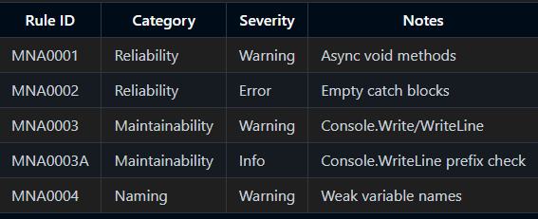
Each analyzer declares its rule with a DiagnosticDescriptor and exposes it in SupportedDiagnostics.
In Initialize(AnalysisContext)
Disable analysis on generated code and enable concurrent execution.

Slide 4
Register callbacks that Roslyn will call during analysis:
Syntax callbacks when we need the exact C# syntax shape.
Operation callbacks when we care about bound semantics, for example conversions.
Symbol callbacks for symbol centered checks, for example parameter names.
CompilationStartAction to cache symbols once per compilation.
Inside callbacks:
Use SemanticModel, Compilation, or Operation to read meaning, not just text.
Decide if a location should be reported.
Call ReportDiagnostic(Diagnostic.Create(...)), optionally with extra properties that the UI can surface as suggestions.

Slide 5
MNA0001 AsyncVoid
Goal
Discourage async void, which is hard to await and to test.
Key registrations:
RegisterSyntaxNodeAction for MethodDeclaration and LocalFunctionStatement.
RegisterOperationAction for Conversion and for DelegateCreation. These catch async lambdas that get converted to or created as void delegates.

Slide 6
public async void DoWork()
{
await Task.Delay(1000);
throw new Exception("Boom!");}
public async Task DoWorkAsync()
{
await Task.Delay(1000);
throw new Exception("Handled by caller with try/catch");
}
Action a = async () => await Task.Delay(1000);
Func<Task> a = async () => await Task.Delay(1000);

Slide 7
Decision flow
For methods and local functions:
Check async modifier and void return type.
Get IMethodSymbol.
Skip anything that is not a normal method (constructors, operators).
Skip overrides and explicit interface implementations since signature is fixed by a contract.
Skip things that look like event handlers: (object sender, EventArgs args) or derived EventArgs.
Report at the void keyword with a message that recommends Task or Task<T> and attach a Suggestion property.

Slide 8
For async lambdas assigned to void delegates:
Look at IConversionOperation and IDelegateCreationOperation.
If the target delegate returns void and the lambda syntax has async, this is an async void lambda.
Skip delegates that match the event handler pattern.
Report at the lambda location with the same recommendation.

Slide 9
MNA0004 Weak variable names
Goal
Help readability by discouraging names that are too short or too generic.
Key registrations:
RegisterCompilationStartAction to resolve and cache well known types once, for example IEnumerable<T> and EventArgs.
Within that start action:
RegisterSyntaxNodeAction for VariableDeclarator to catch locals and fields.
RegisterSymbolAction for parameters.
RegisterSyntaxNodeAction for SingleVariableDesignation to catch foreach (var x in ...).
Scope covered:
Locals and fields (fields only when not const).
Parameters.
Foreach variable designations (configurable).

Slide 10
Rules applied:
Minimum length rule with an allow list for common short names like id, ct, ok.
Token rule for common weak names such as tmp, data, foo.
Discard _ is ignored.
Classic for counters i, j, k allowed only when declared in the for initializer.
Special case for parameters named e when the type derives from EventArgs.
Type aware suggestions
If the type is bool, suggest a name starting with is, has, or can.
If the type is a collection or implements IEnumerable<T>, suggest a plural form.

Slide 11
Decision flow
Step 1: Collect candidates:
From locals, fields (non-const), parameters, and foreach variables.
Step 2: Apply skips
Ignore _ discard.
Ignore i, j, k if in a for-loop initializer.
Ignore e if parameter type derives from EventArgs.
Step 3: Apply rules
Length rule: flag if shorter than min_length (unless in allow-list like id, ct, ok).
Token rule: flag if in known weak set (tmp, data, obj, …).
Step 4: Enrich with type-aware hints
If type is bool → suggest prefix is/has/can.
If type is a collection → suggest plural.
Step 5 – Report diagnostic
Diagnostic points to the identifier location.
Suggestion included in properties for UI display.

Slide 12
MNA0002 Empty catch
Problem
Empty catch blocks swallow exceptions silently, hiding bugs and making debugging very hard.
Implementation
Registers on catch clauses
Uses options to decide:
whether to treat catch { ; } as empty
whether to ignore OperationCanceledException (often intentionally swallowed in async code)
whether to ignore specific exception types configured in .editorconfig
Reports when the body is effectively empty and not exempt by the above rules.

Slide 13
MNA0003 Console.WriteLine
Problem
Direct Console.Write/WriteLine is discouraged in production code; logging frameworks should be used. In our variant, we also enforce a configurable prefix to console output.
Implementation
Registers on all invocation operations.
Resolves System.Console and checks Write/WriteLine.
Applies options:
required prefix (with case-sensitivity toggle)
allow console calls in test code (detected via attributes like [TestMethod])
Reports at the call site (or at the message argument if present).
Diagnostic carries a Suggestion property with the expected prefix.

Slide 14
Analyzer configuration with .editorconfig
Not every team has the same naming rules or logging conventions. Roslyn analyzers support configuration through .editorconfig, and I expose custom keys so projects can tune the analyzers without touching code.

Slide 15
How it works
Schema classes
Each analyzer with options has a schema (WeakVarOptionsSchema, ConsoleWriteOptionsSchema, …).
The schema defines default values.
The schema knows how to bind .editorconfig keys into a typed options record.
Option readers
OptionReaders.cs contains helpers like ReadBool, ReadInt, ReadSet.
They parse values from AnalyzerConfigOptions.
Tolerant to casing and missing keys.Always fall back to defaults.

Slide 16
Accessor and cache
OptionsAccessor<TOptions> maps from a SyntaxTree or Symbol to the right options.
Bound once per compilation and cached using ConditionalWeakTable.Analyzers call context.
GetOptions<WeakVarOptions, WeakVarOptionsSchema>() to get the right snapshot for their context.
Analyzer code
Inside a callback (symbol, syntax, or operation analysis):
Analyzer reads var opts = context.GetOptions<WeakVarOptions, WeakVarOptionsSchema>();
Options drive decisions (e.g. opts.MinLength, opts.AllowedNames).

Slide 17
AnalyzerOptionExtensions
Convenience methods analyzers call to fetch .editorconfig options. (context.GetWeakVarOptions())
Hide complex generic calls behind a one-liner
Make analyzer code simpler and more readable
How they work
Analyzer calls context.GetXOptions().
Extension looks up an OptionsAccessor<TOptions> from OptionAccessorCache.
Accessor:
Reads .editorconfig for the syntax tree or symbol.
Binds values via the schema.
Returns cached typed options.
Analyzer gets a ready to use TOptions record.

Slide 18
AnalysisRunner
Orchestrates Roslyn compilation and analyzer execution.
Provides async APIs
AnalyzeSolutionAsync: Opens the solution, loops through projects, runs analyzers.
AnalyzeProjectAsync: Same, but for one project file.
Collects raw Diagnostic objects from Roslyn.
Converts them into our custom DiagnosticInfo
Analyzer ID, severity, message.
Project/file info.
Snippet with highlighted span.
Optional suggestion from diagnostic properties.

Slide 19
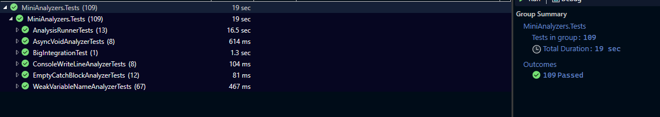
Tests

Slide 20
UI
Browse & select .sln / .csproj.
Run analyzers.
Results appear in grid with severity, ID, message.
Double-click to expand code snippet

Slide 21
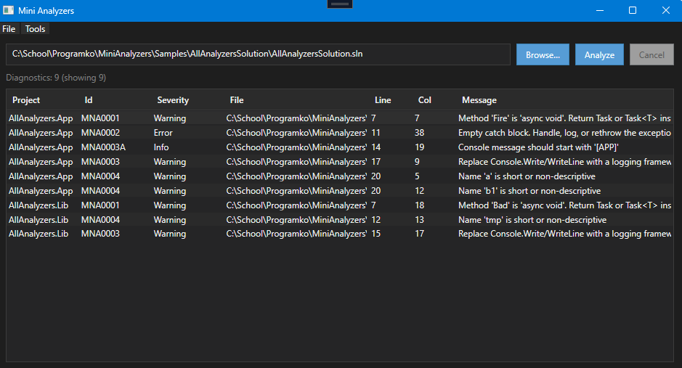

Slide 22
UI Filter Settings
Lets users fine-tune the results shown in the UI.
Provides an easy way to:
Include only specific rule IDs.
Exclude unwanted rule IDs.
Adjust severity filters (Info / Warning / Error).
Bindings update the shared FilterSettings instantly.

Slide 23
