Slide 1
meBOP 2017
Sarah Moghrabi

Slide 2
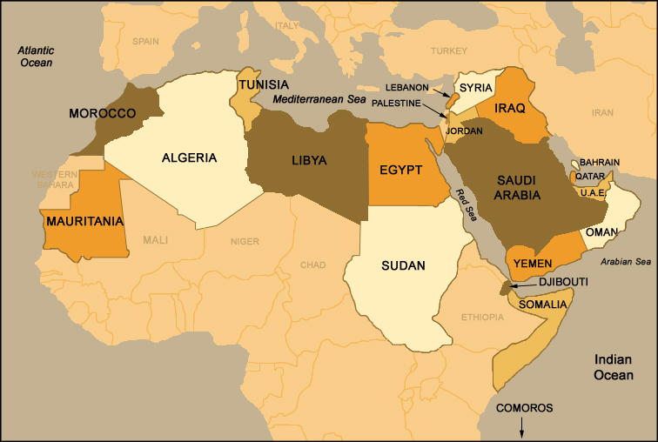

Slide 3
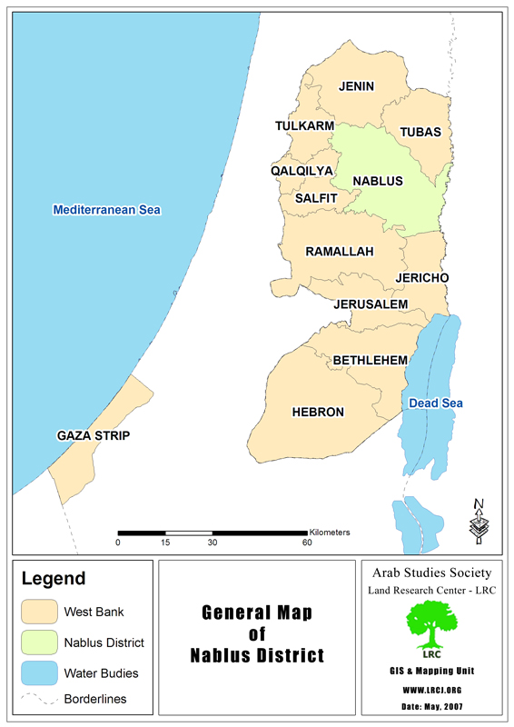

Slide 4
Graduated medical school in 2016
Interned at Ministry of Health hospitals and primary care clinics
Next step?
Notes:
Pursue a phd
Specialize in im
Expand my knowledge and build on my research skills
Want to dabble in the clinical and academic world of medicine

Slide 5
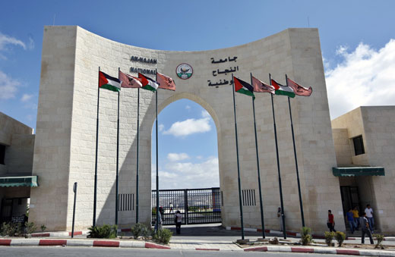
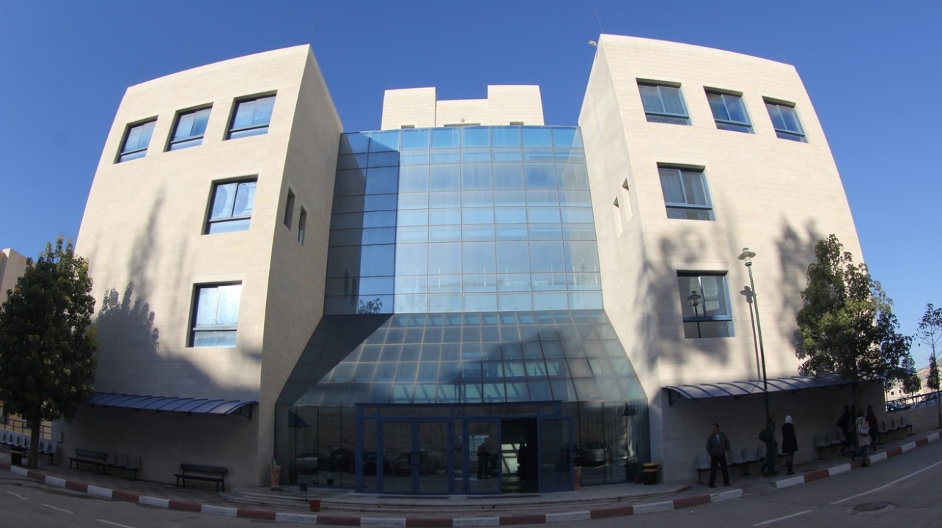

Slide 6
Parasitism in West Bank
Leishmaniasis
Visceral Leishmaniasis:
4
Cutaneous Leishmaniasis:
387

Slide 7
Parasitism in West Bank
Echinococcosis
Hydatid cyst:
46

Slide 8
Parasitism in West Bank
Helminths
Ascariasis:
172
Enterobiasis:
1345
Strongyloidasis:
142
Tiniasis solium/saginata:
0

Slide 9
Parasitism in West Bank
Ameobiasis & Giardiasis
Ameobiasis (trophozoite):
445
Giardiasis:
94

Slide 10
Parasitism in West Bank
Toxoplasmosis:
1
Trichomoniasis:
727

Slide 11
Research in West Bank
Descriptive researches
Lack of facilities
Lack of fund

Slide 12
Thank you

