Slide 1


UNIVERSITY OF YAOUNDE I
FACULTY OF SCIENCE
DEPARTMENT OF BIOCHEMISTRY
P.O. Box 812, Yaoundé, Cameroon
Tel./Fax: (237) 22223-4496
LABORATORY FOR PHYTOBIOCHEMISTRY AND MEDICINAL PLANTS STUDIES
ANTIMICROBIAL AND BIOCONTROL AGENTS UNIT
Head, Prof. Dr. Fabrice FEKAM BOYOM, MS, DS, ScD
Darline DIZE, Msc
Tel.: +237 670 17 54 29
Email: darline.dize@yahoo.fr

Slide 2
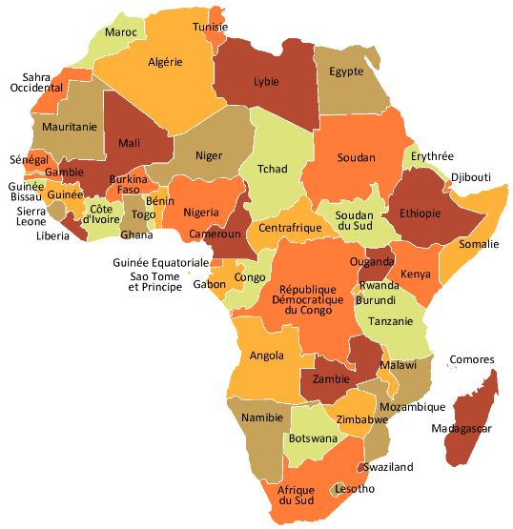
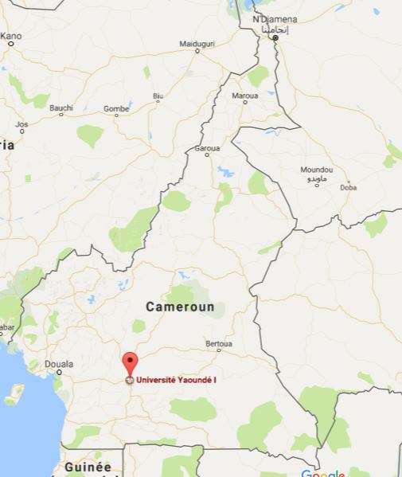
Geographic place-Institute and Laboratory situation

Slide 3
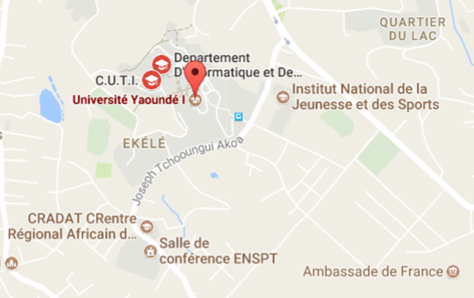
Geographic place-Institute and Laboratory situation
Cameroon: Central Africa
Town: Yaoundé
District: Ngoa-Ekelle

Slide 4
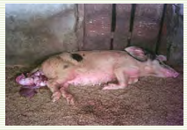
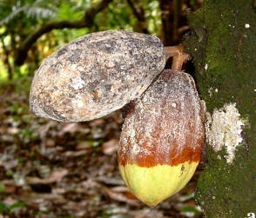
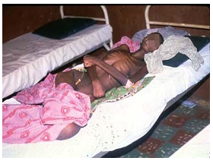
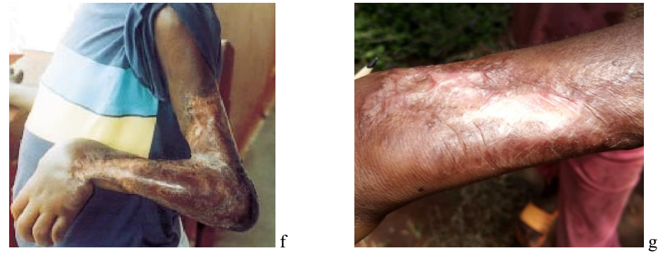
Main research question of the Laboratory
Can studying plants metabolites results in innovative drugs against endemic NTDs and plants diseases?

Slide 5
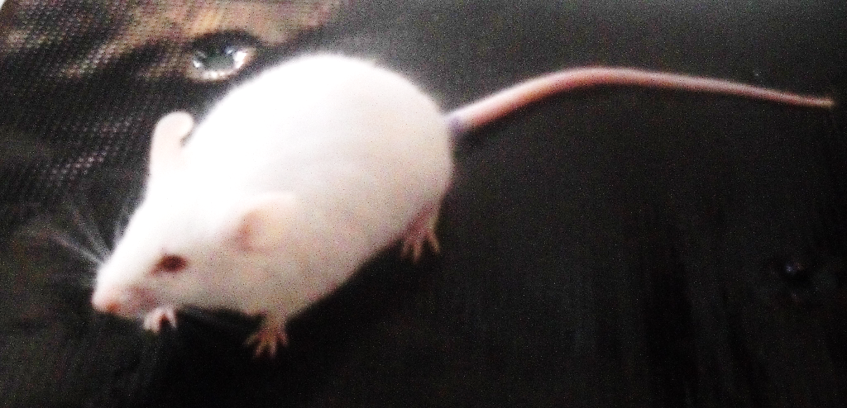
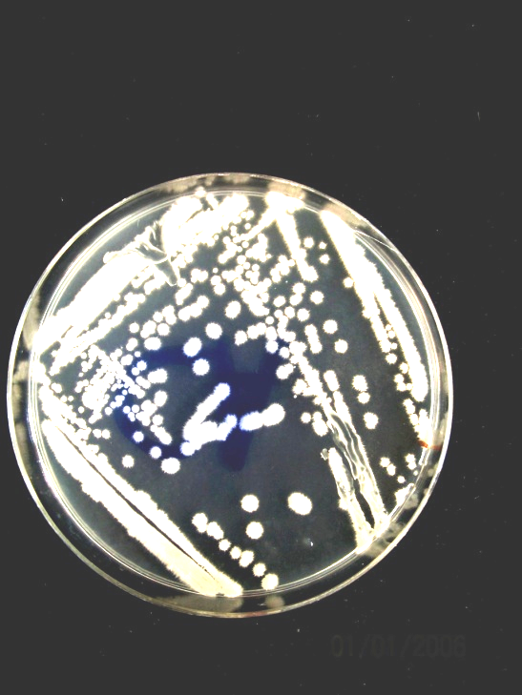
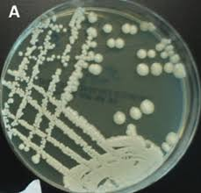
Main research activities of the Laboratory
To seek answers to this main question, research at AmBcAU focuses on:
Natural products isolation and characterization
In vitro/In vivo antiparasitic screening
In vitro/In vivo antibacterial and antifungal screening

Slide 6
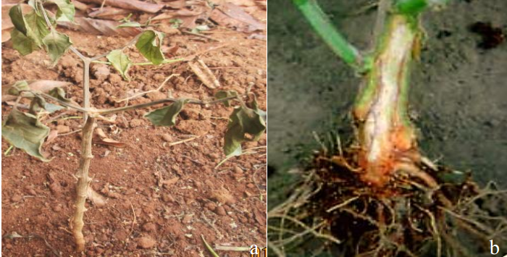
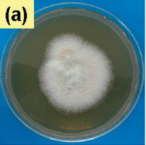
Main research activities of the Laboratory
To seek answers to this main question, research at AmBcAU focuses on:
Cytotoxicity and toxicity studies
Biological control studies against plants pests

Slide 7
Long-term scientific goals
To become an independent research leader in the field of drug discovery against NTDs
To formulate efficacious, safe, and cost-effective phytodrugs against NTDs
Main research question of my proposal
The impact of Trypanosoma’s gene regulation on its pathogenicity (VSG)
  Drug sensitivity activity
  Combination of the potents compound
  targets
  What are intermediate metabolites release during parasite-extract interaction

Slide 8
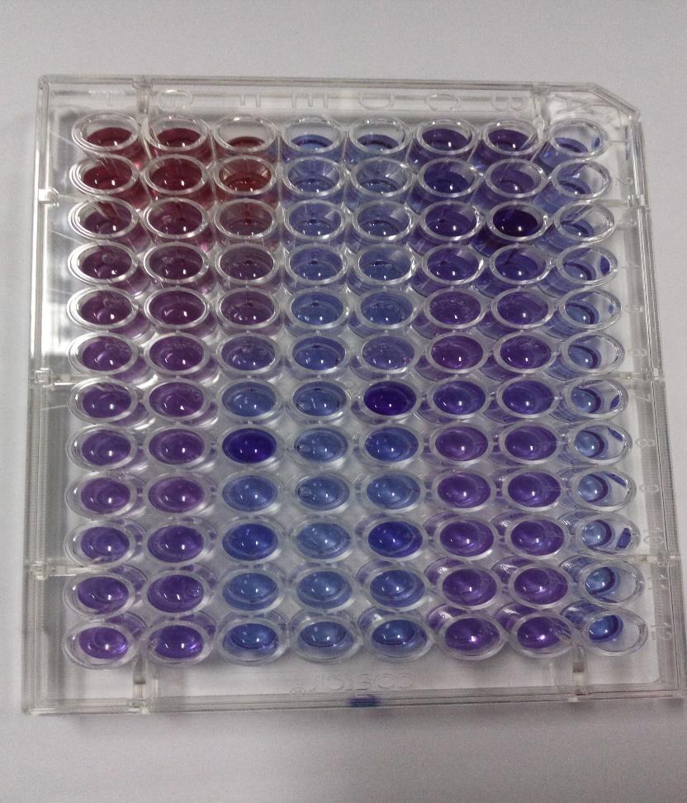
My hands-on laboratory expertise
I am comfortable in:
  In vitro screening of drugs againts protozoan, fungal, and bacterial pathogens

Slide 9
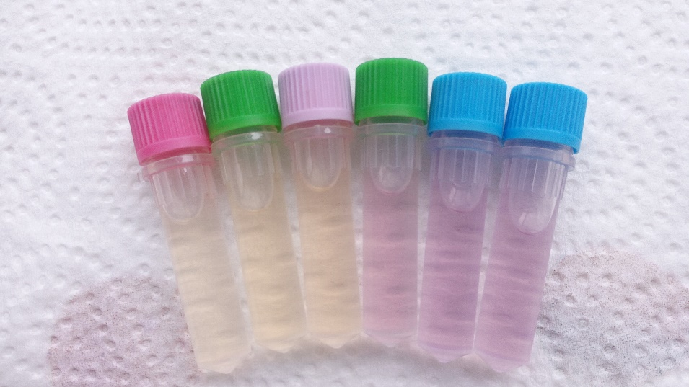
My hands-on laboratory expertise
I am comfortable in:
  Antioxidant screening
  Mammalian cells culture and cytotoxicity assays

Slide 10
Needed ressources/expertise to promote my project.
Chemistry: Structure elucidation
Genetic: identification of new drug targets
Pharmacokinetics: biodisponibility, drug metabolism
Faced difficulties
Funding
Equipement

Slide 11
THANK FOR YOUR KIND ATTENTION

