Slide 1
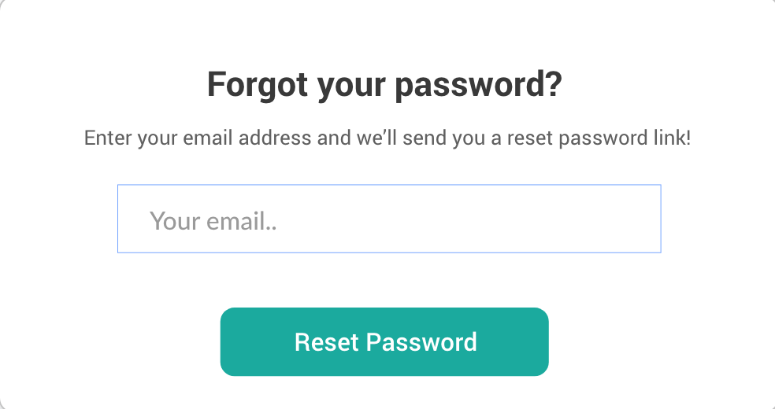
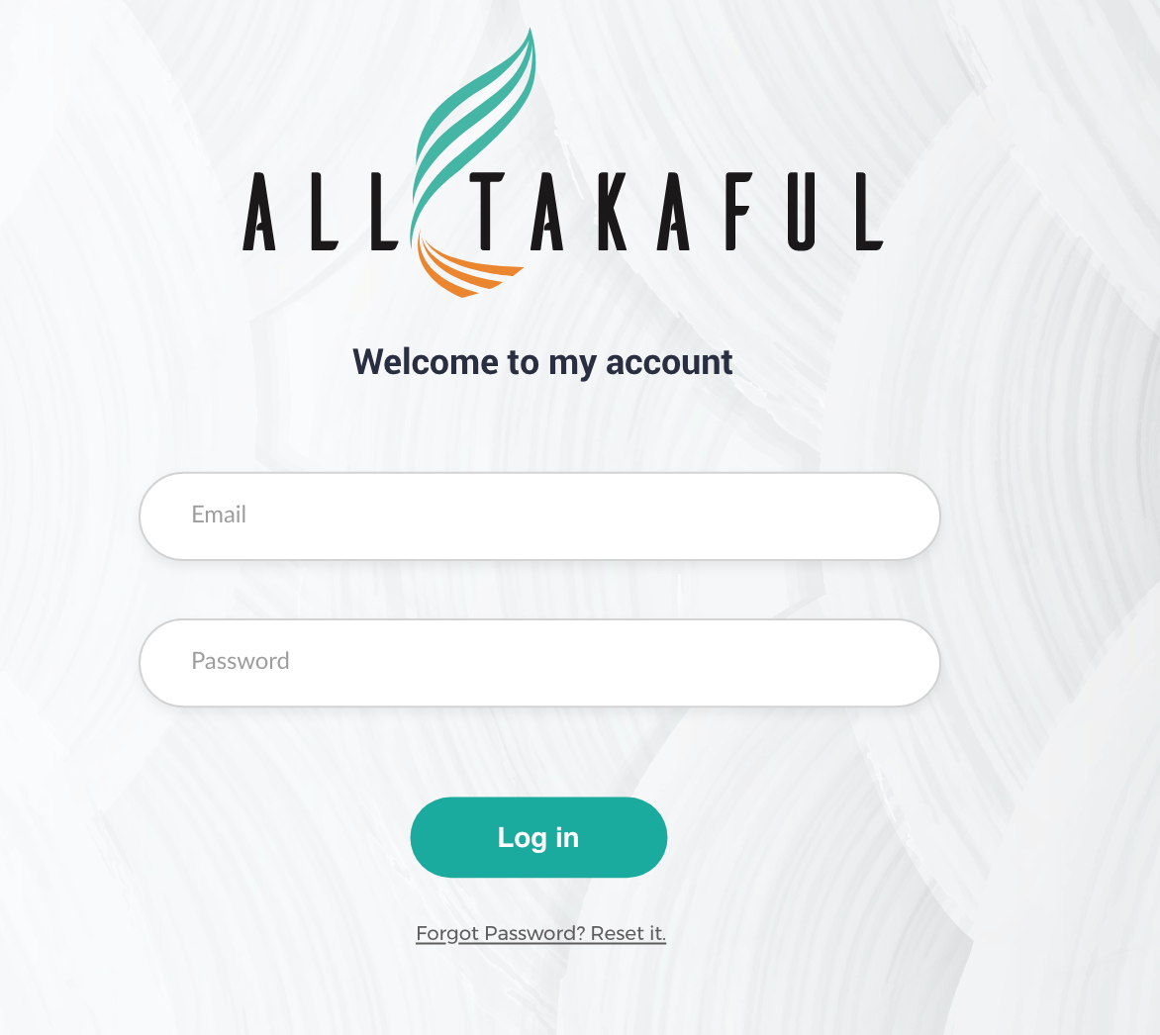
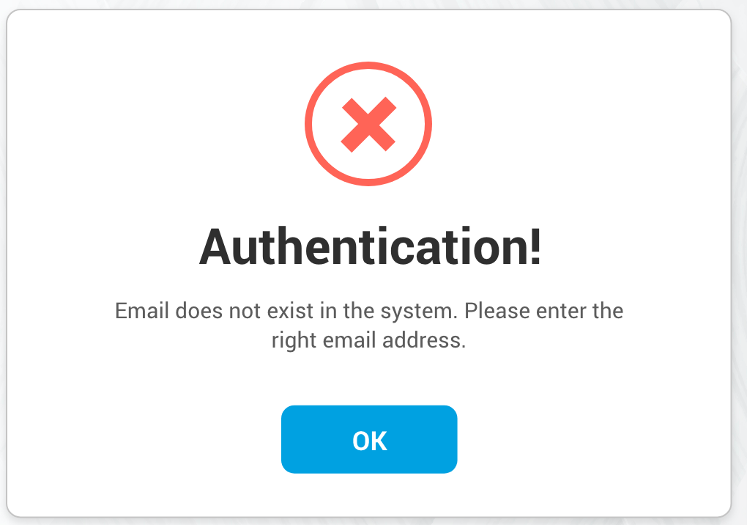
/login
/forgotpassword
A02
A01
Notes:
LOGIN => Call Login API
Forgot Password => Open Forgot password screen
Reset Password => Call API to send temp password thru email

Slide 2
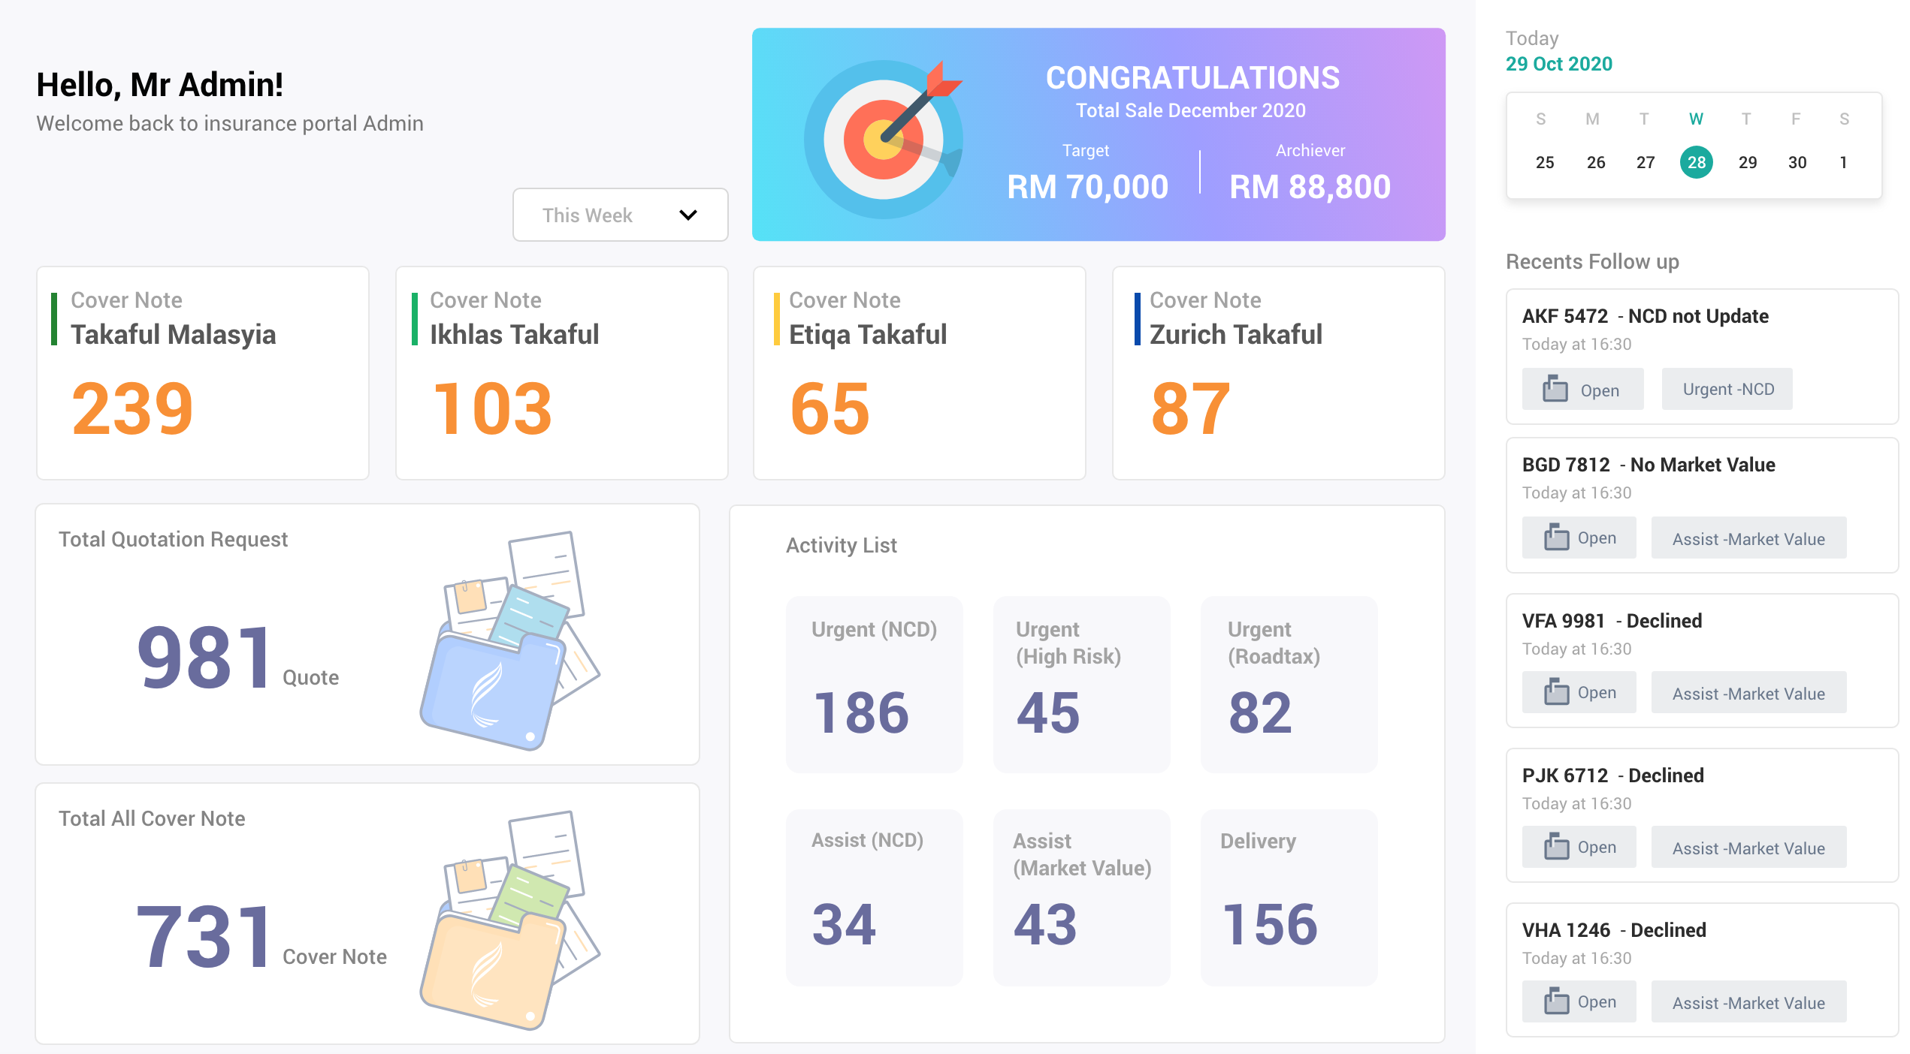
/admin/dashboard
A
F01
F02
B
C
F03
E
F05
D
F04
Notes:
A => Call API to get sale statistic
B => Call API to get the cover note statistic
C => Call API to get the most recent issue
D => Call API to get basket statistic
E => Call API to get the Quote statistic

Slide 3
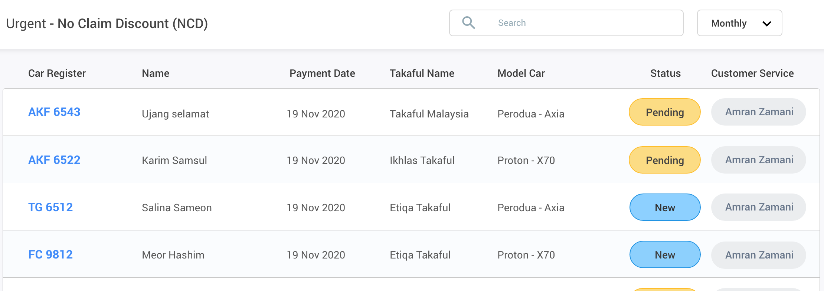
/admin/urgent/ncd_basket
G01
G04 when clicked
Notes:
Call API to get the NCD basket
When click the car reg no, call API to tag the record to the login user, and show the detail screen

Slide 4
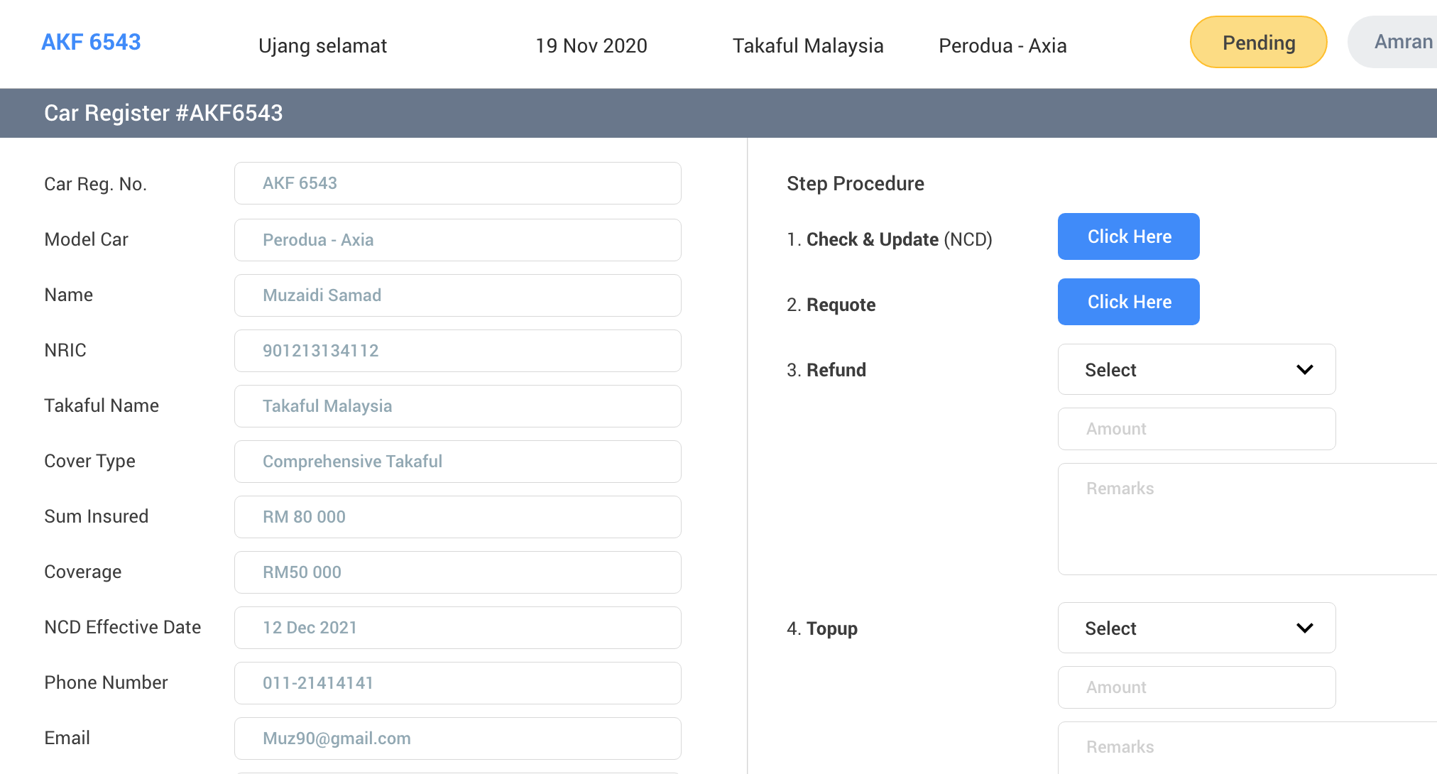
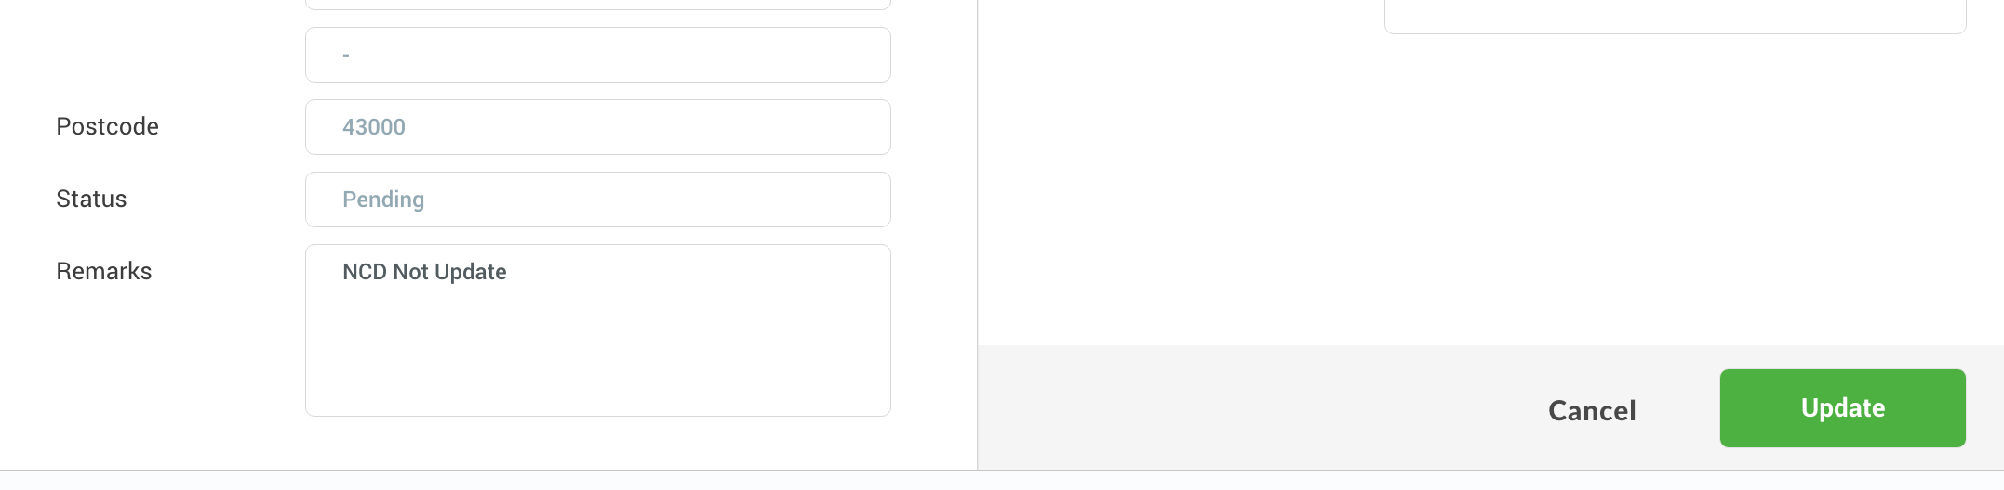
/admin/urgent/ncd_basket
G02
B05
B04
B04
Notes:
Update => Call API to update record. BE will update the quote information and recrawl again to get the latest quotation.

Slide 5
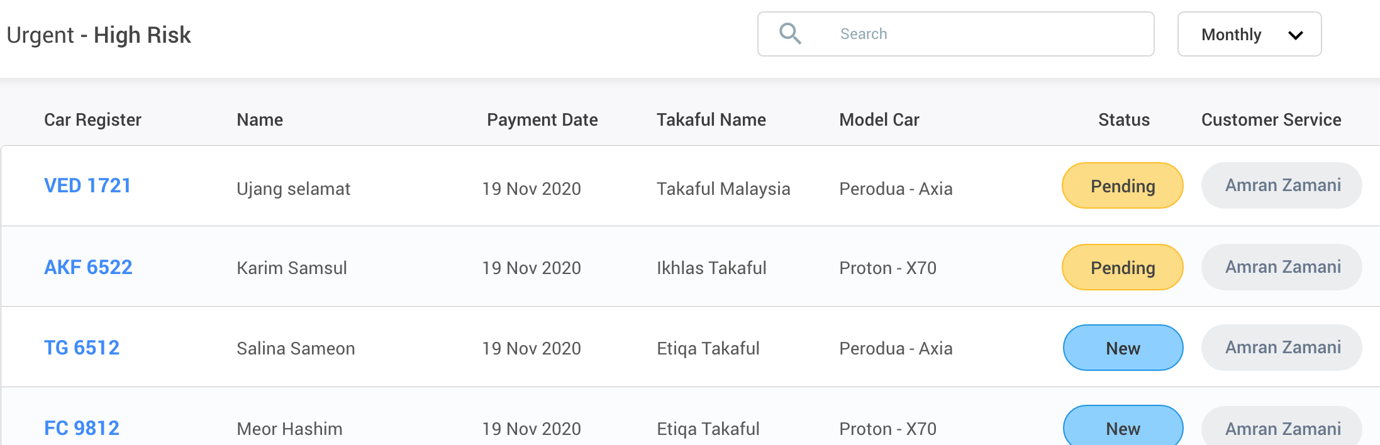
/admin/urgent/risk_basket
G03
G04 when clicked
Notes:
Call API to get the High Risk basket
When click the car reg no, call API to tag the record to the login user, and show the detail screen

Slide 6
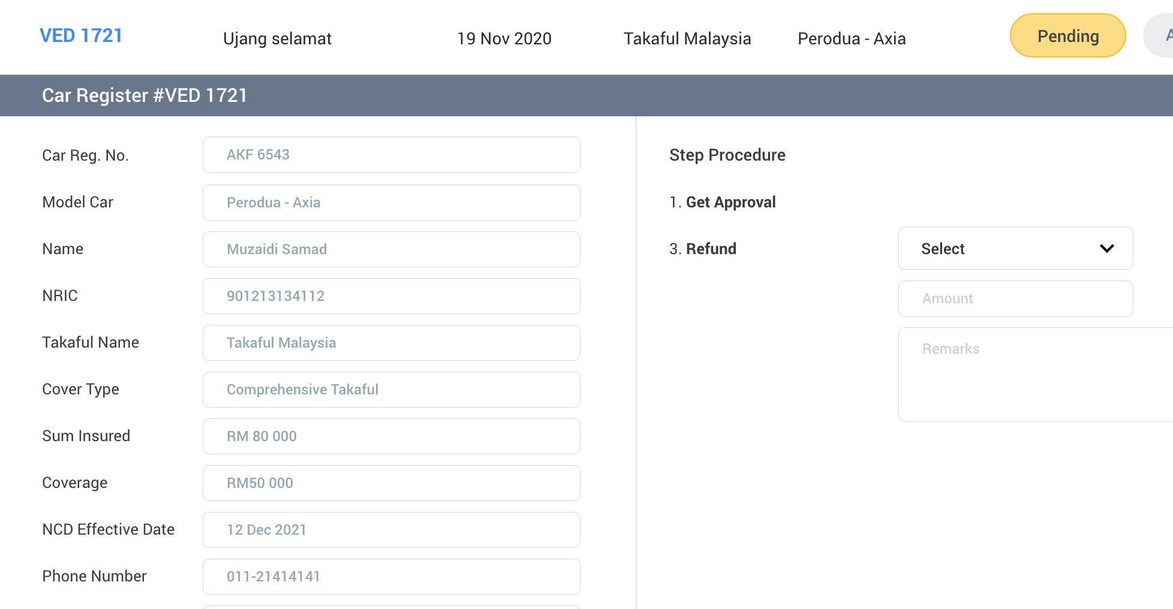
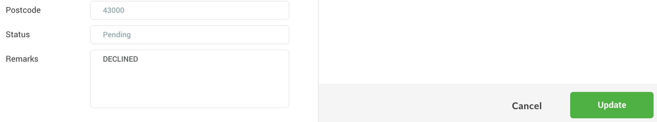
/admin/urgent/risk_basket
G02
B04
Notes:
Update => Call API to update record. BE will update the quote information. If the CS get the approval, update the quotation and recrawl again. If cannot get approval, send for refund

Slide 7
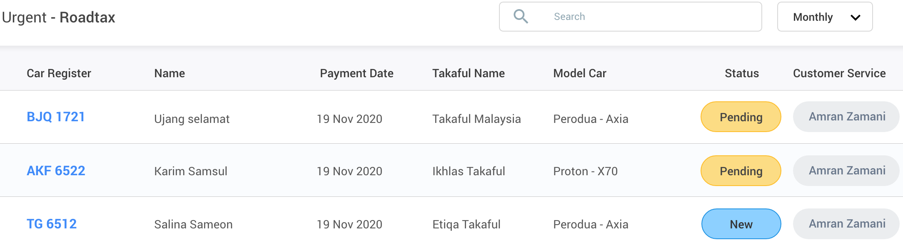
/admin/urgent/roadtax_basket
G05
G04 when clicked
Notes:
Call API to get the Roadtax basket
When click the car reg no, call API to tag the record to the login user, and show the detail screen

Slide 8
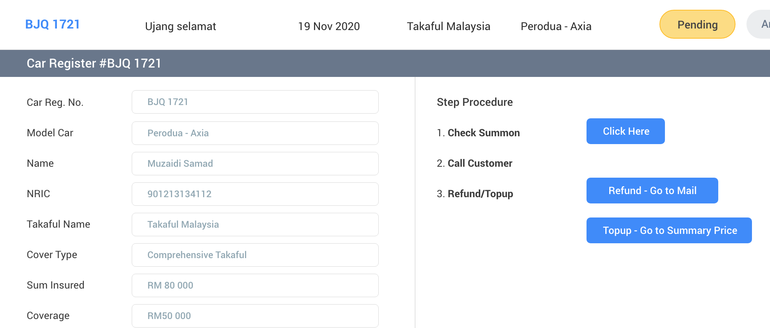
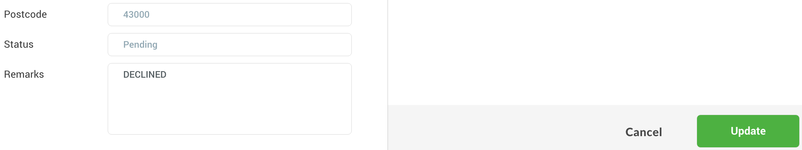
/admin/urgent/roadtax_basket
G02
C07
Go to payment summary page
B04
Notes:
Update => Call API to update record. If customer want to refund, send for refund. If customer want to topup, update quotation and send the summary link to customer.
Refund => Call API to send Email and send to Refund Basket
Topup => Call API to calculate the topup and send to summary page
Click Here => Go to myEg Summon page

Slide 9
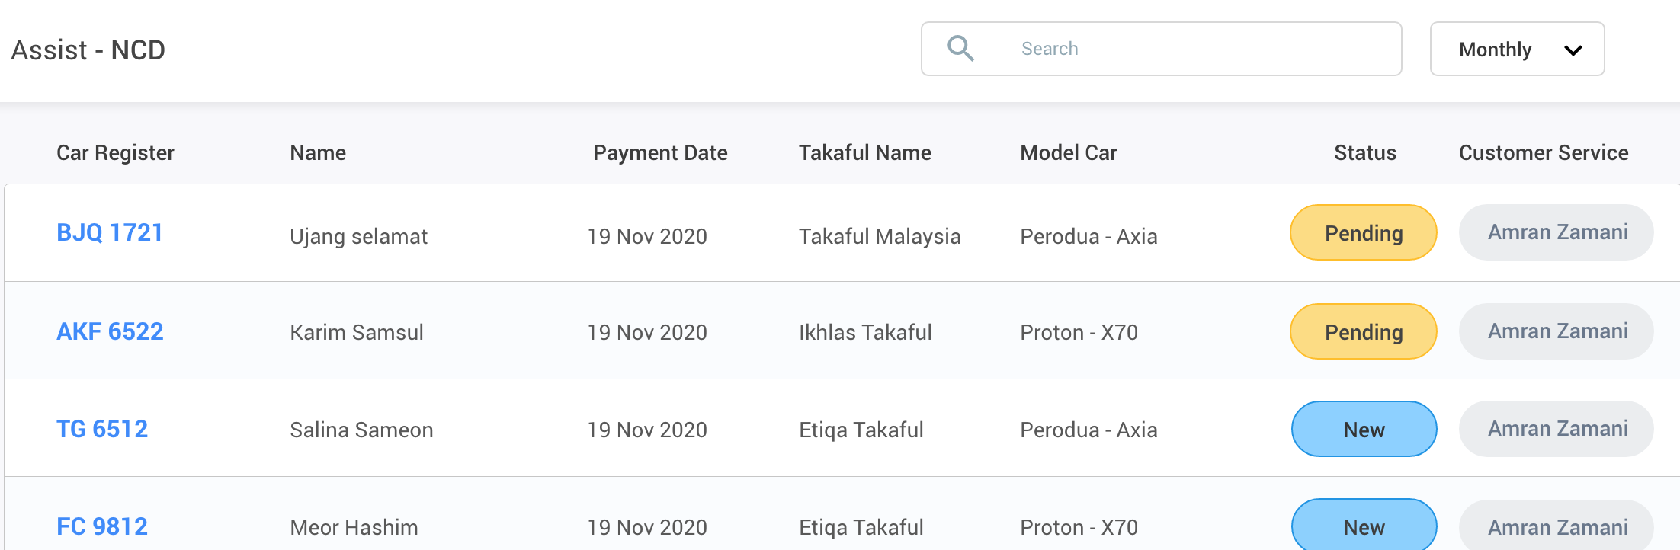
/admin/assist/ncd_basket
G01
G04 when clicked
Notes:
Call API to get the ncd basket
When click the car reg no, call API to tag the record to the login user, and show the detail screen

Slide 10
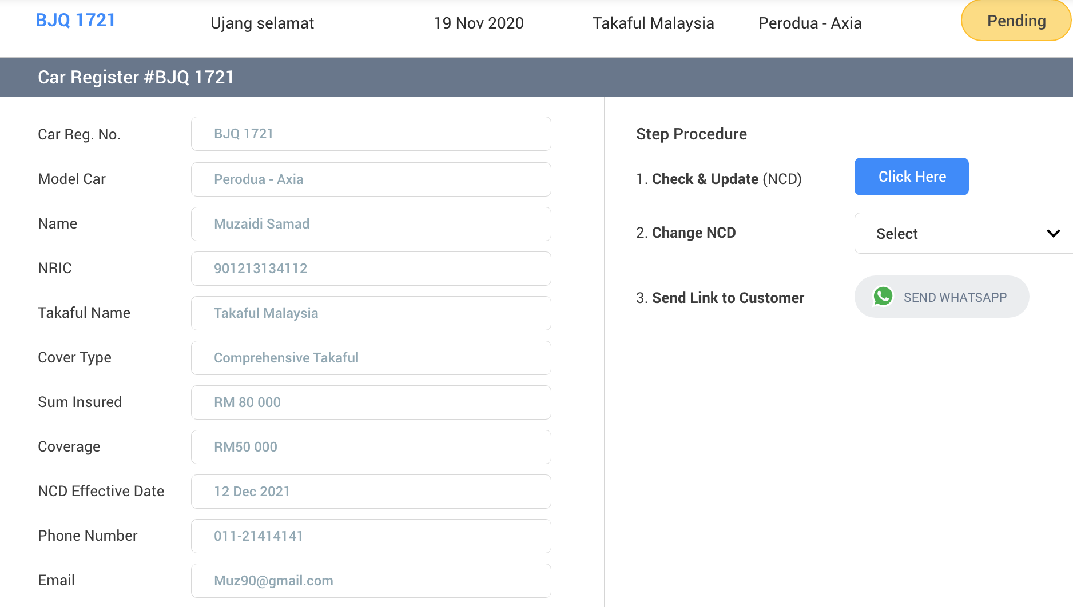
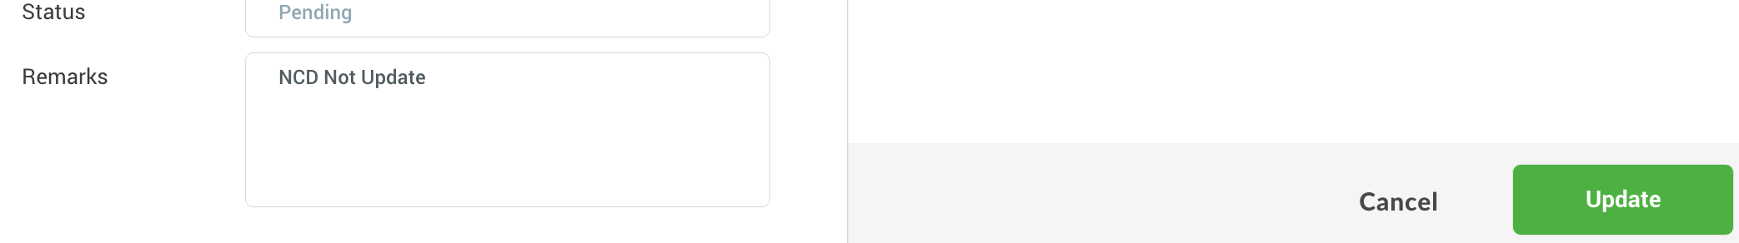
/admin/assist/ncd_basket
G02
C08
B04
Notes:
Update => Call API to update record. BE Recrawl the quotation again.
Send WA => Call API to send WA

Slide 11
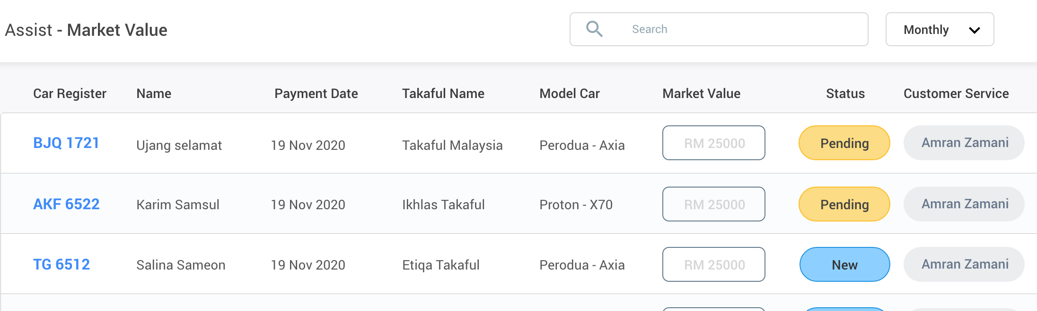
/admin/assist/market_value_basket
G06
G04 when clicked
Notes:
Call API to get the market value basket
When click the car reg no, call API to tag the record to the login user, and show the detail screen

Slide 12
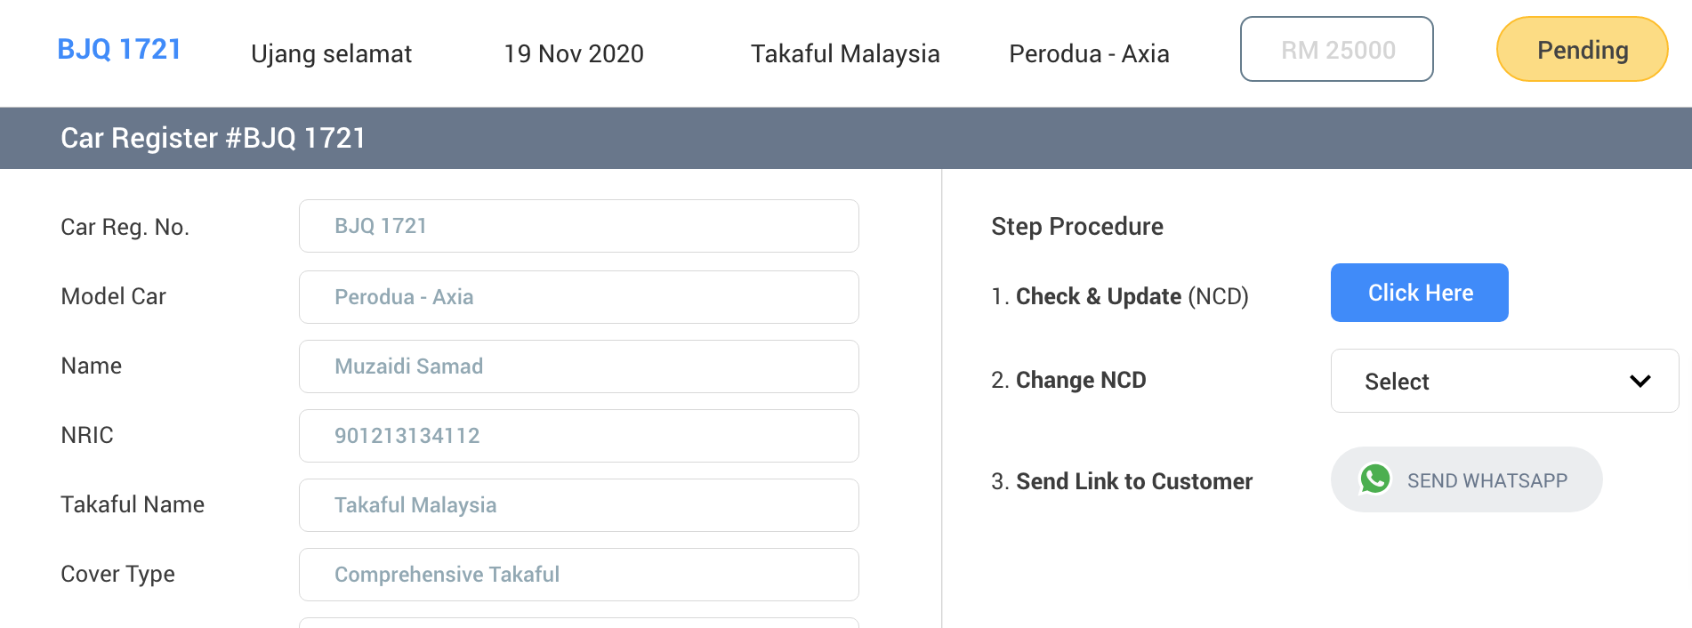
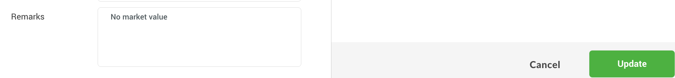
/admin/assist/market_value_basket
G02
C08
B04
Notes:
Update => Call API to update record. BE Recrawl the quotation again.
Send WA => Call API to send WA

Slide 13
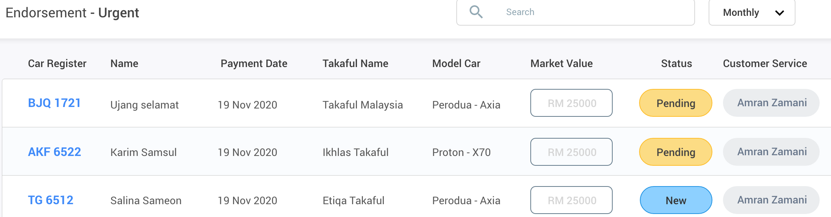
/admin/urgent/endorsement_basket
G07
G04 when clicked
Notes:
Call API to get the endorsement basket
When click the car reg no, call API to tag the record to the login user, and show the detail screen

Slide 14
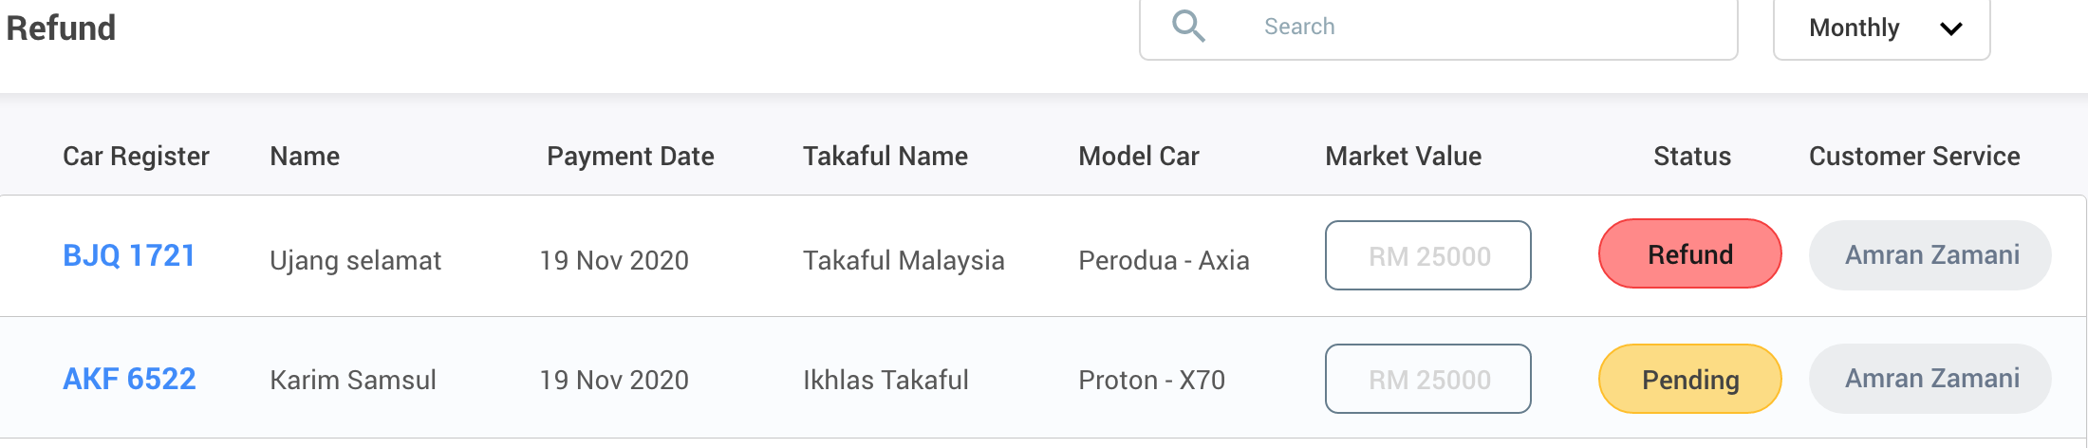
/admin/urgent/refund_basket
G08
G04 when clicked
Notes:
Call API to get the refund basket
When click the car reg no, call API to tag the record to the login user, and show the detail screen

Slide 15
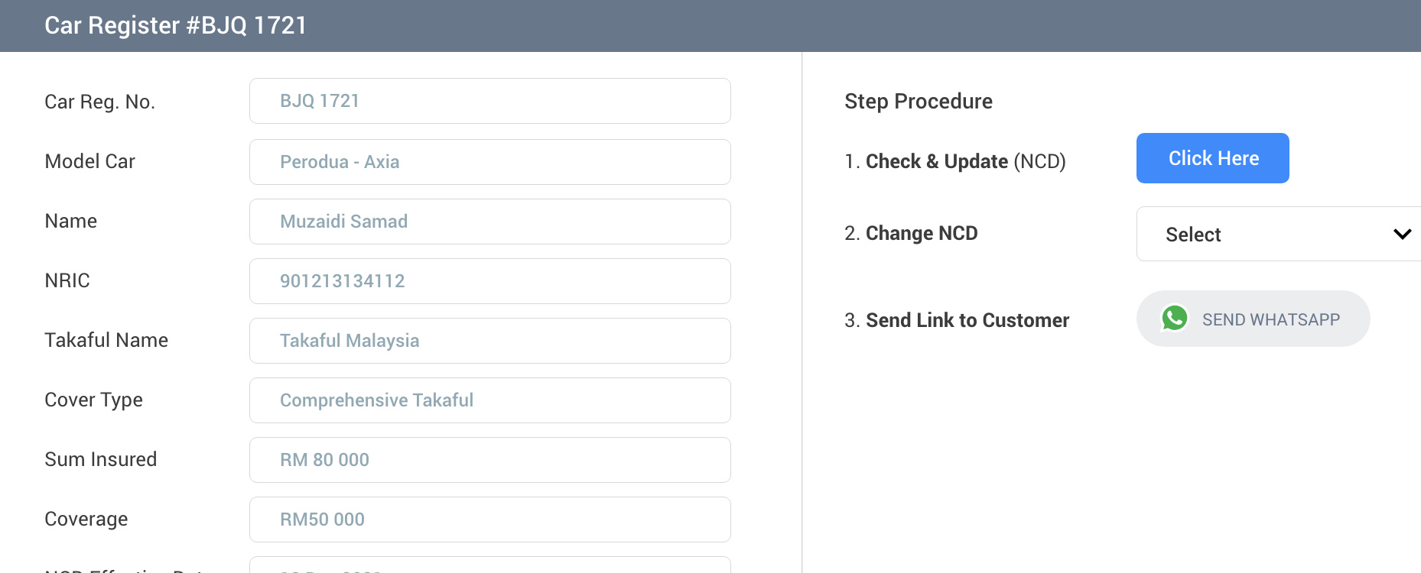
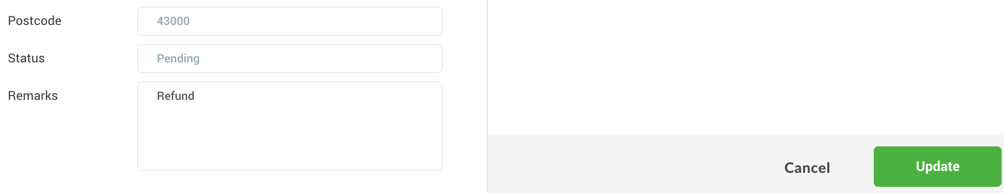
/admin/urgent/refund_basket
G02
B05
C08
B04
Notes:
Update => Call API to update record. Finance will refund to customer.
Send WA => Call API to send WA

Slide 16
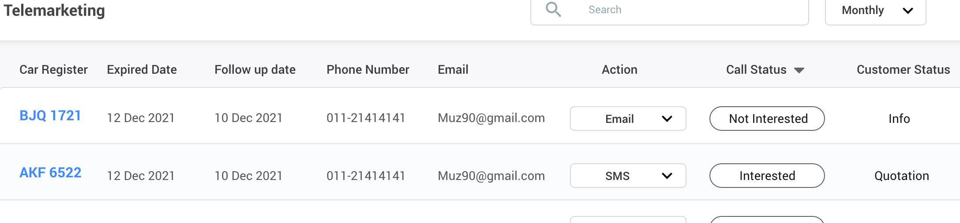
/admin/marketing
H01
H04 when clicked
Notes:
Call API to get the refund basket
When click the car reg no, call API to tag the record to the login user, and show the detail screen

Slide 17
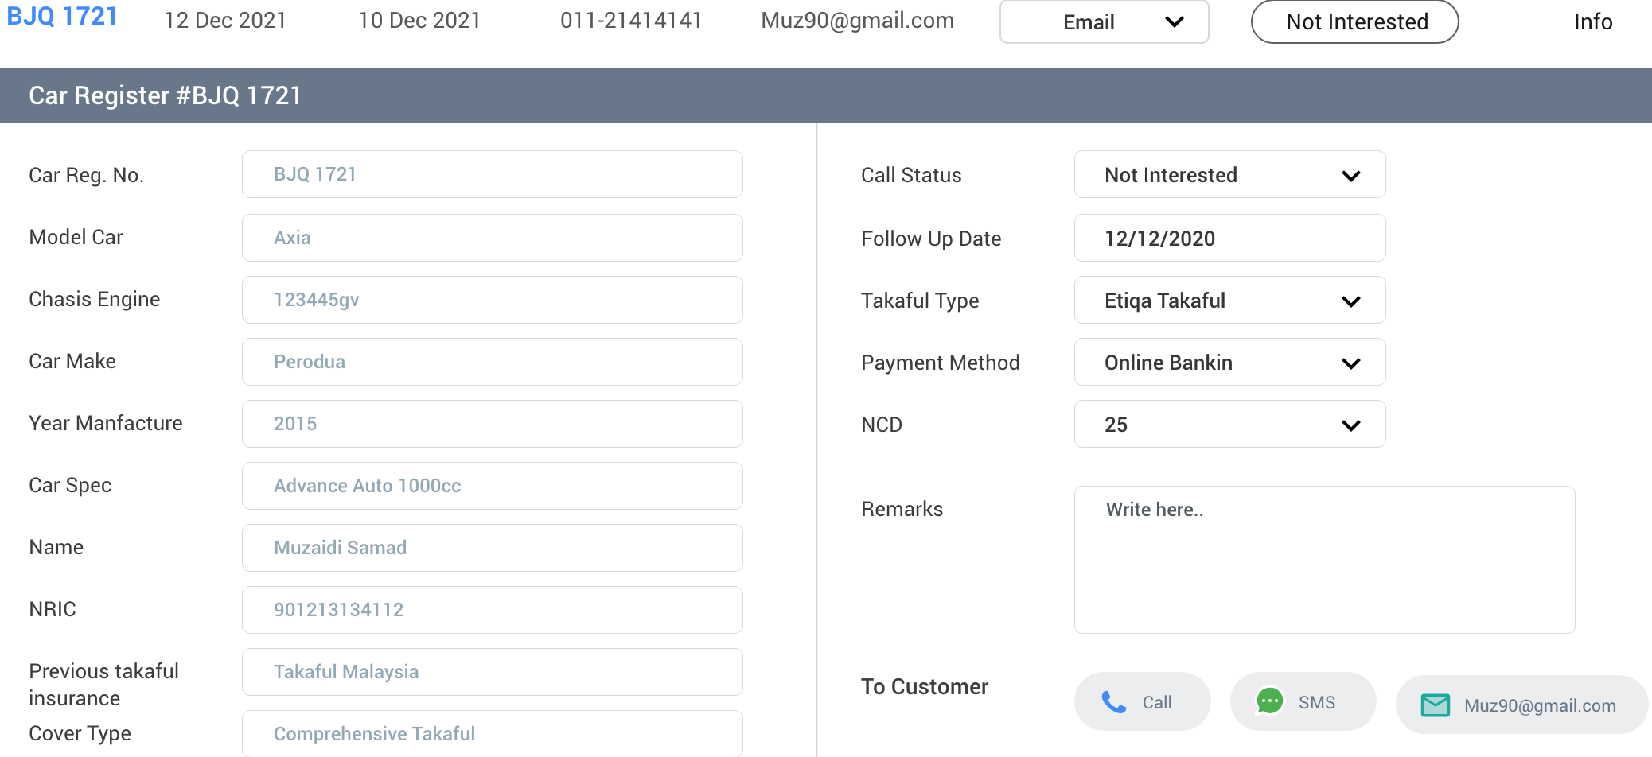
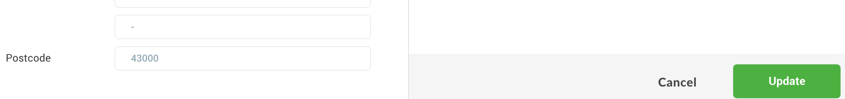
/admin/marketing
H02
C10
C09
C07
H03
Notes:
Update => Call API to update record.
Call => Trigger VOIP call
SMS => Call API to send SMS
Email => Call API to send email

